Slide 1
A Comparative Study of Multithreading Frameworks
Presentation - N
May 3, 2017
Presented to
Dr. Robert Chun
By
Swapnil Gaikwad

Slide 2
Overview
Introduction
Multithreading Frameworks
Need for Comparison
Comparison Parameters
Software Parameters
Hardware Parameters
Demo Program
Conclusion
References

Slide 3
Introduction
The choice of frameworks
OpenMP
Intel Cilk Plus
Intel TBB
GPRM
And many more
Problem of choosing correct framework
Learning multiple frameworks
Abstraction from frameworks

Slide 4
OpenMP
Based on fork-join() model
Available for C, C++, and Fortran
Most popular
Advantages
Easy to use, POC, migrations
Loop level parallelism
Limitations
Task Level Parallelism
Nested Parallelism, Recursion

Slide 5
Intel Cilk Plus
Based on MIT Cilk C extension
Available for C and C++
Rising in popularity
Advantages
Easy to use
Task level parallelism
Task stealing
Limitations
Works only on Intel Hardware

Slide 6
Intel TBB
Intel Threading Building Blocks
Object Oriented template based library
Available for C++
Advantages
Easy modeling of complex workflows, flow graph construct
Video Compression, Graph processing
Limitations
Template structure
Comparatively hard implementation, POC
Works only on Intel Hardware

Slide 7
GPRM
Glasgow Parallel Reduction Model
Template based Object-Oriented library like Intel TBB
Available for C++
Advantages
Universally available
Task stealing, automated scheduling and thread spawning
Limitations
Template Structure
Not popular yet

Slide 8
Need for Comparison
Efficiency
Time
Money
Dynamic Selection
Automated Runtime Selection

Slide 9
Modular Parallel Abstraction Layer (MPAL)
Animal Speak()
Abstract:: for()
Dog
Cat
OpenMp
Cilk Plus
Bark()
Meow()
#pragma omp parallel for
_cilk_for()

Slide 10
Comparison Parameters
Software Parameters
Task Balance
Space Complexity
Task Granularity
Hardware Parameters
Hardware Architecture
Number of Cores

Slide 11
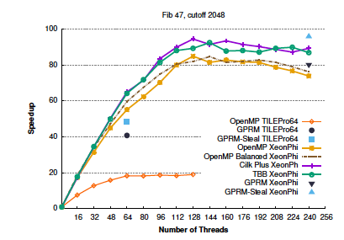
Unbalanced Tasks
Example: Fibonacci Series
F(n) = F(n-1) + F(n-2)
Work Distribution among threads
Cilk Plus = TBB > OpenMP
Notes:
Talk about Project 3
OpenMP divides the tasks among threads, no default stealing

Slide 12
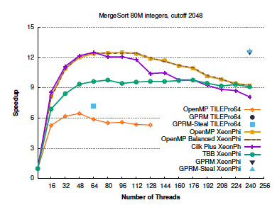
Space Complexity
Example: Merge Sort
Memory Management
OpenMP = Cilk Plus > TBB

Slide 13
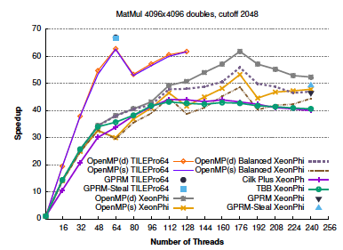
Task Granularity
Example: Matrix Multiplication
Near Super-linear speed-up is possible
TBB = OpenMP > Cilk Plus

Slide 14
Hardware
Intel Xeon Phi | Tilera TILEPro64
60 cores connected by a bidirectional ring interconnect | composed of 64 tiles, interconnected via multiple 8x8 mesh networks
includes a SIMD 512-bit wide VPU (Vector Processing Unit) | no SIMD capability
The VPU can process 16 single-precision or 8 double-precision operations per cycle | up to 3 operations per cycle
MatMul: OpenMP > GPRM | MatMul: GPRM > OpenMP

Slide 15
Program Example
Serial Fibonacci:
unsigned long fib(unsigned long n)
{
if (n < 2)
return n;
return fib(n-1) + fib(n-2);
}
https://github.com/swapnilmg/MultithreadingFrameworks

Slide 16
OpenMP
unsigned long fib(unsigned long n)
{
if (n < 2)
return n;
unsigned long x, y;
#pragma omp task shared(x) firstprivate(n)
x = fib(n-1);
#pragma omp task shared(y) firstprivate(n)
y = fib(n-2);
#pragma omp taskwait
return x + y;
}

Slide 17
Cilk Plus
unsigned long fib(unsigned long n)
{
if (n < 2)
return n;
unsigned long x = cilk_spawn fib(n-1);
unsigned long y = fib(n-2);
cilk_sync;
return x + y;
}

Slide 18
Intel TBB
unsigned long fib (unsigned long n) {
unsigned long sum;
task_scheduler_init anonymous;
FibTask& a = *new(task::allocate_root()) FibTask(n,&sum);
task::spawn_root_and_wait(a);
return sum;
}

Slide 19
Intel TBB cont.
class FibTask: public task {
public:
const unsigned long n;
unsigned long* const sum;
FibTask( unsigned long n_, unsigned long* sum_ ) :
n(n_), sum(sum_) {}
task* execute() {
if(n < 30) {*sum = SerialFib(n);} else {
unsigned long x, y;
FibTask& a = *new( allocate_child() ) FibTask(n-1,&x);
FibTask& b = *new( task::allocate_root() ) FibTask(n-2,&y);
set_ref_count(2);
spawn( a );
task::spawn_and_wait_for_all(b);
*sum = x+y; }
}

Slide 20
Conclusion and Future Work
Demonstrated performance difference
Identified some feature that impact speed-up
Identified impact of hardware
Create Quantifiable Rules
Train models to select the best frameworks using Machine Learning Techniques

Slide 21
References
O. J. Arndt, T. Lefherz and H. Blume, "Abstracting Parallel Programming and its Analysis Towards Framework Independent Development," in 2015 IEEE 9th International Symposium on Embedded Multicore/Many-core Systems-on-Chip, Turin, 2015.
E. Ayguade, N. Copty, A. Duran, J. Hoeflinger, Y. Lin, F. Massaioli, X. Teruel, P. Unnikrishnan and G. Zhang, "The design of openmp tasks," IEEE Transactions on Parallel and Distributed Systems, vol. 20, no. 3, pp. 404-418, March 2009.
E. Saule and Ü. Çatalyürek, "An Early Evaluation of the Scalability of Graph Algorithms on the Intel MIC Architecture," in 2012 IEEE 26th International Parallel and Distributed Processing Symposium Workshops & PhD Forum, Shanghai, 2012.
W. Kim and M. Voss, "Multicore Desktop Programming with Intel Threading Building Blocks," IEEE Software, vol. 28, no. 1, pp. 23-31, Jan.-Feb. 2011.

Slide 22
References
A. Tousimojarad and W. Vanderbauwhede, "Number of Tasks, not Threads, is Key," in 2015 23rd Euromicro International Conference on Parallel, Distributed, and Network-Based Processing, Turku, 2015.
T. Cormen, C. Leiserson, R. Rivest and C. Stein, Introduction to Algorithms, Cambridge, MA: MIT Press, 2009.
Tilera, "Tile processor user architecture manual ug105," April 2011. [Online]. Available: http://www.tilera.com/scm/docs/UG105-Optimization-Guide.pdf. [Accessed 22 April 2017].
“Comparing Cilk Plus.” [Online] Available: https://www.cilkplus.org/faq/24. [Accessed 22 April 2017]

Slide 23
Thank You!

