Slide 1
Predicting Results of IPL Matches using Machine Learning
Project By:
Ajit Agalawe
Yudhishthir Patil
Abhishek Kushare
Swapnil Pakhale
Mayur Vanjari
Hrushikesh Rao
Shriram Mantri Vidyanidhi InfoTech Academy

Slide 2
Project Lifecycle
Data Source : Kaggle
Data Pre-processing
Data Analysis and Visualization
Feature Engineering and Feature Selection
Model creation
Model training
Calculating Predictions
Webpage Deployment

Slide 3
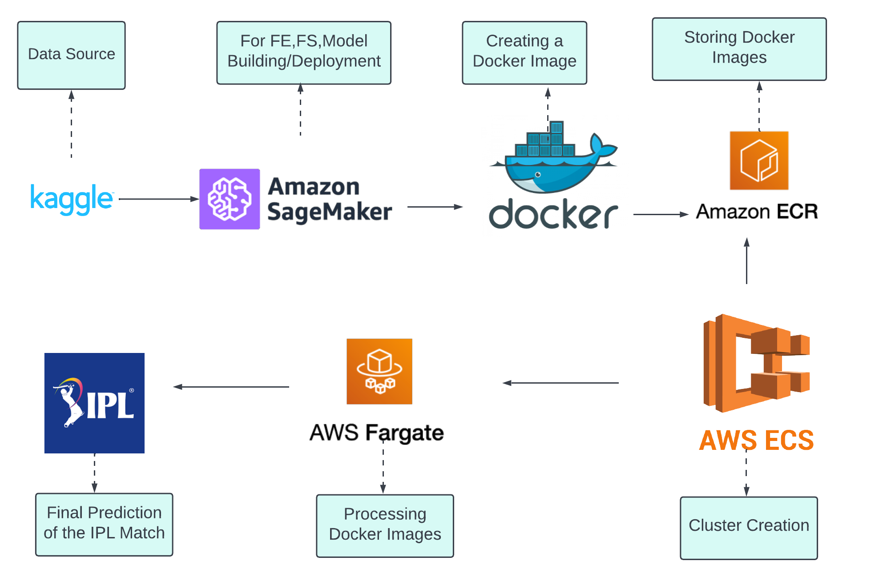
Architecture of the Project

Slide 4
Team Contribution:
Yudhishthir Patil : Data Analysis and Visualization
Abhishek Kushare : Data Analysis and Visualization
Mayur Vanjari : Feature Engineering and Feature Selection
Hrushikesh Rao : Feature Engineering and Feature Selection
Swapnil Pakhale : Model creation, Model Training, Prediction
Ajit Agalawe : Cloud Integration and Webpage Deployment

Slide 5
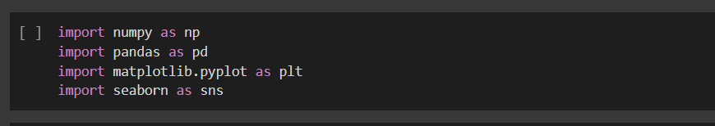

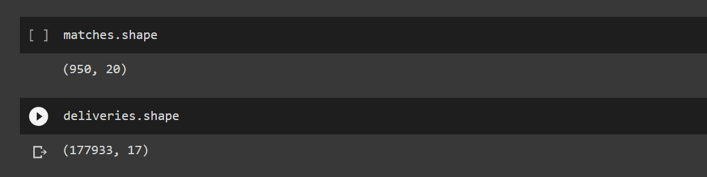
Data_Set Analysis
Importing Libraries and Datasets

Slide 6
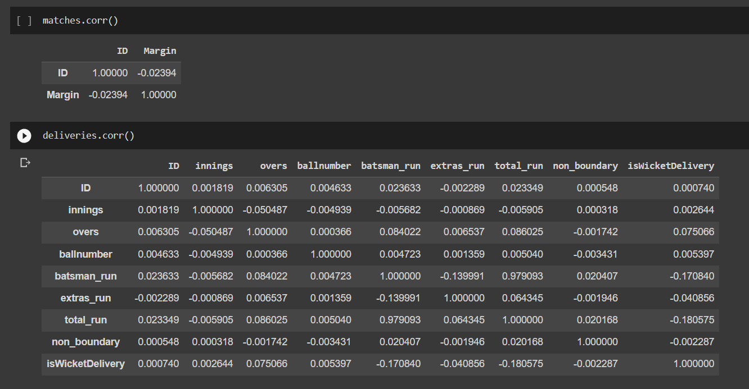
Data_Set Analysis
Finding Correlation Relationshp
i

Slide 7
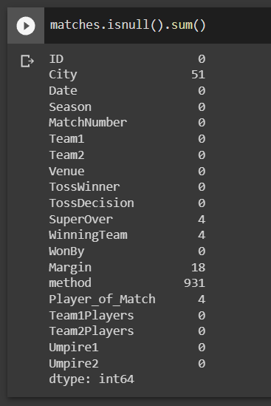
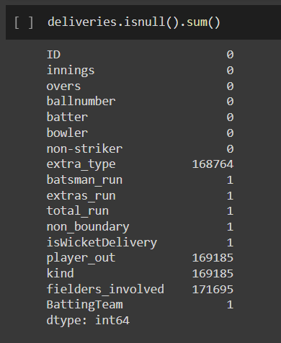
Finding Null Values

Slide 8
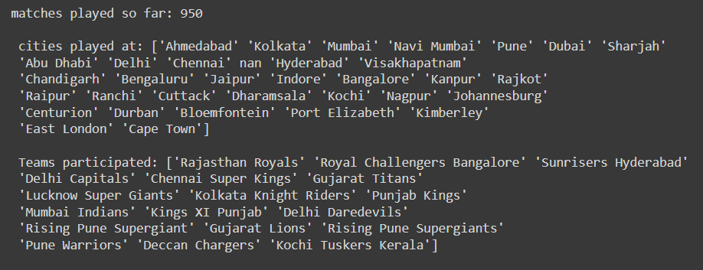
Total Cities Played at : 33
Total teams Participated until now : 18
Current Played Teams 2022 : 10

Slide 9
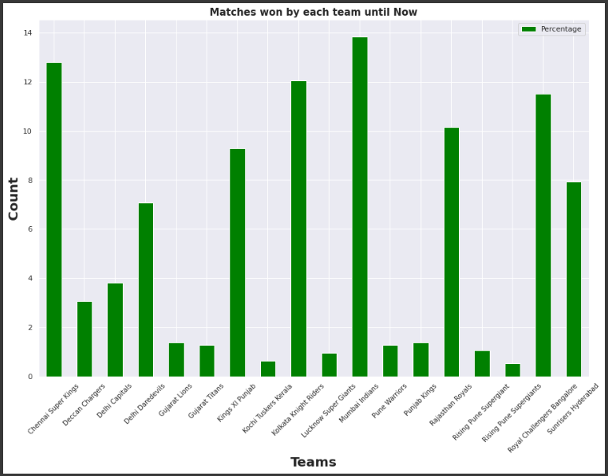
Percentage of Match winning of the Teams in IPL
Mumbai Indians Has Highest IPL winnings :131
Lowest IPL Winnings are of Rising Pune Supergiants : 5

Slide 10
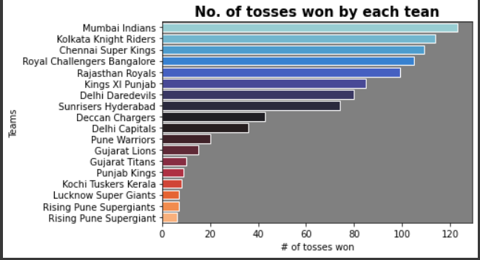
NO. of Toss Win by Each Team

Slide 11
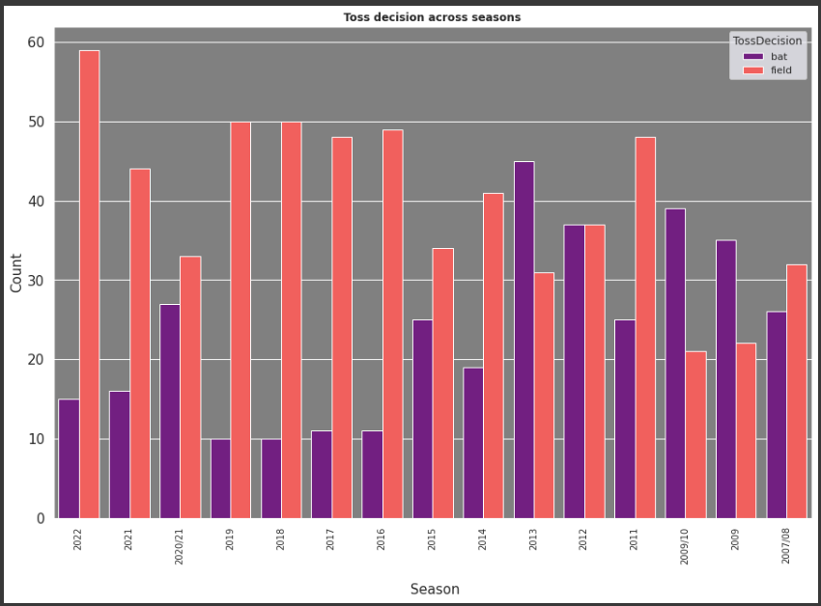
Toss Decision By Teams in Each Season

Slide 12
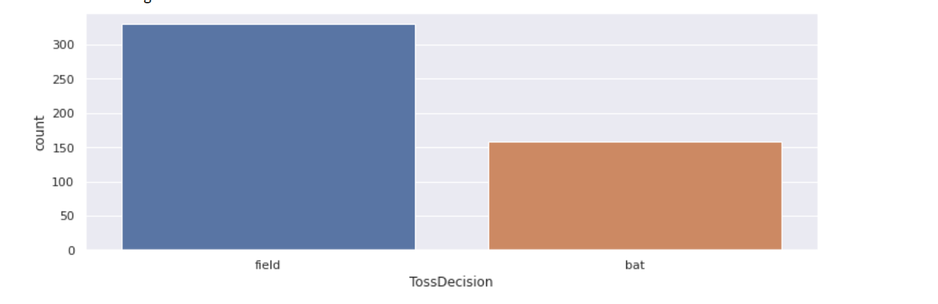
Toss and Match Winner’s Decision

Slide 13
Feature Engineering
We have grouped the id and inning column on the basis of which
we find how many runs scored by each team
The we have created dataframe and created total runs scored

Slide 14
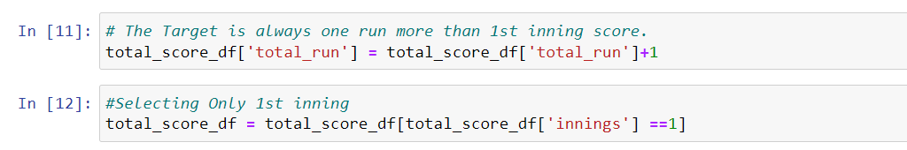
Then we have created another dataframe for how much runs required for chasing team to win the match
In this we merge the ID and the total runs column

Slide 15
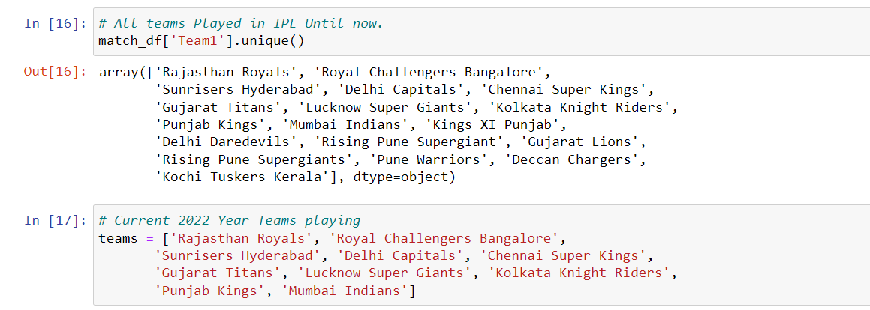
We have only select those teams which were currently playing in the 2022 season

Slide 16
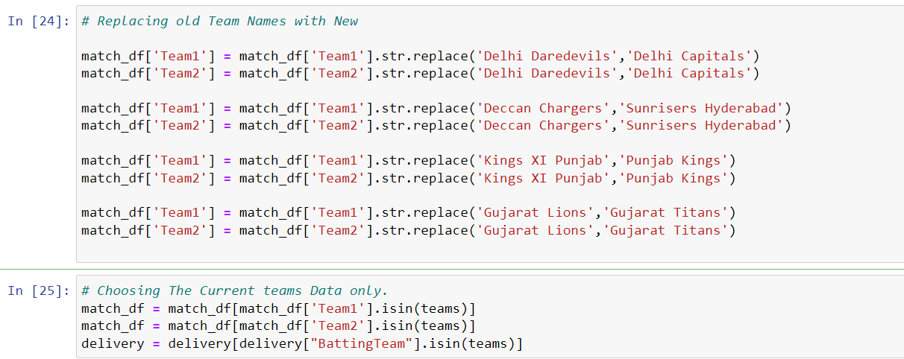
Then we have replace the old teams name with new ones
And then stored the current team names in the Dataframe.

Slide 17
Here we have selected only those columns which are required for prediction
Current score which showed us what is the current score of the team in x no. of overs
Runs left which derived how many runs were left for the batting
team to win the match

Slide 18
Balls left which gave us the data about how many balls or overs
were left to achieve the target to win the match
Wickets left which gave us an idea about how many wickets were left out of 10

Slide 19
CRR show us how many average runs per over are made by the batting team
RRR mean the runs required for the batting team to win the match

Slide 20
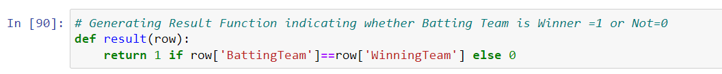
Result using function so that if the team chasing wins the match it will return 1 in the result column and 0 if the chasing team lost.
Data frame final_df in this we took the necessary columns which were required for the predicting the probability of the Teams And Model Development.

Slide 21
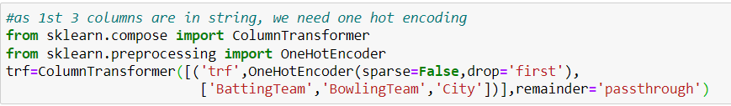

To do one hot encoding
To split the dataset into train and test

Slide 22
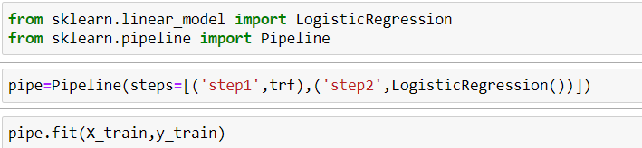
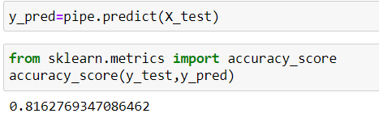

To do pipeline and pass to the model

Slide 23

Choosing the model
Model | Accuracy
1. Logistic Regression | 81.62 %
2. Decision Tree | 90.92 %
3. Random Forest | 94.87 %
4. Support-Vector Machines (SVM) | 78.30 %
Pickling the code

Slide 24
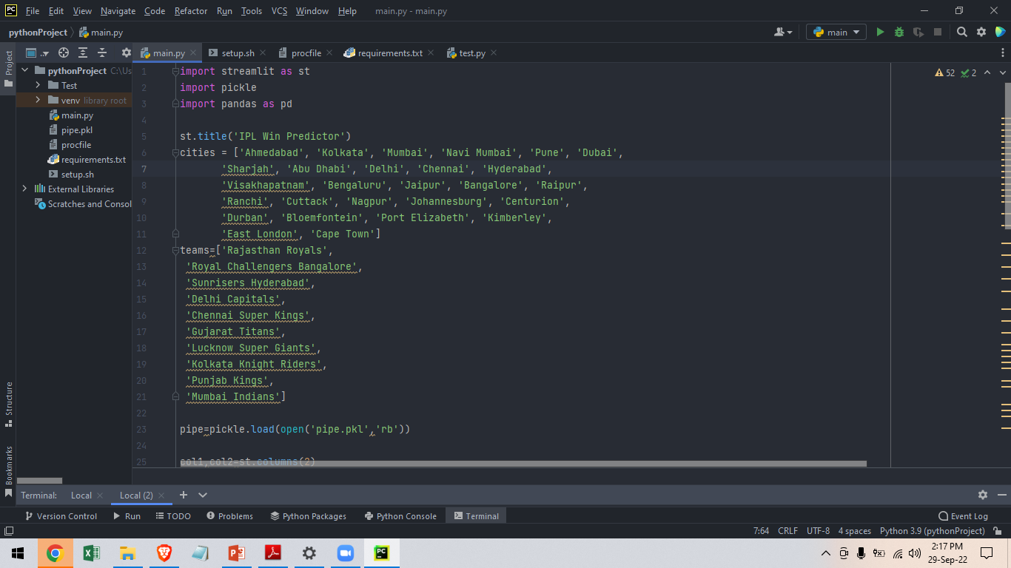
Using Streamlit library:

Slide 25
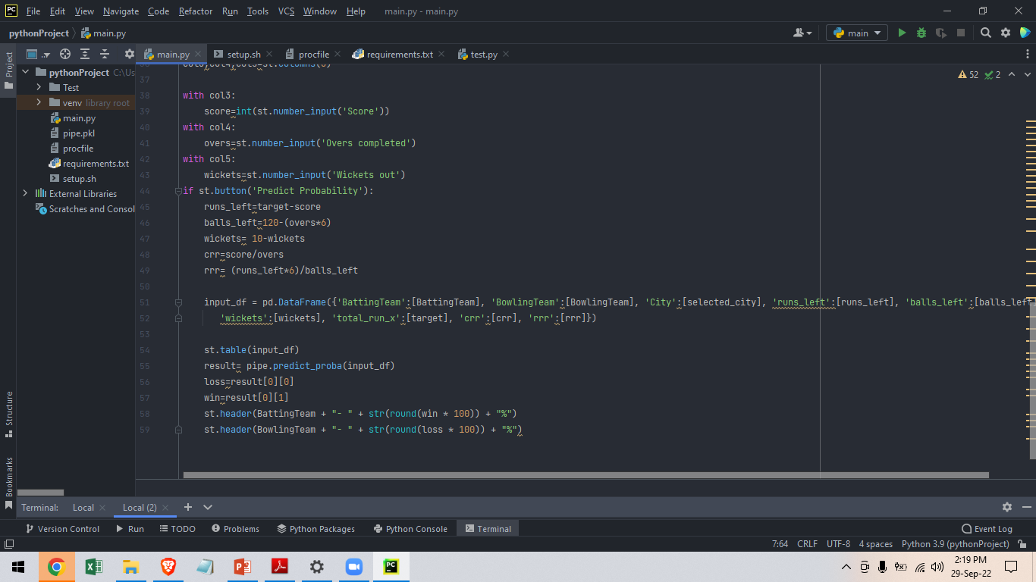
Using Streamlit library:

Slide 26
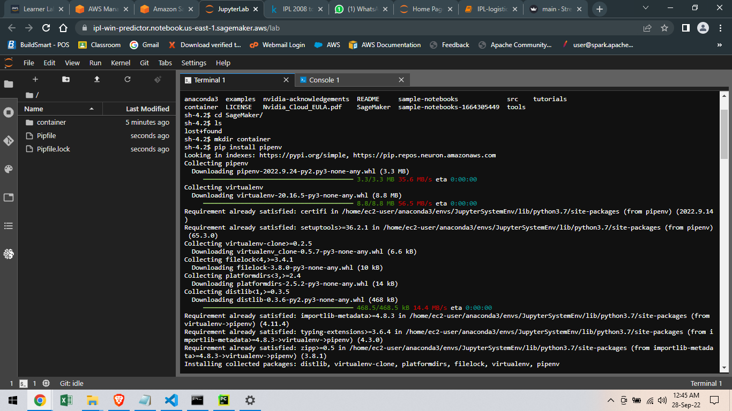
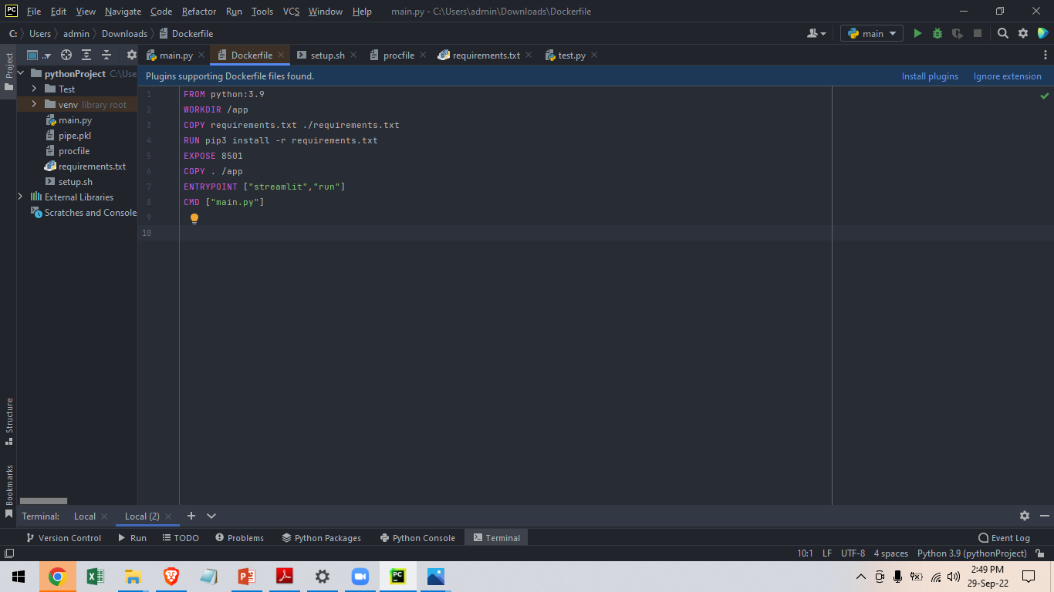
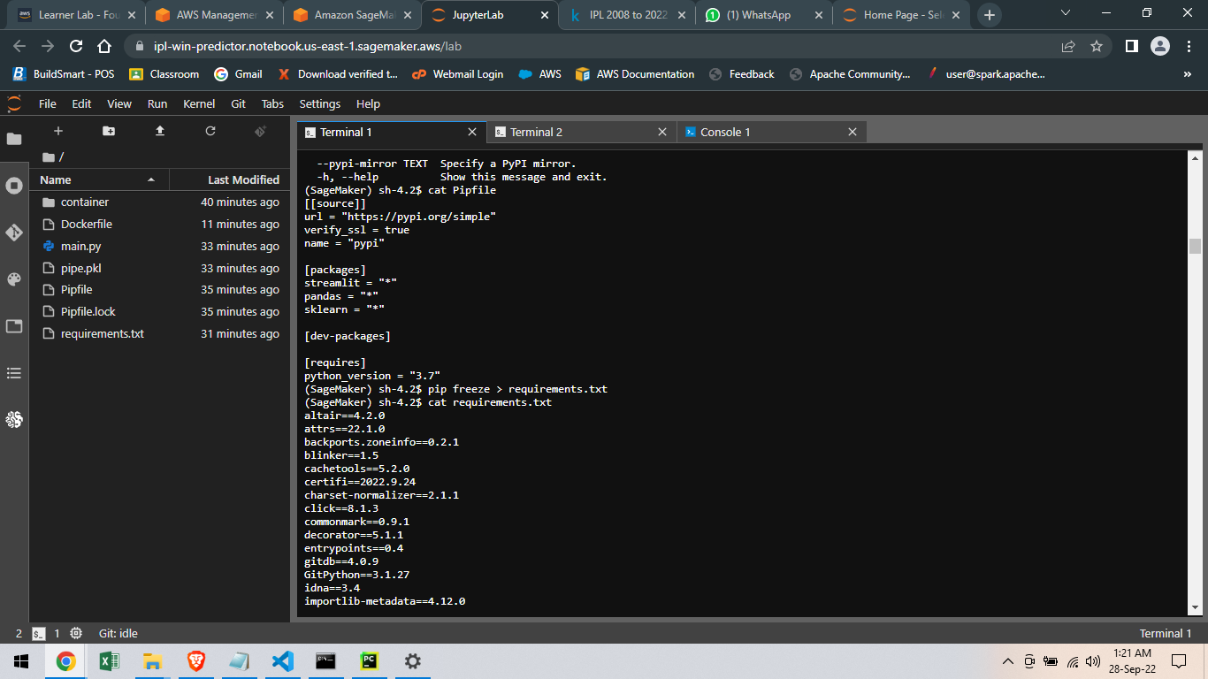
Creating Docker Image
Installing Virtual Environment in Sagemaker Instance and installing necessary libraries in it.
Creating Dockerfile and requirements.txt file.

Slide 27
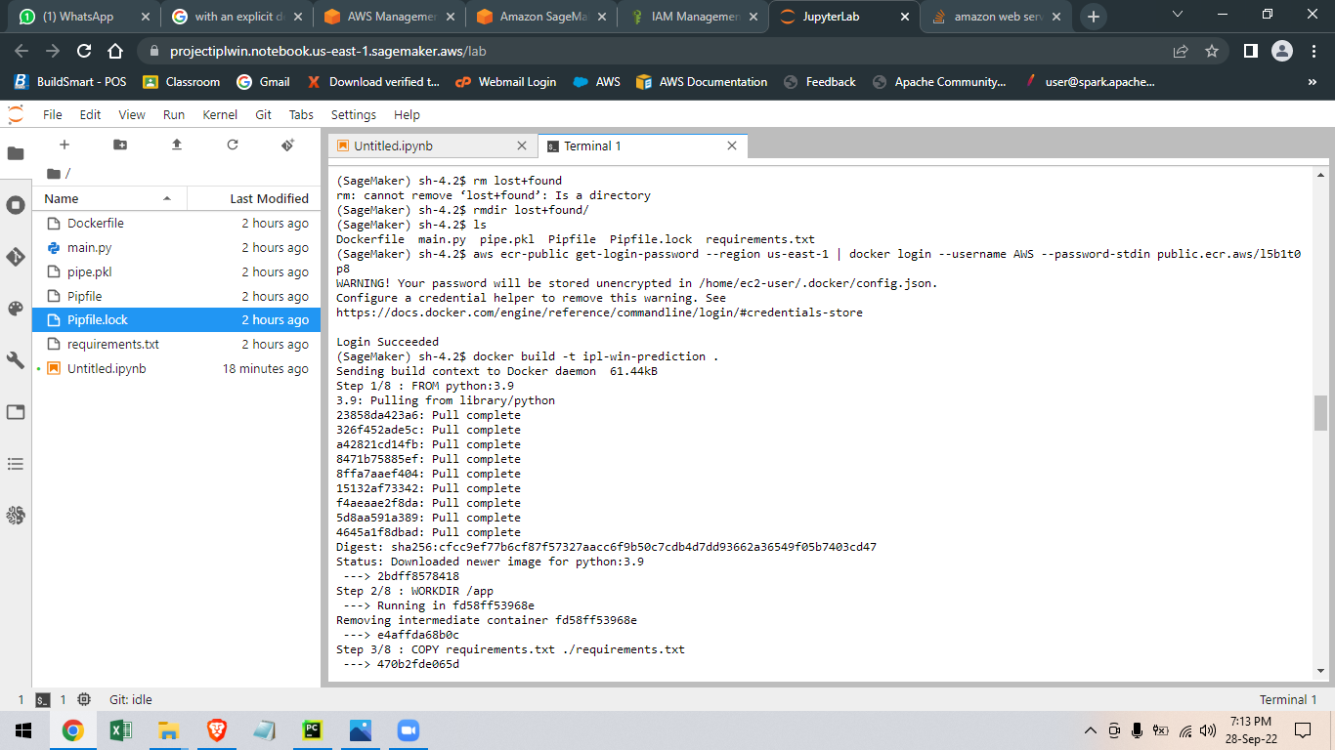
Docker building image

Slide 28
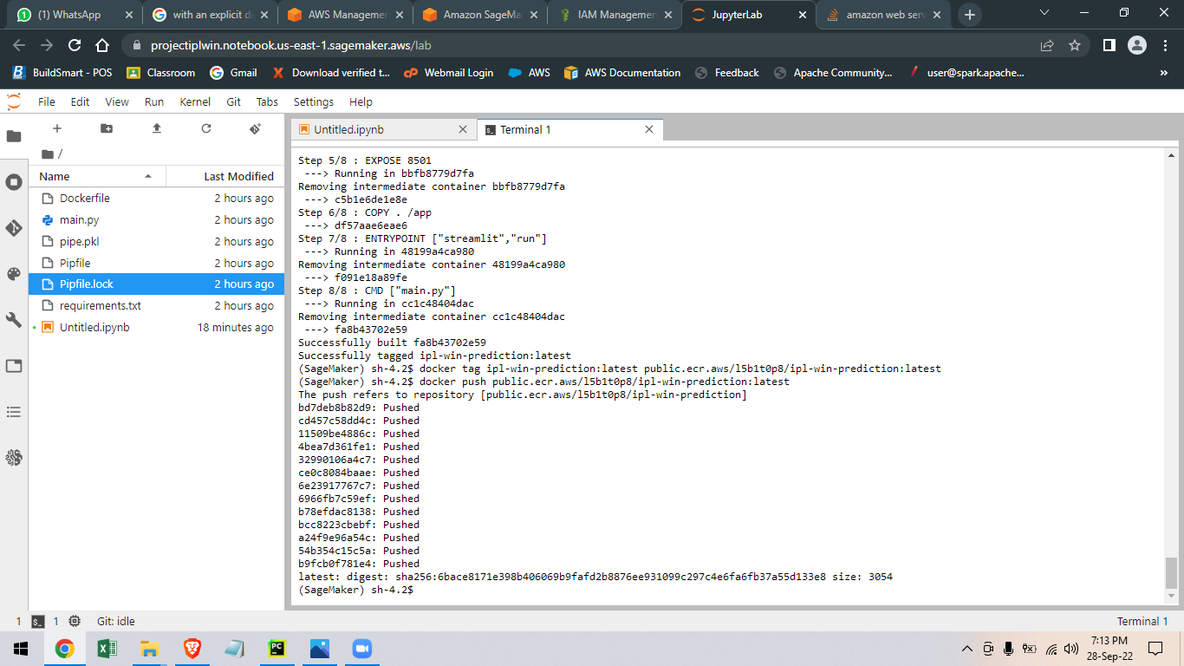
Pushing Docker Image to AWS ECR
Pushing Docker Image to AWS ECR

Slide 29
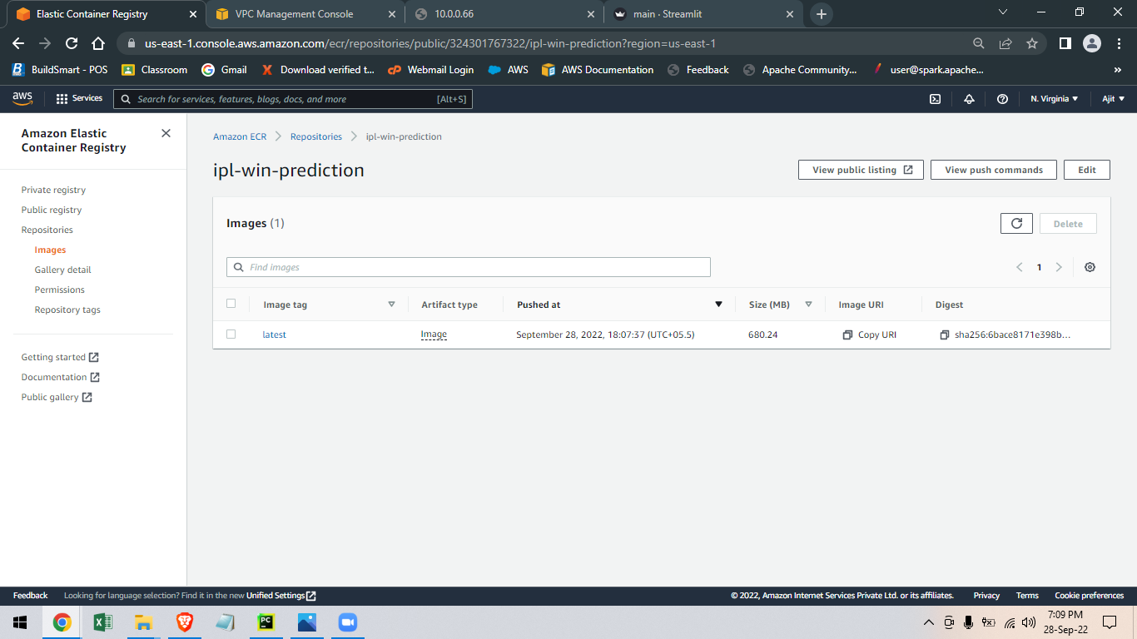
Docker image in ECR

Slide 30
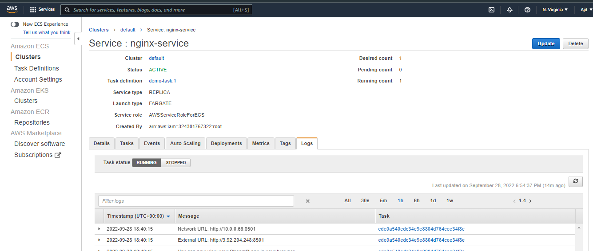
Cluster after processing image

Slide 31
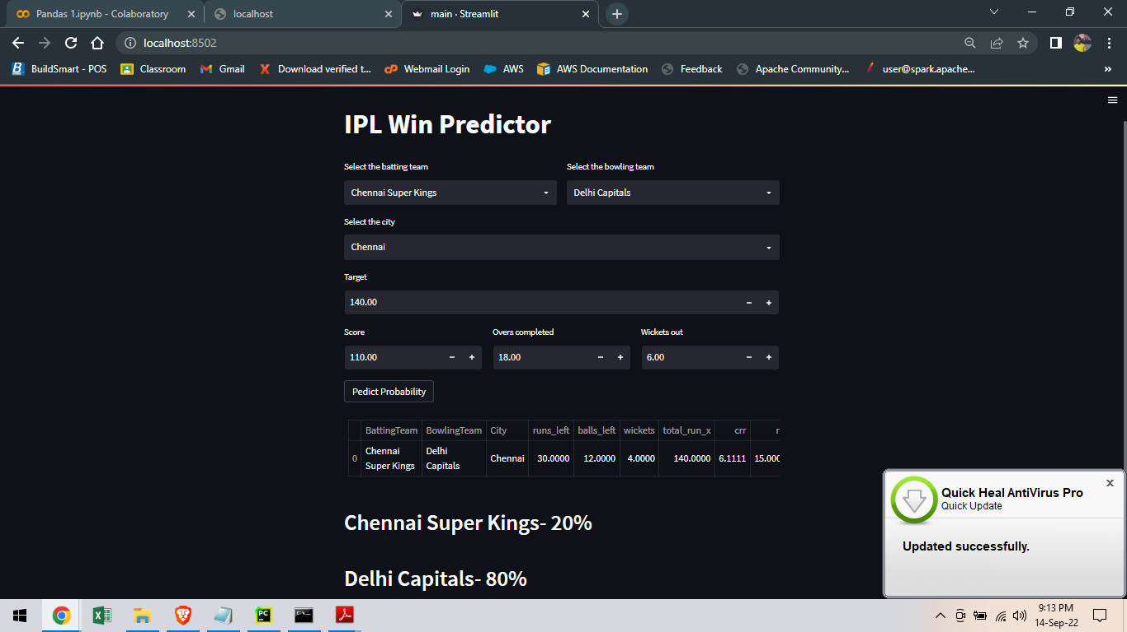
Webpage for user

Slide 32
THANK YOU

