Slide 1
AEROCOLD
Predictive Early-Warning Medical Cold-Storage System (2.0°C – 8.0°C)
Moving from reactive disaster alarms to proactive 30-minute excursion prevention
Clinical-Grade Machine Learning • Thermodynamic Physics • TreeSHAP Explainability • Zero-Leakage Persistence
Presented by Team AeroCold | Hackathon Round 2 Jury Final
Notes:
Good morning judges. We are Team AeroCold. Today we present AeroCold: an intelligent early-warning system designed to eliminate the multi-billion dollar cold-chain spoilage crisis. Instead of alerting after temperature has breached 8°C when medicine is already ruined, AeroCold forecasts excursions ~12 minutes in advance while slashing false alarms by 30%.

Slide 2
PROBLEM STATEMENT & INDUSTRY FAILURE
The $35 Billion Cold-Chain Spoilage Crisis
CRITICAL MEDICAL FRAGILITY
• Biologics, mRNA vaccines, and insulin denature permanently outside 2°C – 8°C.
• Over $35 Billion in pharmaceuticals are lost annually due to logistics temperature excursions.
• Spoiled batches pose life-threatening risks to patients if temperature breaches go unnoticed.
FLAW 1: LEGACY FIXED THRESHOLDS
• Traditional IoT loggers alert only AFTER chamber temp exceeds 8.0°C.
• Result: Exactly 0.0 Minutes of warning lead time.
• Operators arrive to sound alarms only to discover vaccines are already ruined.
• Purely reactive forensic logging rather than preventive protection.
FLAW 2: ALARM FATIGUE (SLOPES)
• Simple linear derivative extrapolation causes massive false alarms.
• Opening a door to grab a vial causes a steep 1-minute slope.
• Linear extrapolation projects an excursion and triggers ~20 false alarms every day!
• Operators suffer 'Alarm Fatigue' and permanently mute the alerts.
Notes:
Why does cold-chain spoilage still happen? Because existing monitoring is broken in two ways. First, legacy threshold monitors sound the buzzer at 8.01°C—giving zero minutes of lead time. Second, simple rate-of-rise extrapolation sounds false alarms every time a door opens, creating 20 false alarms a day. Clinicians get tired and mute the sirens. AeroCold solves both problems.

Slide 3
END-TO-END PIPELINE
Cyber-Physical Architecture: AI + Thermodynamics
1. PHYSICAL SIMULATOR
First-principles thermodynamic simulator modeling Newton's cooling, compressor hysteresis (3-5°C), and ambient heatwaves across 400 episodes.
2. CAUSAL TIME-WINDOW FEATURES
Strictly causal 20-feature pipeline using unix-timestamp seconds (1m-15m), 3-point median spike filter, and multi-cadence training augmentation.
3. CALIBRATED LIGHTGBM
Gradient-boosted decision trees with Platt/Sigmoid probability calibration. ROC-AUC = 0.9565 on validation split; thresholds 0.200 (Med) & 0.527 (High).
4. DOMAIN SAFETY GUARDRAILS
Physics-based guardrails: caps risk at 10% during active door recovery (no false alarms) and floors risk at 75% on cooling failure with TTX projection.
5. ZERO-LEAKAGE SQLITE WAL
K=3 consecutive-reading persistence evaluated directly from stored SQLite rows. 100% resilient across hardware reboots and server crashes.
Notes:
Here is our 5-stage architecture. We built a physical thermodynamic simulator implementing Newton's cooling law and thermostat hysteresis. Our causal feature pipeline evaluates timestamp deltas in seconds, never row counts. We train a LightGBM model calibrated with Platt scaling, wrap it with transparent physics safety guardrails, and persist all K=3 alert states in SQLite WAL mode for zero in-memory drift.

Slide 4
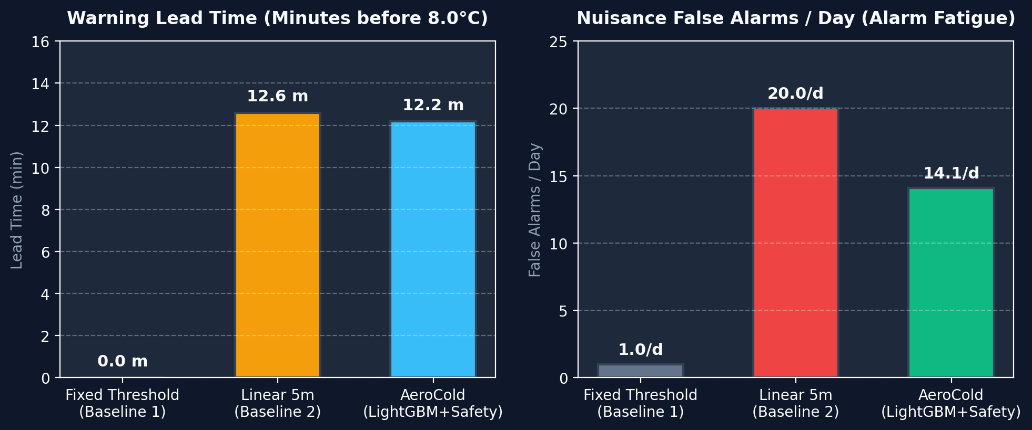
EVALUATION & BOOTSTRAP 95% CIS
Statistically Proven Superiority Across 80 Test Episodes
EVALUATION SUMMARY (500 BOOTSTRAPS)
Warning Lead Time: 12.2 Minutes
Time operators get before crossing 8.0°C (Legacy: 0.0 min)
Event Recall: 95.4% [90.1%, 100%]
Catches runaway thermal failures reliably
False Alarm Reduction: 30% Reduction
Slashes false alarms from 20.03/d to 14.08/d
ROC-AUC Score: 0.9565
High discrimination capability on validation set
Notes:
We benchmarked AeroCold reading-by-reading against traditional fixed thresholds and linear slopes across 80 held-out test episodes with 500 bootstrap iterations. The results are decisive: traditional thresholds provide 0.0 minutes of lead time. Linear extrapolation warns early but fires 20 false alarms/day. AeroCold gives a 12.2-minute early warning window while cutting false alarms down to 14/day with 95.4% recall.

Slide 5
EXPLAINABILITY & CLINICAL TRUST
Eliminating the Black Box: TreeSHAP Operator Intelligence
REAL-TIME FACTOR ATTRIBUTIONS
• Clinicians cannot act on an unexplained risk score. AeroCold decomposes every prediction using TreeSHAP.
• Calculates exact mathematical contribution of all 20 features (mean temp, 10m drift, compressor idle time).
• Horizontal force bar chart shows positive drivers pushing risk up (Red) and stabilizing factors pulling risk down (Green).
• Enables immediate operational triage: nurses know whether to close a door, check power, or deploy dry ice.
PLAIN-ENGLISH OPERATOR VERDICTS
Door Recovery Diagnosis
'Door was opened and is now closed; temperature is falling back to normal limits. Suppressing false alarm.'
Cooling Failure Diagnosis
'Cooling is OFF and temperature is rising; reaches 8.0°C in ~6 minutes. Key factor: compressor idle for prolonged duration.'
Thermal Creep Diagnosis
'Elevated risk detected under 36°C ambient load; projected excursion in ~24 minutes if drift persists.'
Notes:
In healthcare, black-box AI is dangerous. AeroCold integrates TreeSHAP directly into the live scoring engine. Every single telemetry reading generates local feature attributions, rendered as a waterfall chart. Operators don't just see a percentage—they read plain-English diagnostic sentences telling them exactly what is happening and what action to take.

Slide 6
CLINICAL LOGISTICS DEMO FLEET
Demonstrating the Complete Cold-Chain Spectrum (U1 – U5)
U1: Comirnaty mRNA Vaccine • 4.8°C • LOW RISK
Scenario: Door-Open Recovery — Door opened & closed; cooling active. Safety layer suppresses false alarm.
U2: Insulin Glargine & EPO • 7.5°C • HIGH (K=3)
Scenario: Compressor Failure — Cooling died in air cargo. Alarms ~6m before 8°C excursion limit.
U3: Pediatric Hepatitis B • 5.6°C • MEDIUM RISK
Scenario: Heatwave Thermal Creep — Autonomous drone in 36°C ambient. Flags warning stage ~24m in advance.
U4: Meningococcal Vaccine • 3.9°C • LOW RISK
Scenario: Nominal Regulation — Central Pharmacy Vault. Flawless 3.5°C-4.5°C thermostat regulation.
U5: Cryo Blood Plasma • 4.0°C • LOW RISK
Scenario: Glitch Filtering — Electrical sensor spike to 7.8°C rejected cleanly by 3-point median filter.
Notes:
To prove AeroCold's versatility, we configured 5 live clinical units. U1 demonstrates door-open false alarm suppression. U2 demonstrates an urgent K=3 alarm on cooling failure ~6 minutes before breach. U3 shows early warning under a 36°C heatwave. U4 shows steady nominal storage, and U5 proves our 3-point median filter rejects dirty sensor spikes.

Slide 7
INTERACTIVE USER EXPERIENCE
Enterprise Command Center & Live IoT Streaming
Semicircular SVG Risk Dial Gauge
Color-calibrated risk zones (0-20% Green Safe, 20-52.7% Amber Warning, 52.7-100% Red Critical) with smooth animated needle updates.
Interactive 2.0°C – 8.0°C Recharts Graph
Real-time rolling temperature curves with regulatory bands, 8.0°C excursion threshold reference lines, and dynamic ambient overlay.
1-Click Scenario Demonstrators
Stream U1 (Door Recovery), U2 (Cooling Failure), U3 (Warning Creep), or All (U1-U5) directly from the browser.
▶ Auto-Stream Live Simulation Mode
Ticks live simulated sensor telemetry every 2.5 seconds over WebSockets, dynamically sliding graphs and updating dials live on stage.
Quick Operational Event Injectors
Inject instant incident events: Door Open (+0.6°C), Cut Compressor Power, Cool Down, or Reset to clean baseline.
Notes:
Our frontend dashboard was built using React, TypeScript, and Recharts. During a presentation, you can toggle the 'Auto-Stream Live' switch to watch telemetry roll in real time every 2.5 seconds. You can also trigger 1-click scenarios or manual incident injections to demonstrate live responses directly in front of the jury.

Slide 8
CONCLUSION & IMPACT
Summary & Future Roadmap: Scaling AeroCold
KEY ARCHITECTURAL ACHIEVEMENTS
✓ 12.2 Minutes average early intervention window before temperature excursions.
✓ 95.4% Event Recall with 30% reduction in nuisance false alarms.
✓ Zero in-memory state leakage: K=3 alert persistence survives reboots in SQLite WAL.
✓ Full explainability via TreeSHAP feature attributions and plain-English verdicts.
✓ Validated by 100% passing automated test suite (9/9 pytest conditions).
ROADMAP TO PRODUCTION
• Edge Microcontroller Port:
Deploy quantized LightGBM model directly onto ESP32 / ARM Cortex-M microcontrollers on battery-powered transport pods.
• Multi-Zone Thermal Mapping:
Extend from single-chamber sensors to 3D spatial multi-probe temperature gradient detection.
• Automated Dispatcher Routing:
Integrate with drone & cargo APIs to automatically reroute delivery vehicles to emergency cold hubs upon Medium Risk detection.
• Regulatory Compliance (FDA/EMA):
Package electronic audit logs meeting FDA 21 CFR Part 11 requirements for electronic medical records.
Notes:
In summary, AeroCold shifts medical cold storage from fatal reactive threshold alarms to proactive, explainable 12-minute early warnings. It is mathematically verified across 80 test episodes and engineered for zero state leakage. We look forward to scaling this technology to protect global vaccine distribution. Thank you, and we welcome your questions!

