Slide 1
Best Neighbourhood Recommender system

Slide 2
Business Problem
This project is for the raw material contractors who are looking to start new business in the Downtown Toronto Borough of Toronto city. The contractors who want to deliver good quality, fresh vegetables and other raw materials to the different types of restaurants, cafes, breakfast spot and bakery in city.
This recommender system will recommend best neighbourhood in which he/she can build a warehouse so that it will cover most of the restaurants nearby and provide quality service to them by providing on time and fresh delivery of raw materials.

Slide 3
Data
For this project we need the following data:
Data is scrapped from Wikipedia table and stored in dataframe.
Data source: https://en.wikipedia.org/wiki/List_of_postal_codes_of_Canada:_M
Second dataset used is Geospatial_Coordinates.csv which is provided in the course
This dataset contains latitude and longitudes of the different postal codes.
Third Data source used is foursquare API to get the venue details in neighbourhood.
Data source: Foursquare API- "https://developer.foursquare.com/"
Description: By using this API we will get all the venues and its details in each neighbourhood.

Slide 4
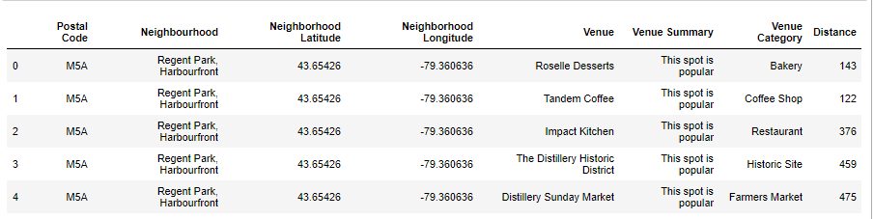
Final Data obtained will look as below

Slide 5
Methodology
Collecting Dataset:
Data is collected from Wikipedia table https://en.wikipedia.org/wiki/List_of_postal_codes_of_Canada:_M . We will use different postal code from table and co-ordinates of each postal code to find venues in different neighbourhood.
Using Foursquare API to retrieve venues:
Once the data is collected and converted into dataframe, we are using Downtown Toronto Borough data here. To find venues in different neighbourhood of Toronto we used foursquare API which will provide us with the different venues and its details in neighbourhood. We kept radius limit of 1500 to limit the venues in area.

Slide 6
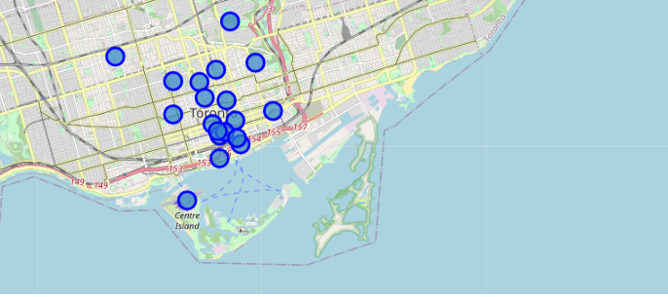
Getting neighbourhoods in Toronto

Slide 7
Processing and cleaning Data Obtained
After all the data is obtained from Wikipedia and foursquare API, data needs to be cleaned to apply various techniques on it. Main useful feature from collected data is ‘venue category’ which helps us in identifying restaurants.
First we will one hot encode venue category, then we make groups by neighbourhoods and then we will take count of total restaurants and add ‘Total Restaurants’ column in dataframe. Same is done for joints and ‘Total Joints’ columns is added in dataframe.

Slide 8
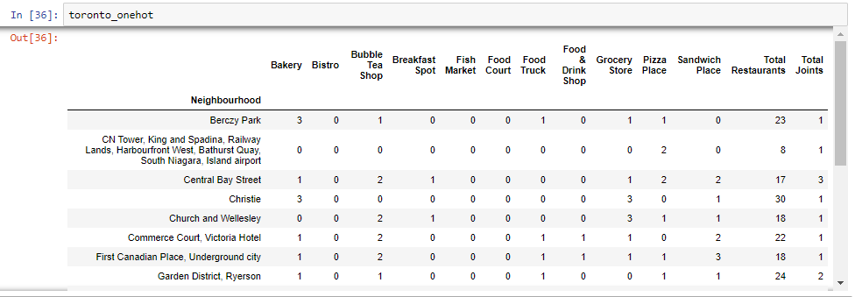
Processed data shown below

Slide 9
Applying K-Means Clustering Machine Learning Technique
Now that our processed data is ready we will apply machine learning Model on the data. In this problem we used K- Means clustering machine learning model to cluster neighbourhoods.
We used cluster value of 5 so that we can divide all the areas in 5 clusters. After Clustering is done we created new dataframe which will give us neighbourhood and its cluster number.

Slide 10
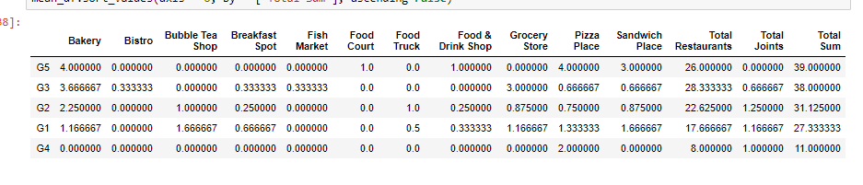
New dataframe with 5 groups

Slide 11
Results
For results we focused on centres of each clusters and found that G5 is the best group.
Total sum is calculated from addition of Total restaurants, total joints and other restaurants.
According to our results we will recommend group 5 as the best neighbourhood to start the new business and group 4 is worst neighbourhood.

Slide 12
Conclusion
Based on results group 5 is the best neighbourhood and its details as follows:
Neighbourhood: 'Kensington Market, Chinatown, Grange Park'
Neighbourhood Latitude: 43.6532057
Neighbourhood Longitude: -79.4000493

Slide 13
Thank You

