Slide 1
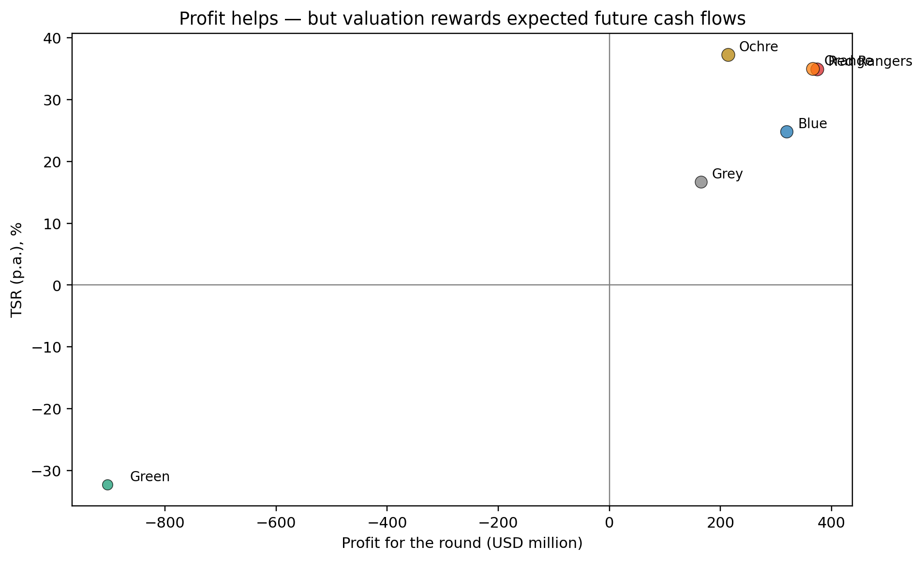
CESIM Global Challenge
Universe 1 • Round 1 Debrief
GL Sec D Group July 2026
Core teaching question
What did the market reward, what did it punish, and what should each team do differently in Round 2?
Socratic questions
? Before seeing the results, what did you think the market would reward?
? Which single decision did your team believe mattered most?
GL Sec D • U1 R1
Source: Universe 1 results + CESIM materials
1/25

Slide 2
How we will read the round
Do not start with rank; start with the causal chain behind rank.
Demand
Revenue
Margin
Cash flow
Risk
Share price
TSR
• Demand → Revenue → Margin → Cash flow → Risk → Share price → TSR.
• A round can look profitable and still lose valuation strength if growth quality or risk is weak.
• Round 1 is an early signal; it is not the final destiny of the game.
Socratic questions
? What must be true for a high-profit firm to have a lower TSR?
? Where in this chain can a seemingly good decision become harmful?
GL Sec D • U1 R1
Source: Universe 1 results + CESIM materials
2/25

Slide 3
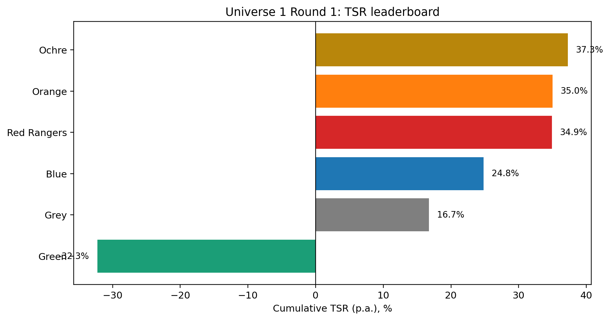
Round 1 leaderboard
Ochre leads TSR, while Green is sharply penalised.
• Ochre: highest TSR at 37.3%.
• Orange and Red Rangers are almost tied on TSR, though Red Rangers has the highest profit.
• Green posts a negative TSR despite having cash on the balance sheet.
Socratic questions
? What did the market see in Ochre that it did not see in Red Rangers?
? What did Green do that converted activity into value destruction?
GL Sec D • U1 R1
Source: Universe 1 results + CESIM materials
3/25

Slide 4
The first managerial puzzle
The most profitable team did not win the round.
• Red Rangers earned the highest profit: USD 373.7m.
• Ochre earned USD 213.5m, but had the highest TSR and market capitalisation.
• The simulation is valuing future cash flows and risk, not only current earnings.
Team
Profit
TSR
Red Rangers
373.7m
34.9%
Orange
366.0m
35.0%
Ochre
213.5m
37.3%
Green
–903.3m
–32.3%
Socratic questions
? If you were an investor, why might you pay more for Ochre than for Red Rangers?
? What is the difference between accounting profit and economic value?
GL Sec D • U1 R1
Source: Universe 1 results + CESIM materials
4/25

Slide 5
First-principles value logic
TSR is the market’s judgement on expected cash flows after risk.
Price × Volume
Revenue
Revenue – Costs
EBITDA / EBIT
EBIT – Tax – Investment
Free Cash Flow
FCF ÷ Risk
Enterprise Value
Equity Value ÷ Shares
Share Price / TSR
• Price × volume creates revenue.
• Revenue minus operating choices creates EBITDA/EBIT.
• Investments, working capital, and financing shape free cash flow and risk.
• Share price translates that value into TSR.
Socratic questions
? Which decision in Round 1 most directly affected cash flow?
? Which decision most directly affected risk?
GL Sec D • U1 R1
Source: Universe 1 results + CESIM materials
5/25

Slide 6
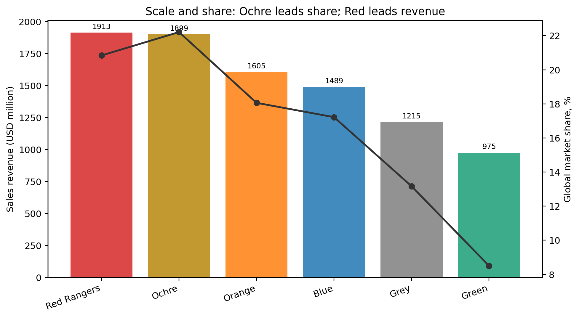
Revenue and market share
Scale mattered, but the quality of scale mattered more.
• Red Rangers leads sales revenue at USD 1.913bn.
• Ochre leads global market share at 22.2%.
• Green is smallest on revenue and second-lowest on global market share.
Socratic questions
? Is the aim to maximise market share, or to maximise value from share?
? Where did scale translate into valuation, and where did it not?
GL Sec D • U1 R1
Source: Universe 1 results + CESIM materials
6/25

Slide 7
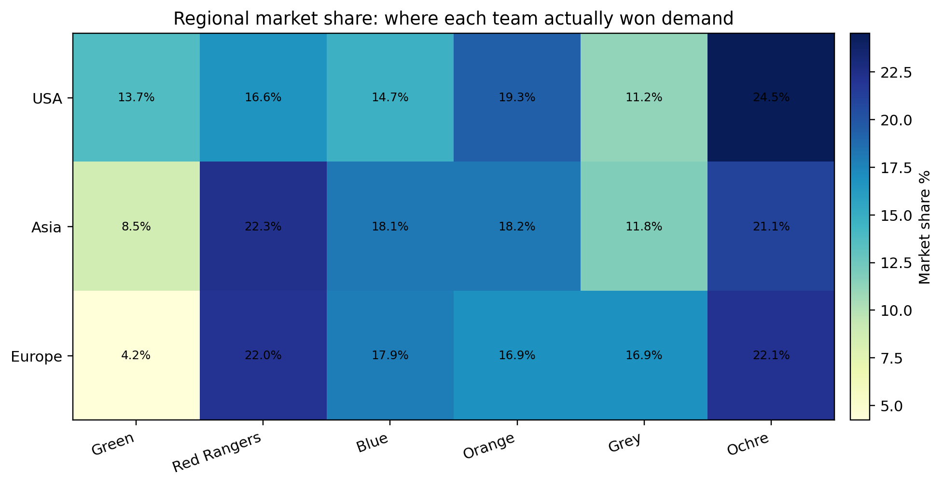
Regional battle map
No team won everywhere; regional fit drove the round.
• Ochre is strong in USA and Europe and competitive in Asia.
• Red Rangers has the strongest Asia share and strong Europe share.
• Green is weak in Europe and Asia despite large investments.
Socratic questions
? Which market punished premium pricing most severely?
? Where should each team focus in Round 2: defend, attack, or exit?
GL Sec D • U1 R1
Source: Universe 1 results + CESIM materials
7/25

Slide 8
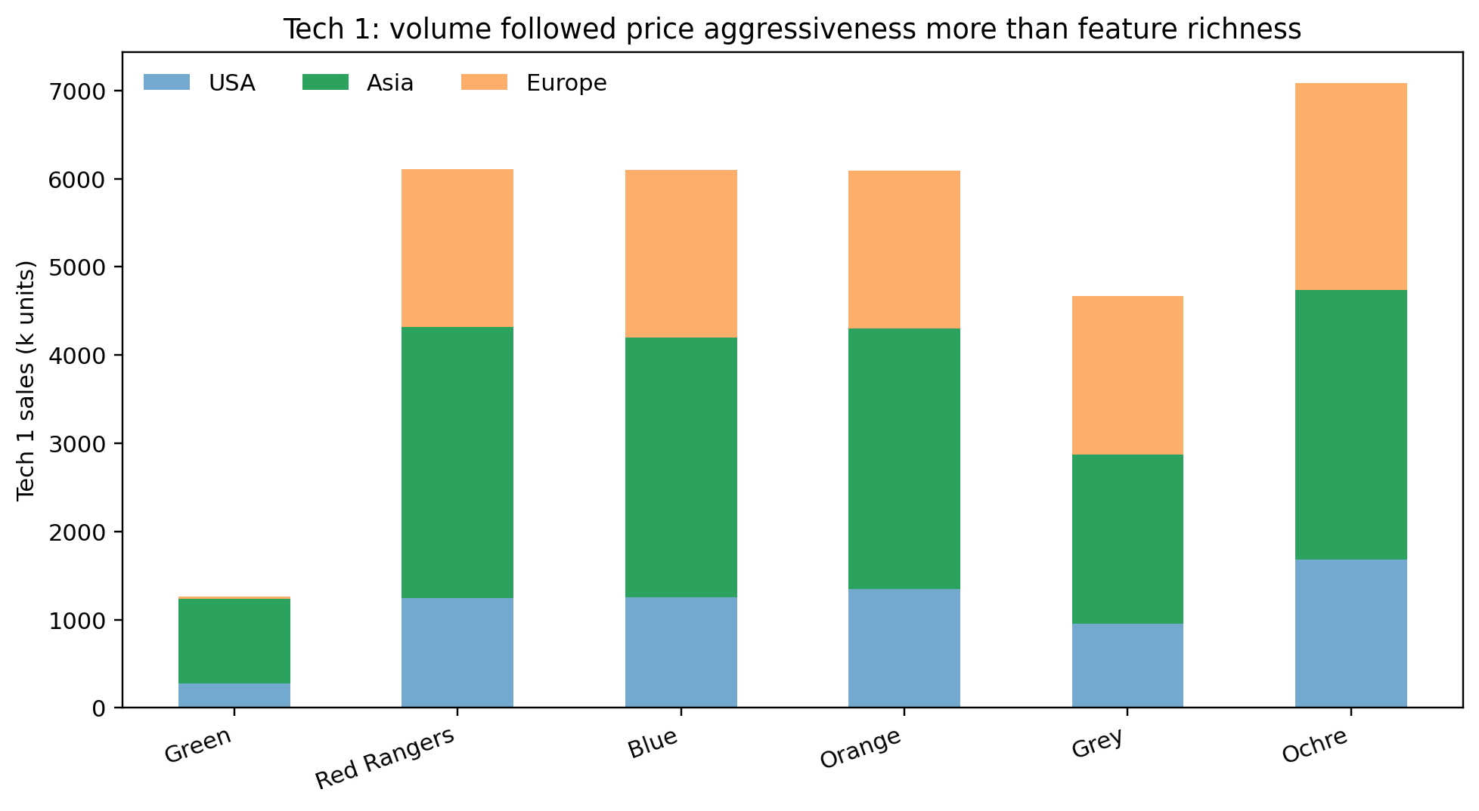
Pricing and volume: Tech 1
Round 1 demand rewarded aggressive price-volume positioning more than feature-heavy premium positioning.
• Green offered many features with high prices, but captured very low Tech 1 volume in Europe.
• Ochre and Red Rangers used stronger volume positions across regions.
• Feature richness alone did not compensate for price sensitivity.
Socratic questions
? What customer problem did extra features solve in Round 1?
? When does premium pricing become arrogance rather than strategy?
GL Sec D • U1 R1
Source: Universe 1 results + CESIM materials
8/25

Slide 9
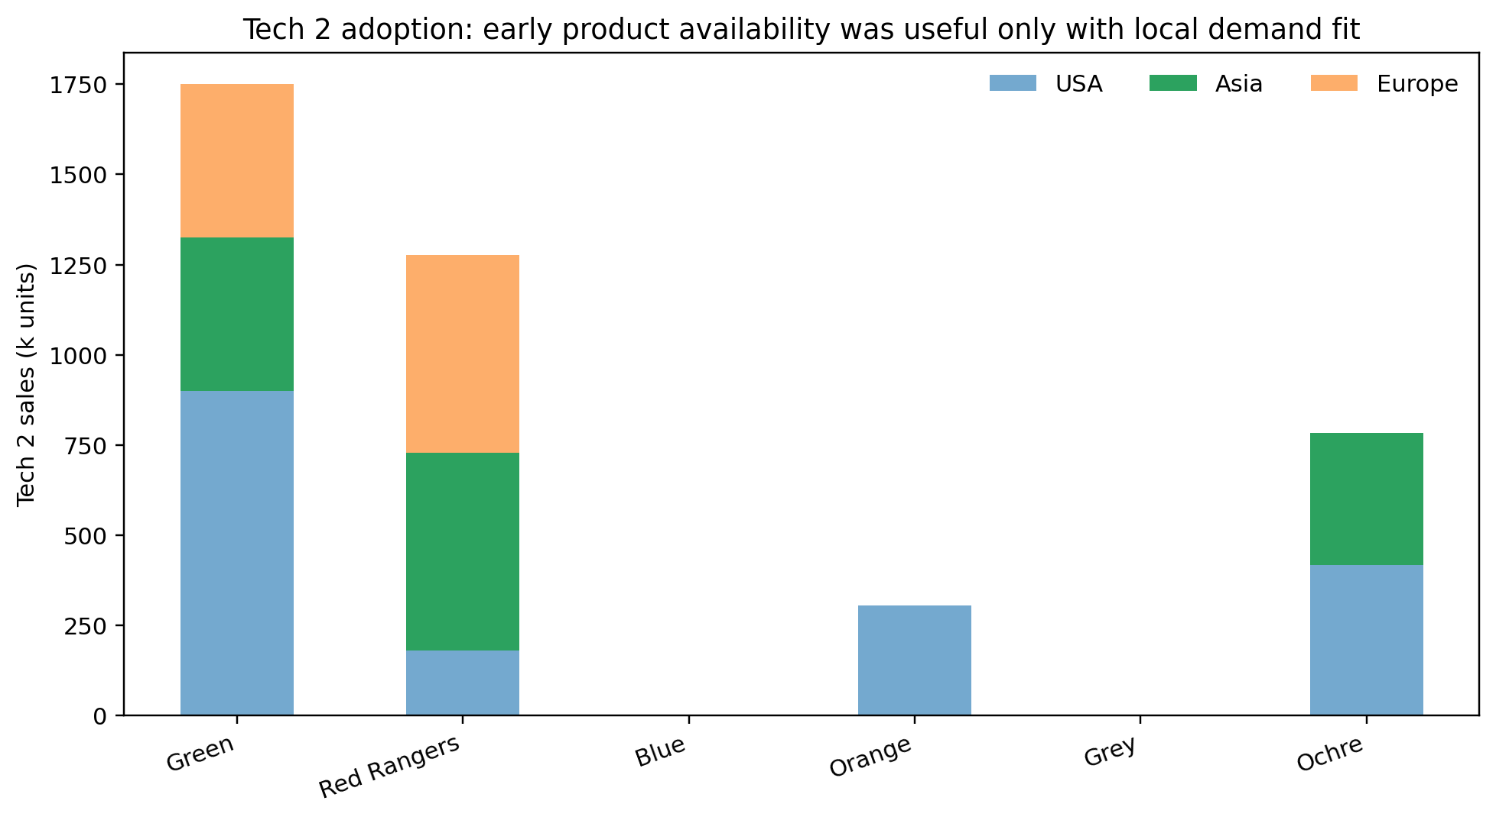
Technology timing: Tech 2
Being early is not enough; technology must meet demand at the right price and capacity.
• Green sold the largest Tech 2 volume in USA but left significant demand unsatisfied in Europe.
• Red Rangers captured Tech 2 share efficiently in Asia and Europe.
• Technology choices must be tied to market coverage and logistics.
Socratic questions
? Was Tech 2 a product advantage or a capacity-management problem?
? Which team timed technology rather than merely buying technology?
GL Sec D • U1 R1
Source: Universe 1 results + CESIM materials
9/25

Slide 10
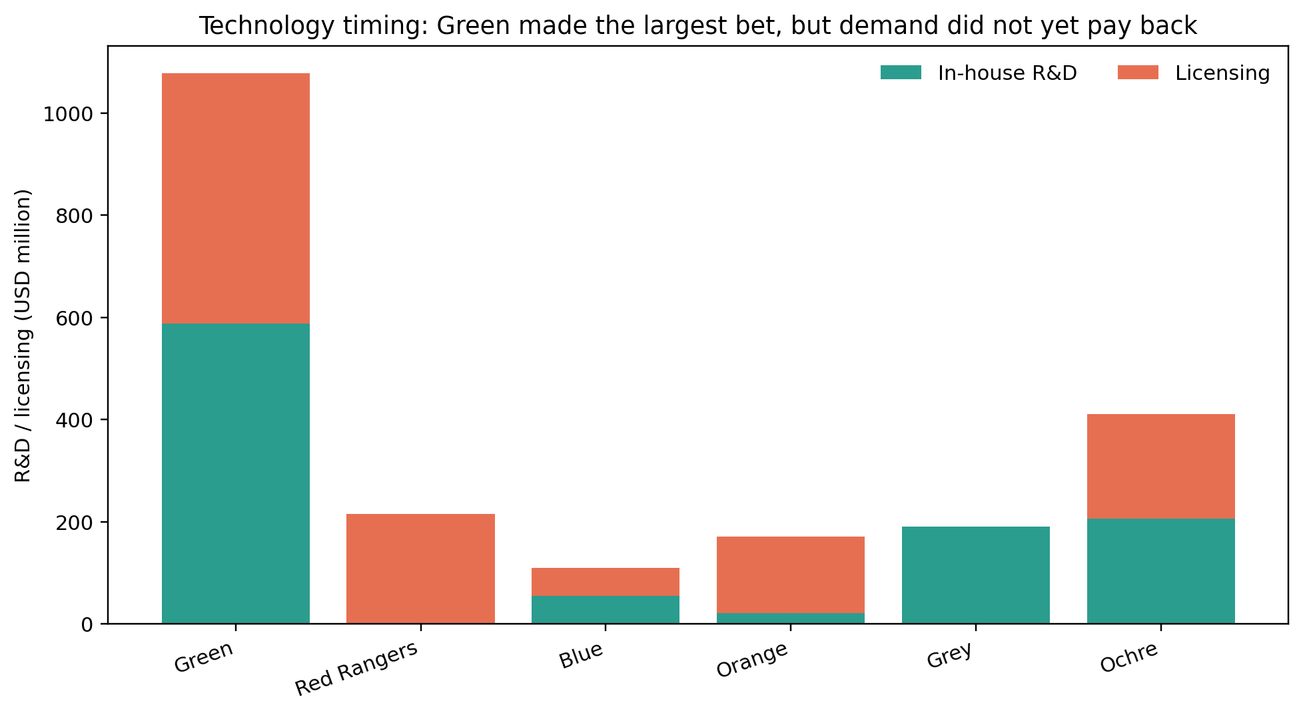
R&D and licensing
Green over-accelerated technology spending relative to realised Round 1 demand.
• Green spent USD 1.078bn on R&D/licensing, far above all teams.
• Ochre also invested heavily, but combined it with stronger market capture.
• Blue invested least and still generated solid profit and TSR.
Socratic questions
? When is R&D an investment, and when is it an expense without strategic discipline?
? What evidence would justify a large one-round technology bet?
GL Sec D • U1 R1
Source: Universe 1 results + CESIM materials
10/25

Slide 11
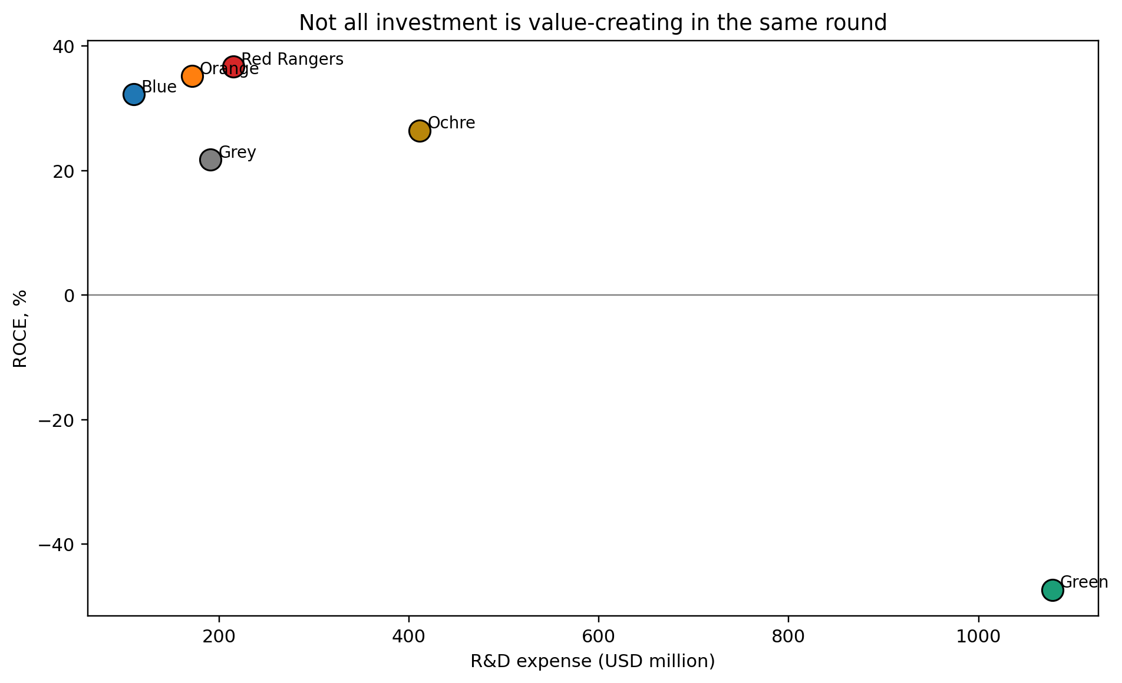
R&D versus ROCE
Investment quality, not investment size, separated teams.
• Red Rangers, Orange, and Blue converted moderate investment into strong ROCE.
• Green’s very large R&D spend produced negative ROCE in Round 1.
• The next question is whether Green’s bet pays back in later rounds.
Socratic questions
? Should we call Green’s move foolish, or premature? What evidence is needed?
? What return threshold should govern R&D spending?
GL Sec D • U1 R1
Source: Universe 1 results + CESIM materials
11/25

Slide 12
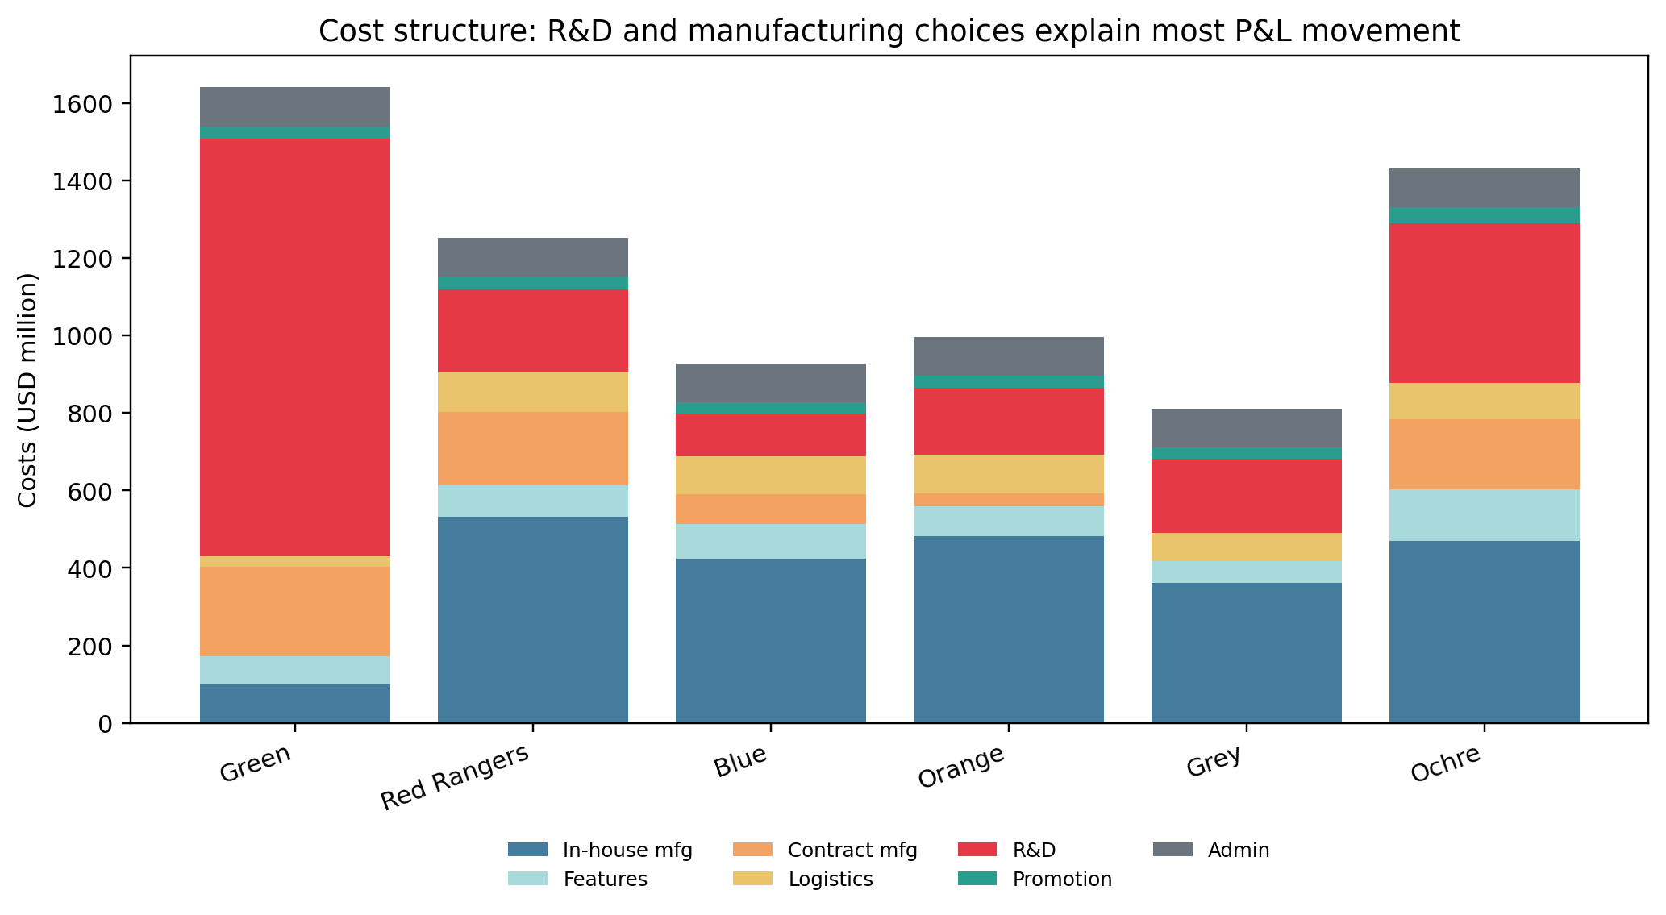
Cost structure explains the profit gap
The P&L story is mainly about R&D, contract manufacturing, and manufacturing cost discipline.
• Green’s total costs exceeded sales by a wide margin.
• Red Rangers and Orange balanced sales growth with cost control.
• Ochre accepted higher R&D, but also achieved the strongest demand position.
Socratic questions
? Which cost was strategic, and which cost was waste?
? Where did teams buy flexibility at the cost of margin?
GL Sec D • U1 R1
Source: Universe 1 results + CESIM materials
12/25

Slide 13
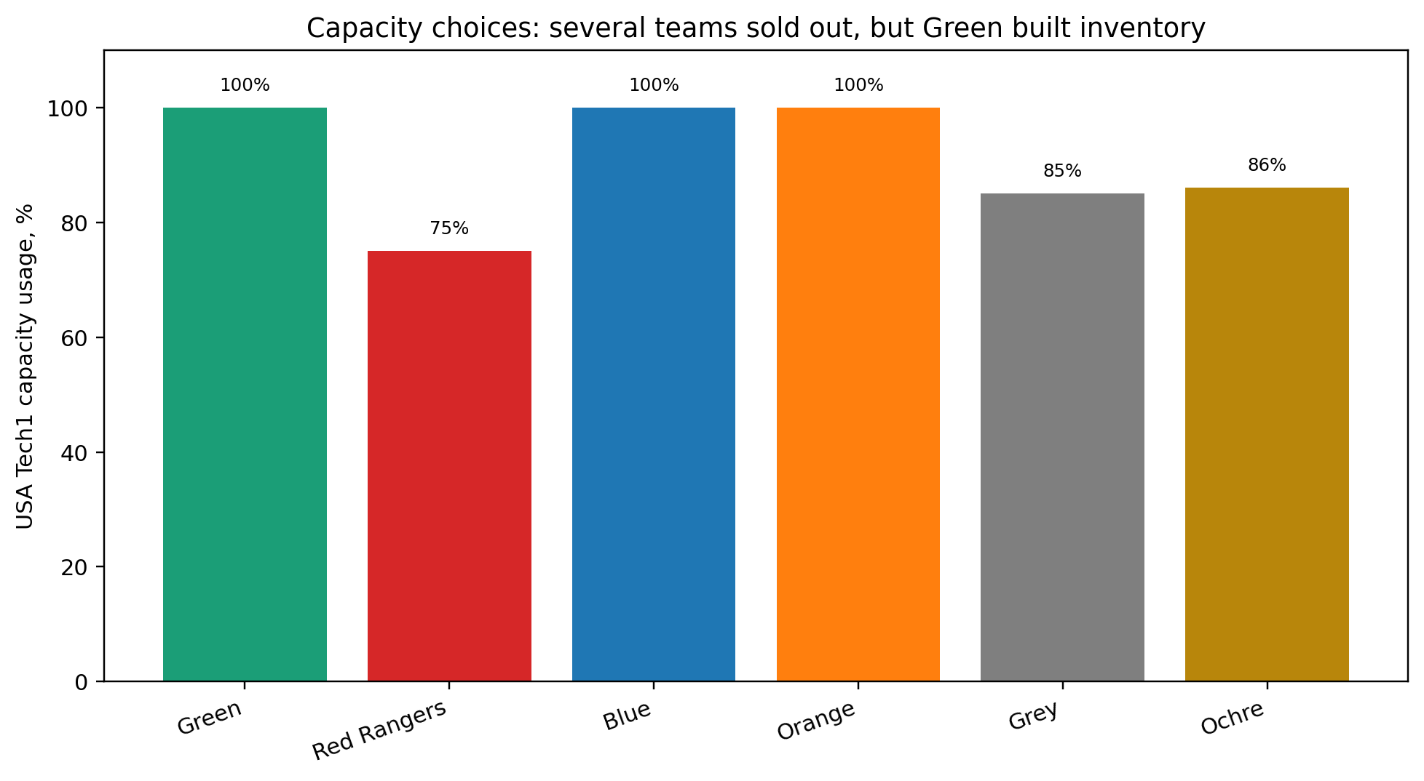
Capacity and production choices
Several teams used capacity tightly, but inventory outcomes show forecasting quality.
• Green, Blue, and Orange ran USA Tech 1 at full capacity.
• Green still ended with very high inventory, signalling mismatch between product mix and demand.
• Ochre and Red Rangers protected volume through contract manufacturing and market fit.
Socratic questions
? What is the difference between high utilisation and good utilisation?
? How would you test whether your production plan follows demand or hope?
GL Sec D • U1 R1
Source: Universe 1 results + CESIM materials
13/25

Slide 14
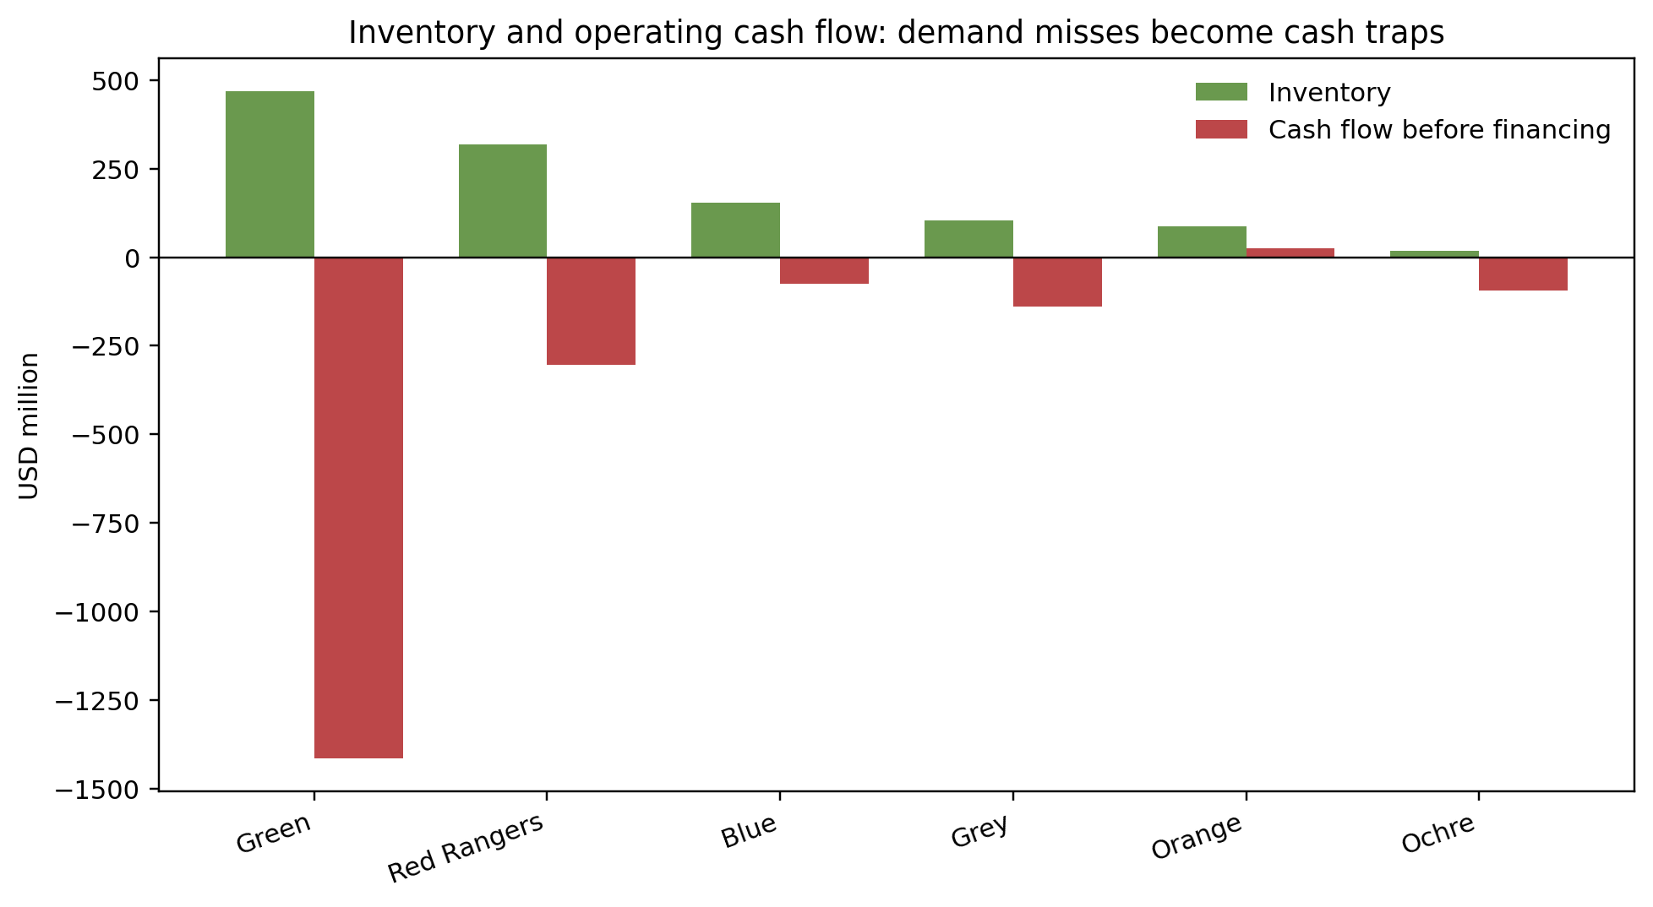
Inventory and cash-flow trap
Green’s weak demand conversion tied up cash and created negative operating cash flow.
• Green ended with USD 467.7m inventory and cash flow before financing of –USD 1.414bn.
• Orange had the best cash-flow position before financing.
• Inventory is not an asset if it reflects unsold wrong bets.
Socratic questions
? When does inventory become evidence of strategic error?
? What would you cut first: production, features, price, or R&D?
GL Sec D • U1 R1
Source: Universe 1 results + CESIM materials
14/25

Slide 15
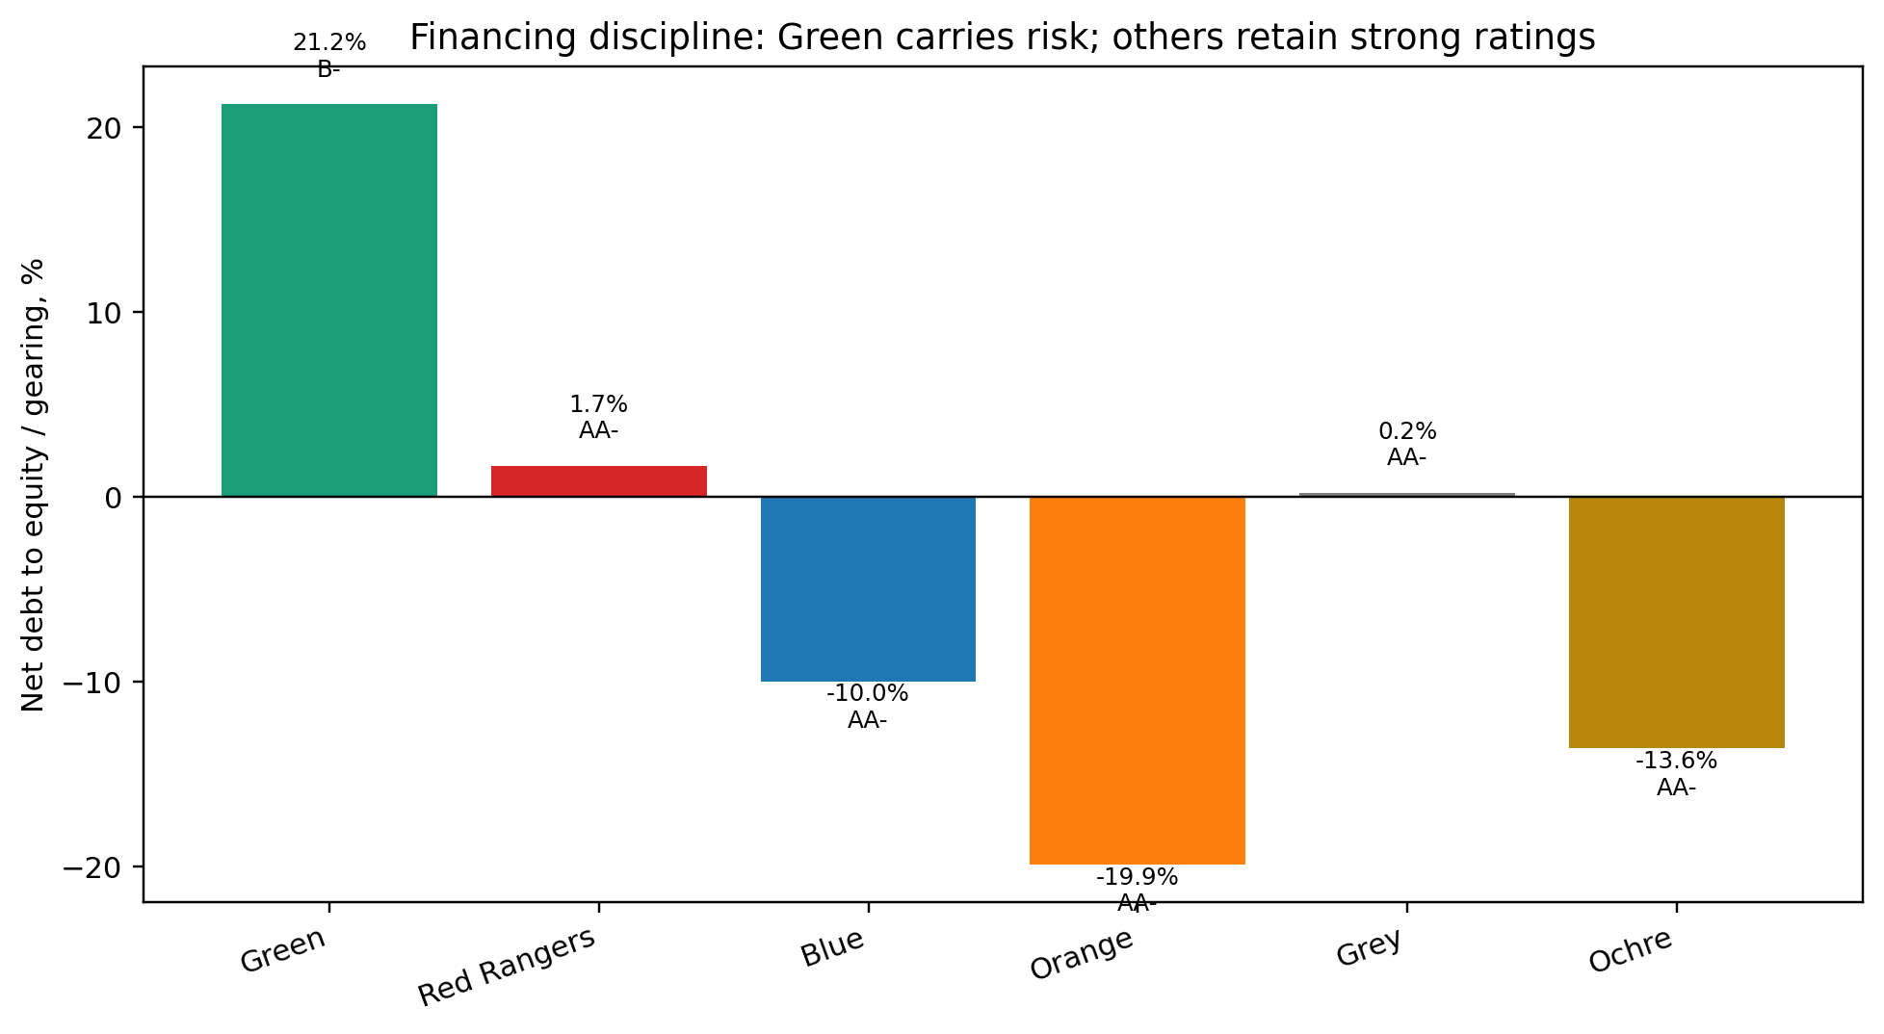
Financing and risk
The market punished financial risk and unplanned debt sharply.
• Green is the only team with B– credit rating.
• Other teams retained AA– ratings.
• Gearing and short-term debt raise required return and reduce valuation.
Socratic questions
? Why does the same cash flow become less valuable when risk rises?
? Is debt a problem here, or is unplanned debt the problem?
GL Sec D • U1 R1
Source: Universe 1 results + CESIM materials
15/25

Slide 16
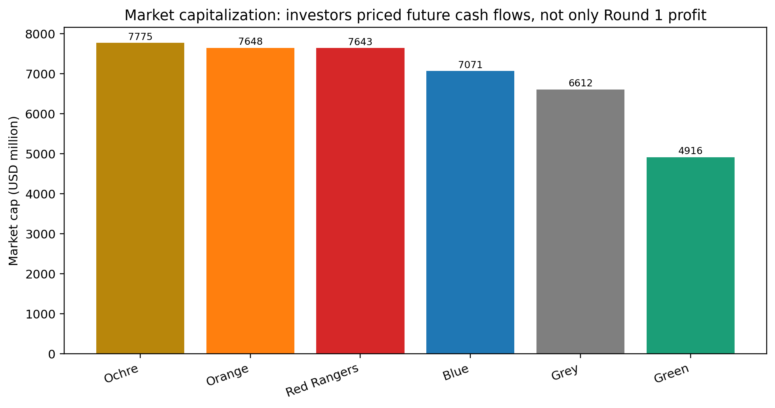
Market capitalisation view
Investors valued Ochre’s future position slightly above the close runners-up.
• Ochre market cap: USD 7.775bn.
• Orange and Red Rangers are close behind at about USD 7.65bn and USD 7.64bn.
• Green fell to USD 4.916bn despite issuing equity and holding cash.
Socratic questions
? What must Ochre protect now to justify this valuation?
? What would make Red Rangers overtake Ochre next round?
GL Sec D • U1 R1
Source: Universe 1 results + CESIM materials
16/25

Slide 17
Winner profile: Ochre
Ochre won by combining market share leadership with credible future value.
• Highest TSR and share price.
• Highest global market share.
• Lower profit than Red/Orange, but stronger market valuation.
Metric
Ochre
TSR
37.3%
Share price
$259
Global share
22.2%
Profit
213.5m
Market cap
7,775m
Socratic questions
? What is the hidden risk in Ochre’s position?
? Should Ochre now defend share or improve margins?
GL Sec D • U1 R1
Source: Universe 1 results + CESIM materials
17/25

Slide 18
Profit leader profile: Red Rangers
Red Rangers built the strongest current earnings engine.
• Highest profit: USD 373.7m.
• Highest sales revenue: USD 1.913bn.
• Strong ROCE and solid market share, especially Asia and Europe.
Metric
Red Rangers
Profit
373.7m
Revenue
1,913m
ROCE
36.7%
Asia share
22.3%
Europe share
22.0%
Socratic questions
? Why did Red Rangers not top TSR despite the highest profit?
? What one move could make Red Rangers the next leader?
GL Sec D • U1 R1
Source: Universe 1 results + CESIM materials
18/25

Slide 19
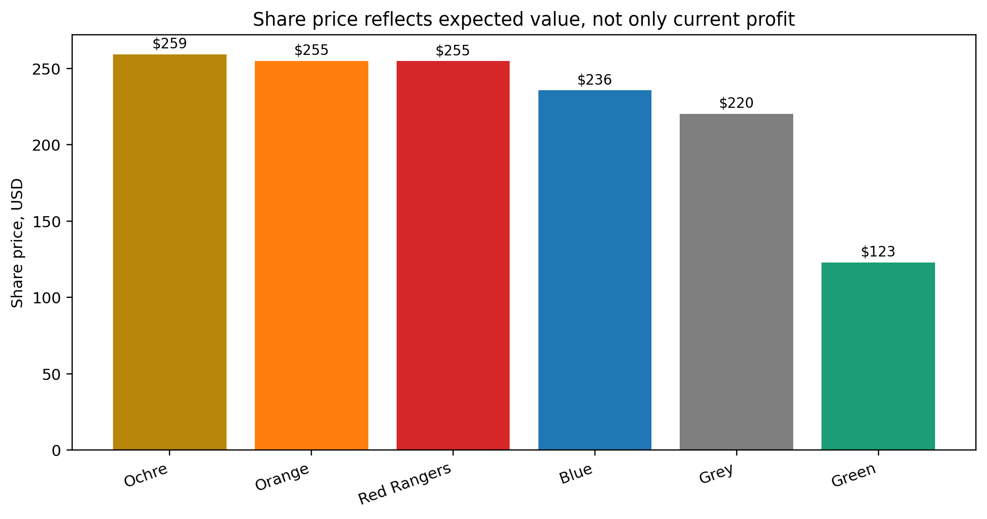
Efficiency profile: Orange and Blue
Orange and Blue show disciplined conversion from moderate investment to strong returns.
Metric
Orange
Blue
TSR
35.0%
24.8%
Profit
366.0m
318.8m
ROCE
35.2%
32.3%
R&D
171.4m
110.0m
Cash-flow before financing
25.7m
–75.4m
• Orange: strong TSR, high ROS, positive cash flow before financing.
• Blue: lower investment, solid profit, good margins.
• Both illustrate disciplined execution rather than dramatic bets.
Socratic questions
? Is disciplined moderation safer, or does it risk falling behind technology shifts?
? Which of these teams has the better Round 2 platform?
GL Sec D • U1 R1
Source: Universe 1 results + CESIM materials
19/25

Slide 20
Warning case: Green
Green illustrates the danger of confusing strategic ambition with strategic fit.
• Highest R&D/licensing spend and the only negative profit.
• Largest inventory and severe negative operating cash flow.
• B– credit rating raises valuation risk.
Metric
Green
R&D/licensing
1,077.7m
Profit
–903.3m
Inventory
467.7m
Cash-flow before financing
–1,414.4m
Credit rating
B–
Socratic questions
? What assumption did Green make about demand and technology adoption?
? What is the first rescue move Green should make?
GL Sec D • U1 R1
Source: Universe 1 results + CESIM materials
20/25

Slide 21
What the market rewarded
Round 1 rewarded disciplined demand capture and credible future cash-flow potential.
Reward 1
Reward 2
Reward 3
Reward 4
Demand capture
Margins
Risk control
Future options
• Strong market share with acceptable margins.
• Moderate or well-timed R&D.
• Sound working-capital control.
• Low financial risk and strong credit rating.
Socratic questions
? Which reward was most important: share, margin, risk, or growth option?
? Can a team maximise all four at once?
GL Sec D • U1 R1
Source: Universe 1 results + CESIM materials
21/25

Slide 22
What the market punished
Round 1 punished expensive bets without demand validation.
Penalty 1
Penalty 2
Penalty 3
Penalty 4
Mistimed R&D
Inventory
Debt risk
Weak fit
• Overspending ahead of market readiness.
• Inventory caused by poor price-product-market fit.
• Unplanned short-term debt and weakened credit rating.
• Premium features without proven willingness to pay.
Socratic questions
? Which punished decision was reversible? Which was sticky?
? What data should teams check before submitting Round 2 decisions?
GL Sec D • U1 R1
Source: Universe 1 results + CESIM materials
22/25

Slide 23
Socratic question bank for Universe 1
Use questions to make students explain causality, not defend outcomes.
Step
Question to ask
Assumption
What did we believe about demand?
Evidence
Which result confirms or rejects it?
Trade-off
What did we sacrifice?
Action
What will we change in Round 2?
Socratic questions
? What did the market reward? What did it punish?
? Was your result a strategy or a lucky accident?
GL Sec D • U1 R1
Source: Universe 1 results + CESIM materials
23/25

Slide 24
Round 2 decision checklist
Make the next decision from evidence, not emotion.
Decision area
Round 2 question
Demand
Where is demand most price-sensitive?
Price
What price protects volume and margin?
R&D
What must be ready now vs later?
Production
What should we make, where, and how much?
Finance
Will cash flow and rating survive the plan?
Socratic questions
? Which single metric will your team watch first next round?
? What decision rule will prevent repeating your Round 1 mistake?
GL Sec D • U1 R1
Source: Universe 1 results + CESIM materials
24/25

Slide 25
Closing reflection
The best strategy is not the boldest; it is the most coherent.
Coherence is the discipline of making all choices point in the same strategic direction.
• Coherence links market choice, product choice, operations, finance, and risk.
• Round 1 winners built credible value stories.
• Round 1 underperformance can still become learning advantage.
Socratic questions
? What will your team stop doing immediately?
? What will your team do more deliberately in Round 2?
GL Sec D • U1 R1
Source: Universe 1 results + CESIM materials
25/25

