Slide 1
CESIM Global Challenge
Universe 1 • Round 2 Comparative Debrief
GL Sec C Group July 2026
R2 leader by TSR
R2 profit leader
Biggest rescue
Largest warning
Harshad
Big Bulls
Green
Lakshmi
Teaching point
Socratic questions
• Round 2 is not just a ranking; it is a test of whether teams learned from Round 1.
• We will compare R1 to R2, then diagnose Round 2 from first principles: demand, margin, cash flow, risk and TSR.
? What did the market reward in Round 2?
? Which teams created real value, and which merely created activity?
? What should each team stop doing before Round 3?
Source: Section C Universe 1 Round 1 & Round 2 results + CESIM valuation/results guides
1/30

Slide 2
How to read Round 2
GL Sec C • U1 R2
2/30
Start with the causal chain, not the leaderboard.
Teaching point
• Demand creates revenue; costs and capacity decide margins; cash and debt shape risk; risk changes valuation.
• Cumulative TSR after Round 2 reflects two years of decisions, not only the latest round.
• Therefore, round-to-round learning matters more than one score.
Demand
→
Revenue
→
Margin
→
Cash flow
→
Risk
→
Share price
→
TSR
Socratic questions
? Which number is an outcome, and which number is a cause?
? Where did your team’s strategy break: demand, cost, cash, or risk?
Source: Section C Universe 1 Round 1 & Round 2 results + CESIM valuation/results guides

Slide 3
Universe-level movement
GL Sec C • U1 R2
3/30
Growth came with better absolute profit, but not better profit quality.
Sales revenue change
Profit change
Profit margin
Average TSR
+33.6%
+27.8%
7.1% → 6.8%
18.1% → 10.2%
Aggregate sales grew strongly across the universe.
Absolute profit improved, but unevenly.
Margin slipped despite scale.
Cumulative TSR was dragged down by severe losers.
Teaching point
Socratic questions
• Round 2 is a more competitive universe: revenue grew 33.6%, yet aggregate margin fell from 7.1% to 6.8%.
• The market rewarded teams that grew while preserving margins and credit quality.
? Is this good growth or expensive growth?
? Why can profit rise while the quality of profit falls?
? What would make investors discount this growth?
Source: Section C Universe 1 Round 1 & Round 2 results + CESIM valuation/results guides

Slide 4
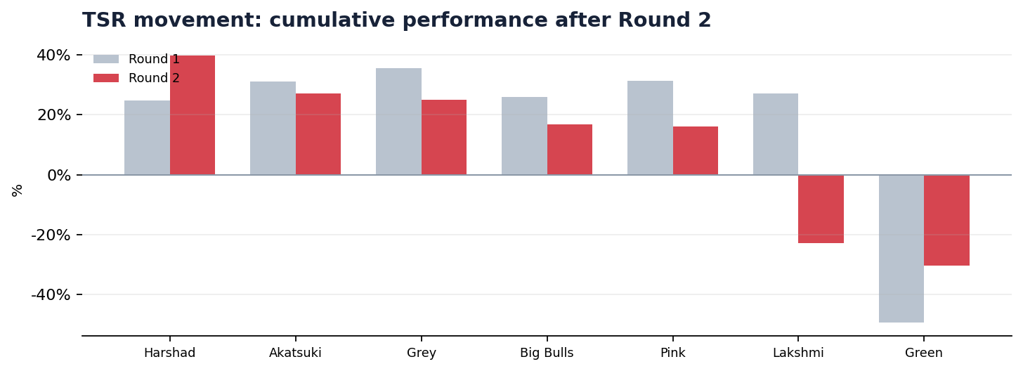
Leaderboard after Round 2
GL Sec C • U1 R2
4/30
Harshad leads TSR; Big Bulls leads profit; Grey is the quiet compounder.
Teaching point
• Harshad Mehta Gang moves from a mid-table Round 1 position to the top TSR position.
• Grey remains strong with improved profit and AA rating.
• Big Bulls has the strongest Round 2 profit but a lower cumulative TSR than Harshad and Grey.
Socratic questions
? What did Harshad do that converted scale into valuation?
? Why does the profit leader not automatically become the TSR leader?
Source: Section C Universe 1 Round 1 & Round 2 results + CESIM valuation/results guides

Slide 5
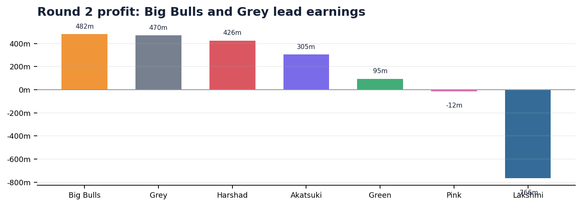
The major Round 2 puzzle
GL Sec C • U1 R2
5/30
The best current profit does not produce the highest TSR.
Teaching point
• Big Bulls has the highest Round 2 profit at $482.0m.
• Harshad has lower Round 2 profit but the highest cumulative TSR and share price.
• Valuation sees more than current income: it prices scale, risk and future cash-flow credibility.
Socratic questions
? Would you invest in Big Bulls or Harshad today? Why?
? Which signal should dominate: profit, share, ROCE or risk?
Source: Section C Universe 1 Round 1 & Round 2 results + CESIM valuation/results guides

Slide 6
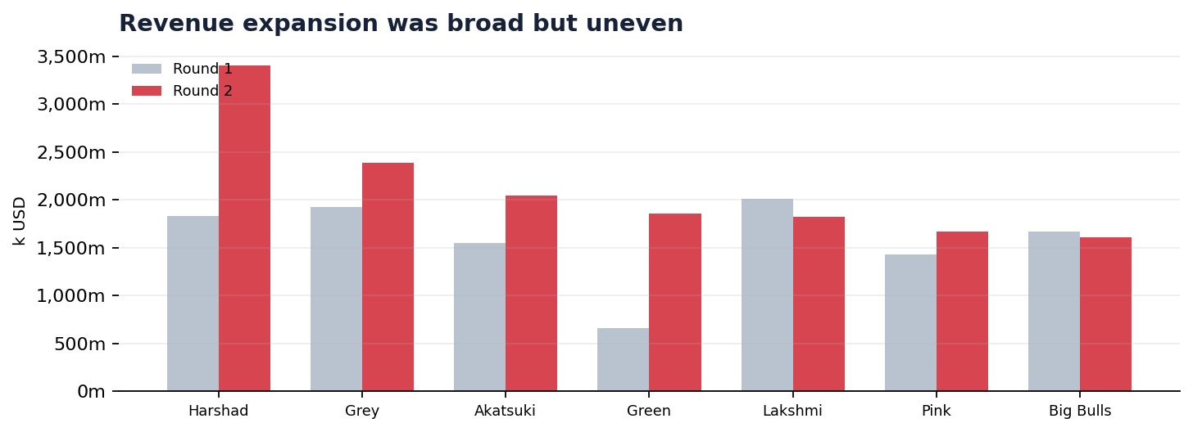
Revenue comparison
GL Sec C • U1 R2
6/30
Harshad captured the largest scale shift from Round 1 to Round 2.
Teaching point
• Universe revenue increased by 33.6%.
• Harshad added roughly $1.57bn in revenue; Green added $1.19bn after a poor Round 1.
• Lakshmi and Big Bulls shrank revenue, but their profit outcomes diverged sharply.
Socratic questions
? When is revenue growth a sign of strategic health?
? Which team grew because of fit, and which grew despite inefficiency?
Source: Section C Universe 1 Round 1 & Round 2 results + CESIM valuation/results guides

Slide 7
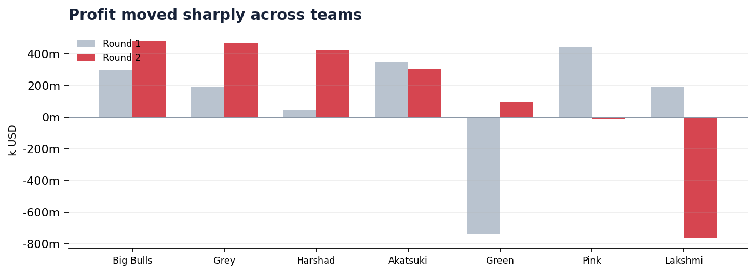
Profit comparison
GL Sec C • U1 R2
7/30
Profit movements reveal learning, rescue and deterioration.
Teaching point
• Green improved by roughly $833m, moving from deep loss to positive profit.
• Lakshmi fell by about $958m, the largest deterioration.
• Pink shifted from the highest Round 1 profit to a Round 2 loss.
Socratic questions
? Which team learned fastest from Round 1?
? What must have gone wrong when high Round 1 profit becomes Round 2 loss?
Source: Section C Universe 1 Round 1 & Round 2 results + CESIM valuation/results guides

Slide 8
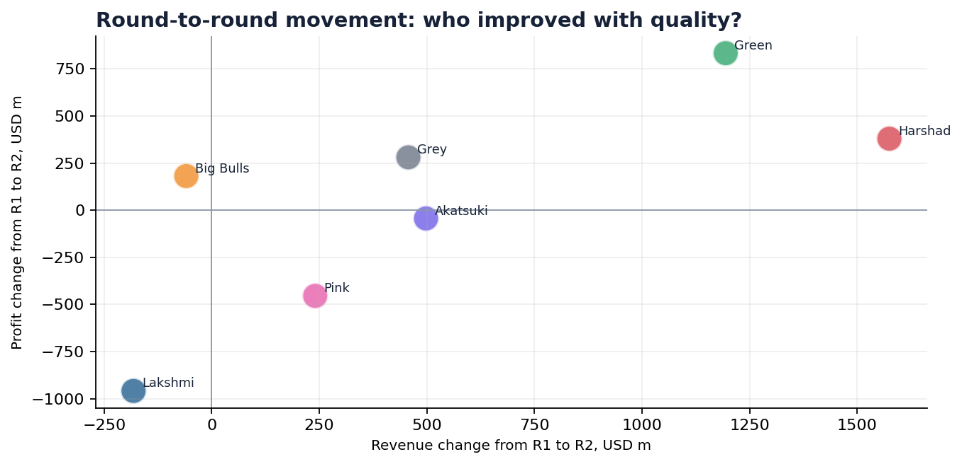
Strategic movement map
GL Sec C • U1 R2
8/30
The best movement is profitable growth, not growth alone.
Teaching point
• Harshad and Green show strong revenue-and-profit improvement.
• Grey has measured revenue growth with meaningful profit improvement.
• Lakshmi is the danger case: lower revenue and much lower profit.
Socratic questions
? Which quadrant is strategically strongest?
? Can Green’s improvement be called a turnaround if debt remains high?
Source: Section C Universe 1 Round 1 & Round 2 results + CESIM valuation/results guides

Slide 9
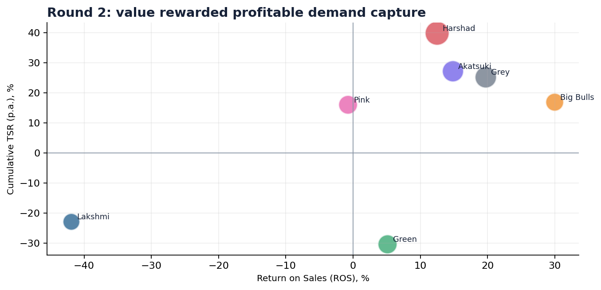
Round 2 value-quality map
GL Sec C • U1 R2
9/30
TSR rises when margin, market share and risk tell the same story.
Teaching point
• Harshad sits in the high-TSR zone with solid ROS and high global share.
• Big Bulls has the highest ROS but lower cumulative TSR because value is cumulative and risk-sensitive.
• Lakshmi’s negative ROS is immediately visible as value destruction.
Socratic questions
? What combination of signals would make a share price rise?
? Which team is under-valued or over-valued relative to its operating performance?
Source: Section C Universe 1 Round 1 & Round 2 results + CESIM valuation/results guides

Slide 10
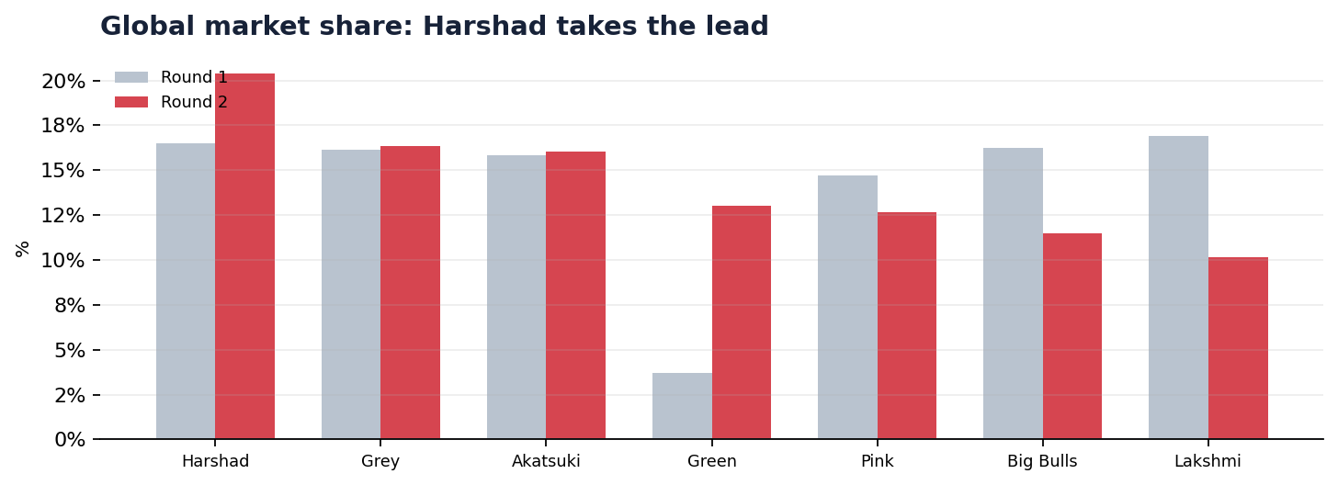
Market share battle
GL Sec C • U1 R2
10/30
Harshad becomes the global market-share leader.
Teaching point
• Harshad’s global market share rose from 16.5% to 20.4%.
• Green recovered share from 3.7% to 13.0%, but still carries financial strain.
• Lakshmi lost share sharply, from 16.9% to 10.1%.
Socratic questions
? Did the market reward low price, features, capacity, or timing?
? Is market share an objective or only a means to cash flow?
Source: Section C Universe 1 Round 1 & Round 2 results + CESIM valuation/results guides

Slide 11
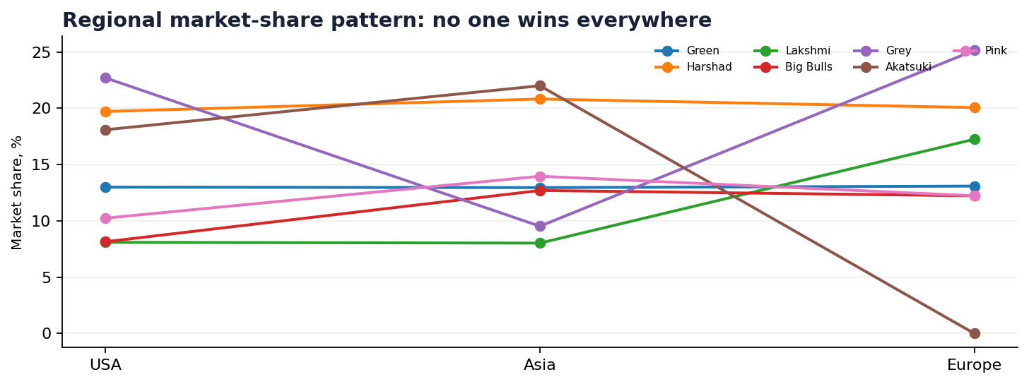
Regional battle map
GL Sec C • U1 R2
11/30
No team won everywhere; Round 2 required regional precision.
Teaching point
• Harshad is consistently strong across USA, Asia and Europe.
• Grey dominates USA and Europe but is weaker in Asia.
• Akatsuki leads Asia but has zero Europe sales in the extracted Round 2 market report.
Socratic questions
? Which region should each team defend, attack, or abandon?
? What assumption about one global market did the results reject?
Source: Section C Universe 1 Round 1 & Round 2 results + CESIM valuation/results guides

Slide 12
Pricing and technology signals
GL Sec C • U1 R2
12/30
Premium features worked only where the customer accepted the value proposition.
USA signal
Asia signal
Europe signal
Grey: 22.7% share
Akatsuki: 22.0% share
Grey: 25.1% share
Grey used a relatively low Tech 1 price with 6 features and captured the highest USA share.
Akatsuki led Asia, but unsatisfied demand suggests capacity or allocation constraints.
Grey combined competitive pricing with strong demand capture in Europe.
Teaching point
Socratic questions
• Lakshmi carried the heaviest feature load but suffered weak profit and CC credit rating.
• Feature richness is not strategy unless customers pay enough to cover cost and risk.
• Round 2 rewarded market-specific price-feature fit.
? What willingness-to-pay assumption did your team make?
? Where did customers refuse to pay for features?
? How would you redesign the price-feature bundle for Round 3?
Source: Section C Universe 1 Round 1 & Round 2 results + CESIM valuation/results guides

Slide 13
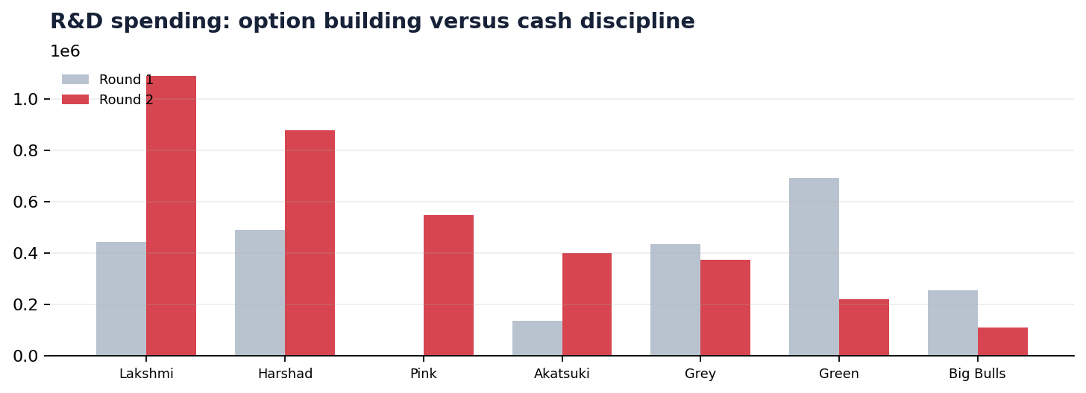
R&D and option discipline
GL Sec C • U1 R2
13/30
Technology investment must be timed against market readiness and cash capacity.
Teaching point
• In CESIM, R&D can create future options, but it hits the income statement immediately.
• Teams with heavy spending need evidence that demand and capacity will convert the option into cash.
• Green recovered operationally, while Lakshmi’s risk profile deteriorated sharply.
Socratic questions
? What evidence justifies an aggressive R&D bet?
? When is R&D leadership a strength, and when is it self-inflicted fragility?
Source: Section C Universe 1 Round 1 & Round 2 results + CESIM valuation/results guides

Slide 14
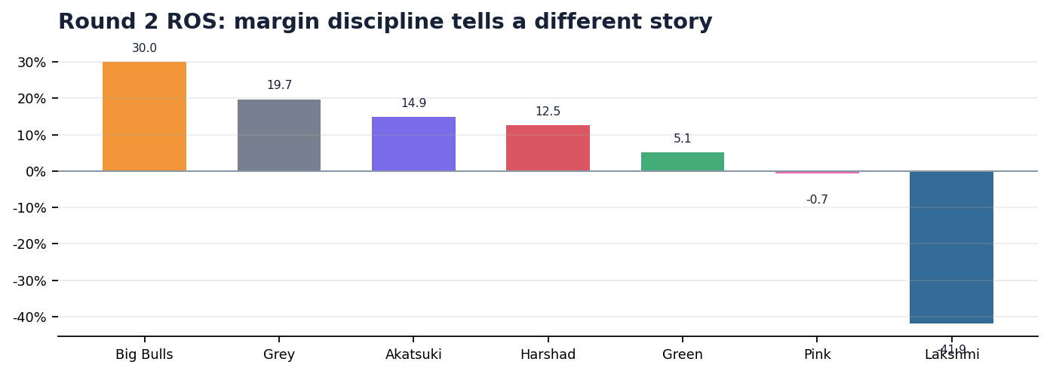
Margin discipline
GL Sec C • U1 R2
14/30
Big Bulls proves that lower revenue can still create high profit when margin is protected.
Teaching point
• Big Bulls has the highest ROS at 30.0%.
• Grey also shows strong margin quality at 19.7%.
• Lakshmi and Pink show the danger of weak conversion from sales to profit.
Socratic questions
? Would you rather have Harshad’s scale or Big Bulls’ margin?
? What is the minimum margin your team will defend in Round 3?
Source: Section C Universe 1 Round 1 & Round 2 results + CESIM valuation/results guides

Slide 15
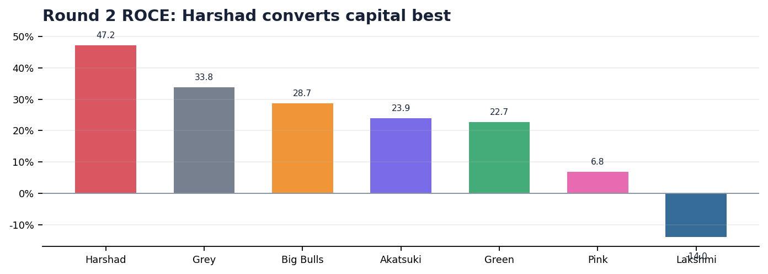
Capital productivity
GL Sec C • U1 R2
15/30
Harshad’s strongest managerial signal is ROCE.
Teaching point
• Harshad delivers the highest ROCE at 47.2%.
• Grey follows with strong capital productivity and low WACC.
• Lakshmi destroys capital with negative ROCE.
Socratic questions
? What capital was employed, and what return did it generate?
? Which team should grow capacity, and which should pause?
Source: Section C Universe 1 Round 1 & Round 2 results + CESIM valuation/results guides

Slide 16
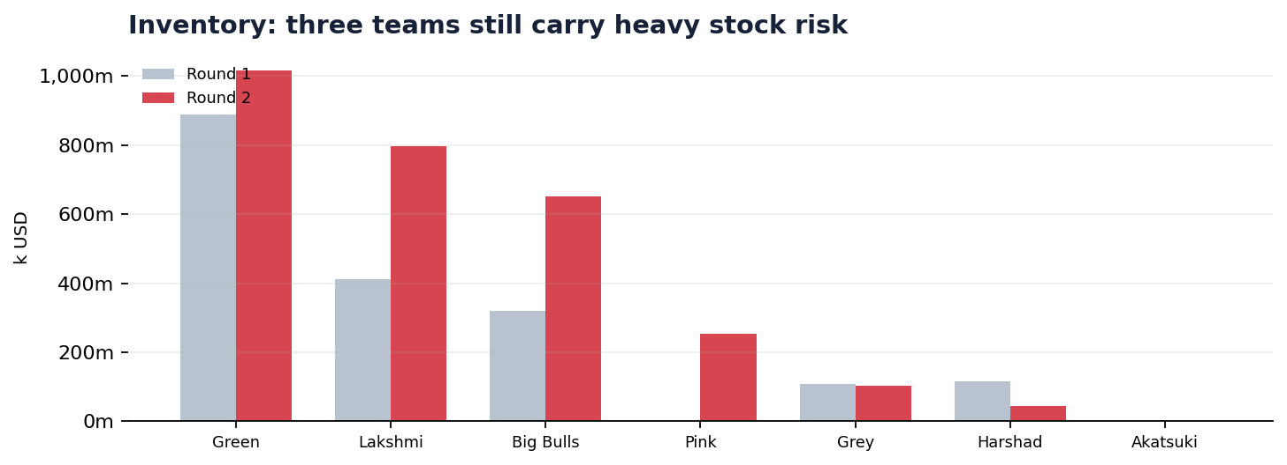
Inventory trap
GL Sec C • U1 R2
16/30
Inventory tells us where forecasting, pricing, product mix or capacity went wrong.
Teaching point
• Green still carries over $1.0bn inventory after Round 2.
• Lakshmi and Big Bulls also carry high inventory, though their profit outcomes differ.
• Akatsuki has no inventory, but no Europe sales: low inventory can also mean missed opportunity.
Socratic questions
? Is inventory a buffer or a symptom?
? Which inventory should be liquidated, and which should be strategically held?
Source: Section C Universe 1 Round 1 & Round 2 results + CESIM valuation/results guides

Slide 17
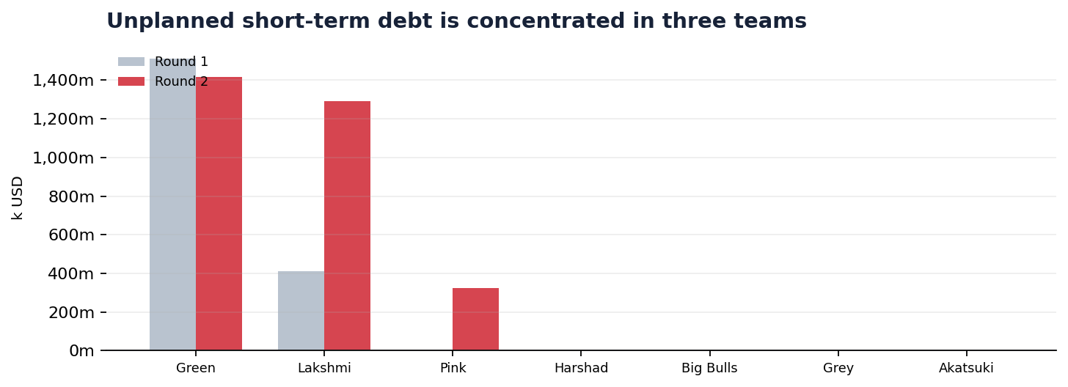
Cash and financing risk
GL Sec C • U1 R2
17/30
Debt and credit ratings show which strategies were financially fragile.
Teaching point
• Green, Lakshmi and Pink carry unplanned short-term debt.
• Lakshmi’s credit rating falls to CC; Green remains risky at B.
• Harshad, Big Bulls, Grey and Akatsuki preserve strong credit quality.
Socratic questions
? Why does the same operating profit become less valuable with more risk?
? Which team needs a cash rescue before a growth plan?
Source: Section C Universe 1 Round 1 & Round 2 results + CESIM valuation/results guides

Slide 18
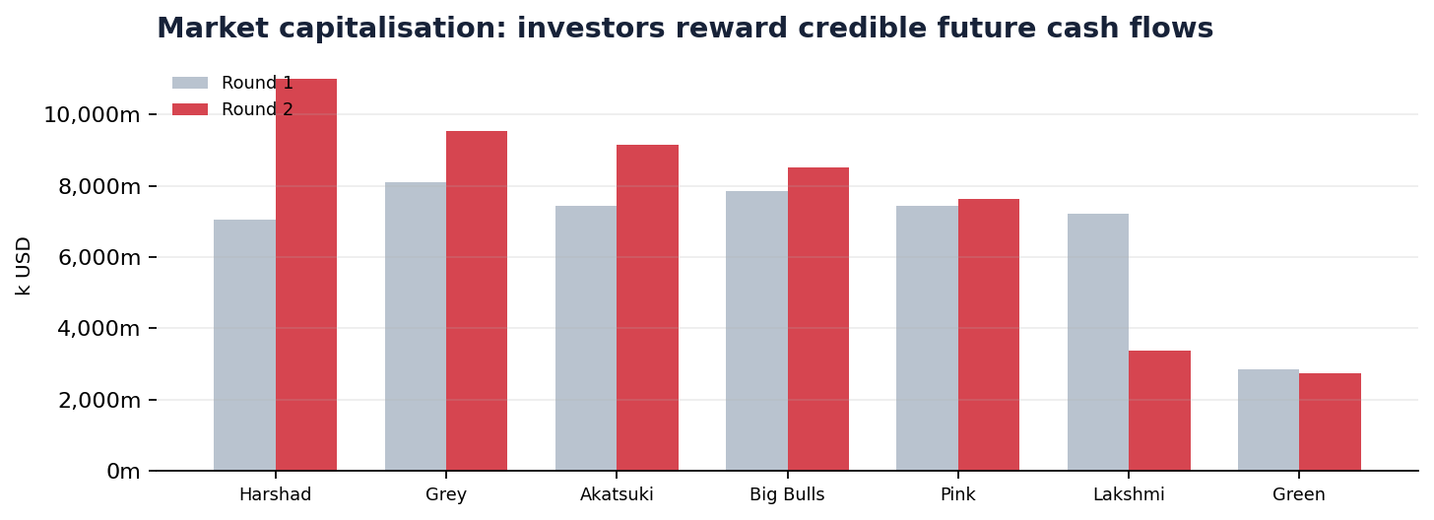
Valuation view
GL Sec C • U1 R2
18/30
The market valued Harshad’s scale and quality above the field.
Teaching point
• Harshad has the highest market capitalisation at about $11.0bn.
• Grey and Akatsuki sit in the next value tier.
• Lakshmi and Green remain valuation laggards despite very different operating stories.
Socratic questions
? What exactly is the market capitalising here?
? Which team has the highest upside if it fixes one weakness?
Source: Section C Universe 1 Round 1 & Round 2 results + CESIM valuation/results guides

Slide 19
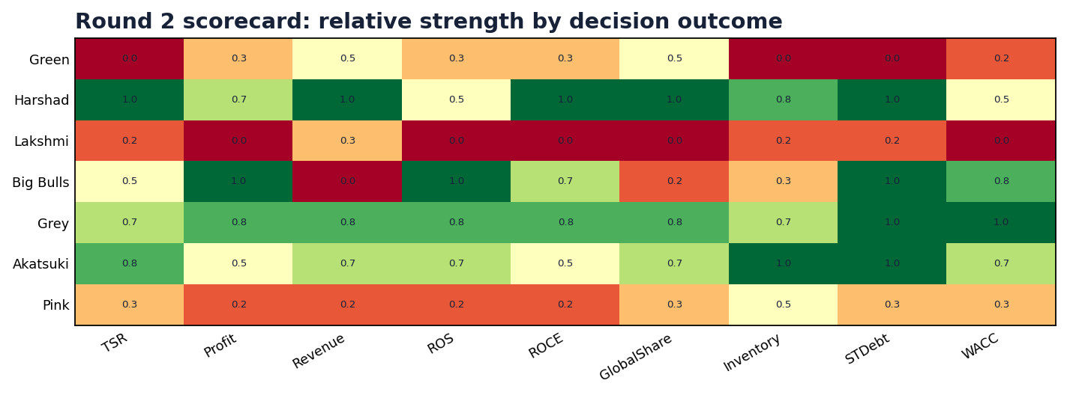
Relative scorecard
GL Sec C • U1 R2
19/30
A state-of-play view: where each team is strong or exposed.
Teaching point
• Harshad is broadly strong across TSR, revenue, ROCE and market share.
• Grey scores well across risk, margins and valuation strength.
• Lakshmi is weak on margin, risk and shareholder return.
Socratic questions
? Which column explains your team’s score most powerfully?
? Which weakness is easiest to repair before Round 3?
Source: Section C Universe 1 Round 1 & Round 2 results + CESIM valuation/results guides

Slide 20
Winner profile: Harshad Mehta Gang
GL Sec C • U1 R2
20/30
Scale + ROCE + market share made Harshad the Round 2 value leader.
TSR
Profit
ROS
ROCE
Credit
39.8%
$426m
12.5%
47.2%
AA-
Teaching point
Socratic questions
• Highest cumulative TSR: 39.8%.
• Highest revenue: $3.40bn.
• Highest ROCE: 47.2%.
• Global share leader: 20.4%.
? What must Harshad protect: share, margin, or ROCE?
? Can Harshad keep growing without inviting price retaliation?
Source: Section C Universe 1 Round 1 & Round 2 results + CESIM valuation/results guides

Slide 21
Compounder profile: Grey
GL Sec C • U1 R2
21/30
Grey is the quiet strategist: lower drama, high quality.
TSR
Profit
ROS
ROCE
Credit
25.1%
$470m
19.7%
33.8%
AA
Teaching point
Socratic questions
• Second-highest profit: $470.5m.
• Strong ROS: 19.7%; ROCE: 33.8%.
• Best Europe share and strongest USA share.
• AA credit rating and lowest WACC.
? Is Grey the most strategically coherent team?
? Should Grey attack Asia or deepen its USA/Europe strength?
Source: Section C Universe 1 Round 1 & Round 2 results + CESIM valuation/results guides

Slide 22
Profit leader profile: Big Bulls
GL Sec C • U1 R2
22/30
Big Bulls created the strongest Round 2 profit engine, but not the best cumulative TSR.
TSR
Profit
ROS
ROCE
Credit
16.8%
$482m
30.0%
28.7%
AA
Teaching point
Socratic questions
• Highest Round 2 profit: $482.0m.
• Highest ROS: 30.0%.
• Lower revenue and lower global share than in Round 1.
• Strong AA credit rating.
? Is Big Bulls too disciplined or too cautious?
? How can Big Bulls convert margin into shareholder return?
Source: Section C Universe 1 Round 1 & Round 2 results + CESIM valuation/results guides

Slide 23
Regional specialist profile: Akatsuki
GL Sec C • U1 R2
23/30
Akatsuki has strong value and Asia leadership, but Europe is a major question.
TSR
Profit
ROS
ROCE
Credit
27.1%
$305m
14.9%
23.9%
AA
Teaching point
Socratic questions
• TSR remains strong at 27.1%.
• Asia share leader: 22.0%.
• Zero Europe sales in the extracted Round 2 report despite European demand.
• AA credit rating and high cash.
? Was the Europe outcome intentional focus or execution failure?
? Can a regional specialist win a global valuation game?
Source: Section C Universe 1 Round 1 & Round 2 results + CESIM valuation/results guides

Slide 24
Turnaround profile: Green
GL Sec C • U1 R2
24/30
Green recovered operationally, but the balance sheet is still wounded.
TSR
Profit
ROS
ROCE
Credit
-30.4%
$95m
5.1%
22.7%
B
Teaching point
Socratic questions
• Profit improved by about $833m from Round 1.
• Global share rose from 3.7% to 13.0%.
• Still has over $1.4bn unplanned short-term debt.
• Credit rating remains weak at B.
? Is Green now a turnaround story or still a risk story?
? What is the first discipline Green must impose?
Source: Section C Universe 1 Round 1 & Round 2 results + CESIM valuation/results guides

Slide 25
Warning profile: Pink
GL Sec C • U1 R2
25/30
Pink lost profit quality despite reasonable cumulative TSR.
TSR
Profit
ROS
ROCE
Credit
16.0%
$-12m
-0.7%
6.8%
BBB+
Teaching point
Socratic questions
• Profit fell from $441.9m to a loss of $12.5m.
• Credit rating declined to BBB+.
• Unplanned short-term debt appeared.
• Global share slipped from 14.7% to 12.7%.
? What changed between Round 1 and Round 2?
? Which cost or market assumption must Pink challenge first?
Source: Section C Universe 1 Round 1 & Round 2 results + CESIM valuation/results guides

Slide 26
Crisis profile: Lakshmi Chit Fund
GL Sec C • U1 R2
26/30
Lakshmi is the clearest case of value destruction in Round 2.
TSR
Profit
ROS
ROCE
Credit
-22.9%
$-766m
-41.9%
-14.0%
CC
Teaching point
Socratic questions
• Round 2 loss: $765.7m.
• TSR fell to -22.9%.
• Credit rating declined to CC.
• High inventory and high unplanned debt.
? What assumption failed most badly: demand, pricing, features, capacity or financing?
? What would a credible rescue plan include?
Source: Section C Universe 1 Round 1 & Round 2 results + CESIM valuation/results guides

Slide 27
What the market rewarded in Round 2
GL Sec C • U1 R2
27/30
Coherent strategies beat isolated brilliance.
Teaching point
• Scale with capital productivity: Harshad.
• Margin with discipline: Big Bulls and Grey.
• Risk control: Grey, Akatsuki, Big Bulls and Harshad.
• Regional clarity: Grey in USA/Europe and Akatsuki in Asia.
Socratic questions
? Which reward was most important in your team’s result?
? Can your team explain its result through one coherent strategic logic?
Scale
Margin
Risk control
Regional fit
Reward
Reward
Reward
Reward
Source: Section C Universe 1 Round 1 & Round 2 results + CESIM valuation/results guides

Slide 28
What the market punished
GL Sec C • U1 R2
28/30
Round 2 punished mismatch more than ambition.
Teaching point
• Feature-heavy or technology-heavy offers without sufficient willingness to pay.
• Inventory that reveals forecast error or product-market mismatch.
• Unplanned debt that increases risk and lowers valuation.
• Regional neglect: either missing demand or selling into the wrong place.
Socratic questions
? Which punished decision is reversible before Round 3?
? Which punished decision will haunt your team for several rounds?
Mismatch
Inventory
Unplanned debt
Regional neglect
Penalty
Penalty
Penalty
Penalty
Source: Section C Universe 1 Round 1 & Round 2 results + CESIM valuation/results guides

Slide 29
Round 3 decision checklist
GL Sec C • U1 R2
29/30
Make the next decision from evidence, not from emotional reaction.
Teaching point
• Demand: where do we have demonstrated willingness to pay?
• Price-feature: which bundle has the highest contribution margin?
• Production: what should be made locally, outsourced, or stopped?
• Finance: what cash-flow guardrail cannot be violated?
• Technology: which option must be ready now, and which can wait?
Socratic questions
? What one metric will your team monitor first after Round 3?
? What decision rule will prevent repeating your Round 2 mistake?
Demand
Price
Product
Production
Finance
Technology
Source: Section C Universe 1 Round 1 & Round 2 results + CESIM valuation/results guides

Slide 30
Closing reflection
The best strategy is not the boldest. It is the most coherent.
Round 2 shows four management truths: growth is not enough; margins are fragile; inventory is judgment made visible; and financial risk changes the value of every future cash flow.
Socratic questions
Final teaching line
? What will your team stop doing immediately?
? What will your team do more deliberately in Round 3?
? What would your investors ask you before giving you more capital?
Coherence creates value.
A coherent team links market choice, price, product, production, finance and risk into one clear managerial logic.
30/30

