Slide 1
Identify Types of Devices Connected to 802.11 WiFi
Swapnil Samant
CS 5390 – Wireless Networks
Spring 2018
UTEP
04/30/2018

Slide 2
Information Available
MAC Address
DHCP Fingerprint
MAC Sublayer Management Entity (MLME)

Slide 3
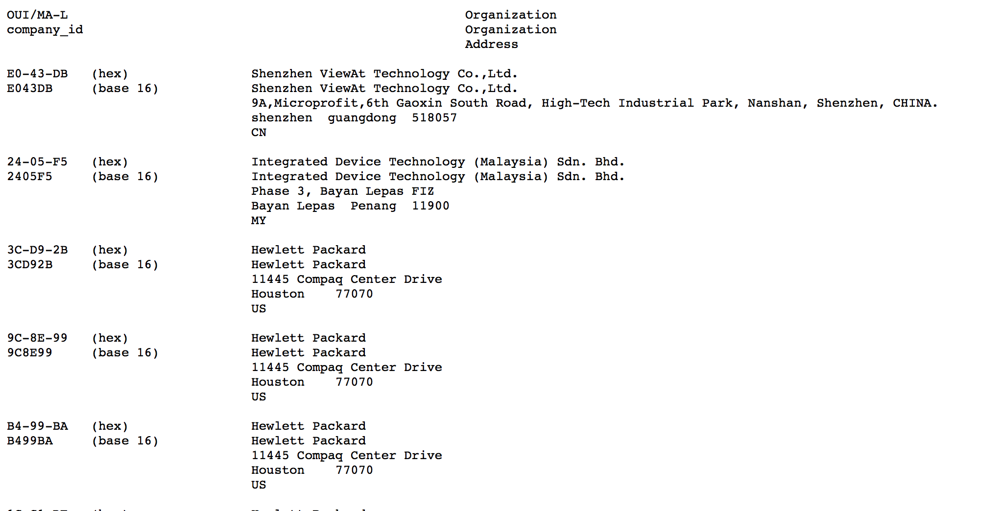
MAC Address
IEEE OUI (http://standards-oui.ieee.org/oui.txt)

Slide 4
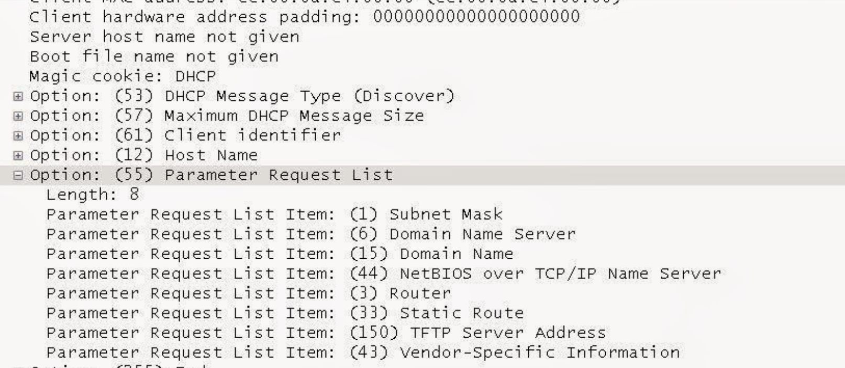
DHCP Fingerprint
Parameter request list (Discover and Request Packets from client)
Option 55:
1 – Subnet Mask
6 – Domain Name Server
15 – Domain Name
3 – Router
33 – Static Route
e.g. 1,6,15,44,3,33,150

Slide 5
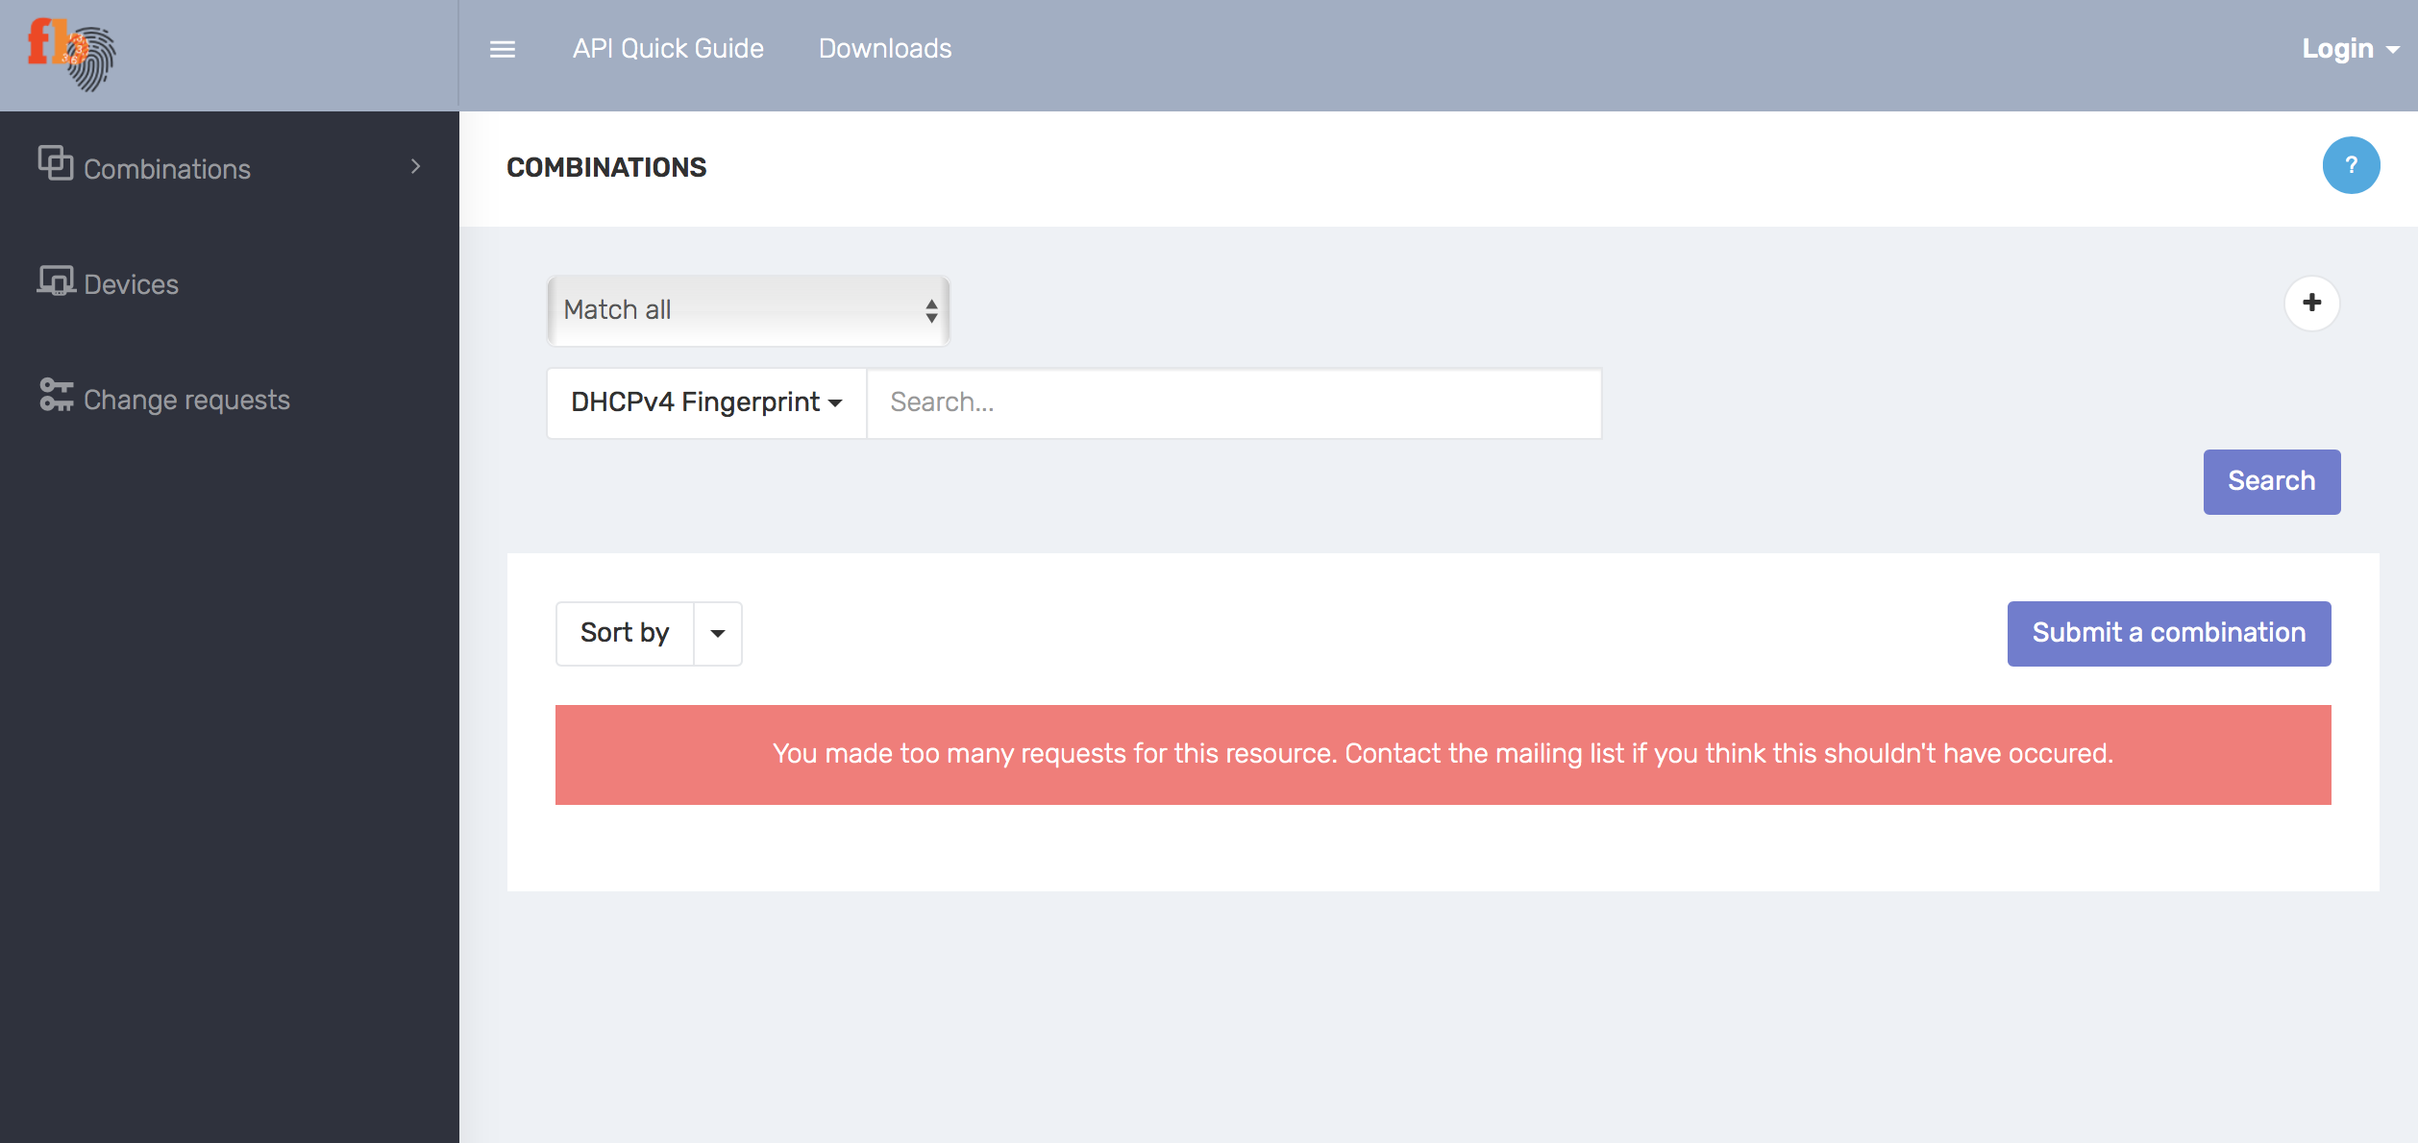
DHCP Fingerprint - Fingerbank

Slide 6
MAC Sublayer Management Entity (MLME)
Types of MLME frames
QoS Data Frames,
Acknowledgement frames,
Request-to-send frames,
Clear-to-send frames
Probe Request
Probe Response
Association frames
Set of Fixed Parameters
Tagged parameters (Required and optional)
optional fields implemented as Type-­Length-­Value tuples

Slide 7
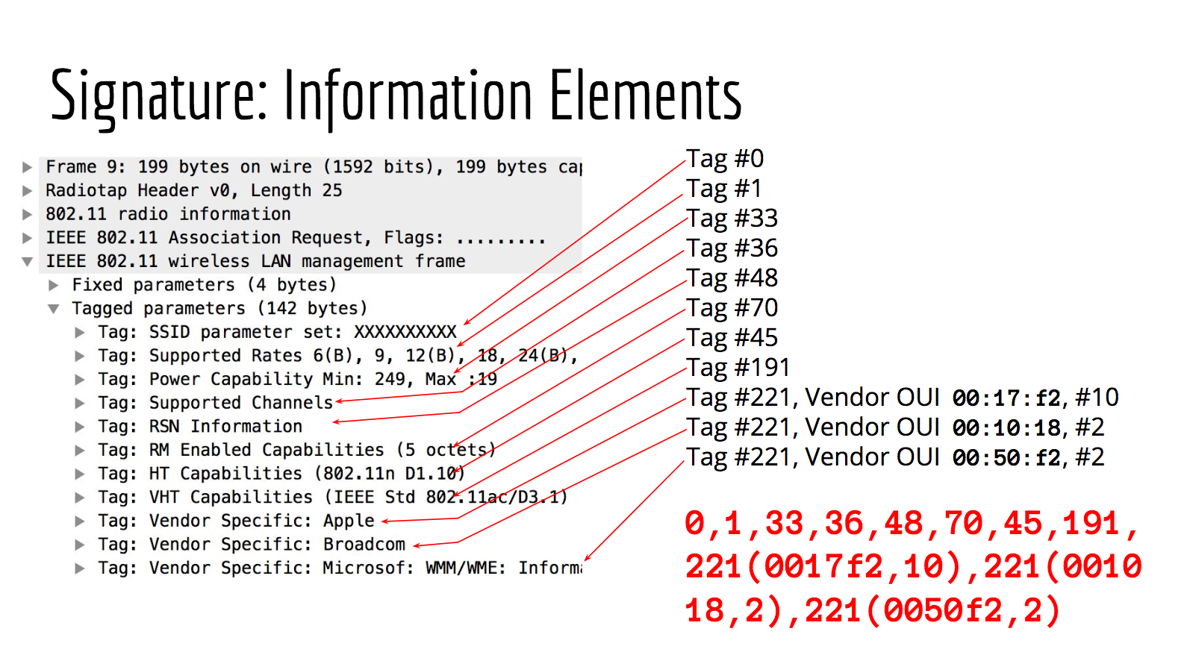
https://media.defcon.org/DEF%20CON%2025/DEF%20CON%2025%20presentations/DEFCON-25-Denton-Gentry-I-Know-What-You-Are-By-The-Smell-Of-Your-Wifi-UPDATED.pdf

Slide 8
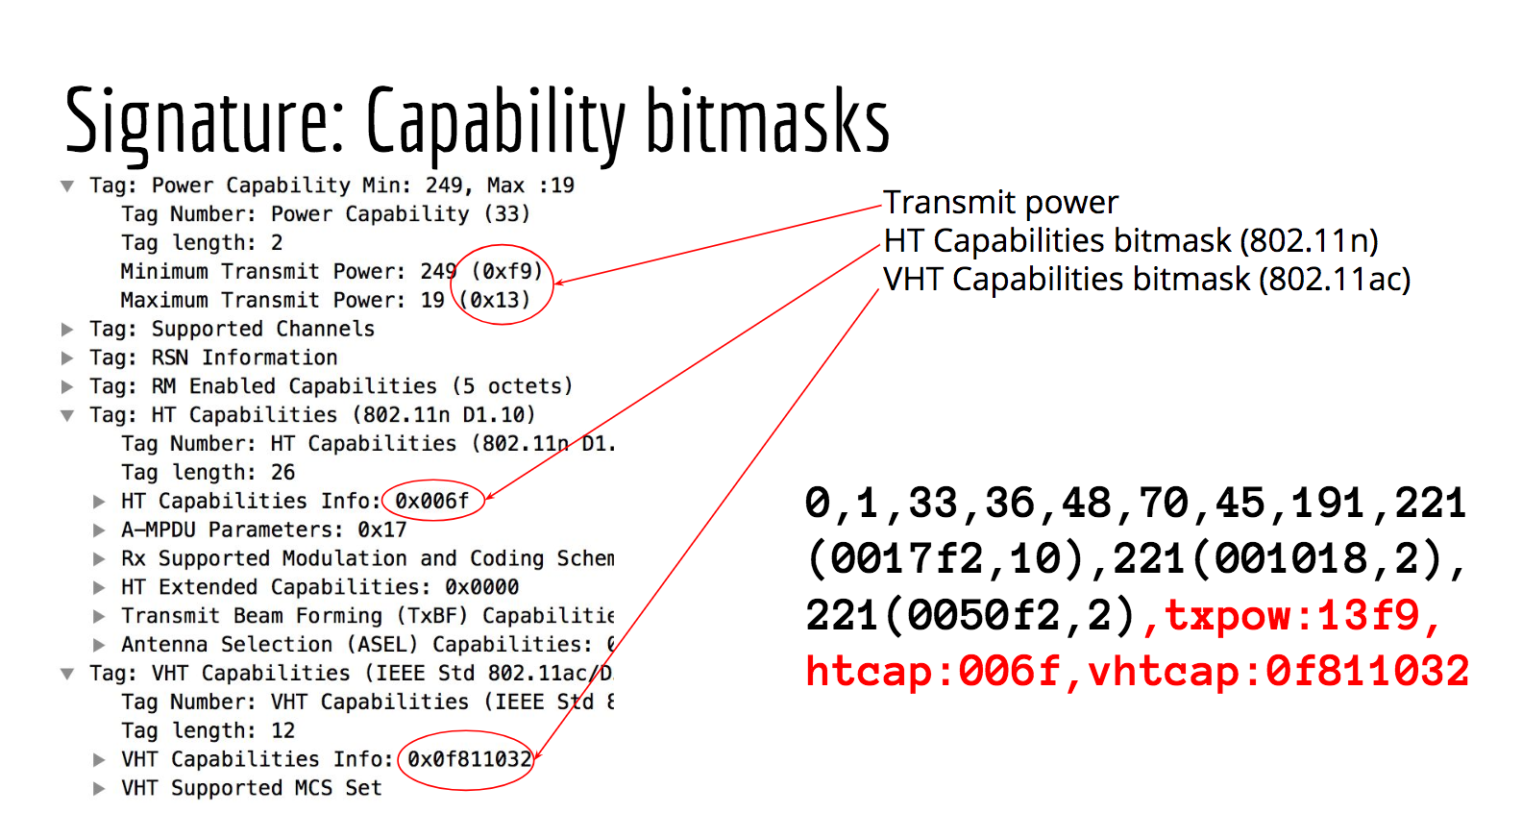
https://media.defcon.org/DEF%20CON%2025/DEF%20CON%2025%20presentations/DEFCON-25-Denton-Gentry-I-Know-What-You-Are-By-The-Smell-Of-Your-Wifi-UPDATED.pdf

Slide 9
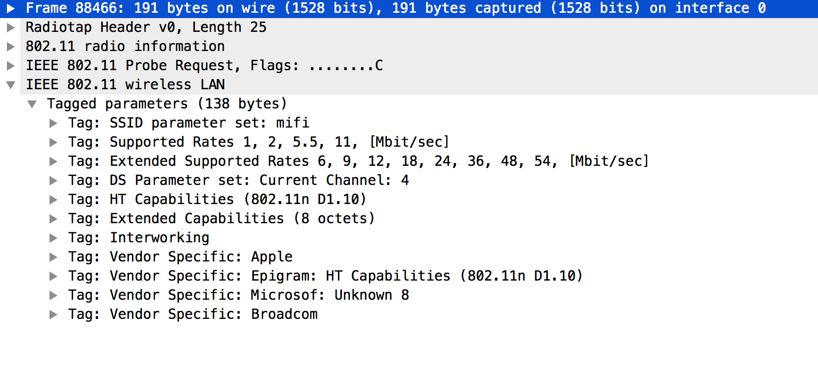
MLME – Probe Request Frame
iPhone SE
wifi4|probe:0,1,50,3,45,127,107,221(0017f2,10),221(0050f2,8),221(001018,2),htcap:4021,htagg:17,htmcs:000000ff,extcap:0400088400000040|assoc:0,1,50,33,36,127,221(0017f2,10),221(001018,2),txpow:1402,extcap:0000000000000040

Slide 10
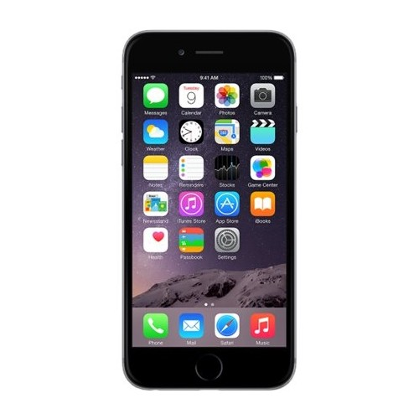

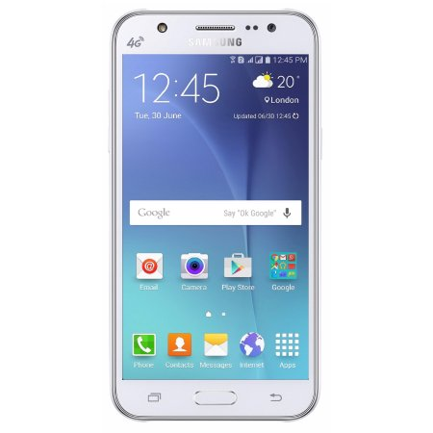


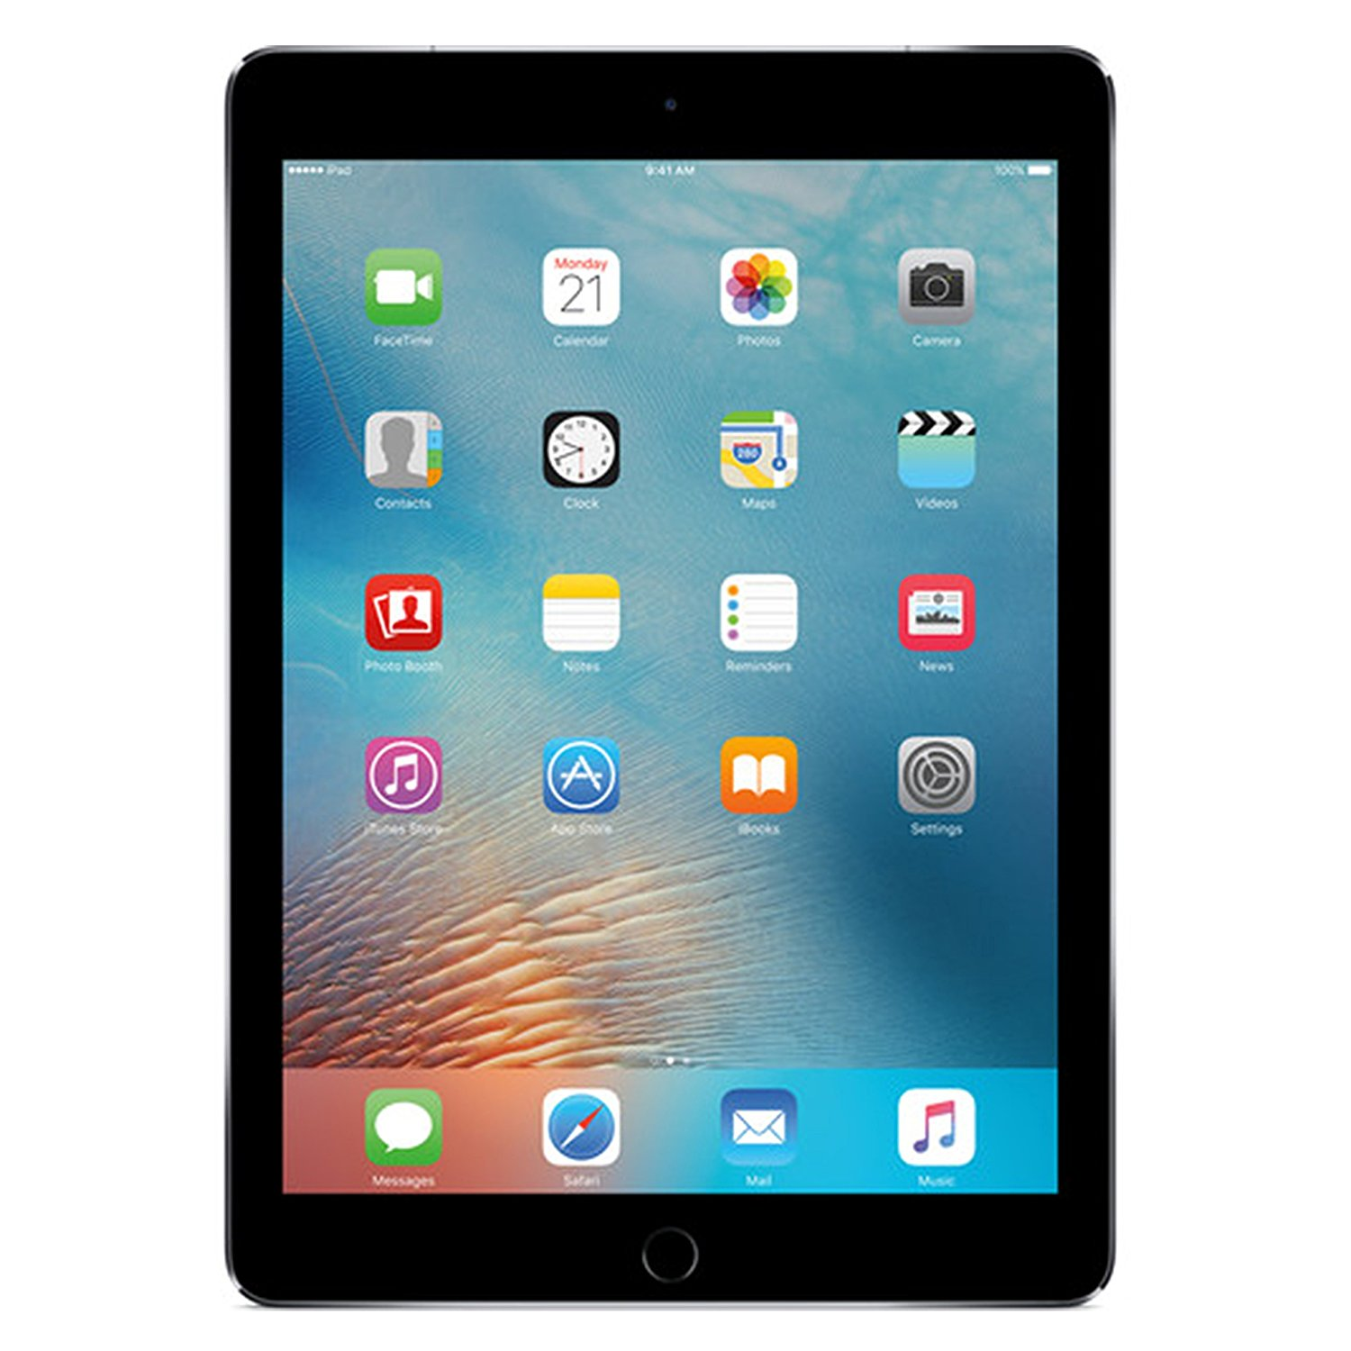
Setup

Slide 11
Applications
Link quality management for access points
Intrusion detection
Enterprise BYOD management

Slide 12
References
Passive Taxonomy of Wifi Clients using MLME Frame Contents. Google, Inc., 2016.
DEF CON 25 Conference - Denton Gentry - I Know What You Are By the Smell of Your Wi-Fi https://www.youtube.com/watch?v=n_gSJkswdhU
https://github.com/NetworkDeviceTaxonomy/wifi_taxonomy

Slide 13
Thank you!
Questions??

