Slide 1
Analyzing the Effects of Twitter Sentiments on Stock Prices
Group 10
Avinash Bobbala, Gauthami Aithal, Shashikiran Peddireddy, Swapnil Sethi, Ujas Shah

Slide 2
Dataset creation details
Fetched daily tweets using a python library called “Tweepy” which streamed Tweets from their official API
Incorporated Kaggle dataset with company relevant tweets from 2015 - 2020
Collected Stock prices from “Yahoo Finance library” for the same time period to aid historical data analysis and stock price/trend prediction.
Did some preliminary data cleaning like duplicate, special chars, URL removal, handling missing values
To ensure that we have quality data we filtered out the tweets based on tags like verified, hashtags, search_query and retweets
Finally stored/consolidated the data from different sources on PostgreSQL DB for further analysis.

Slide 3
Dataset Creation Flowchart
Sentiment Analysis + Stock Price Prediction
Database
(PostgreSQL)
Consolidate & Clean
Tweets Kaggle Dataset
(Kaggle)
Daily tweets
(Twitter API)
Stock Prices
(Yahoo Finances)

Slide 4
Model - TextBlob
Uses Natural Language ToolKit(NLTK)
Supports complex analysis and operations on textual Data
Calculates Polarity and Subjectivity of a sentence
Polarity lies between [-1,1] and Subjectivity lies between [0,1]
Accuracy: 0.508
For example: We calculated polarity and subjectivity for “I do not like this example at all, it is too boring”. For this particular example, polarity = -1 and subjectivity is 1, which is fair.
However, for the sentence “This was a helpful example but I would prefer another one”. It returns 0.0 for both subjectivity and polarity which is not the finest answer we’d expect.

Slide 5
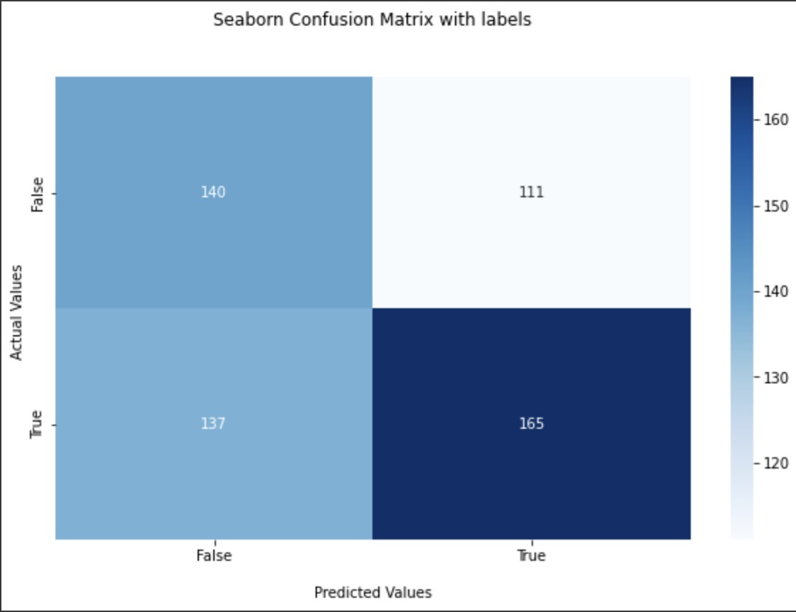
Model - VADER
VADER (Valence Aware Dictionary for sEntiment Reasoning) is a model used for text sentiment analysis that is sensitive to both polarity (positive/negative) and intensity (strength) of emotion
Lexical approaches look at the sentiment category or score of each word in the sentence and decide what the sentiment category or score of the whole sentence is
The main advantage of lexical approach lies in the fact that we do not need to train a model using labeled data, since we have everything we need to assess the sentiment of sentences in the dictionary of emotions
Accuracy: 0.553
Notes:
Advantages of VADER:
It does not require any training data.
It can very well understand the sentiment of a text containing emoticons, slangs, conjunctions, capital words, punctuations and much more.
It works excellent on social media text.
VADER can work with multiple domains.

Slide 6
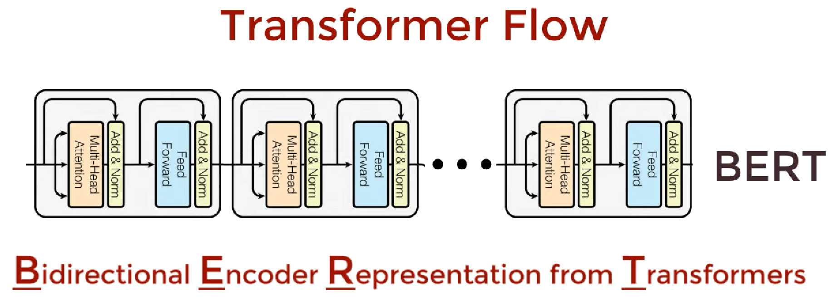
Model - roBERTa
Problems that can be solved by BERT
Neural Machine Translation
Question Answering
Text Summarization
Sentiment Analysis
Notes:
Some features that roBERTa uses to improve upon BERT are:
training the model longer, with bigger batches, over more data
removing the next sentence prediction objective;
training on longer sequences
dynamically changing the masking pattern applied to the training data

Slide 7
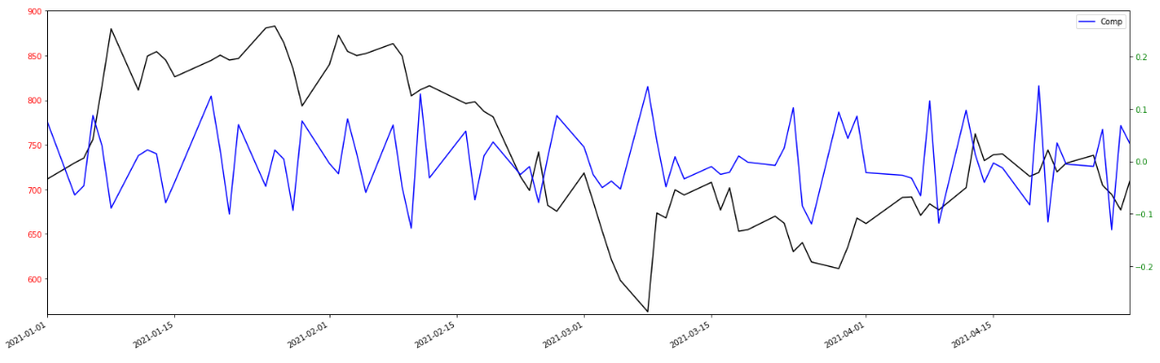
Model - roBERTa
Roberta is language model developed by Meta that improves on Bidirectional Encoder Representations from Transformers, or BERT, the self-supervised method released by Google in 2018
BERT is a revolutionary technique that achieved state-of-the-art results on a range of NLP tasks while relying on unannotated text drawn from the web, as opposed to a language corpus that’s been labeled specifically for a given task
RoBERTa builds on BERT’s language masking strategy, wherein the system learns to predict intentionally hidden sections of text within otherwise unannotated language examples
Accuracy: 0.6
Notes:
Some features that roBERTa uses to improve upon BERT are:
training the model longer, with bigger batches, over more data
removing the next sentence prediction objective;
training on longer sequences
dynamically changing the masking pattern applied to the training data

Slide 8
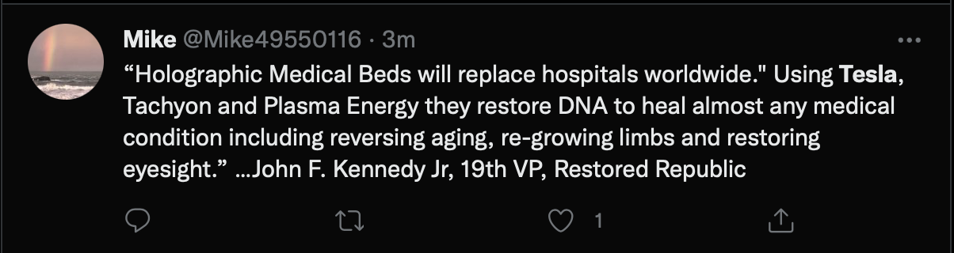
About our results –>
More time can be spent fine tuning the hyper-parameters of roBERTa to get better results
However, there is a ceiling on our results
Stock movements are inherently stochastic
We couldn’t manually label the tweets ourselves and train a model
Pre-trained models were not specifically trained for tweets with a financial focus
Only 5000 tweets a day were collect
Furthermore a lot of tweets in our scrapings were tweets that were completely unrelated to our aim
Notes:
Stock movements are inherently stochastic and hence predicting them is tough
We couldn’t manually label the tweets ourselves and train a model, in part owing to the expertise and the compute power required for it. And hence had to rely on more generalised models to extract sentiment
Pre-trained models were not specifically trained for tweets with a financial focus
Only 5000 tweets a day were collected, which is a fraction of the total number of our target tweets, skewing the sentiment
Furthermore a lot of tweets in our scrapings were tweets that were completely unrelated to our aim, but these tweets couldn’t be filtered out as that would have to be manually done.

Slide 9
Future Scope
We have investigated the relation between public mood as measured from a large scale collection of tweets from twitter and the Stock market values. Our results show that public mood can be moderately captured from the large-scale Twitter feeds by the means of natural language processing techniques employed in this project.
Future work regarding this study would include using the model on different stock markets across the world. Furthermore, using a data range of more than 10 years may provide more accurate results. Additionally, analyzing the models in different economic situations such as booms or recession may allow us to better see the productivity of the models.
Extracted sentiments may be biased because not all the people who trade in stocks share their opinions on twitter. Stocktwits is a financial communication platform designed solely for sharing ideas and insights of investors, entrepreneurs and traders. The current study can be extended by incorporating stocktwits data.

Slide 10
Back Stage
Which part is most difficult?
Which part is most interesting?
If we could start it over, what would we modify?
What is the most valuable thing we learned from conducting the project?
Notes:
Part 2: Back stage (2 minutes)

Slide 11
About us!
Avinash Bobbala - TextBlob modelling and the presentation
Gauthami Aithal - Data collection
Shashikiran Peddireddy - roBERTa and presentation
Swapnil Sethi - ETL processes, data cleaning, VADER modelling
Ujas Shah - Modelling and presentation
Notes:
Part 3: Authors (2 minutes)
Who you are? and what is your role in the project?
What are your expertise? Why should people invite you for the next project?

