Slide 1


Slide 2
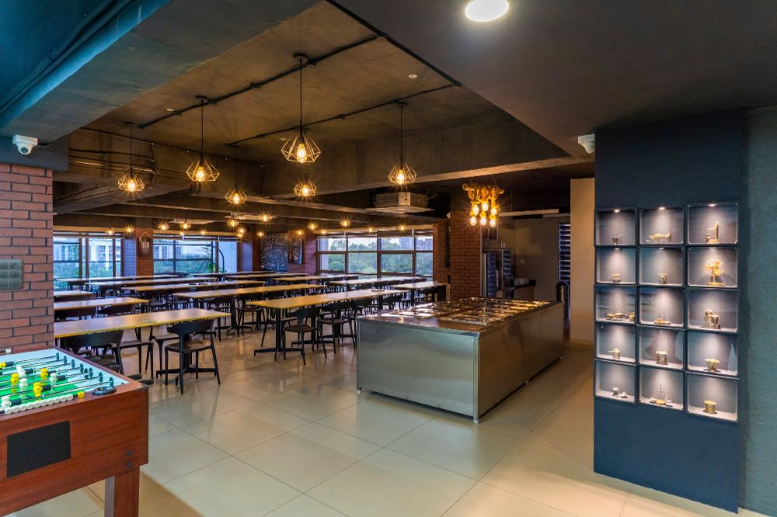
Mission statement
To make lunch service, easy and readily accessible for all the Simform employees by lowering the waiting time and showing the approximate number of people having lunch in real-time.

Slide 3





Key Problem
Longer waiting time
Space availability
Plate counting
Advance booking
Feedback

Slide 4
Solution
We will be providing a management application where employees can access the application to make lunch service easy and readily accessible for all the Simform employees.
Most importantly, we will not only reduce the waiting time but also show an exact number of people having lunch in real-time at the present day.

Slide 5




Features
For user
Available count and live count
Lunch menu
Starting time of lunch
Advance booking
For canteen
Automatic counting
Live status of people

Slide 6



Tech-stack
Frontend Technologies – Flutter
Backend Technologies – Python
DevOps- Heroku server

Slide 7






Competitors

Slide 8
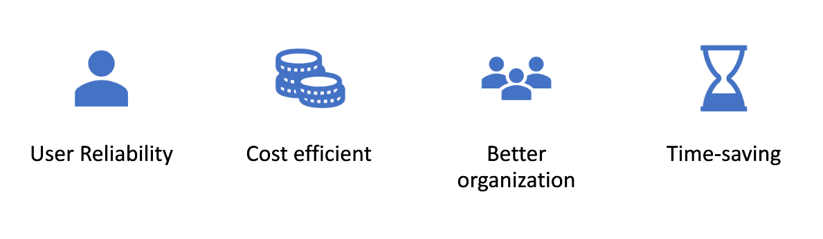
Uniqueness

Slide 9
Why Us ?
We add development capacity to tech teams. Our value isn’t limited to building teams but is equally distributed across the project lifecycle. We are a custom software development company that guarantees the successful delivery of your project.

Slide 10
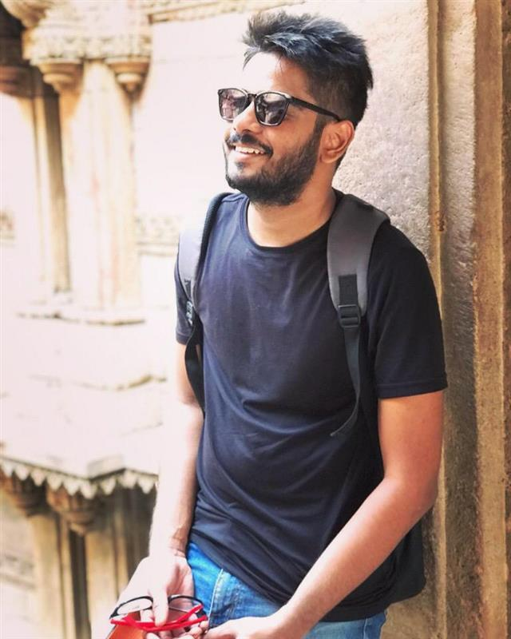
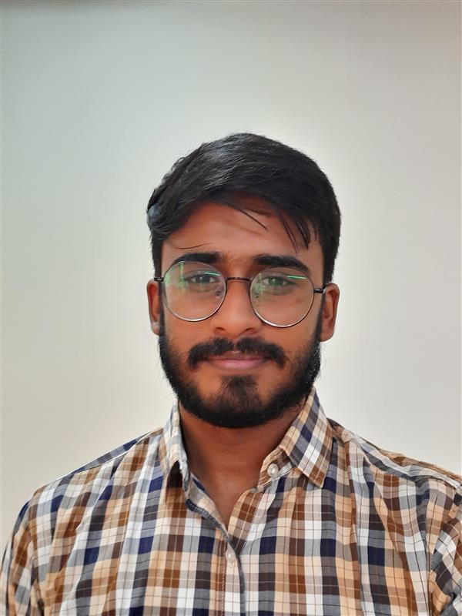
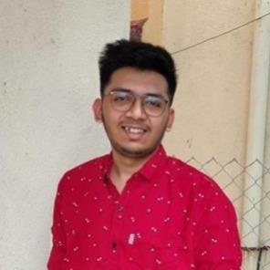
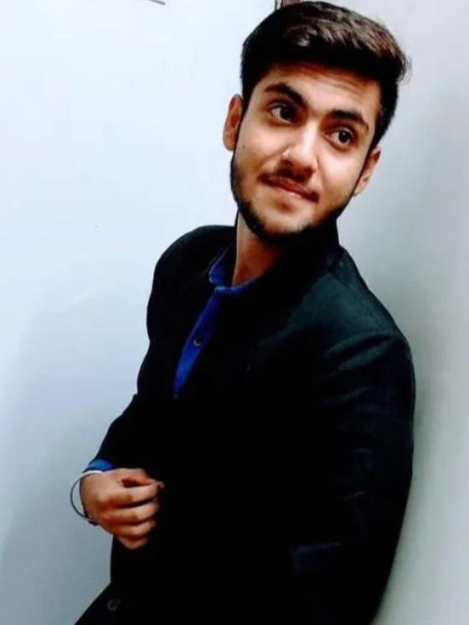

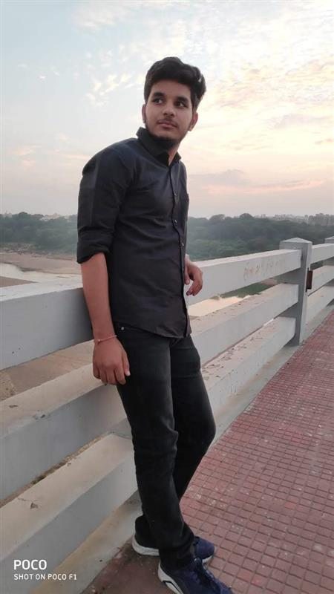
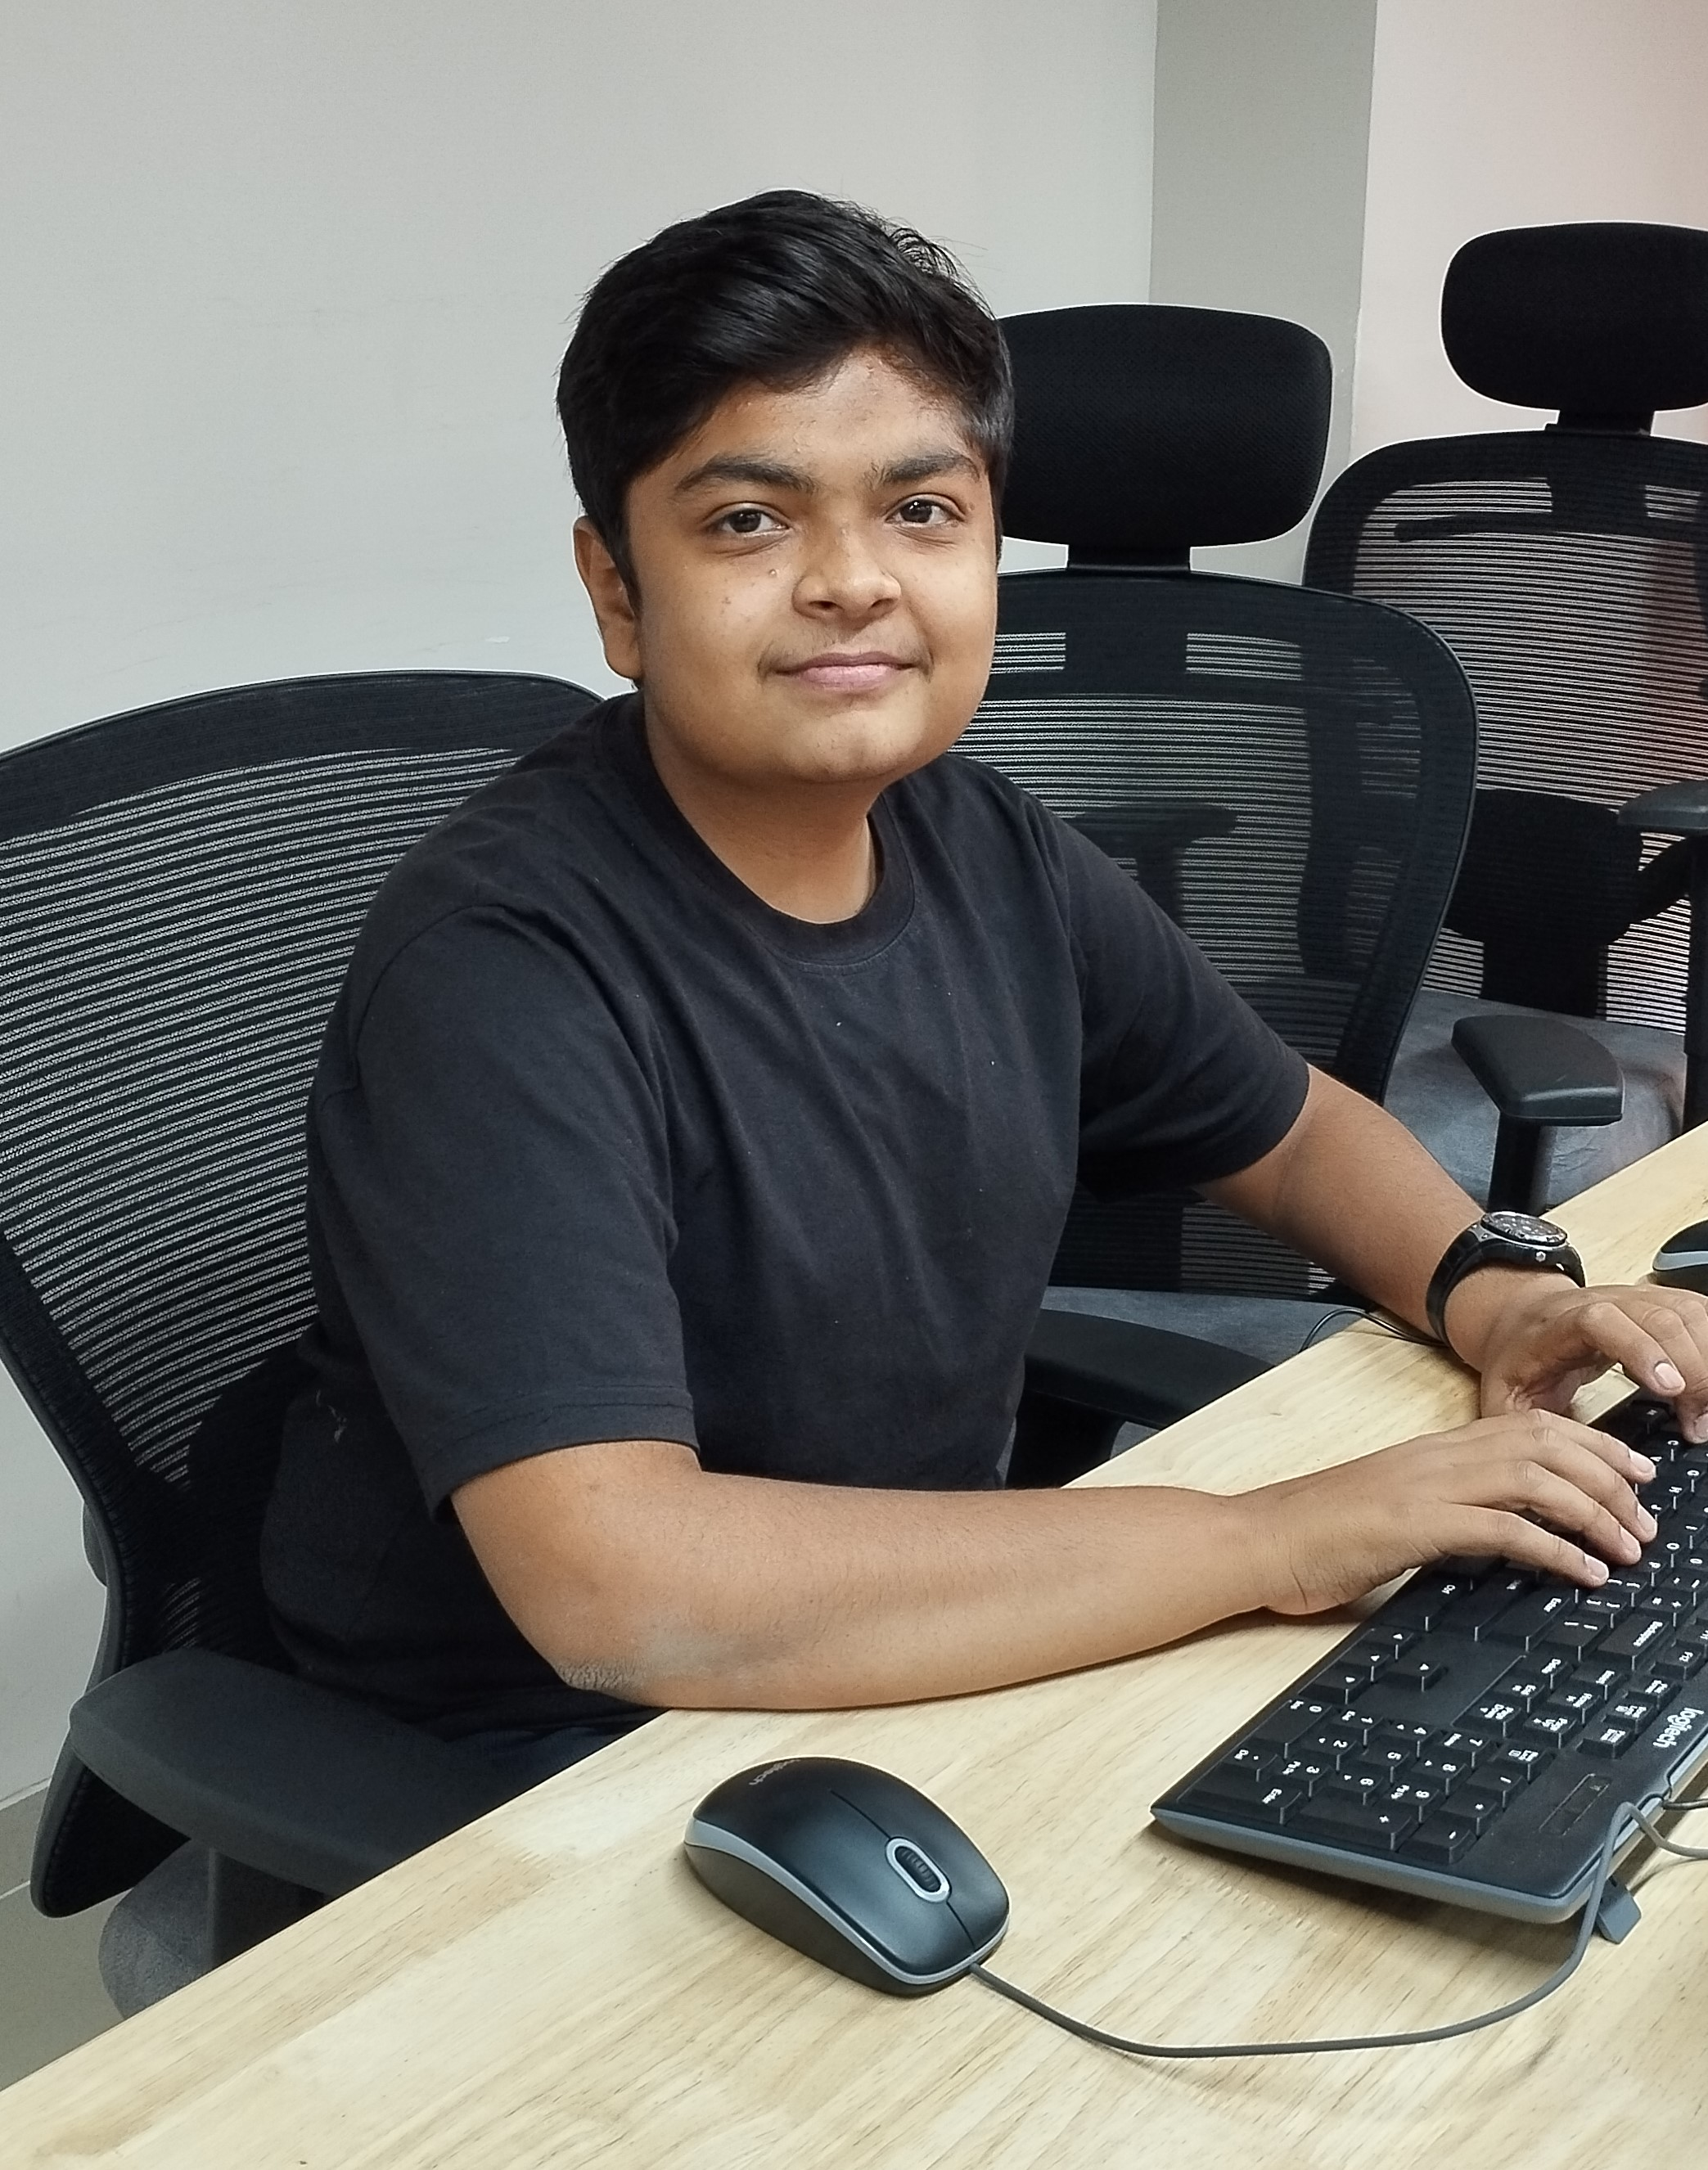
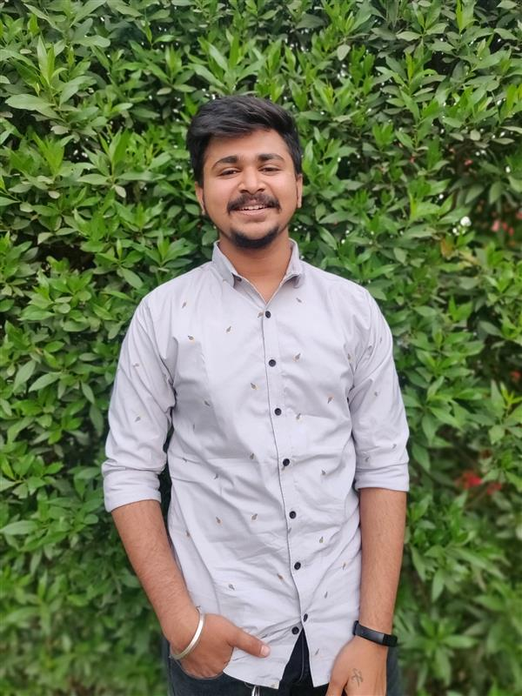
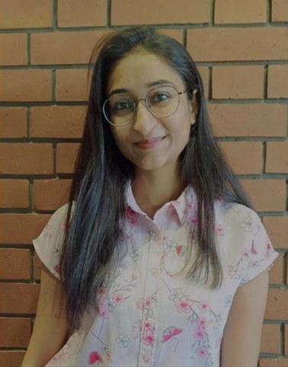
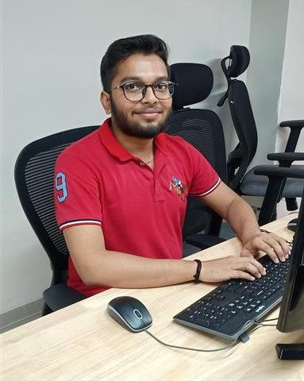
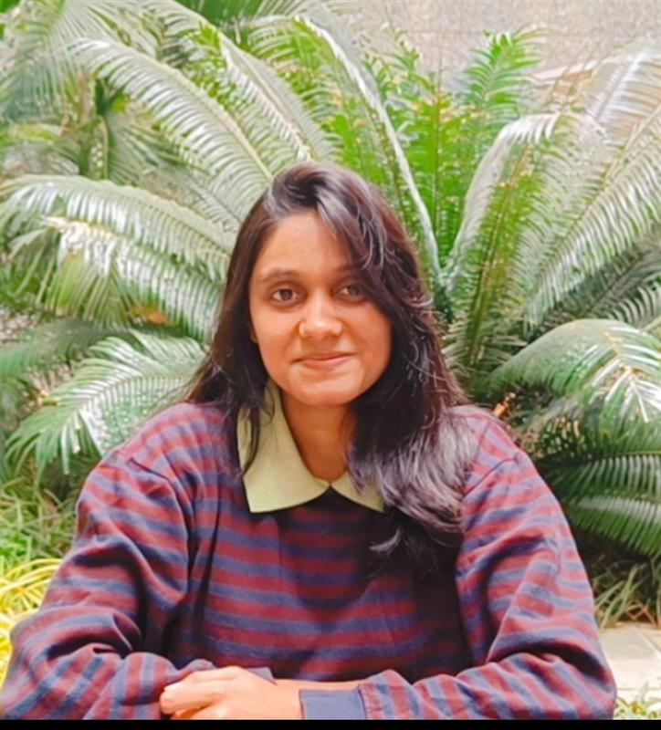
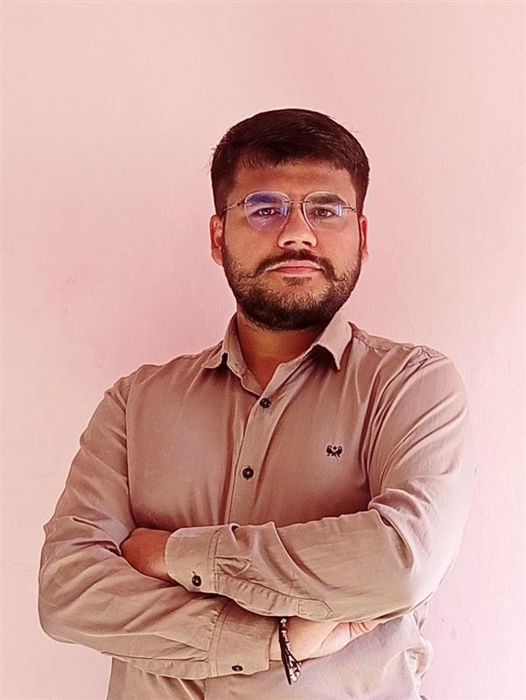
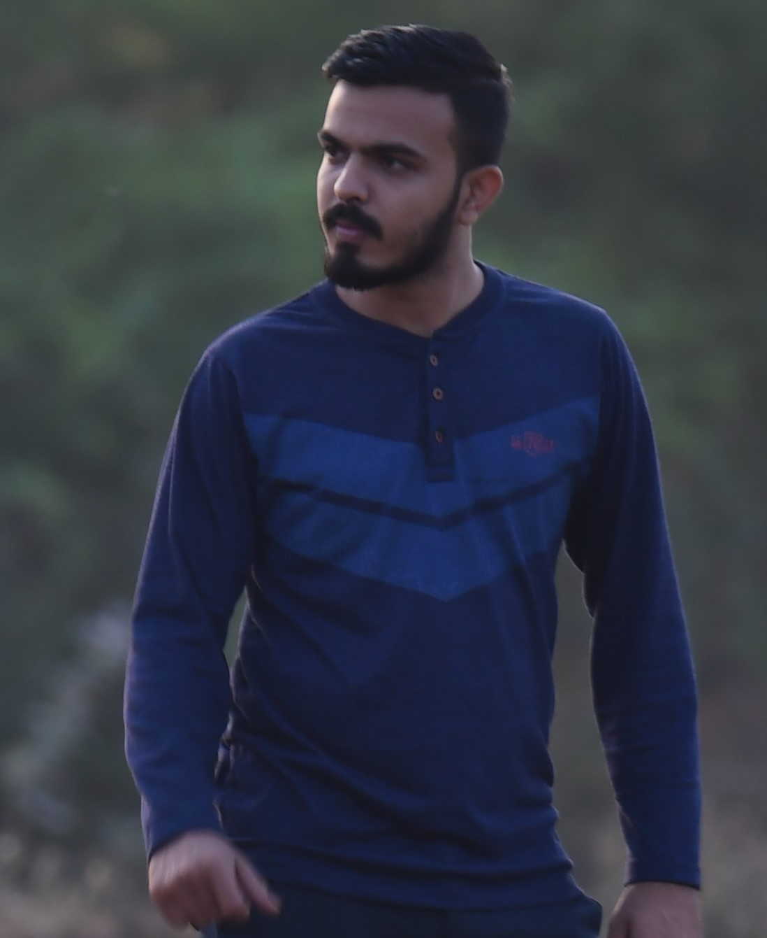
Our Team
Swapnil Shah
Flutter
Kavan Trivedi
Flutter
Jaimin Rana
Flutter
Jatin Tolwani
Flutter
Sakshi Soni
Quality Assurance
Sunny Yadav
Python
Yash Vinda
Python
Kuldep Patel
Python
Prachi Acharya
Python
Siddharth Asodariya
Python
Tanvi Rupareliya
Python
Jay Hareshna
Devops
Jashraj Joshi
Business Analyst

Slide 11
Thank You

