Slide 1

Amazon Web Services
Under the guidance of:
Sumit Sah
Name: Swapnilshikha Bhakat
Branch: Computer Science
and Engineering
SIC. No. : 22BCSE87
SEMESTER: 3rd semester

Slide 2
INTRODUCTION
What is Cloud Computing ?
Cloud computing is the on-demand availability of computer system resources, especially data storage and computing power, without direct active management by the user.
What is Amazon Web Services ?
AWS is the Amazon’s cloud computing platform that is widely used by organizations of every type, size, and industry to manage functionalities such as data backup, virtual desktops, software development and customer-facing web applications.
It offers a wide range of cloud services, and gives freedom to build, manage and deploy applications on a massive global network.

Slide 3
OBJECTIVES
To understand the basic concepts of Cloud Computing.
Getting hands-on experience with cloud service platforms that would provide practical experience on the topics.
Traverse through various services offered by Amazon Web Services like Amazon EC2 (Elastic Compute Cloud) for scalable computing capacity, Amazon S3 (Simple Storage Service) for object storage, Amazon RDS (Relational Database Service) for controlled relational databases and many more.
Gaining practical knowledge of some examples of industrial scenarios, shared by industrial experts.
To be able to create and handle cloud-based infrastructure.

Slide 4

CONTENTS OF THE PROGRAM
Amazon Web Services and its basic services.
Networks and Availability Zones all over the globe.
Deployment of resources over cloud and accessing them through Internet.
Virtual hosting and Application load balancer for traffic management.
Auto-scaling applications for efficient use of the resources.
Ensuring security by adding rules to network access methods by using VPC peering and endpoints.
Deploying a web application on a fully functional cloud infrastructure.

Slide 5
METHODOLOGY
Basics of cloud computing and AWS's role in the industry.
Engaging in hands-on labs for real-time experience to reinforce theoretical knowledge.
Analyzing case studies showcasing its applications in industrial scenarios.
Encouraging participants to apply AWS skills in their own projects.
Regular assessments to gauge understanding and track progress.
Guidance on AWS certifications for future career development.
Connecting with a community of AWS learners and sharing experiences and insights.
Collecting feedback for course improvement and offering real-time support during the course.

Slide 6
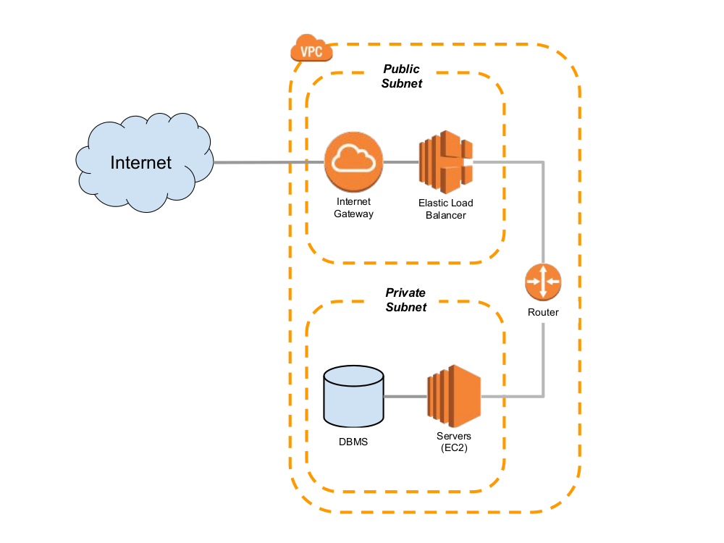
Projects Done
The task was given to create a VPC (Virtual Private Cloud) which contained two subnets, which was - Public and Private subnet.
The public subnet contained web servers (minimum 2) and the private subnet contained data-base server installed with any latest version of MySQL.
The public subnet should be configured with Load Balancer (including domain name and SSL certificate) and should be mapped Route 53.
Auto-scaling should be configured with the server in public subnet. Open VPN set-up should also be done here.

Slide 7
CONCLUSION
This AWS internship course marks a significant milestone in one’s professional journey. The completion of this course is a commendable achievement that signifies not only the acquisition of technical knowledge but also the development of skills required in IT companies.
The skills acquired during the course lay a solid foundation for on-going professional growth. The AWS certification earned through this course will serve as a gateway to limitless opportunities in the field of cloud computing.

