Slide 1
DDoS Attack Identification and Defense using SDN based on Entropy and SVM
Submitted by:
Swapnil Sude (116346948)
Alekhya Lingireddy (116087667)
Shubha Jain (116140126)

Slide 2
Abstract
Software-defined networking(SDN) architectural framework eases the work of the n/w administrators by separating the data plane from the control plane.
It supports a programmable interface for applications development related to security, management etc. and the centralized logical controller provides more control over the total network, which has complete network visibility.
Due to the centralized nature of SDN i.e. the controller at the center of SDN taking the logical decisions, there arises a threat of malicious users launching cyber attacks on this central component thereby, dislodging the entire network. Some attacks include Application level attacks, Brute Force attack, man in the middle attacks, DDoS attack etc.

Slide 3
Introduction
Consider, a centralized virtual server running as a controller, which installs and manages the flows in data plane through OpenFlow communication protocol. The use of OpenFlow makes the controller a primary victim for the attacker because of the following reasons:
There is no standard for security implementation and developers of products are implementing their own proprietary methods.
The programmable aspect also makes them much more vulnerable to malicious attacks and code exploits.
The southbound interface can be targeted with denial of service and side channel attacks.

Slide 4
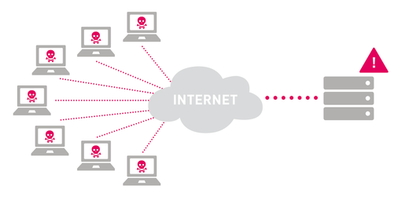
What is DDoS Attack?
Distributed Denial of Service attack is a malicious attempt launched from multiple connected devices simultaneously, from different parts of the Internet.
All of these devices attack a single target at the same time, usually with the goal of generating so much traffic that bandwidth to the target is completely saturated, so that valid customer traffic doesn't get through.

Slide 5
Types of DDoS
UDP Flood: The attacker ﬂoods the random ports on a remote host with numerous UDP packets which causes the host to repeatedly check for the application listening at that port and when no application is found, reply with ICMP Destination unreachable packet. This exhausts the resources of the victim and can lead to inaccessibility.
ICMP Flood: A huge amount of ping requests are sent by the attacker to the remote machine continuously without even waiting or bothering about the ICMP reply messages. Because of this the remote machine gets involved in sending the reply messages for the requests received which can exhaust its resources.
SYN Flood: This attack exploits the weakness of TCP three way handshake mechanism. In this attack multiple SYN-request messages are sent to the host, usually with spoofed IP address which causes the host to send multiple SYN-ACK responses. But the ﬁnal ACK response is not sent by the requester and the host resources are utilized since it is waiting for a response. Also the maximum number of simultaneous connections that can be made is reached causing a denial of service.
HTTP Flood: The attacker exploits HTTP GET or POST requests to attack a web server or application. HTTP ﬂoods do not use malformed packets, spooﬁng or reﬂection techniques, and require less bandwidth than other attacks to bring down the targeted site or server.

Slide 6
Detection Methods
ENTROPY
MACHINE LEARNING METHODS(SUPPORT VECTOR MACHINE)

Slide 7
Entropy
The entropy detection method is mainly used to calculate the distribution randomness of some attributes in the network packets’ headers.
These attributes could be the packet’s source IP address, TTL value, or some other values indicating the packet’s properties.
The bigger the entropy, more random the source IP is. The smaller the entropy, the narrower the distribution range of packet’s source addresses is, and some addresses have quite high emergence probability.

Slide 8
Why Entropy for DDoS detection?
Entropy based discretization is a lightweight DDoS attack detection module, which will be running on the edge switches to reduce the ﬂow collection overhead to the controller.
Here, ﬁrst we initialize λ i.e., threshold entropy and ∆T i.e., time interval.
For each ∆T we will calculate entropy of network and compare it with the threshold entropy to conclude whether the trafﬁc is normal trafﬁc or attack trafﬁc.
If the trafﬁc is normal trafﬁc then we will update the threshold entropy and next time when the ∆T is over, we will use this updated threshold entropy.
To calculate the entropy of network we will take ﬂow entries from switches where the module will be running. The efﬁciency will depends on the ∆T. As ∆T decreases the efﬁciency will increase but decrease in ∆T will cause an increase in calculation overhead.
Thus, by appropriately setting the value of ∆T, the accuracy of DDoS detection can be signiﬁcantly increased.
The main reason for considering entropy is its ability for measuring randomness in a network. The higher the randomness the higher is the entropy and vice versa. So, whenever the entropy is less than a threshold value we can say that a DDoS attack is occurred.

Slide 9
Support Vector Machine
A Support Vector Machine is a Supervised Algorithm used for classiﬁcation and regression.
From a set of Training Data points, the SVM model represents them in a space, it maps them by categories and divides them by the separating Hyper-Planes.
When new Data Points arrive based on the nature of the point it categorizes the data into the clusters previously formed.
Since, SVM maximizes the classiﬁcation margin the achievable accuracy is very high.

Slide 10
Why SVM for DDoS detection?
Since detection of DDoS is a decision problem, a classiﬁer is a very good approach to do this.
Thus, we use Support Vector Machine Classiﬁer on the Flow table entries in the Software Deﬁned Network.
We will ﬁrst train the Support Vector machine based on the network scenario and environment.
Thus, the SVM will know the exact nature of the ﬂow of trafﬁc in both normal and DDoS scenarios. The advantage of the OpenFlow protocol helps to collect ﬂow information and then classify the trafﬁc into normal or attack trafﬁc.

Slide 11
Project Implementation

Slide 12
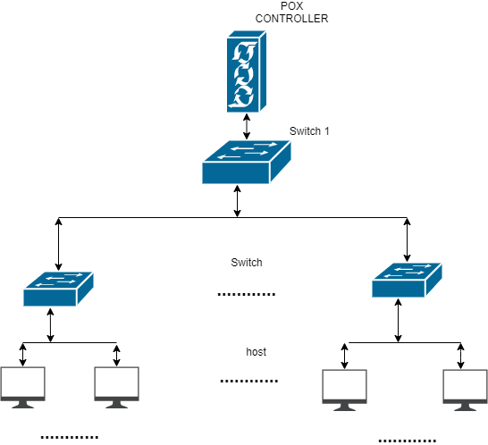
Network Topology

Slide 13
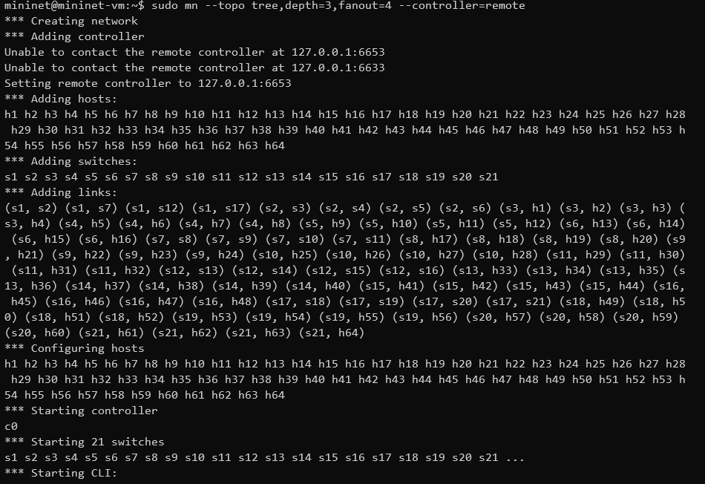

Slide 14
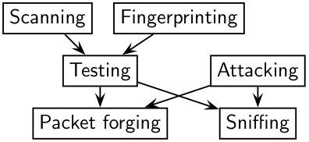
Traffic Generation
Scapy: It is a Python program that enables the user to send, sniff and dissect and forge network packets.
This capability allows construction of tools that can probe, scan or attack networks.
Scapy mainly does two things: sending packets and receiving answers. In other words, Scapy is a powerful interactive packet manipulation program. It is able to forge or decode packets of a wide number of protocols, send them on the wire, capture them, match requests and replies, and much more.

Slide 15
Modules Used
sys module of Python accesses system specific parameters and functions.
getopt module of Python helps scripts to parse the command line arguments.
os module to import Popen which fetches shell commands into python program.
Scapy module of Python imports functions such as sendp, IP, UDP, Ethernet and TCP.
random module of Python imports randrange function.
if_name_ is used to avoid the running of the main function when called from other programs.

Slide 16
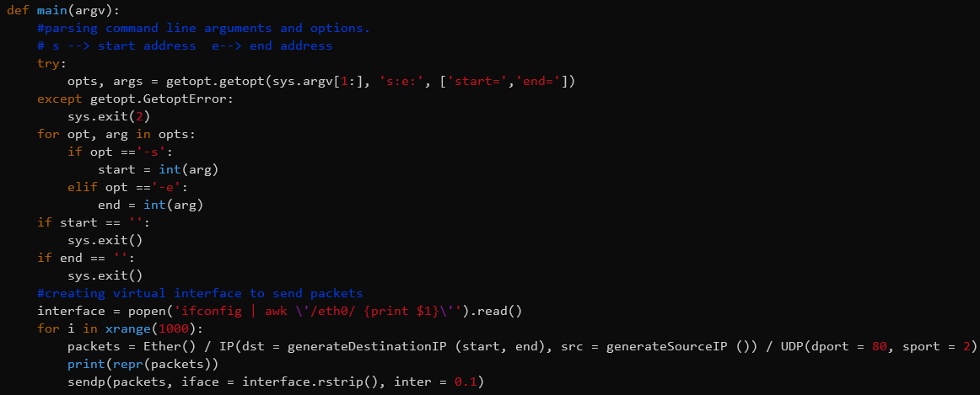
Traffic Generation Code
The launch traffic code basically, generates random source IP and send the packets to random destinations in the given range of the host IPs.

Slide 17
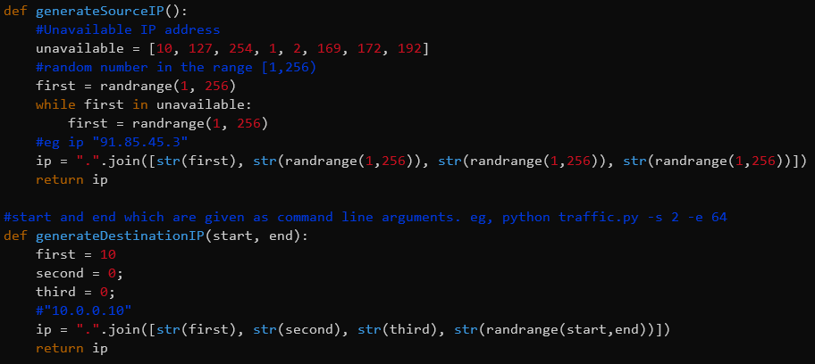

Slide 18
Code Explanation
We first initialize the start and end values of the destination hosts between which we send the packets from random source ips.
Then a parser function, fetches the start and end values from the command line interface to the python program.
Then generatedestinationIP function is used to generate destination IP addresses of the hosts based on entered start and end values.
The generatesourceIP function is used for generating random source IP addresses and we don’t use the values [1,2,10,127,169,172,192] for the first octet of IP address as they are not valid to be used regular purpose (reserved). The generatesourceIP and generatedestinationIP are linked with module pox.lib.addresses.
Then we use popen command that reads the IP address using ifconfig to open ethernet interface eth0 to send packets.
The packets created are sent out from eth0 with the help of sendp along with the destination ip and the source ip that we created using randrange function.

Slide 19
Attack Generation
While sending the attack from few selected hosts to some selected targets, the entropy value in the controller decreases.
The target ip address are sent from the command prompt of the hosts which are acting like a botnet.
The Launch Attack code is like Launch Traffic code.
The time module provides various time related functions.
The logging module helps implement logging system for applications. The logging.getlogger function suppresses all messages that have a lower level of seriousness than error messages, before importing scapy.

Slide 20
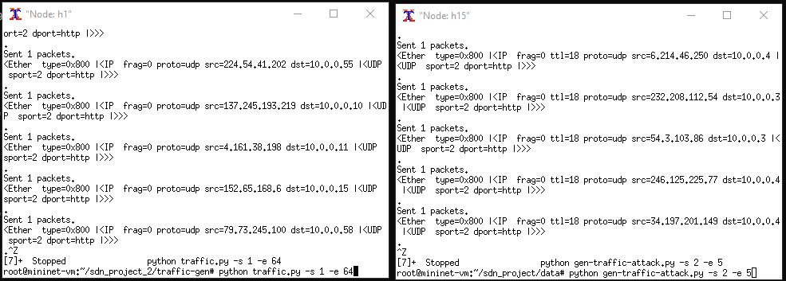
Terminal Output
Normal Traffic generation: Range: -s 1 –e 64 => 10.0.0.1 to 10.0.0.64 | Attack Traffic generation: Range: -s 2 –e5 => 10.0.0.2 to 10.0.0.5

Slide 21
Attack Detection Methods

Slide 22
Entropy Based Attack Detection

Slide 23
Modules Used
The math module is imported for performing mathematical functions such as finding log values.
The pox.core module comprises of POX’s core API and functionalities.
The core.getlogger function returns a logger, which is the root logger of the hierarchy.

Slide 24
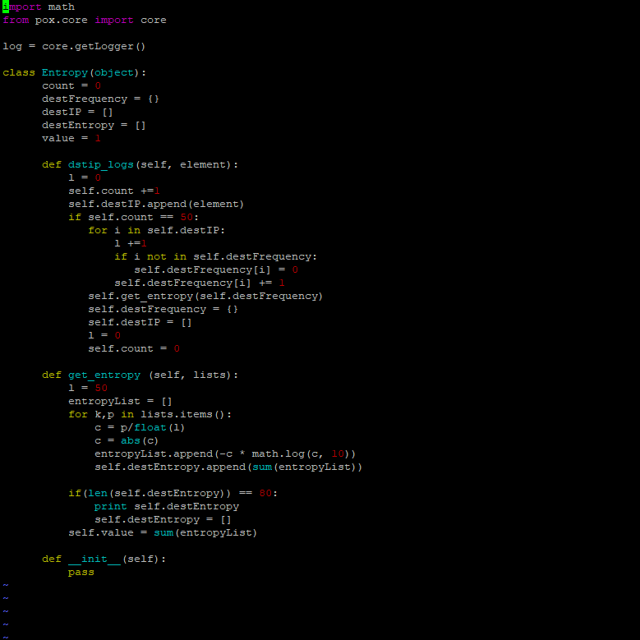
Entropy based detection code

Slide 26
Code Explanation
The destFrequency dictionary, dstIP list and destEntropy list are set as null in the Entropy class. The count and value are assigned with values as 0 and 1 respectively.
In the dstip_logs function, we collect statistics related to the detection of attack i.e entropy.
Every packet in message is collected into dstIP and count is incremented for every packet in. When the count value reaches 50, the 50 Packet_In messages would be parsed for their destination IP addresses in the hash table. If it is present in the table its value increments otherwise it is listed with 1. Entropy is calculated using this hash table values.
In the get_entropy function, the probability of destination ip occurring in the window is calculated and then the entropy by the formula
entropy H= - sum of all (pi)log(pi)

Slide 27
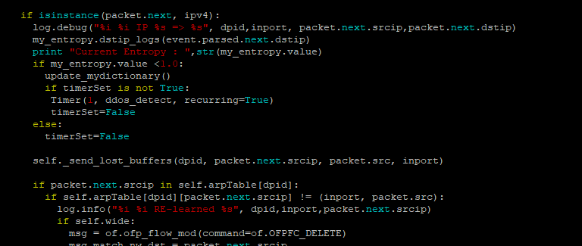
POX L3_Learning Edit

Slide 28
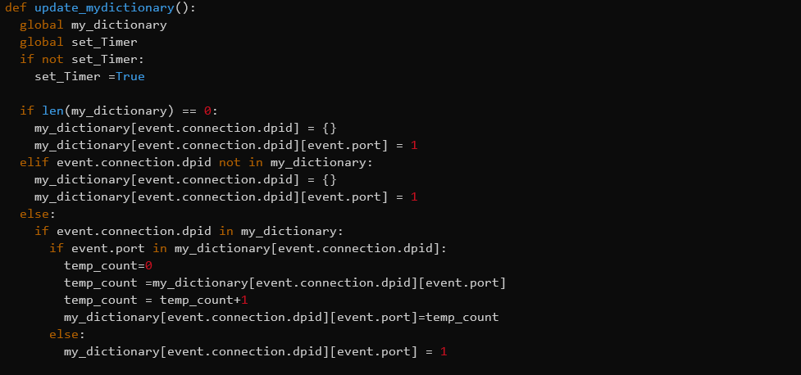

Slide 29
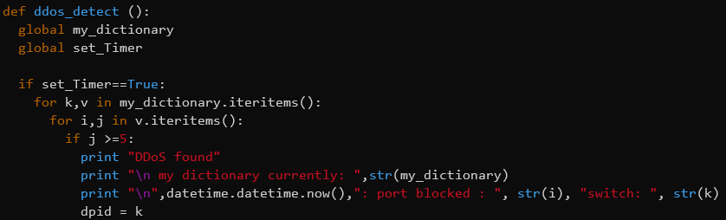

Slide 30

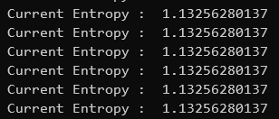
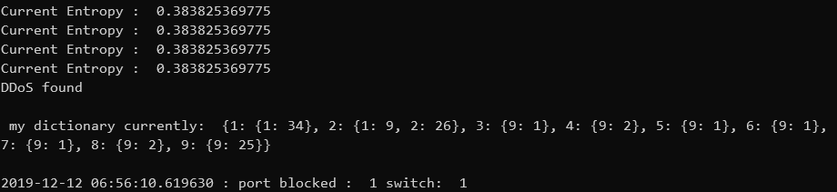
CLI Output

Slide 31
SVM based attack detection code

Slide 32
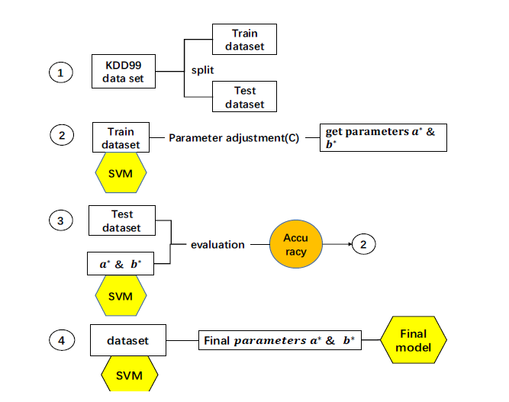
In our case, the Train data is the data we collected and processed into the attributes.
Test data is the data that we acquire real time while running the controller and generating the normal traffic and attack traffic.
We try to improve the accuracy by verifying the model with various attributes.

Slide 33
Modules Used
The time module is used to perform various time related functions.
The sklearn module is used to import the svm model for classifying.
The pox.core module comprises of POX’s core API and functionalities.
The core.getlogger function returns a logger, which is the root logger of the hierarchy.

Slide 34
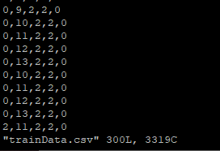
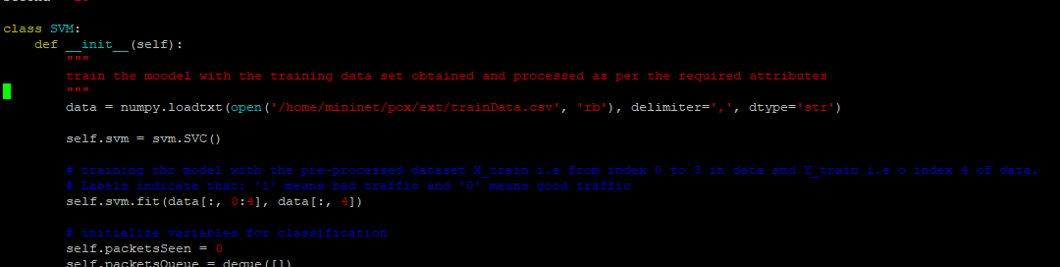
trainData.csv is the dataset of: {protocol (0 or 1 or 2), total # of packets in last second, total # of unique source IP addresses in last second, total # of unique destination IP addresses in last second} => 0(normal traffic) or 1(bad traffic)

Slide 35
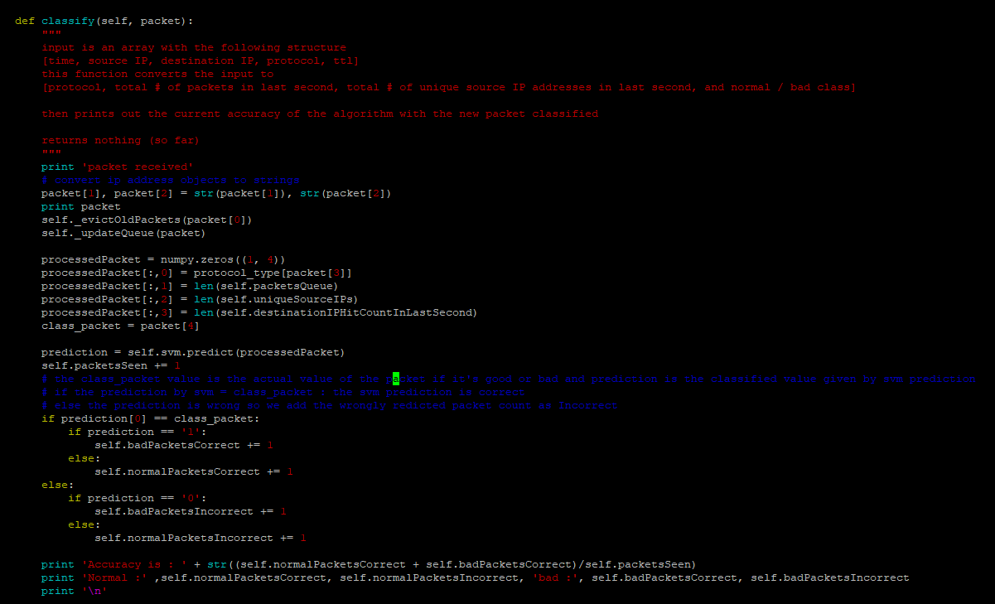

Slide 36
Code Explanation
We first train the traffic data that we collected either offline using wireshark/tshark or real-time data collected at controller to the svm model. => Supervised learning
Then we try to classify the current packet through its attributes and check if the model predicts the packet correctly by comparing the prediction value with the actual class of current Packet.
We are calculating class of Packet using the TTL value which we deliberately made it less for bad traffic and normal for good traffic for the sake of data differentiation during the training.
We are not using TTL as a classifier. The model, from current packets, only takes X_test values and tries to predict the Y_test and we verify it with the available class of packet that we obtained using the TTL.
Data: X_train data in this case will be
protocol
total # of packets in last second
total # of unique source IP addresses in last second
total # of unique destination IP addresses in last second
Labels: Y_train data will be Class of Packet = 1 if bad traffic and 0 if good traffic.

Slide 37
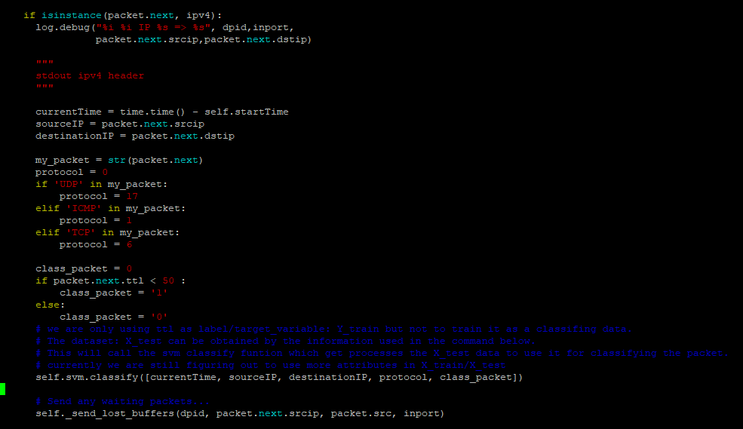
POX L3_Learning Edit

Slide 38
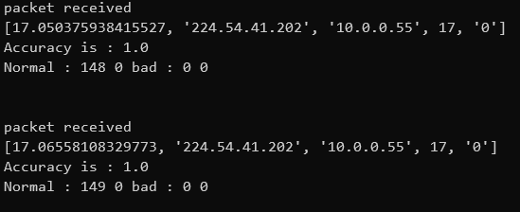
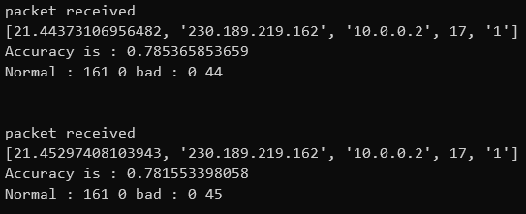
CLI Output

Slide 39
Results
DDoS Initialized
DDoS Blocked
Network_perf
Scenario:
h1 sends normal traffic
h2 and h3 attack h64

Slide 40
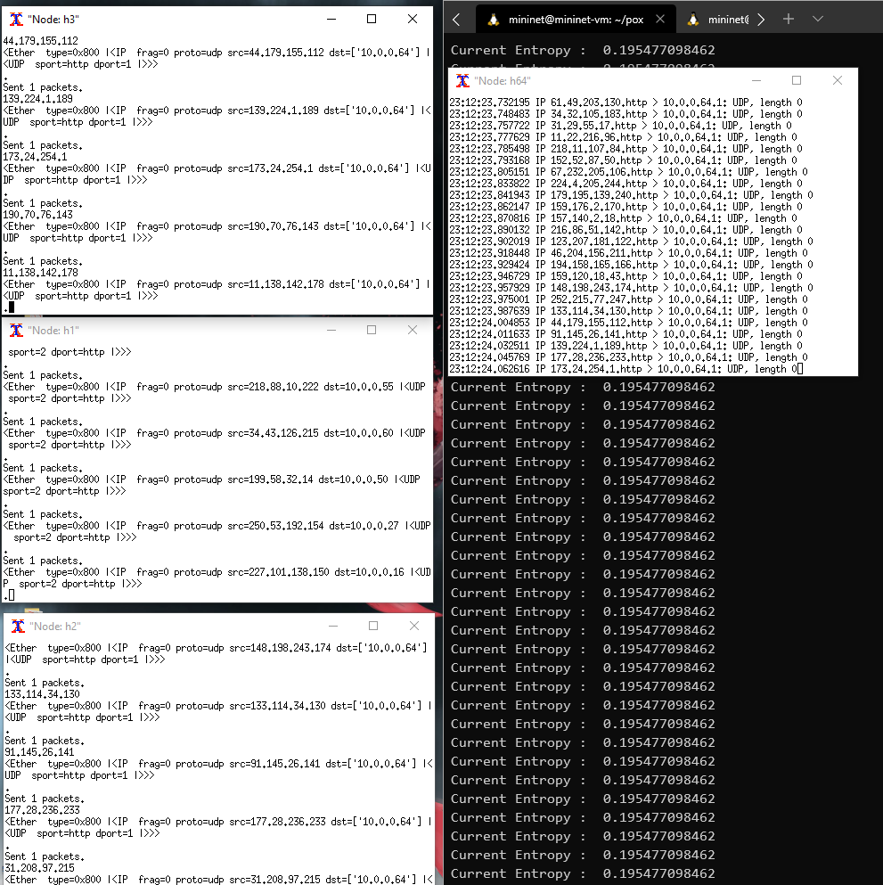
DDoS initialized:
Malicious Traffic observed in tcpdump of the targeted host.

Slide 41
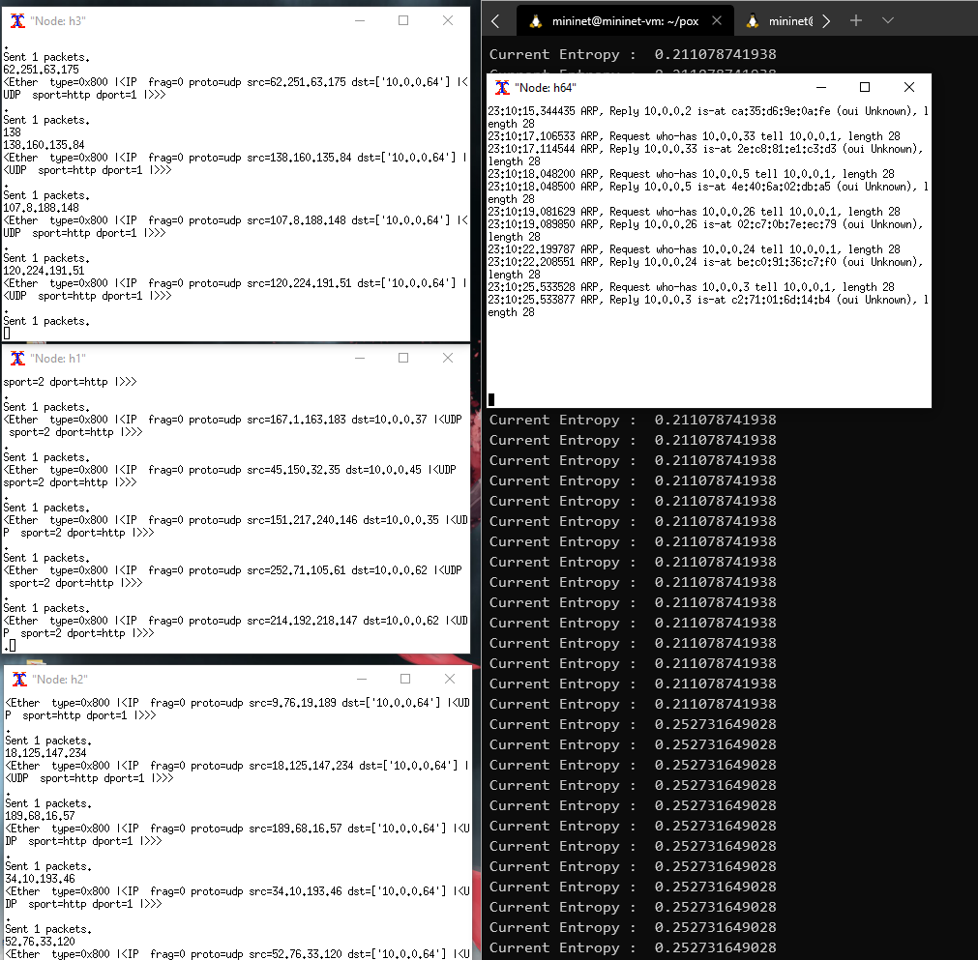
DDoS detection and mitigation:
Tcpdump shows normal traffic but not the DDoS traffic.

Slide 42
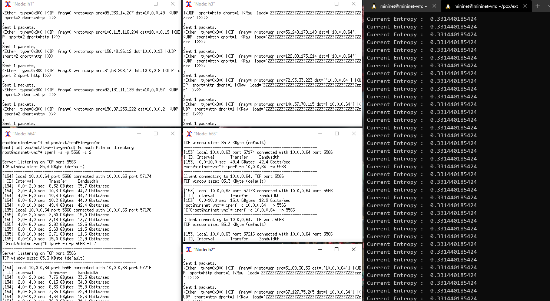
Network performance under normal traffic.
Network performance under DDoS attack.
Network performance under DDoS attack with Entropy.

Slide 43
Thank You

Slide 44
Citations:
https://ieeexplore.ieee.org/document/8636336
https://link.springer.com/chapter/10.1007/978-3-540-77048-0_35
https://openflow.stanford.edu/display/ONL/POX+Wiki.html
https://onlinelibrary.wiley.com/doi/epdf/10.1002/cpe.5402
https://www.cloudflare.com/learning/ddos/what-is-a-ddos-attack/
https://blog.paessler.com/types-of-ddos-attacks
https://scapy.readthedocs.io/en/latest/introduction.html#about-scapy
https://scikit-learn.org/stable/modules/generated/sklearn.svm.SVC.html

