Slide 1

Spark
In-Memory Cluster Computing for
Iterative and Interactive Applications
Matei Zaharia, Mosharaf Chowdhury, Tathagata Das, Ankur Dave, Justin Ma, Murphy McCauley, Michael Franklin, Scott Shenker, Ion Stoica
UC BERKELEY

Slide 2
Motivation
Most current cluster programming models are based on acyclic data flow from stable storage to stable storage
Map
Reduce
Input
Map
Output
Reduce
Map
Notes:
Acyclic

Slide 3
Motivation
Most current cluster programming models are based on acyclic data flow from stable storage to stable storage
Map
Reduce
Benefits of data flow: runtime can decide where to run tasks and can automatically recover from failures
Input
Map
Output
Reduce
Map
Notes:
Also applies to Dryad, SQL, etc
Benefits: easy to do fault tolerance and

Slide 4
Motivation
Acyclic data flow is inefficient for applications that repeatedly reuse a working set of data:
Iterative algorithms (machine learning, graphs)
Interactive data mining tools (R, Excel, Python)
With current frameworks, apps reload data from stable storage on each query
Notes:
Point out that both types of apps are actually quite common / desirable in data analytics

Slide 5
Example: Iterative Apps
iteration 1
result 1
iteration 2
result 2
iteration 3
result 3
Input
. . .
iter. 1
iter. 2
. . .
Input
Notes:
Each iteration is, for example, a MapReduce job

Slide 6
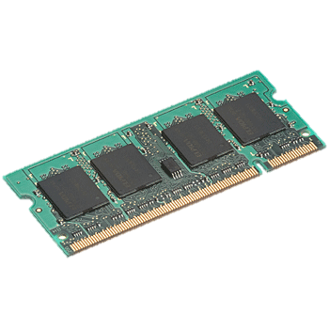
Goal: Keep Working Set in RAM
iteration 1
one-time processing
iteration 2
iteration 3
Input
Distributed memory
. . .
iter. 1
iter. 2
. . .
Input

Slide 7
Challenge
Distributed memory abstraction must be
Fault-tolerant
Efficient in large commodity clusters
How do we design a programming interface that can provide fault tolerance efficiently?

Slide 8
Challenge
Existing distributed storage abstractions offer an interface based on fine-grained updates
Reads and writes to cells in a table
E.g. key-value stores, databases, distributed memory
Requires replicating data or update logs across nodes for fault tolerance
Expensive for data-intensive apps

Slide 9
Solution: Resilient Distributed Datasets (RDDs)
Offer an interface based on coarse-grained transformations (e.g. map, group-by, join)
Allows for efficient fault recovery using lineage
Log one operation to apply to many elements
Recompute lost partitions of dataset on failure
No cost if nothing fails

Slide 10
RDD Recovery
iteration 1
one-time processing
iteration 2
iteration 3
Input
Distributed memory
. . .
iter. 1
iter. 2
. . .
Input

Slide 11
Generality of RDDs
Despite coarse-grained interface, RDDs can express surprisingly many parallel algorithms
These naturally apply the same operation to many items
Unify many current programming models
Data flow models: MapReduce, Dryad, SQL, …
Specialized tools for iterative apps: BSP (Pregel), iterative MapReduce (Twister), incremental (CBP)
Also support new apps that these models don’t
Notes:
Key idea: add “variables” to the “functions” in functional programming

Slide 12
Outline
Programming model
Applications
Implementation
Demo
Current work

Slide 13
Spark Programming Interface
Language-integrated API in Scala
Can be used interactively from Scala interpreter
Provides:
Resilient distributed datasets (RDDs)
Transformations to build RDDs (map, join, filter, …)
Actions on RDDs (return a result to the program or write data to storage: reduce, count, save, …)
Notes:
You write a single program → similar to DryadLINQ
Distributed data sets with parallel operations on them are pretty standard; the new thing is that they can be reused across ops
Variables in the driver program can be used in parallel ops; accumulators useful for sending information back, cached vars are an optimization
Mention cached vars useful for some workloads that won’t be shown here
Mention it’s all designed to be easy to distribute in a fault-tolerant fashion

Slide 14

Example: Log Mining
Load error messages from a log into memory, then interactively search for various patterns
Base RDD
Msgs. 1
lines = spark.textFile(“hdfs://...”)
errors = lines.filter(_.startsWith(“ERROR”))
messages = errors.map(_.split(‘\t’)(2))
messages.persist()
Transformed RDD
Worker
results
tasks
Block 1
Driver
Action
messages.filter(_.contains(“foo”)).count
messages.filter(_.contains(“bar”)).count
Msgs. 2
Worker
. . .
Msgs. 3
Result: full-text search of Wikipedia in <1 sec (vs 20 sec for on-disk data)
Worker
Block 2
Result: scaled to 1 TB data in 5-7 sec (vs 170 sec for on-disk data)
Block 3
Notes:
Key idea: add “variables” to the “functions” in functional programming

Slide 15
RDD Fault Tolerance
RDDs maintain lineage information that can be used to reconstruct lost partitions
Ex:
messages = textFile(...).filter(_.startsWith(“ERROR”))
.map(_.split(‘\t’)(2))
HDFSFile
FilteredRDD
MappedRDD
filter (func = _.startsWith(...))
map (func = _.split(...))

Slide 16
Example: Logistic Regression
Goal: find best line separating two sets of points
random initial line
+
+
+
+
+
+
–
+
+
–
–
–
+
+
–
–
–
–
–
–
target
Notes:
Note that dataset is reused on each gradient computation

Slide 17
Logistic Regression Code
val data = spark.textFile(...).map(readPoint).persist()
var w = Vector.random(D)
for (i <- 1 to ITERATIONS) {
val gradient = data.map(p =>
(1 / (1 + exp(-p.y*(w dot p.x))) - 1) * p.y * p.x
).reduce((a,b) => a+b)
w -= gradient
}
println("Final w: " + w)

Slide 18
Logistic Regression Performance
127 s / iteration
first iteration 174 s
further iterations 6 s
Notes:
This is for a 29 GB dataset on 20 EC2 m1.xlarge machines (4 cores each)

Slide 19
RDDs in More Detail
RDDs additionally provide:
Control over partitioning (e.g. hash-based), which can be used to optimize data placement across queries
Control over persistence (e.g. store on disk vs in RAM)
Fine-grained reads (treat RDD as a big table)

Slide 20
RDDs vs Distributed Shared Memory
Concern | RDDs | Distr. Shared Mem.
Reads | Fine-grained | Fine-grained
Writes | Bulk transformations | Fine-grained
Consistency | Trivial (immutable) | Up to app / runtime
Fault recovery | Fine-grained and low-overhead using lineage | Requires checkpoints and program rollback
Straggler mitigation | Possible using speculative execution | Difficult
Work placement | Automatic based on data locality | Up to app (but runtime aims for transparency)

Slide 21
Spark Applications
EM alg. for traffic prediction (Mobile Millennium)
In-memory OLAP & anomaly detection (Conviva)
Twitter spam classification (Monarch)
Alternating least squares matrix factorization
Pregel on Spark (Bagel)
SQL on Spark (Shark)

Slide 22
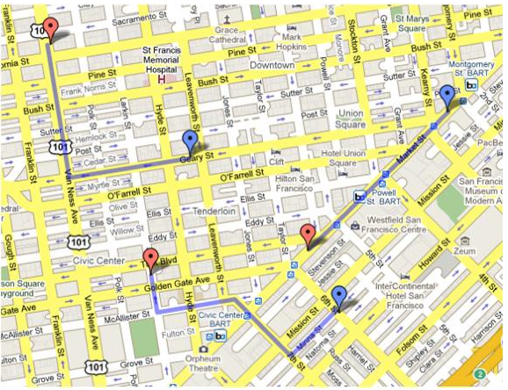
Mobile Millennium App
Estimate city traffic using position observations from “probe vehicles” (e.g. GPS-carrying taxis)

Slide 23
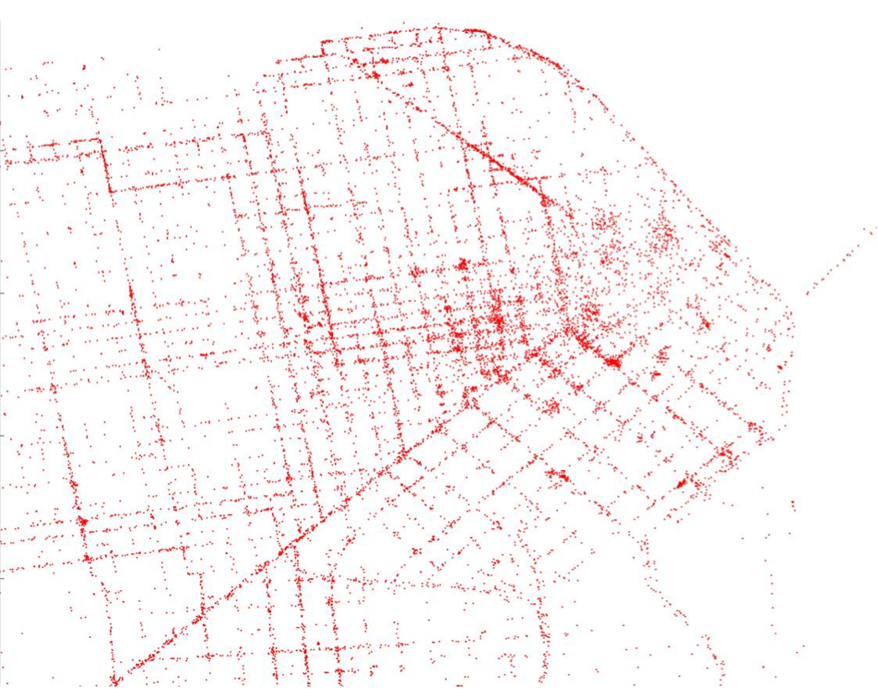
Sample Data
Tim Hunter, with the support of the Mobile Millennium team P.I. Alex Bayen (traffic.berkeley.edu)
Notes:
One day’s worth of SF taxi measurements

Slide 24
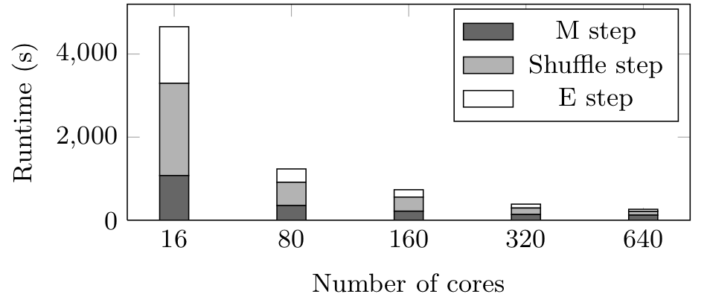
Implementation
Expectation maximization (EM) algorithm using iterated map and groupByKey on the same data
3x faster with in-memory RDDs

Slide 25
Conviva GeoReport
Time (hours)
Aggregations on many keys w/ same WHERE clause
40× gain comes from:
Not re-reading unused columns or filtered records
Avoiding repeated decompression
In-memory storage of deserialized objects

Slide 26
Implementation
Spark runs on the Mesos cluster manager [NSDI 11], letting it share resources with Hadoop & other apps
Can read from any Hadoop input source (HDFS, S3, …)
Spark
Hadoop
MPI
…
Mesos
Node
Node
Node
Node
~10,000 lines of code, no changes to Scala
Notes:
Mention it’s designed to be fault-tolerant

Slide 27
RDD Representation
Simple common interface:
Set of partitions
Preferred locations for each partition
List of parent RDDs
Function to compute a partition given parents
Optional partitioning info
Allows capturing wide range of transformations
Users can easily add new transformations

Slide 28
Scheduler
Dryad-like task DAG
Pipelines functions within a stage
Cache-aware for data reuse & locality
Partitioning-aware to avoid shuffles
A:
B:
G:
Stage 1
groupBy
C:
D:
F:
map
E:
join
Stage 2
union
Stage 3
= cached partition
Notes:
NOT a modified version of Hadoop

Slide 29
Language Integration
Scala closures are Serializable Java objects
Serialize on driver, load & run on workers
Not quite enough
Nested closures may reference entire outer scope
May pull in non-Serializable variables not used inside
Solution: bytecode analysis + reflection

Slide 30
Interactive Spark
Modified Scala interpreter to allow Spark to be used interactively from the command line
Altered code generation to make each “line” typed have references to objects it depends on
Added facility to ship generated classes to workers
Enables in-memory exploration of big data

Slide 31
Outline
Spark programming model
Applications
Implementation
Demo
Current work

Slide 32
Spark Debugger
Debugging general distributed apps is very hard
Idea: leverage the structure of computations in Spark, MapReduce, Pregel, and other systems
These split jobs into independent, deterministic tasks for fault tolerance; use this for debugging:
Log lineage for all RDDs created (small)
Let user replay any task in jdb, or rebuild any RDD

Slide 33
Conclusion
Spark’s RDDs offer a simple and efficient programming model for a broad range of apps
Achieve fault tolerance efficiently by providing coarse-grained operations and tracking lineage
Can express many current programming models
www.spark-project.org

Slide 34
Related Work
DryadLINQ, FlumeJava
Similar “distributed dataset” API, but cannot reuse datasets efficiently across queries
Relational databases
Lineage/provenance, logical logging, materialized views
GraphLab, Piccolo, BigTable, RAMCloud
Fine-grained writes similar to distributed shared memory
Iterative MapReduce (e.g. Twister, HaLoop)
Cannot define multiple distributed datasets, run different map/reduce pairs on them, or query data interactively

Slide 35
Spark Operations
Transformations (define a new RDD) | map filter sample groupByKey reduceByKey sortByKey | flatMap union join cogroup cross mapValues
Actions (return a result to driver program) | collect reduce count save lookupKey

Slide 36
Fault Recovery Results
Notes:
These are for K-means

Slide 37
Behavior with Not Enough RAM

Slide 38
PageRank Results

Slide 39
Pregel
Graph processing system based on BSP model
Vertices in the graph have states
At each superstep, each vertex can update its state and send messages to vertices in next step

Slide 40
Pregel Using RDDs
map
Input graph
Vertex states₀
Messages₀
group by vertex ID
Superstep 1
map
Vertex states₁
Messages₁
group by vertex ID
Superstep 2
map
Vertex states₂
Messages₂
. . .

Slide 41
Pregel Using RDDs
map
Input graph
Vertex states₀
Messages₀
group by vertex ID
verts = // RDD of (ID, State) pairs
msgs = // RDD of (ID, Message) pairs
newData = verts.cogroup(msgs).mapValues(
(id, vert, msgs) => userFunc(id, vert, msgs)
// gives (id, newState, outgoingMsgs)
).persist()
newVerts = newData.mapValues((v,ms) => v)
newMsgs = newData.flatMap((id,(v,ms)) => ms)
Superstep 1
map
Vertex states₁
Messages₁
group by vertex ID
Superstep 2
map
Vertex states₂
Messages₂
. . .

Slide 42
Placement Optimizations
Partition vertex RDDs in same way across steps
So that states never need to be sent across nodes
Use a custom partitioner to minimize traffic (e.g. group pages by domain)
Easily expressible with RDD partitioning

