Slide 1

Spark and Shark
High-Speed In-Memory Analytics over Hadoop and Hive Data
Matei Zaharia, in collaboration with
Mosharaf Chowdhury, Tathagata Das, Ankur Dave, Cliff Engle, Michael Franklin, Haoyuan Li, Antonio Lupher, Justin Ma, Murphy McCauley, Scott Shenker, Ion Stoica, Reynold Xin
UC Berkeley
spark-project.org
UC BERKELEY

Slide 2
What is Spark?
Not a modified version of Hadoop
Separate, fast, MapReduce-like engine
In-memory data storage for very fast iterative queries
General execution graphs and powerful optimizations
Up to 40x faster than Hadoop
Compatible with Hadoop’s storage APIs
Can read/write to any Hadoop-supported system, including HDFS, HBase, SequenceFiles, etc

Slide 3
What is Shark?
Port of Apache Hive to run on Spark
Compatible with existing Hive data, metastores, and queries (HiveQL, UDFs, etc)
Similar speedups of up to 40x

Slide 4
Project History
Spark project started in 2009, open sourced 2010
Shark started summer 2011, alpha April 2012
In use at Berkeley, Princeton, Klout, Foursquare, Conviva, Quantifind, Yahoo! Research & others
200+ member meetup, 500+ watchers on GitHub

Slide 5
This Talk
Spark programming model
User applications
Shark overview
Demo
Next major addition: Streaming Spark

Slide 6
Why a New Programming Model?
MapReduce greatly simplified big data analysis
But as soon as it got popular, users wanted more:
More complex, multi-stage applications (e.g. iterative graph algorithms and machine learning)
More interactive ad-hoc queries
Both multi-stage and interactive apps require faster data sharing across parallel jobs

Slide 7
Data Sharing in MapReduce
HDFS read
HDFS write
HDFS read
HDFS write
iter. 1
iter. 2
. . .
Input
HDFS read
query 1
result 1
query 2
result 2
query 3
result 3
Input
. . .
Slow due to replication, serialization, and disk IO
Notes:
Each iteration is, for example, a MapReduce job

Slide 8
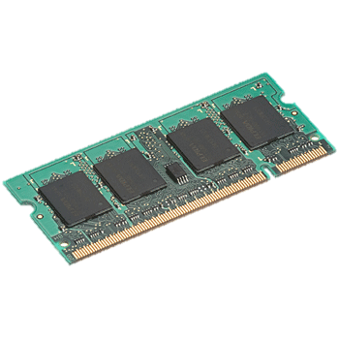
Data Sharing in Spark
iter. 1
iter. 2
. . .
Input
query 1
one-time processing
query 2
query 3
Input
Distributed memory
. . .
10-100× faster than network and disk

Slide 9
Spark Programming Model
Key idea: resilient distributed datasets (RDDs)
Distributed collections of objects that can be cached in memory across cluster nodes
Manipulated through various parallel operators
Automatically rebuilt on failure
Interface
Clean language-integrated API in Scala
Can be used interactively from Scala console

Slide 10

Example: Log Mining
Load error messages from a log into memory, then interactively search for various patterns
Base RDD
Cache 1
lines = spark.textFile(“hdfs://...”)
errors = lines.filter(_.startsWith(“ERROR”))
messages = errors.map(_.split(‘\t’)(2))
cachedMsgs = messages.cache()
Transformed RDD
Worker
results
tasks
Block 1
Driver
Action
cachedMsgs.filter(_.contains(“foo”)).count
cachedMsgs.filter(_.contains(“bar”)).count
Cache 2
Worker
. . .
Cache 3
Result: full-text search of Wikipedia in <1 sec (vs 20 sec for on-disk data)
Worker
Block 2
Result: scaled to 1 TB data in 5-7 sec (vs 170 sec for on-disk data)
Block 3
Notes:
Add “variables” to the “functions” in functional programming

Slide 11
Fault Tolerance
RDDs track the series of transformations used to build them (their lineage) to recompute lost data
E.g:
messages = textFile(...).filter(_.contains(“error”))
.map(_.split(‘\t’)(2))
HadoopRDD
path = hdfs://…
FilteredRDD
func = _.contains(...)
MappedRDD
func = _.split(…)

Slide 12
Example: Logistic Regression
val data = spark.textFile(...).map(readPoint).cache()
var w = Vector.random(D)
for (i <- 1 to ITERATIONS) {
val gradient = data.map(p =>
(1 / (1 + exp(-p.y*(w dot p.x))) - 1) * p.y * p.x
).reduce(_ + _)
w -= gradient
}
println("Final w: " + w)
Load data in memory once
Initial parameter vector
Repeated MapReduce steps to do gradient descent
Notes:
Key idea: add “variables” to the “functions” in functional programming

Slide 13
Logistic Regression Performance
127 s / iteration
first iteration 174 s
further iterations 6 s
Notes:
This is for a 29 GB dataset on 20 EC2 m1.xlarge machines (4 cores each)

Slide 14
Supported Operators
map
filter
groupBy
sort
join
leftOuterJoin
rightOuterJoin
reduce
count
reduceByKey
groupByKey
first
union
cross
sample
cogroup
take
partitionBy
pipe
save
...

Slide 15
Other Engine Features
General graphs of operators (e.g. map-reduce-reduce)
Hash-based reduces (faster than Hadoop’s sort)
Controlled data partitioning to lower communication

Slide 16







Spark Users

Slide 17
User Applications
In-memory analytics & anomaly detection (Conviva)
Interactive queries on data streams (Quantifind)
Exploratory log analysis (Foursquare)
Traffic estimation w/ GPS data (Mobile Millennium)
Twitter spam classification (Monarch)
. . .

Slide 18
Conviva GeoReport
Time (hours)
Group aggregations on many keys w/ same filter
40× gain over Hive from avoiding repeated reading, deserialization and filtering

Slide 19
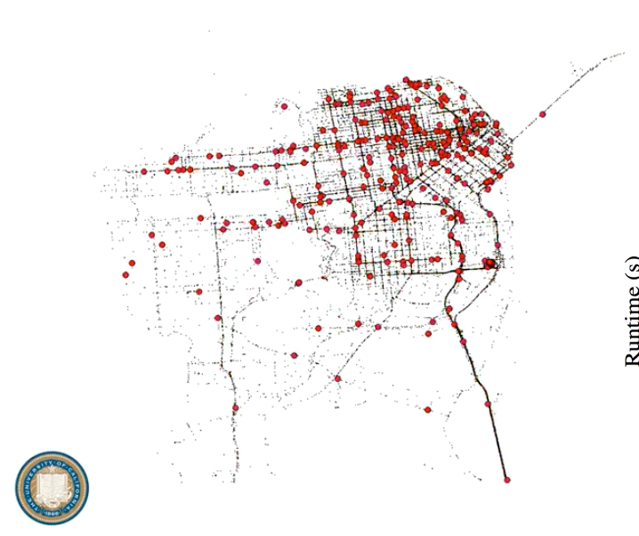
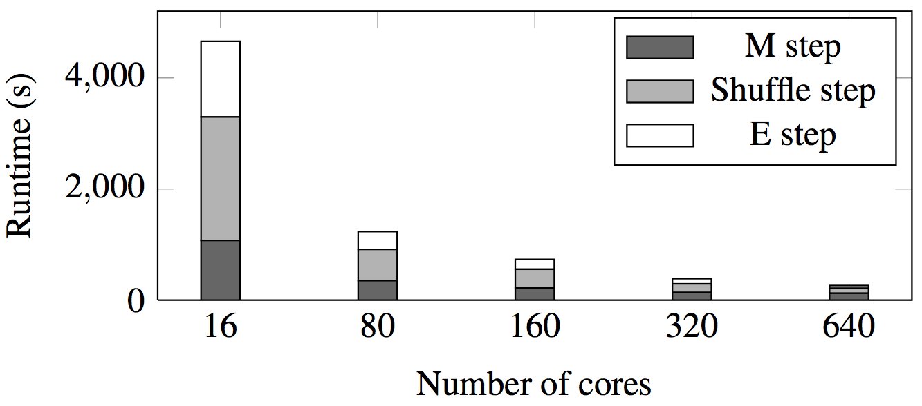
Mobile Millennium Project
Estimate city traffic from crowdsourced GPS data
Iterative EM algorithm scaling to 160 nodes
Credit: Tim Hunter, with support of the Mobile Millennium team; P.I. Alex Bayen; traffic.berkeley.edu

Slide 20
Shark: Hive on Spark
Notes:
This will show interactive search on 50 GB of Wikipedia data

Slide 21
Motivation
Hive is great, but Hadoop’s execution engine makes even the smallest queries take minutes
Scala is good for programmers, but many data users only know SQL
Can we extend Hive to run on Spark?

Slide 22
Hive Architecture
Meta store
Client
CLI
JDBC
Driver
SQL Parser
Query Optimizer
Physical Plan
Execution
MapReduce
HDFS

Slide 23
Shark Architecture
Meta store
Client
CLI
JDBC
Cache Mgr.
Driver
SQL Parser
Query Optimizer
Physical Plan
Execution
Spark
HDFS
[Engle et al, SIGMOD 2012]
Notes:
Query planning is also better in Shark due to (1) more optimizations and (2) use of more optimized Spark operators such as hash-based join

Slide 24
Efficient In-Memory Storage
Simply caching Hive records as Java objects is inefficient due to high per-object overhead
Instead, Shark employs column-oriented storage using arrays of primitive types
Row Storage
Column Storage
1
john
4.1
1
2
3
2
mike
3.5
john
mike
sally
3
sally
6.4
4.1
3.5
6.4

Slide 25
Efficient In-Memory Storage
Simply caching Hive records as Java objects is inefficient due to high per-object overhead
Instead, Shark employs column-oriented storage using arrays of primitive types
Row Storage
Column Storage
Benefit: similarly compact size to serialized data, but >5x faster to access
1
john
4.1
1
2
3
2
mike
3.5
john
mike
sally
3
sally
6.4
4.1
3.5
6.4

Slide 26
Using Shark
CREATE TABLE mydata_cached AS SELECT …
Run standard HiveQL on it, including UDFs
A few esoteric features are not yet supported
Can also call from Scala to mix with Spark
Early alpha release at shark.cs.berkeley.edu

Slide 27
Benchmark Query 1
SELECT * FROM grep WHERE field LIKE ‘%XYZ%’;

Slide 28
Benchmark Query 2
SELECT sourceIP, AVG(pageRank), SUM(adRevenue) AS earnings FROM rankings AS R, userVisits AS V ON R.pageURL = V.destURL WHERE V.visitDate BETWEEN ‘1999-01-01’ AND ‘2000-01-01’ GROUP BY V.sourceIP ORDER BY earnings DESC LIMIT 1;

Slide 29
Demo
Notes:
This will show interactive search on 50 GB of Wikipedia data

Slide 30
What’s Next?
Recall that Spark’s model was motivated by two emerging uses (interactive and multi-stage apps)
Another emerging use case that needs fast data sharing is stream processing
Track and update state in memory as events arrive
Large-scale reporting, click analysis, spam filtering, etc

Slide 31
Streaming Spark
Extends Spark to perform streaming computations
Runs as a series of small (~1 s) batch jobs, keeping state in memory as fault-tolerant RDDs
Intermix seamlessly with batch and ad-hoc queries
map
reduceByWindow
tweetStream
.flatMap(_.toLower.split)
.map(word => (word, 1)) .reduceByWindow(“5s”, _ + _)
T=1
T=2
[Zaharia et al, HotCloud 2012]
…

Slide 32
Streaming Spark
Extends Spark to perform streaming computations
Runs as a series of small (~1 s) batch jobs, keeping state in memory as fault-tolerant RDDs
Intermix seamlessly with batch and ad-hoc queries
map
reduceByWindow
tweetStream
.flatMap(_.toLower.split)
.map(word => (word, 1)) .reduceByWindow(5, _ + _)
T=1
Result: can process 42 million records/second (4 GB/s) on 100 nodes at sub-second latency
T=2
[Zaharia et al, HotCloud 2012]
…

Slide 33
Streaming Spark
Extends Spark to perform streaming computations
Runs as a series of small (~1 s) batch jobs, keeping state in memory as fault-tolerant RDDs
Intermix seamlessly with batch and ad-hoc queries
map
reduceByWindow
tweetStream
.flatMap(_.toLower.split)
.map(word => (word, 1)) .reduceByWindow(5, _ + _)
T=1
Alpha coming this summer
T=2
[Zaharia et al, HotCloud 2012]
…

Slide 34
Conclusion
Spark and Shark speed up your interactive and complex analytics on Hadoop data
Download and docs: www.spark-project.org
Easy to run locally, on EC2, or on Mesos and soon YARN
User meetup: meetup.com/spark-users
Training camp at Berkeley in August!
matei@berkeley.edu / @matei_zaharia

Slide 35
Behavior with Not Enough RAM

Slide 36
Software Stack
Shark (Hive on Spark)
Bagel
(Pregel on Spark)
Streaming Spark
…
Spark
Local mode
EC2
Apache Mesos
YARN

