Slide 1

Spark
In-Memory Cluster Computing for
Iterative and Interactive Applications
Matei Zaharia, Mosharaf Chowdhury, Justin Ma,
Michael Franklin, Scott Shenker, Ion Stoica
UC Berkeley

Slide 2
Background
Commodity clusters have become an important computing platform for a variety of applications
  In industry: search, machine translation, ad targeting, …
  In research: bioinformatics, NLP, climate simulation, …
High-level cluster programming models like MapReduce power many of these apps
Theme of this work: provide similarly powerful abstractions for a broader class of applications
Notes:
Explain that trends in data collection rates vs processor and IO speeds are driving this

Slide 3
Motivation
Current popular programming models for clusters transform data flowing from stable storage to stable storage
E.g., MapReduce:
Map
Reduce
Input
Map
Output
Reduce
Map
Notes:
Also applies to Dryad, SQL, etc
Benefits: easy to do fault tolerance and

Slide 4
Motivation
Current popular programming models for clusters transform data flowing from stable storage to stable storage
E.g., MapReduce:
Map
Reduce
Benefits of data flow: runtime can decide where to run tasks and can automatically recover from failures
Input
Map
Output
Reduce
Map
Notes:
Also applies to Dryad, SQL, etc
Benefits: easy to do fault tolerance and

Slide 5
Motivation
Acyclic data flow is a powerful abstraction, but is not efficient for applications that repeatedly reuse a working set of data:
  Iterative algorithms (many in machine learning)
  Interactive data mining tools (R, Excel, Python)
Spark makes working sets a first-class concept to efficiently support these apps

Slide 6
Spark Goal
Provide distributed memory abstractions for clusters to support apps with working sets
Retain the attractive properties of MapReduce:
  Fault tolerance (for crashes & stragglers)
  Data locality
  Scalability
Solution: augment data flow model with “resilient distributed datasets” (RDDs)
Notes:
RDDs = first-class way to manipulate and persist intermediate datasets

Slide 7
Generality of RDDs
We conjecture that Spark’s combination of data flow with RDDs unifies many proposed cluster programming models
  General data flow models: MapReduce, Dryad, SQL
  Specialized models for stateful apps: Pregel (BSP), HaLoop (iterative MR), Continuous Bulk Processing
Instead of specialized APIs for one type of app, give user first-class control of distrib. datasets
Notes:
Key idea:

Slide 8
Outline
Spark programming model
Example applications
Implementation
Demo
Future work

Slide 9
Programming Model
Resilient distributed datasets (RDDs)
  Immutable collections partitioned across cluster that can be rebuilt if a partition is lost
  Created by transforming data in stable storage using data flow operators (map, filter, group-by, …)
  Can be cached across parallel operations
Parallel operations on RDDs
  Reduce, collect, count, save, …
Restricted shared variables
  Accumulators, broadcast variables
Notes:
You write a single program → similar to DryadLINQ
Distributed data sets with parallel operations on them are pretty standard; the new thing is that they can be reused across ops
Variables in the driver program can be used in parallel ops; accumulators useful for sending information back, cached vars are an optimization
Mention cached vars useful for some workloads that won’t be shown here
Mention it’s all designed to be easy to distribute in a fault-tolerant fashion

Slide 10

Example: Log Mining
Load error messages from a log into memory, then interactively search for various patterns
Base RDD
Cache 1
lines = spark.textFile(“hdfs://...”)
errors = lines.filter(_.startsWith(“ERROR”))
messages = errors.map(_.split(‘\t’)(2))
cachedMsgs = messages.cache()
Transformed RDD
Worker
results
tasks
Block 1
Driver
Cached RDD
Parallel operation
cachedMsgs.filter(_.contains(“foo”)).count
cachedMsgs.filter(_.contains(“bar”)).count
Cache 2
Worker
. . .
Cache 3
Result: full-text search of Wikipedia in <1 sec (vs 20 sec for on-disk data)
Worker
Block 2
Block 3

Slide 11
RDDs in More Detail
An RDD is an immutable, partitioned, logical collection of records
  Need not be materialized, but rather contains information to rebuild a dataset from stable storage
Partitioning can be based on a key in each record (using hash or range partitioning)
Built using bulk transformations on other RDDs
Can be cached for future reuse

Slide 12
RDD Operations
Transformations (define a new RDD)
map filter sample union groupByKey reduceByKey join cache …
Parallel operations (return a result to driver)
reduce collect count save lookupKey …

Slide 13
RDD Fault Tolerance
RDDs maintain lineage information that can be used to reconstruct lost partitions
Ex:
cachedMsgs = textFile(...).filter(_.contains(“error”))
.map(_.split(‘\t’)(2))
.cache()
HdfsRDD
path: hdfs://…
FilteredRDD
func: contains(...)
MappedRDD
func: split(…)
CachedRDD

Slide 14
Benefits of RDD Model
Consistency is easy due to immutability
Inexpensive fault tolerance (log lineage rather than replicating/checkpointing data)
Locality-aware scheduling of tasks on partitions
Despite being restricted, model seems applicable to a broad variety of applications

Slide 15
RDDs vs Distributed Shared Memory
Concern | RDDs | Distr. Shared Mem.
Reads | Fine-grained | Fine-grained
Writes | Bulk transformations | Fine-grained
Consistency | Trivial (immutable) | Up to app / runtime
Fault recovery | Fine-grained and low-overhead using lineage | Requires checkpoints and program rollback
Straggler mitigation | Possible using speculative execution | Difficult
Work placement | Automatic based on data locality | Up to app (but runtime aims for transparency)

Slide 16
Related Work
DryadLINQ
  Language-integrated API with SQL-like operations on lazy datasets
  Cannot have a dataset persist across queries
Relational databases
  Lineage/provenance, logical logging, materialized views
Piccolo
  Parallel programs with shared distributed tables; similar to distributed shared memory
Iterative MapReduce (Twister and HaLoop)
  Cannot define multiple distributed datasets, run different map/reduce pairs on them, or query data interactively
RAMCloud
  Allows random read/write to all cells, requiring logging much like distributed shared memory systems

Slide 17
Example: Logistic Regression
Goal: find best line separating two sets of points
random initial line
+
+
+
+
+
+
–
+
+
–
–
–
+
+
–
–
–
–
–
–
target
Notes:
Note that dataset is reused on each gradient computation

Slide 18
Logistic Regression Code
val data = spark.textFile(...).map(readPoint).cache()
var w = Vector.random(D)
for (i <- 1 to ITERATIONS) {
val gradient = data.map(p =>
(1 / (1 + exp(-p.y*(w dot p.x))) - 1) * p.y * p.x
).reduce(_ + _)
w -= gradient
}
println("Final w: " + w)

Slide 19
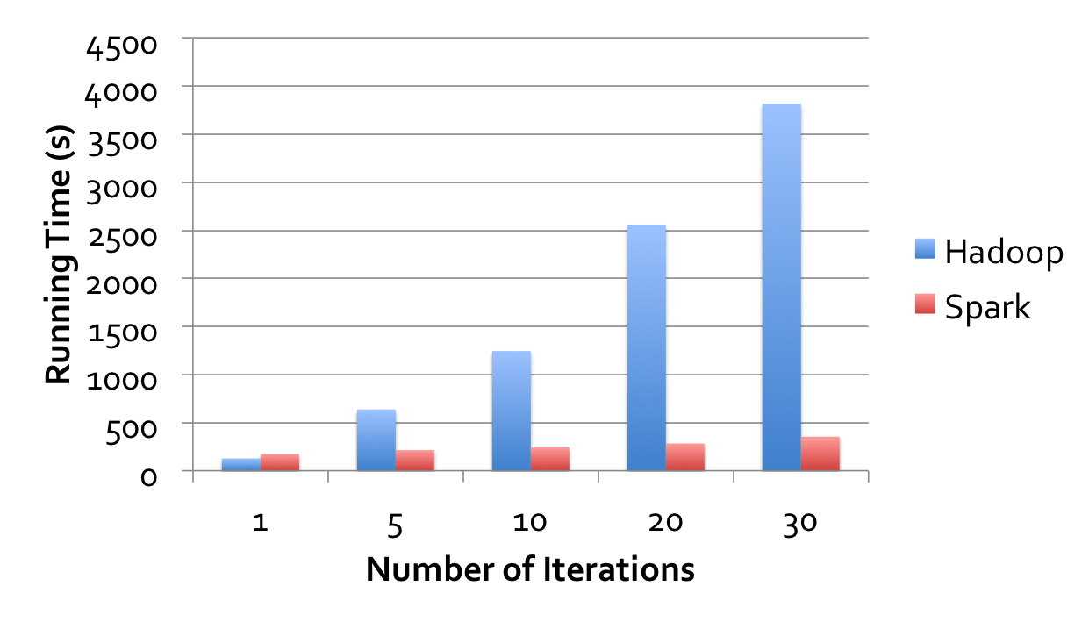
Logistic Regression Performance
127 s / iteration
first iteration 174 s
further iterations 6 s
Notes:
This is for a 29 GB dataset on 20 EC2 m1.xlarge machines (4 cores each)

Slide 20
Example: MapReduce
MapReduce data flow can be expressed using RDD transformations
res = data.flatMap(rec => myMapFunc(rec))
.groupByKey()
.map((key, vals) => myReduceFunc(key, vals))
Or with combiners:
res = data.flatMap(rec => myMapFunc(rec))
.reduceByKey(myCombiner)
.map((key, val) => myReduceFunc(key, val))

Slide 21
Word Count in Spark
val lines = spark.textFile(“hdfs://...”)
val counts = lines.flatMap(_.split(“\\s”))
.reduceByKey(_ + _)
counts.save(“hdfs://...”)

Slide 22
Example: Pregel
Graph processing framework from Google that implements Bulk Synchronous Parallel model
Vertices in the graph have state
At each superstep, each node can update its state and send messages to nodes in future step
Good fit for PageRank, shortest paths, …

Slide 23
Pregel Data Flow
Input graph
Vertex state 1
Messages 1
Group by vertex ID
Superstep 1
Vertex state 2
Messages 2
Group by vertex ID
Superstep 2
. . .

Slide 24
PageRank in Pregel
Input graph
Vertex ranks 1
Contributions 1
Group & add by vertex
Superstep 1 (add contribs)
Vertex ranks 2
Contributions 2
Group & add by vertex
Superstep 2 (add contribs)
. . .

Slide 25
Pregel in Spark
Separate RDDs for immutable graph state and for vertex states and messages at each iteration
Use groupByKey to perform each step
Cache the resulting vertex and message RDDs
Optimization: co-partition input graph and vertex state RDDs to reduce communication

Slide 26
Other Spark Applications
Twitter spam classification (Justin Ma)
EM alg. for traffic prediction (Mobile Millennium)
K-means clustering
Alternating Least Squares matrix factorization
In-memory OLAP aggregation on Hive data
SQL on Spark (future work)

Slide 27
Overview
Spark runs on the Mesos cluster manager [NSDI 11], letting it share resources with Hadoop & other apps
Can read from any Hadoop input source (e.g. HDFS)
Spark
Hadoop
MPI
…
Mesos
Node
Node
Node
Node
~6000 lines of Scala code thanks to building on Mesos
Notes:
Mention it’s designed to be fault-tolerant

Slide 28
Language Integration
Scala closures are Serializable Java objects
  Serialize on driver, load & run on workers
Not quite enough
  Nested closures may reference entire outer scope
  May pull in non-Serializable variables not used inside
  Solution: bytecode analysis + reflection
Shared variables implemented using custom serialized form (e.g. broadcast variable contains pointer to BitTorrent tracker)

Slide 29
Interactive Spark
Modified Scala interpreter to allow Spark to be used interactively from the command line
Required two changes:
  Modified wrapper code generation so that each “line” typed has references to objects for its dependencies
  Place generated classes in distributed filesystem
Enables in-memory exploration of big data

Slide 30
Future Work
Further extend RDD capabilities
  Control over storage layout (e.g. column-oriented)
  Additional caching options (e.g. on disk, replicated)
Leverage lineage for debugging
  Replay any task, rebuild any intermediate RDD
Adaptive checkpointing of RDDs
Higher-level analytics tools built on top of Spark

Slide 31
Conclusion
By making distributed datasets a first-class primitive, Spark provides a simple, efficient programming model for stateful data analytics
RDDs provide:
  Lineage info for fault recovery and debugging
  Adjustable in-memory caching
  Locality-aware parallel operations
We plan to make Spark the basis of a suite of batch and interactive data analysis tools

Slide 32
RDD Internal API
Set of partitions
Preferred locations for each partition
Optional partitioning scheme (hash or range)
Storage strategy (lazy or cached)
Parent RDDs (forming a lineage DAG)

