Slide 1

MovieLens Recommendation System
Team Members:
Swapnil Shrikrishna Verlekar (sv725)
Sanket Dattakumar Dalvi (sd1482)
Saurabh Sunil Kamble (sk2675)

Slide 2
Introduction
The goal of this system is to provide personalized movie suggestions.
We will be using the MovieLens dataset as our data source.
Our aim is to provide users with a seamless and enjoyable movie recommendation experience.
Our main emphasis for this system has been on these three key tasks:
Data selection and preprocessing
Rating Prediction
Item Recommendation

Slide 3
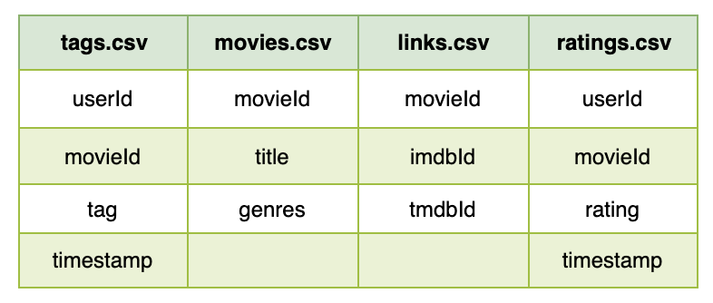
Dataset
MovieLens Dataset (ml-latest-small)
Movies : 9000
Ratings : 100,000
Users : 600

Slide 4
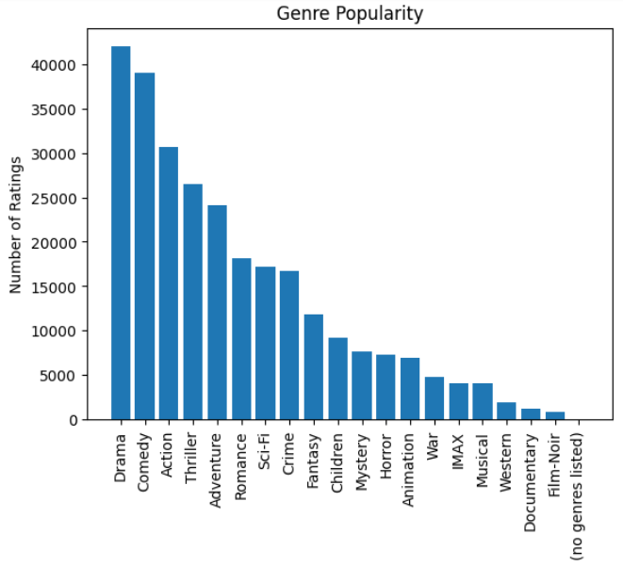
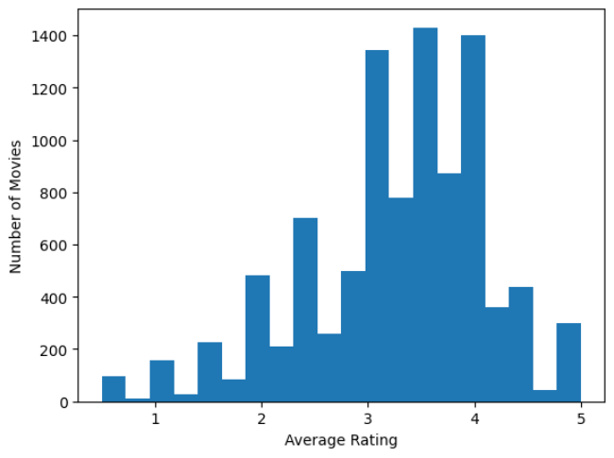
Data Distribution
Popular genres:
Average ratings:

Slide 5
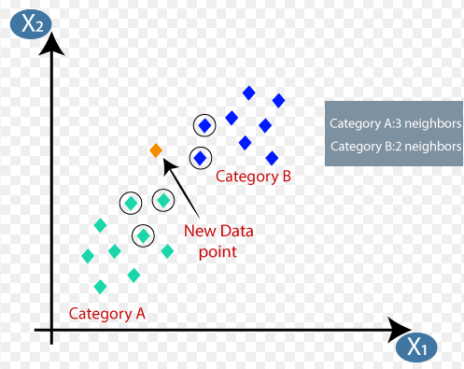
Movie Rating Prediction - Content Based CF - KNN
What’s KNN?
Uses proximity to make classifications/predictions about the grouping of an individual data point.
Why KNN?
Simplicity, No assumptions, Flexibility, Adaptability, Effectiveness
Notes:
Usses proximity of given datapoint wrt to given k nearest datapoints to make predictions
Simplicity: KNN is a simple algorithm that is easy to understand and implement.
No assumptions: KNN makes no assumptions about the underlying data distribution, making it a good choice for datasets where the distribution is unknown.
Flexibility: KNN can be used for both classification and regression problems.
Adaptability: KNN can adapt to changes in the data over time, making it a good choice for dynamic datasets.
Effectiveness: KNN has been shown to be effective in many real-world applications, including recommendation systems.

Slide 6
Movie Rating Prediction - Content Based CF - KNN
Load Movies and Ratings
Merge movie and rating dataset and preprocessing
Train/ Test Split
Rating Prediction
Input matrix to KNN and cluster size
Data Normalization and Tfidf Matrix
Notes:
Load Dataset
Merge based on the movie id and replace the Nan values
Stratified train test split to get equal representation of all classes
Normalize data to get a getting acc and calculator user similarity

Slide 7
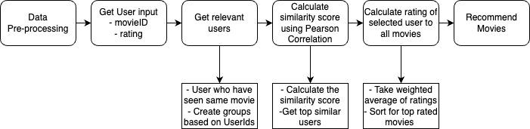
Collaborative Filtering for Movie Recommendations

Slide 8
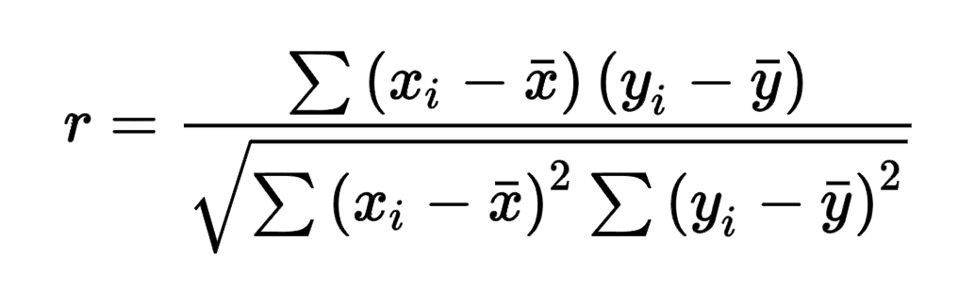
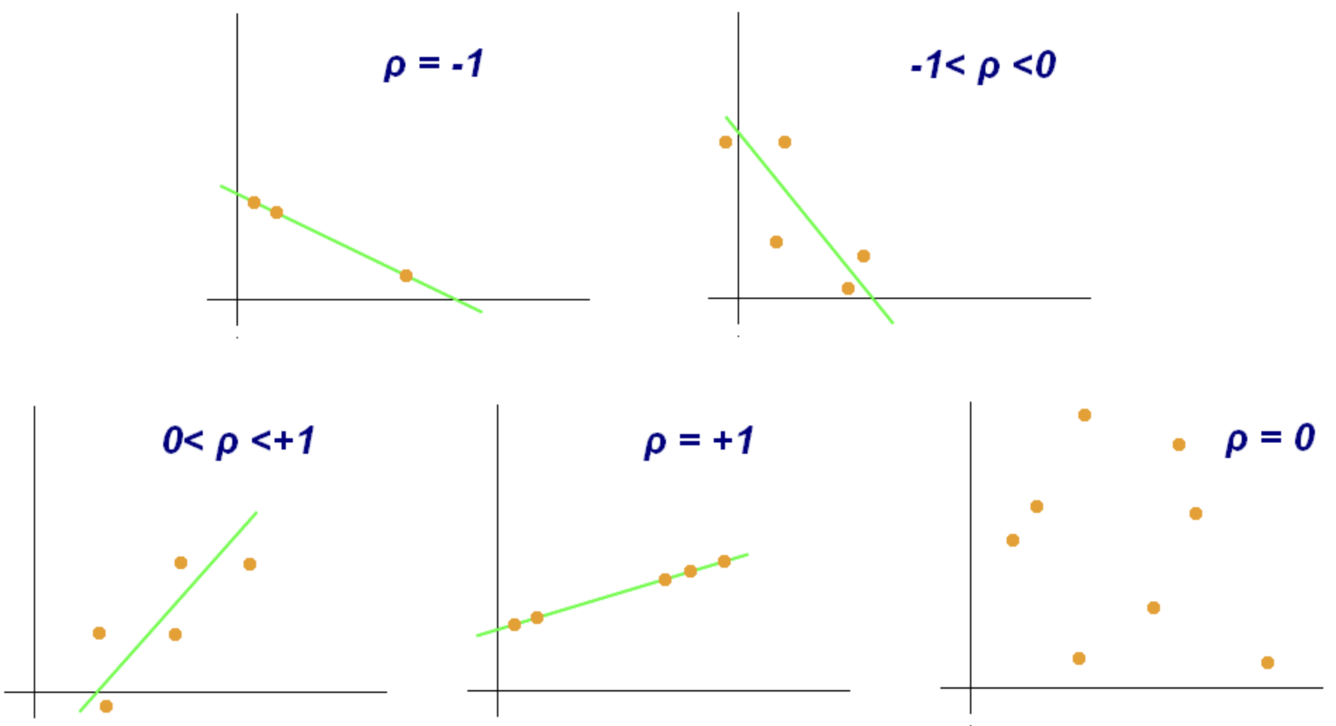
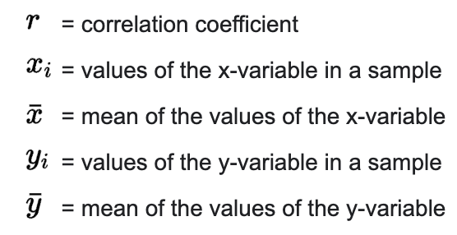
Pearson Correlation Coefficient
Pearson’s correlation coefficient is the test statistics that measures the statistical relationship, or association, between two continuous variables.
Tells magnitude of the association, or correlation, & direction of the relationship.
Coefficient values can range from +1 to -1, where
+1 indicates a perfect positive relationship.
-1 indicates a perfect negative relationship.
0 indicates no relationship exists.
Pearson correlation is invariant to scaling, i.e. multiplying all elements by a nonzero constant or adding any constant to all elements.

Slide 9
Evaluation Metrics
Rmse (k = 100) | 0.615
Mae (k = 100) | 0.531
Precision | 0.805
Recall | 0.400
F-Measure | 0.534
NDCG | 0.961

Slide 10
Optional Tasks
a. Transparency and Explainability of Recommender Systems
b. Fairness and Unbiases of Recommender Systems
c. Privacy Protection for Recommender Systems

Slide 11
ANY QUESTIONS ?

