Slide 1


Slide 2
Brief Synopsis
Challenge: To build a robust Recommender System.
Issues: Every day, we browse and buy things on Amazon, watch Netflix, listen to music on Spotify, and so on. For example, when you want to view a new movie, you normally ask your friends for recommendations; they are aware of your tastes and appropriately recommend a suitable film. Because everyone has their unique preferences, it's impossible to keep track of each user's preferences manually.
Background: Companies have customized Recommendation Engines that offer things to you based on powerful algorithms... Recommendation Systems are similar in that they are nothing more than data filtering tools that employ algorithms to recommend the most relevant items to a certain user.
The Internet is a vast ocean of information, with millions of goods and a massive product catalog. Some Users know exactly what they want, while others have no idea what to look for in such a big collection of information, and this is where Recommendation Systems come in handy.
Some things may be excellent but have not attained Popularity due to a lack of advertising; recommendation systems aid in the popularity of such items by bringing them to the attention of the public.
Ad Targeting is also aided by it. Let's say you're trying to buy a new laptop on the Internet; your recent searches have yielded laptop recommendations, and you'll soon encounter adverts on websites offering laptop savings. So, Ad Targeting is an advertising method that uses specialized software and algorithms to display adverts automatically based on the user's recent searches.
According to research published by the Network Advertising Initiative in 2009, ad targeting generated 2.7 times as much money as non-targeted ads. As a result, it also aids the product's organization in increasing revenues.

Slide 3

Problem Being Solved
Building a recommender system that, based on rating history, will forecast which item to recommend for a person such that sales improve.
Photo by Vlada Karpovich from Pexels

Slide 4

Technology/Tool/Stack
Pandas
Numpy
Sklearn
Matplotlib
Seaborn
Surprise
KNNWithMeans
SVD
NMF
Photo by luis gomes from Pexels

Slide 5

Solution Architecture
For a given item and user we need to predict the rating would be given by him/her to the item.
Building Model-based collaborative filtering system.
Splitting the dataset into train & test as 80:20 ratio.
Trying both user-based and item-based collaborative filtering approach with KNN.
Evaluate both the models using RMSE (Root Mean Squared Error) as a performance matrix.
Tuning the hyper-parameters for better result using GridSearchCV.
Applying SVD (Singular Vector Decomposition) and NMF (Non-Negative Matrix Factorization) to build and compare different models.
Photo by SHVETS production from Pexels

Slide 6
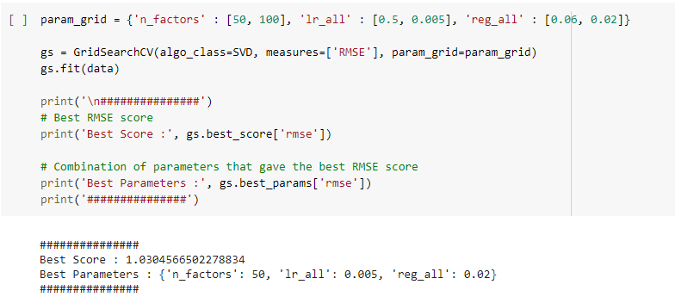
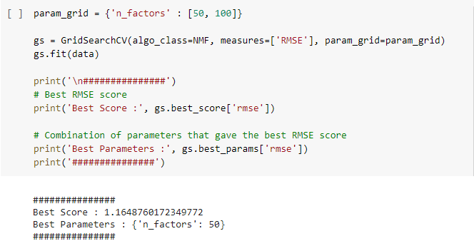
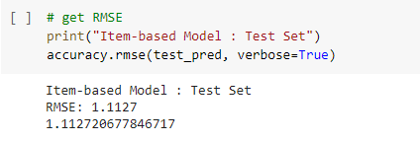
Screenshots
For electronics dataset
Singular Value Decomposition
Non-Negative Matrix Factorization (NMF)
Item-based collaborative filtering using KNNWithMeans

Slide 7
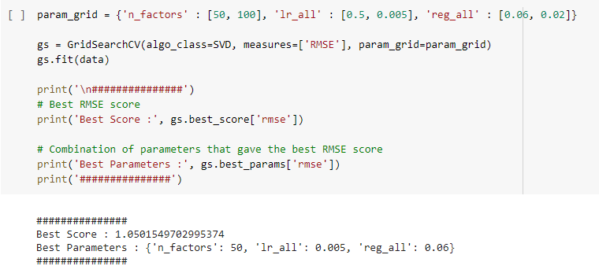
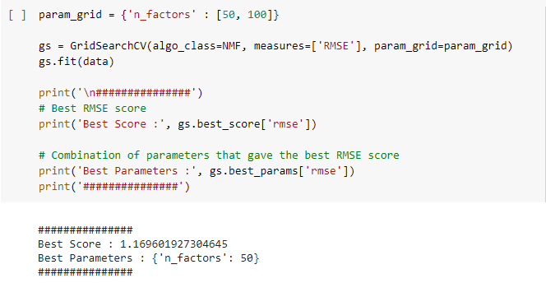
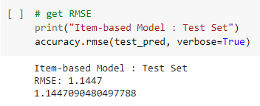
Screenshots
For modcloth dataset
Singular Value Decomposition
Non-Negative Matrix Factorization (NMF)
Item-based collaborative filtering using KNNWithMeans

Slide 8

Challenges Faced
For the electronics dataset, as the no. of records were quite large, it was taking enormous amount of time to compute anything, I switched to Google Colab.
Using each and every item that was rated, I was unable to create a utility matrix i.e. a pivot table as all the available RAM was being used up. Hence I filtere out all those items that were rated less than 5 times. This step also helped me achieve better results by making the model more robust.
I have used only the rating to make the recommendation system since I was not clear about other attributes such as ‘user_attr’, ‘model_attr’, and ‘split’ present in the dataset.
Matrix Factorization using Deep Learning couldn’t be implemented.
Photo by Rodrigo from Pexels

Slide 9
Future enhancements
1
Hybrid Model
A hybrid model that will predict or recommend item based on various stacked models (Like XGBoost + KNN + SVD technique + MF technique) along with a consideration of popularity and other attributes like brand and price, item’s average rating, user’s average rating, etc.
2
Deep Learning based Model
A model would be trained imparting Deep Learning techniques with various architectures.

Slide 10
Thank You

