Slide 1
Introduction to
IEEE 802.11 Wireless LAN Standard
Huafeng Lü
Sep 10, 2002

Slide 2
Outline
Introduction
Architecture
MAC Sublayer
PHY Layer
Typical Product

Slide 3
Why Wireless LAN
Avoid the high installation and maintenance costs incurred by traditional additions, deletions, and changes in infrastructured wired LANs.
Physical and environmental necessities
Operational environment; temporary usage

Slide 4
Challenges and Constraints
Frequency allocation
  All users operates on a common frequency band
  Must be approved and licensed by the government
Inference and reliability
  Collision: begin transmission at the same time; hidden terminal; multipath fading
Security
Power consumption
Human safety
Mobility

Slide 5
Introduction
First Standard of WLANs
IEEE Std 802.11 – 1999
  MAC sublayer, MAC management protocols and services.
  3 PHY layers: infrared, {FHSS, DHSS}@2.4GHz
802.11a, 802.11b, 802.11g: new PHY layers

Slide 6
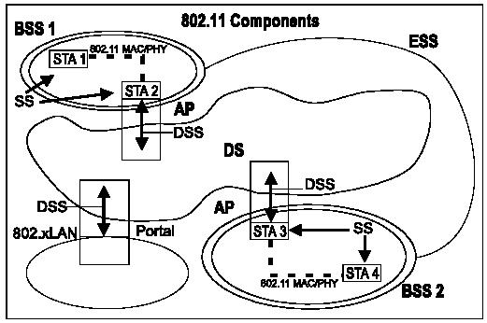
Architecture: Overview

Slide 7
Architecture: Components
STA (Station)
  Consists of a MAC and a PHY
  Referred to as: network adaptor, network interface card
BSS (Basic Service Set)
  Basic building block of an IEEE 802.11 LAN.
  A set of STAs that communicate with one another.
  A group of STAs under the direct control of a single coordination function.

Slide 8
Architecture: Components (cont.)
Independent BSS (IBSS)
  The most basic type of a IEEE 802.11 LAN.
  Each STA can communicate DIRECTLY with any others.
  Often used for temporary internetworked communications, without the aid of an infrastructure.
  Official name of ad-hoc network.
Infrastructure BSS (simply, BSS)
  Communications are through AP: STA1 → AP → STA2
AP (Access Point)
  A special STA to forward communications.
  Analogous to the base station in a cellular communication network.

Slide 9
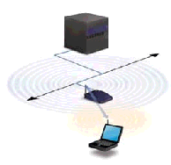

Architecture: Figure 1
Ad Hoc
Infrastructured

Slide 10
Architecture: Components (cont.)
ESS (Extended Service Set)
  A set of infrastructure BSSs to extend mobility range.
  APs communicate among themselves to forward traffic from one BSS to another, via DS.
DS (Distribution System)
  The abstract medium for APs in different BSSs to communicate.
  Can be wired, wireless network, or even not a network.
Portal
  Used to integrate with other kind of IEEE 802 LANs.
  A logical point, at which traffic enter from other LANs into 802.11 DS.

Slide 11
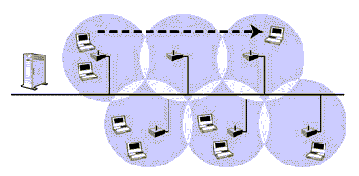
Architecture: Figure 2
ESS and roaming

Slide 12
MAC sublayer
Provides a reliable delivery mechanism for user data over noisy, unreliable wireless medium.
Other advanced LAN services, equal to or beyond those of existing wired LANs.

Slide 13
MAC functions
1. Reliable data delivery services.
  By: a frame exchange protocol.
2. Fair access control to the shared wireless medium.
  By: two mechanisms, DCF & PCF.
3. To protect data it delivers.
  By: privacy service.

Slide 14
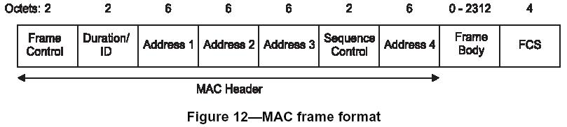
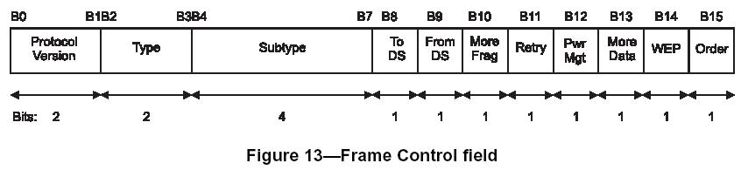
MAC frame format

Slide 15
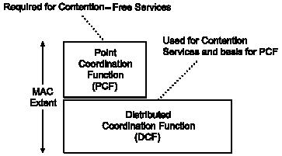
MAC architecture
DCF: basic, distributed, best effort.
PCF: optional, centralized, connect-oriented.
PCF are provided through the services of DCF.
DCF and PCF coexist and alternate; PCF logically sits on top of DCF.

Slide 16
DCF
Distributed Coordination Function
Use CSMA/CD and a random backoff time folowing a busy medium condition.
RTS/CTS, data, ACK

Slide 17
DCF: Carrier-sense Mechanism
To determine the state of the medium, physically and virtually.
Physically: by PHY
Virtually: by MAC, network allocation vector (NAV) mechanism.
  Duration/ID fields of the RTS/CTS and the frame: the time that the medium is (to be) reserved to transmit the frame and the following ACK.
  STAs adjust their NAVs according to these Duration/ID field.
The channel is marked busy if either the physical or virtual carry sensing indicates busy.

Slide 18
DCF: Interframe Space (IFS)
IFS: the timing intervals between frames.
4 different IFS, increasing order:
  SIFS (Short Interframe Space)
    Slot_time: slightly longer than SIFS
  PIFS (PCF interframe space) = SIFS + slot_time
  DIFS (DCF interrame space) = SIFS + 2 * slot_time
  EIFS: much longer than others
Independent of STA bit rate; fixed for a specific PHY.

Slide 19
DCF: Random Backoff Time
When to backoff?
  If the medium is busy, the STA will defer its transmission until the medium remains idle for DIFS (if the last frame is received correctly) or EIFS (if the last frame is not received correctly).
  After this defer, the STA generates a random backoff period for an additional deferral time before transmitting.
  If the Backoff Timer already contains a nonzero value, the selection of a random number is not needed.

Slide 20
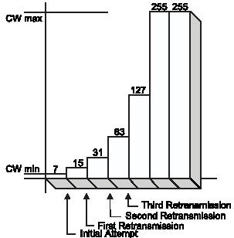
DCF: Random Backoff Time (cont.)
Backoff time = rand() * slot_time
Rand(): uniform distributed random integer in [0, CW].
CW (contention window)
  In [aCWMin, aCWMax]; both bounds are PHY-specific.
  Initially set to aCWMin
  “Almost double” (next 2^{i}-1) for every unsuccessful attempt to transmit
  Once reaching aCWMax, remains at this value until being reset
  Reset to aCWMin after every successful attempt to transmit.

Slide 21
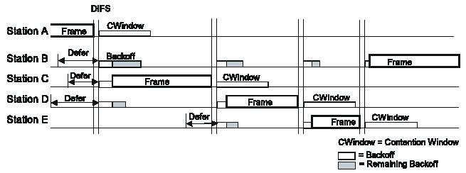
DCF: Backoff Procedure
STA sets its Backoff Timer to a random backoff time. Backoff slots follows DIFS/EIFS idle period.
During each backoff slot, STA uses carrier-sense to check whether there is an activity.
NO: decrement the Backoff Timer by slot_time.
YES: Backoff Timer doesn’t decrement. Backoff procedure is suspended, until another DIFS/EIFS idle period.
Transmit whenever Backoff Timer reach zero.

Slide 22
DCF: MAC frame exchange
RTS, CTS, data, ACK
RTS/ CTS: notify other nodes about the upcoming frame transmission.
ACK (positive acknowledegment): allow the source of the frame to determine when the frame has been successfully received by the destination.
Retransmission: scheduled by the sender if no ACK is received.
dot11RTSThreshold
  If frame length > dot11RTSThreshold, RTS/CTS is used.
  Otherwise, RTS/CTS is not used
Counters and timers: associated with every frame MAC attempts to transmit. Determines when to stop the retransmission of this frame.
  Short/long retry counters
  Lifetime timer
The time interval of SIFS is used.

Slide 23
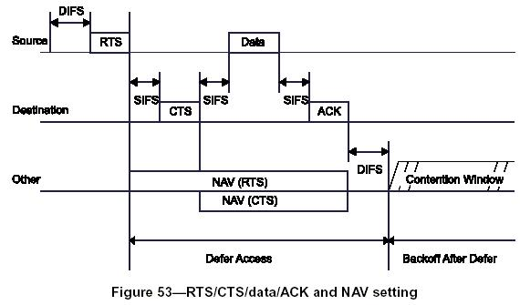
DCF: MAC frame exchange (cont.)

Slide 24
PCF
Point Coordination Function
Provides contention-free frame transfer
PC (Point coordinator)
  performs polling
  Performed by AP within each BSS
CF-aware station
  capable of operating in CFP
CFP (Contention-free period)
CP (Contention period)

Slide 25
PCF in general
Idea:
  STAs request that the PC register them on a polling list
  The PC regularly polls the STAs for traffic while also delivering traffic to them.
CFP and CP alteration.
  CFP: access to the medium is controlled by the PC
  CP: DCF rules operate; STAs (including PC) compete for access to the medium.

Slide 26
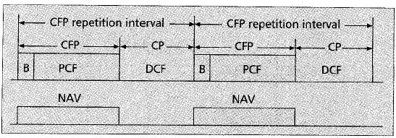
PCF: CFP/CP Alternation
CFP repetition interval (CFP_Rate)
CFP_Max_Duration
  Min: time of 2 max MPDUs
  Max: CFP_Rate – time of max MPDU

Slide 27
How CFP begins
CFP begins when PC gains access to the medium in the normal procedure and transmits a Beacon frame.
The beginning of CFP may be delayed from its nominal start time, since PC must compete for the medium.
Beacon frame: include the NAV time; also sent periodically during the CFP.

Slide 28
During the CFP
PC transmits the Beacon frame periodically
PC delivers traffic to STAs in its BSS
PC polls STAs that have requested CF services with CF-poll.
  If the STA polled has traffic to send, it transmits one frame for each CF-poll it receives;
  Otherwise, the STA doesn’t response to the poll. (Or transmits a Null Function (no data) frame back to PC.)?

Slide 29
During the CFP (cont.)
Traffic in CFP
  Frames sent from PC to STAs
    followed by returning ACKs
  CF-polls
ACKs and CF-polls can be piggybacked onto data frames.
  PC→STA: frame + CF-poll
  STA→PC: frame + ACK to previous frame
  PC→STA₁: frame + CF-poll to STA₁ + ACK to a frame received from STA₂

Slide 30
Preventing STAs accessing medium independently
Primary mechanism: NAV
  The first Beacon contains information about the maximum expected length of the CFP
  Every STA receiving this Beacon enter this length into its NAV
Backup mechanism: PIFS, for STAs that haven’t received the Beacon
  PC ensures the interval between frames on the medium <= PIFS.
    in DCF, idle period is DIFS = PIFS + slot_time
  PC sends a frame and expects the response for at most SIFS.
  If no response in SIFS, PC sends next frame before a PIFS expires after the previous transmission.

Slide 31
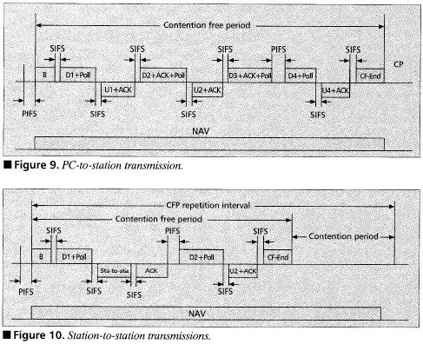
CFP transmission example

Slide 32
How to end a CFP
PC transmits a CF-end frame to announce the end of CFP. (Also can be piggybacked.)
STAs receiving CF-end reset theirs NAVs and then are able to begin the DCF operations.

Slide 33
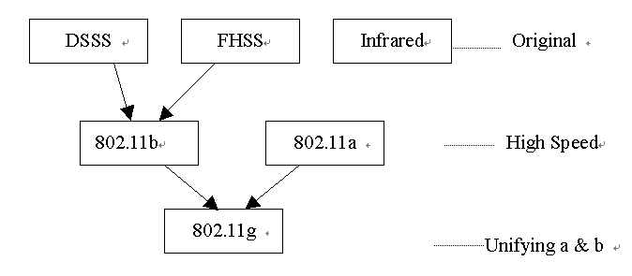
Physical Layer
Interface between MAC and physical media
Evoluation

Slide 34
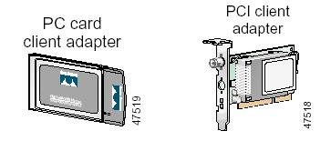
Typical Products:
CISCO Aironet Wireless Adaptor

Slide 35
References
[1] ANSI/IEEE Std 802.11, 1999 Edition
[2] B. Crow, etc: IEEE 802.11 Wireless Local Area Networks. IEEE Communications Magazine, Sep 1997
[3] Bob O’Hara; AI Petrick: IEEE 802.11 Handbook, A Designer’s Companion. Standards Information Network IEEE Press. 1999

