Slide 1
Performance Issues & Improvement on 802.11 MAC
Performance issues
  backoff mechanisms not efficient
  slow hosts degrade fast hosts
  more …
Improvements
  New MAC protocols
  An overlay approach
  more …

Slide 2
Performance Anomaly of 802.11
Martin Heusse, Frank Rousseau, Gilles-Berger Sabbatel, Andrzej Duda
LSR-IMAG Laboratory
Grenoble, France

Slide 3
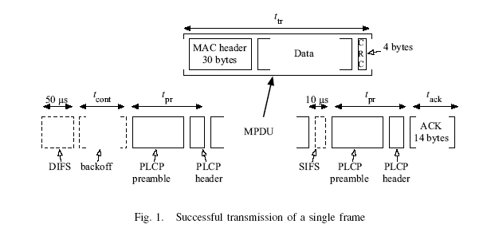
Performance of DCF

Slide 4



Performance of DCF
Overall Transmission time (T) :
Constant Overhead (t_{ov}) :
Proportion of useful throughput (p):

Slide 5


Performance of DCF
Taking into account collisions and exponential backoff,
Overall Transmission Time, T(N), becomes :
Time spent in contention t_{cont}(N) :

Slide 6


Performance of DCF
Assuming that multiple successive collisions are negligible,
Proportion of collisions (P_{c}(N)) experienced for each packet acknowledged successfully :
Proportion (p) of useful throughput obtained by a host:

Slide 7


Performance Anomaly of 802.11b
Fast Host:
Slow Host:
R : transmission rate of ‘fast’ host (11Mbps)
r : transmission rate of ‘slow’ host (5.5, 2 or 1 Mbps)
t^{R}_{ov} : overhead time of ‘fast’ host
t^{r}_{ov :} overhead time of ‘slow’ host

Slide 8



Performance Anomaly of 802.11b
Channel utilization by a ‘fast’ host (U_{f}) :
Average time spent in collisions, t_{jam}, is
Now, the throughput at the MAC layer of each of the (N-1) ‘fast’ hosts is given by,

Slide 9


Performance Anomaly of 802.11b
Similarly for a ‘slow’ host :
and,

Slide 10

Performance Anomaly of 802.11b
Result :
Fast hosts transmitting at a higher rate R obtain the same throughput as slow hosts transmitting at a lower rate r.
i.e.

Slide 11
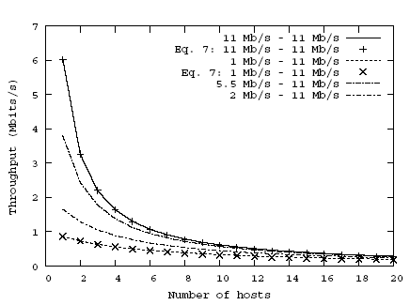
Simulation Studies

Slide 12
Performance Measurements
4 notebooks – Marie, Milos, Kea, and Bali
Linux RedHat 7.3 (kernel 2.4.18)
802.11 cards based on Lucent Orinoco and Compaq WL 110
Lucent Access Point
Wvlan driver for the wireless card

Slide 13
Performance Measurements
Tools used
  netperf – generates TCP and UDP traffic to a target host running netserver.
  tcpperf – generates TCP traffic.
  udpperf – generates UDP traffic.
Metric: average throughput at each second

Slide 14
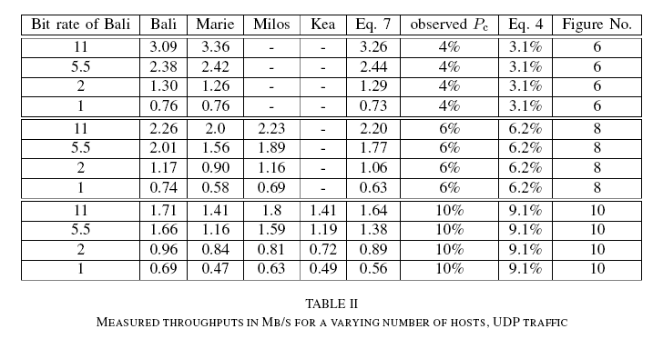
Performance Measurements
Hosts with different rates, no mobility, UDP traffic

Slide 15
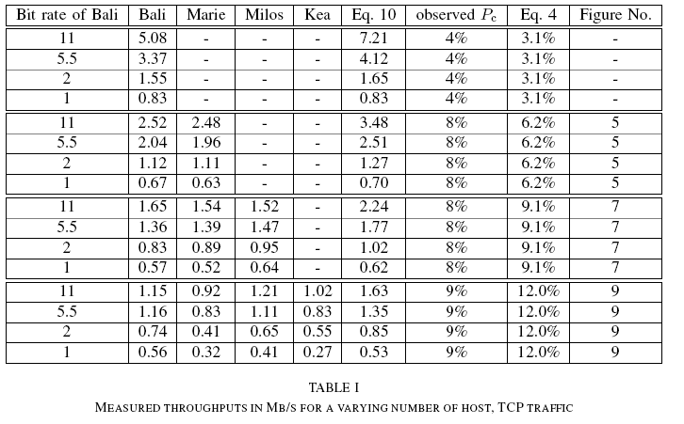
Performance Measurements
Hosts with different rates, no mobility, TCP traffic

Slide 16
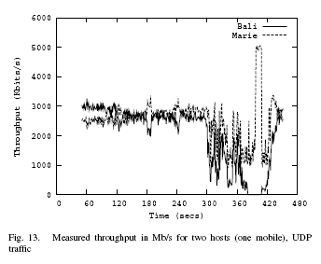
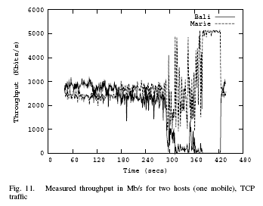
Performance Measurements
Hosts with different rates, real mobility, UDP traffic

Slide 17
An Overlay MAC Layer for 802.11 Networks
Ananth Rao Ion Stoica
UC Berkeley
Mobisys 2005

Slide 18
Problem
802.11 provides no control over resource allocation
Default allocation policy ill-suited for multi-hop networks
  Hidden terminals
  Bad fish problem
  Forwarders get same share as others
A
B
C
D
1M
11M
A
B
C
D
E
A
B
C
D
F

Slide 19
Overlay MAC Layer (OML)
Design goals
  Efficient
  Fair or differentiated allocation
  Flexible and low cost
  Avoid modifying MAC
Solution: Overlay MAC layer (OML)
  No need to change hardware
  Directly use interfaces exposed by 802.11 cards
    Can control only when to send data to card

Slide 20
Main Idea
Use TDMA-like schedule
  Divide time into slots
  Allocate slots to nodes according to weighted fair queuing policy
  Weighted slot allocation (WSA)
    assigns a weight to each node
    in every interference region allocate slots proportion to nodes’ weights
  Benefits
    Achieve any weight allocation
    Increase predictability
    Reduce packet loss

Slide 21
Weighted Slot Allocation
Decide a winner for each slot w/o communication
Keep track of active nodes
  Include current queue length in all packets
Trick: Each node generate a random number on behalf of all nodes in the collision domain (2-hop neighborhood); the highest number wins
  H_i = H(n_i, t) ^ 1/w_i

Slide 22
What’s the slot size?
10 packets of maximum size
  Larger than clock synchronization error
  Larger than packet transmission time
  As small as possible

Slide 23
Which set of nodes to apply WSA?
Ideally node i applies WSA to all nodes that interfere with i
How to determine who interfere with me?
  Assume a node can interfere with all nodes within k-hop distance
  Only an approximation, not accurate
  How to determine interference relationship is an active research!

Slide 24

How to avoid wasting slots?
Inactivity timer
  When timer expires and nothing is sent, next highest hash value node can transmit
  Set to transmit time of 3 maximum sized packets

Slide 25
Improving OML Efficiency
Amortizing the cost of contention resolution ?
  Form groups of N slots
  Transmitter in ith slot of a group, gets to transmit in ith slot of the next group with probability p
Node join/leave takes 1/(1-p) slots to converge ?
  Modify definition of H_i to inflate node weight if it has received less than its fair share of slots

Slide 26
Evaluation Methodology
Simulation in Qualnet
Implementation in Atheros Madwifi driver + Click router

Slide 27
Summary of Results
Overhead: OML thruput comparable to native 802.11
  Reduced contention and retransmissions
Fairness: Fairness index for OML network much higher
  A node’s share = # flows passing thru it
Limitations: Impact of mobility; Interference from native 802.11 clients

Slide 28
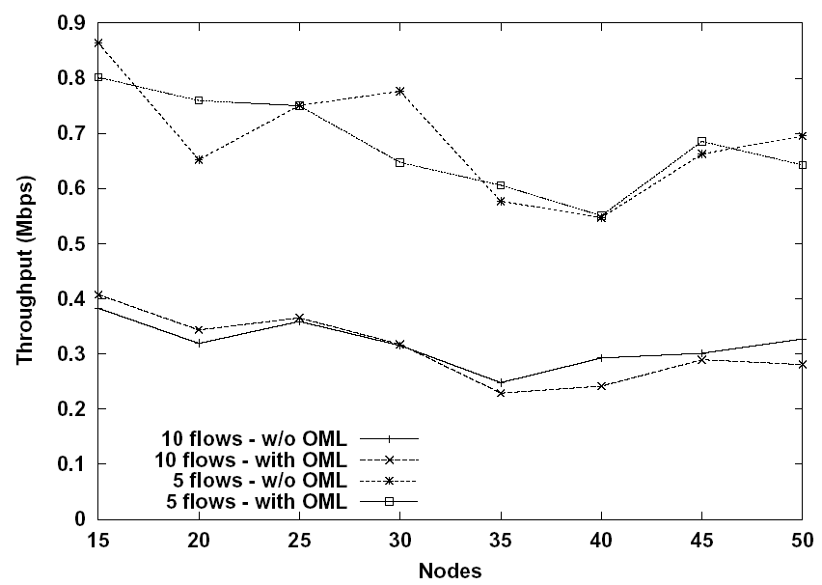
Simulation Results
Similar throughput to 802.11
Control overhead is small

Slide 29
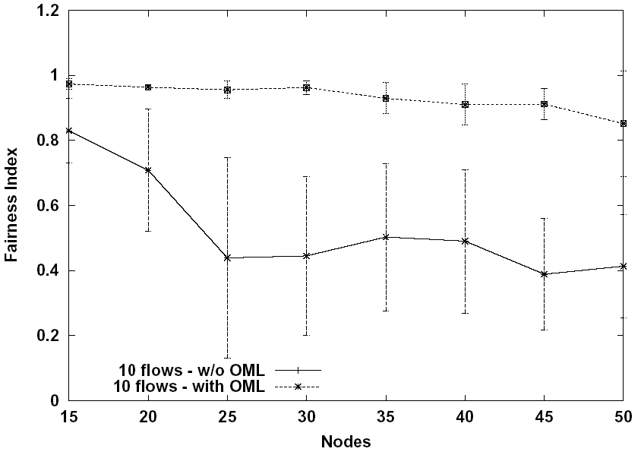
Simulation Results (Cont.)
Improved fairness over standard 802.11
Weight set to number of nodes in output queue

Slide 30
Summary
Coarse-grained scheduling on top of 802.11:
  alleviate inefficiencies of the MAC protocol in resolving contention
  overcome the lack of flexibility of assigning priorities to senders
Enables experiment with new scheduling and bandwidth management algorithms

Slide 31
Limitations
Interference from other 802.11 clients
  Face incrementally deployment issues
Impact of mobility
  Takes some time for newly joined nodes to get its proportional share
How to set weight?
How to know of weights of nodes in interference region (weights can be dynamic)?

