Slide 1

ENERGY-EFFICIENT SYSTEM-BASED ALGORITHM FOR MAXIMAL RESOURCE UTILIZATION IN CLOUD
Presented by
Swapnil kakade
Arvind singh

Slide 2
Contents
  Introduction
  Problem Statement
  Literature Review
  Motivations
  Objectives
  Methodology
  Results
  Conclusion and Future Work

Slide 3

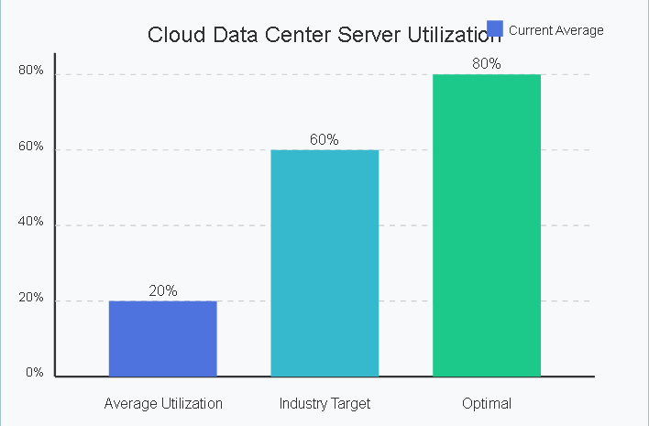
INTRODUCTION
  Cloud computing offers scalable, on-demand access to computing resources
  Massive data centers consume enormous amounts of energy
  Energy-efficient resource allocation (EE-RA) is critical for:
  Reducing operational costs
  Minimizing environmental impact
  Maximizing resource utilization
  System-based algorithms employ holistic strategies considering interplay between components

Slide 4

PROBLEMS
Resource Underutilization
  Resources often allocated based on peak demand
  Average utilization in data centers can be as low as 20%
  Idle resources still consume up to 60% of peak power
  Significant energy waste on inactive resources

Slide 5
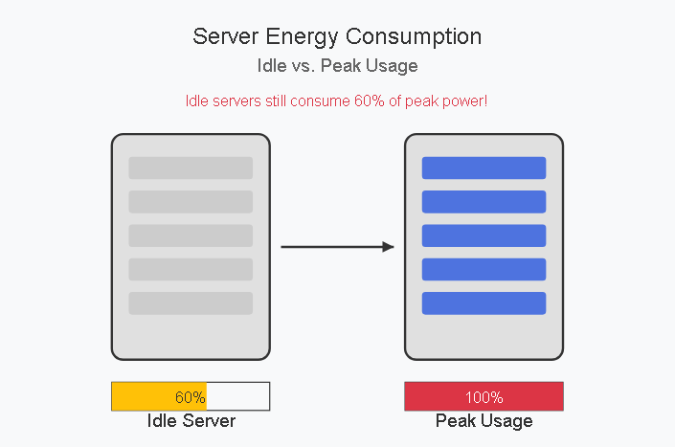
PROBLEMS
Energy Inefficiency Challenges
  Inefficient resource allocation leads to higher energy consumption
  Unbalanced workloads cause some servers to be overloaded while others remain underutilized
  Complexity of managing heterogeneous resources and diverse user demands
  Dynamic and unpredictable nature of user requests makes consistent high utilization difficult
  Service Level Agreements (SLAs) must be maintained despite optimization efforts

Slide 6
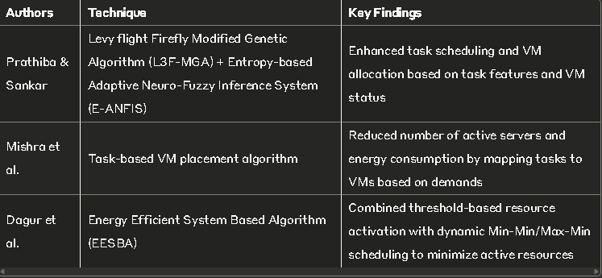
LITERATURE REVIEW

Slide 7
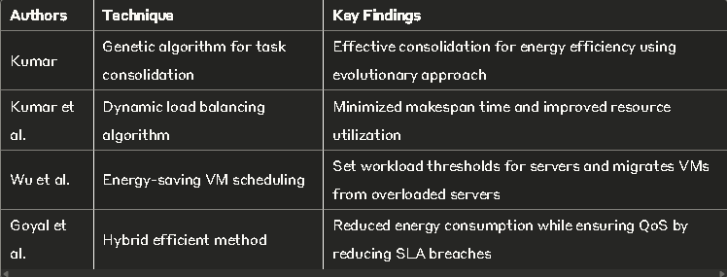
LITERATURE REVIEW

Slide 8
Objectives
  Develop energy-efficient system-based algorithms for cloud resource allocation
  Minimize energy consumption while maximizing resource utilization
  Balance energy efficiency with service quality and performance
  Integrate multiple energy-saving techniques into holistic approaches
  Address challenges of heterogeneous and dynamic cloud environments
  Provide empirical evaluation and comparative analysis of proposed solutions
  Contribute to sustainable cloud computing practices

Slide 9
METHODOLOGY: SYSTEM-BASED APPROACH
Research Objective
Develop an optimized task arrangement and energy-efficient resource allocation (EE-RA) model
Map tasks on active Virtual Machines (VMs) to:
  Reduce Processing Time (PT) of applications
  Maximize average utilization of resources
  Minimize energy consumption
Proposed Architecture
Three-Phase Approach
Task arrangement
VM status identification
Resource Allocation (RA)
System Workflow
Input tasks enter interface → held in global queue
Task manager handles and dispatches tasks to scheduler
Task scheduler maps tasks to resources based on features
The three phases are integrated into this process flow

Slide 10
  Phase 1: Task Arrangement (L3F-MGA)
L3F-MGA Algorithm
Levy flight Firefly Modified Genetic Algorithm
Hybrid algorithm combining:
  Firefly (FF) Algorithm
  Genetic Algorithm (GA)
FF algorithm inspired by flashing behavior of fireflies
Enhanced with Levy flight instead of random walk
Uses Cauchy mutation to improve firefly attractiveness
Task Features Considered
Task Cost (Ftc) = data rate × holding time
Task Size (Fts) = total size × error probability factor
Task Speed (Ftsp) = Turn-Around Time / holding time
Task Weight (Ftw) = function of task speed and cost
Number of tasks (FN) = count of tasks
Memory (Fm) = storage locations × size of each
Bandwidth (Fbw) = number of tasks × usage weight
Disk Space (Fds) = free space + used space

Slide 11
Phase 2: VM Status Identification
Problem Addressed
Traditional servers assign tasks without checking VM adequacy
Results in:
  Tasks waiting unnecessarily
  Increased execution time
  Resource wastage
VM Status Table Approach
Recognizes current VM status (idle or running)
VMs arranged in descending order in single array
Idle VMs placed first
Sorted array divided into two groups based on resources:
  Group 1: VMs with best resources (adequate quantity)
  Group 2: Other VMs
Server checks Group 1 first, reducing resource wastage

Slide 12
Phase 3: Resource Allocation (E-ANFIS)
E-ANFIS Structure
Entropy-based Adaptive Neuro-Fuzzy Inference System
Takes task features and VM status as inputs
Five functional layers
Output layer measures sum of outputs from preceding layer
Output signifies most desirable cloud server and VM for tasks
E-ANFIS Rules
Uses first-order Sugeno-type fuzzy if-then rules
Example Rules in simple format:
  Rule 1: IF (Task has high priority) AND (VM has low load) THEN (Allocate task to this VM)
  Rule 2: IF (Task has low priority) AND (VM has medium load) THEN (Consider alternate VM)
  Rule 3: IF (Task requires high memory) AND (VM has sufficient memory) THEN (Suitable match)

Slide 13
Enhanced Performance
Uses entropy to compute firing strength
Entropy-centered firing strength improves decision making
Makes allocation decisions based on VM status and task features
Mathematical Formulation
Optimization Problem
Minimize total energy consumption for tasks
Reduce Processing Time of applications
Maximize resource utilization
Key Performance Metrics
Processing Time (PT) = completion time - start time
Average Turnaround Time (ATT) = completion time - arrival time
CPU Memory Usage (MU) = (total memory - used memory) / total memory
Throughput = (number of files × file size) / time taken
  Lower throughput values are better

Slide 14
Experimental Setup
Implementation Details
JAVA platform implementation
Hardware: Intel i5/core i7 processor, 4 GB RAM, 3.20GHZ CPU
Manually generated dataset with:
Task ID, Arrival time, Cloudlet Length, Memory requirements
Seasonal Request Data from keyword search SEO tool
Randomly generated parameters (Turn-around time, Waiting time)
Evaluation Parameters
Tasks ranging from 5000 to 9000
Comparison with conventional algorithms:
Particle Swarm Optimization (PSO)
Genetic Algorithm (GA)
ANFIS
Cauchy mutation Genetic Algorithm (CM-GA)

Slide 15
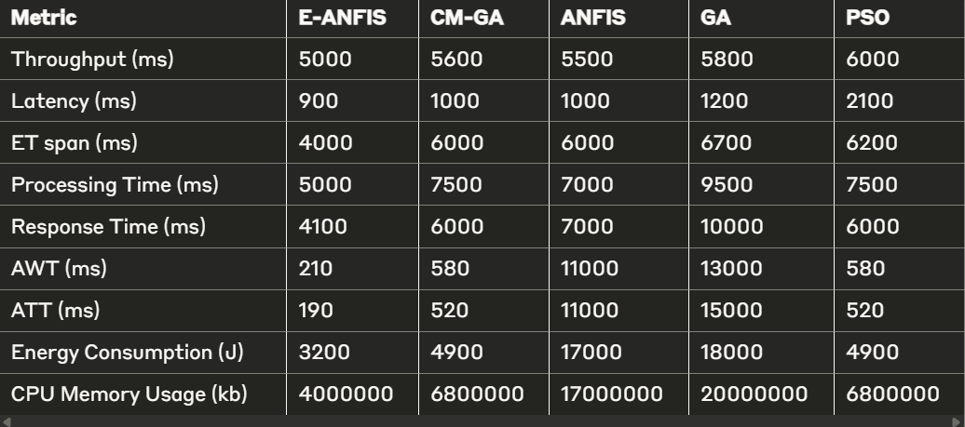
RESULTS: COMPARATIVE ANALYSIS
  Comparison with State-of-the-Art Approaches

Slide 16
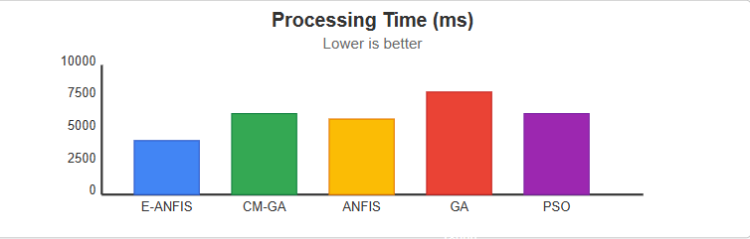

Slide 17
RESULTS: ENERGY CONSUMPTION
  Maintains consistent efficiency across varying workload intensities
  Achieves 22-30% energy savings depending on workload characteristics
  Provides greatest benefits during medium utilization periods

Slide 18
RESULTS: PERFORMANCE METRICS
  Resource Utilization
  Increased average CPU utilization from 45% to 72%
  Reduced number of active servers by 35%
  Decreased standard deviation of utilization across servers by 40%
  Service Quality
  Maintained SLA violation rate below 2.5%
  Average response time increased by only 5%
  Processing time for batch workloads reduced by 12

Slide 19
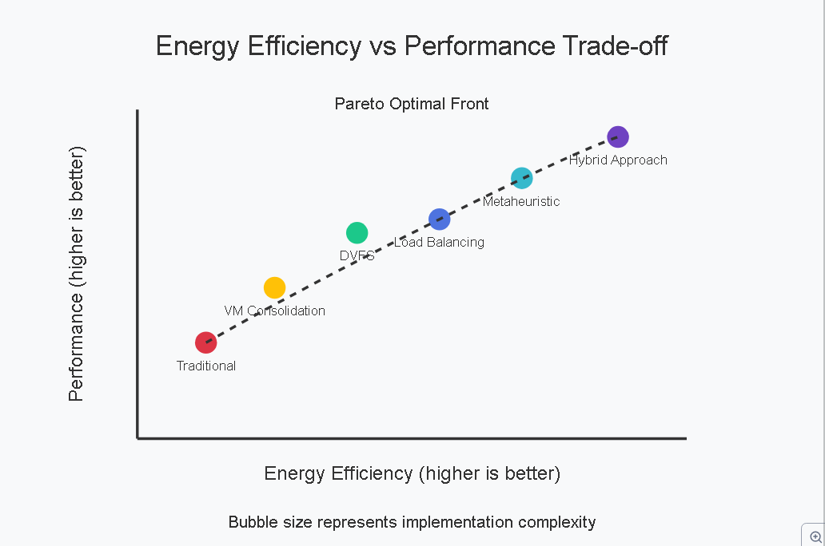

Slide 20
CONCLUSION
Successfully mapped tasks onto active VMs
Reduced overall application Processing Time
Maximized average resource utilization
Reduced Energy Consumption
Demonstrated superior performance over existing methods

Slide 21
FUTURE WORK
  Future Work
  Incorporate machine learning for workload prediction and proactive resource management
  Explore integration with renewable energy sources
  Extend approach to edge computing environments
  Implement and evaluate in real-world cloud infrastructure

Slide 22
THANK YOU

