Slide 1
Dynamic Time Warping (DTW):
Illustration

Slide 2
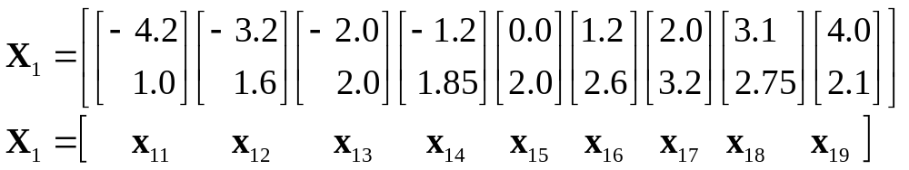
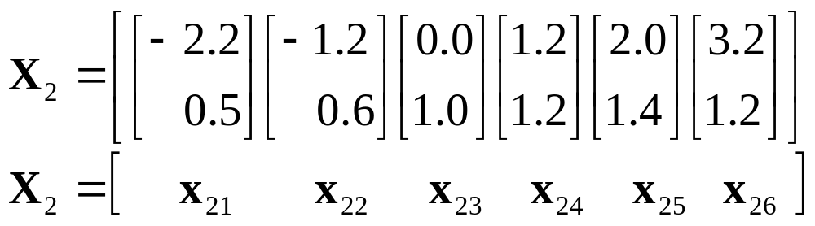
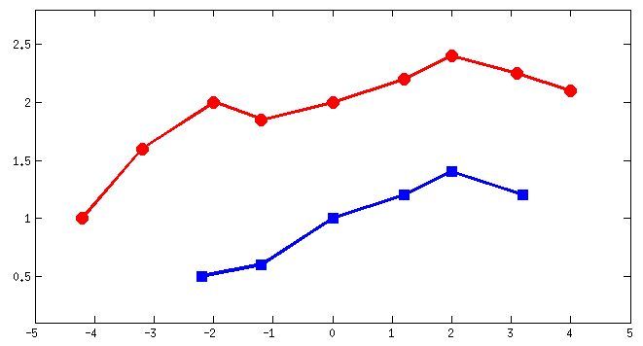
Sequence of Feature Vectors
Reference sequence
Test sequence
X₁
X₂

Slide 3
DTW: Illustration
x₁₉
x₁₈
x₁₇
x₁₆
x₁₅
x₁₄
x₁₃
x₁₂
x₁₁
x₂₁
x₂₂
x₂₃
x₂₄
x₂₅
x₂₆

Slide 4
DTW: Illustration – Euclidian Distance Between Every x_{1i} and x_{2j}
x₁₉
6.40
5.41
4.15
2.94
2.12
1.20
x₁₈
5.76
4.81
3.52
2.45
1.74
1.55
x₁₇
4.99
4.12
2.97
2.15
1.80
2.33
x₁₆
4.00
3.12
2.00
1.40
1.44
2.44
x₁₅
2.66
1.84
1.00
1.44
2.09
3.30
x₁₄
1.68
1.25
1.47
2.49
3.23
4.45
x₁₃
1.51
1.61
2.24
3.30
4.04
5.26
x₁₂
1.49
2.24
3.26
4.42
5.20
6.41
x₁₁
2.06
3.03
4.20
5.40
6.21
7.40
x₂₁
x₂₂
x₂₃
x₂₄
x₂₅
x₂₆

Slide 5
DTW: Illustration
x₁₉
6.40
5.41
4.15
2.94
2.12
1.20
x₁₈
5.76
4.81
3.52
2.45
1.74
1.55
x₁₇
4.99
4.12
2.97
2.15
1.80
2.33
x₁₆
4.00
3.12
2.00
1.40
1.44
2.44
x₁₅
2.66
1.84
1.00
1.44
2.09
3.30
x₁₄
1.68
1.25
1.47
2.49
3.23
4.45
x₁₃
1.51
1.61
2.24
3.30
4.04
5.26
x₁₂
1.49
2.24
3.26
4.42
5.20
6.41
x₁₁
2.06
3.03
4.20
5.40
6.21
7.40
x₂₁
x₂₂
x₂₃
x₂₄
x₂₅
x₂₆

Slide 6
DTW: Illustration
x₁₉
6.40
5.41
4.15
2.94
2.12
1.20
x₁₈
5.76
4.81
3.52
2.45
1.74
1.55
x₁₇
4.99
4.12
2.97
2.15
1.80
2.33
x₁₆
4.00
3.12
2.00
1.40
1.44
2.44
x₁₅
2.66
1.84
1.00
1.44
2.09
3.30
x₁₄
1.68
1.25
1.47
2.49
3.23
4.45
x₁₃
1.51
1.61
2.24
3.30
4.04
5.26
x₁₂
1.49
2.24
3.26
4.42
5.20
6.41
x₁₁
2.06
3.03
4.20
5.40
6.21
7.40
x₂₁
x₂₂
x₂₃
x₂₄
x₂₅
x₂₆

Slide 7
DTW: Illustration
x₁₉
6.40
5.41
4.15
2.94
2.12
1.20
x₁₈
5.76
4.81
3.52
2.45
1.74
1.55
x₁₇
4.99
4.12
2.97
2.15
1.80
2.33
x₁₆
4.00
3.12
2.00
1.40
1.44
2.44
x₁₅
2.66
1.84
1.00
1.44
2.09
3.30
x₁₄
1.68
1.25
1.47
2.49
3.23
4.45
x₁₃
1.51
1.61
2.24
3.30
4.04
5.26
x₁₂
1.49
2.24
3.26
4.42
5.20
6.41
x₁₁
2.06
5.09
9.29
5.40
14.69
22.09
x₂₁
x₂₂
x₂₃
x₂₄
x₂₅
x₂₆

Slide 8
DTW: Illustration
x₁₉
6.40
5.41
4.15
2.94
2.12
1.20
x₁₈
5.76
4.81
3.52
2.45
1.74
1.55
x₁₇
4.99
4.12
2.97
2.15
1.80
2.33
x₁₆
4.00
3.12
2.00
1.40
1.44
2.44
x₁₅
2.66
1.84
1.00
1.44
2.09
3.30
x₁₄
1.68
1.25
1.47
2.49
3.23
4.45
x₁₃
1.51
1.61
2.24
3.30
4.04
5.26
x₁₂
1.49
2.24
3.26
4.42
5.20
6.41
x₁₁
2.06
5.09
9.29
5.40
14.69
22.09
x₂₁
x₂₂
x₂₃
x₂₄
x₂₅
x₂₆

Slide 9
DTW: Illustration
x₁₉
30.55
5.41
4.15
2.94
2.12
1.20
x₁₈
24.15
4.81
3.52
2.45
1.74
1.55
x₁₇
18.39
4.12
2.97
2.15
1.80
2.33
x₁₆
13.40
3.12
2.00
1.40
1.44
2.44
x₁₅
9.40
1.84
1.00
1.44
2.09
3.30
x₁₄
6.74
1.25
1.47
2.49
3.23
4.45
x₁₃
5.06
1.61
2.24
3.30
4.04
5.26
x₁₂
3.55
2.24
3.26
4.42
5.20
6.41
x₁₁
2.06
5.09
9.29
5.40
14.69
22.09
x₂₁
x₂₂
x₂₃
x₂₄
x₂₅
x₂₆

Slide 10
DTW: Illustration
x₁₉
30.55
5.41
4.15
2.94
2.12
1.20
x₁₈
24.15
4.81
3.52
2.45
1.74
1.55
x₁₇
18.39
4.12
2.97
2.15
1.80
2.33
x₁₆
13.40
3.12
2.00
1.40
1.44
2.44
x₁₅
9.40
1.84
1.00
1.44
2.09
3.30
x₁₄
6.74
1.25
1.47
2.49
3.23
4.45
x₁₃
5.06
1.61
5.16
2.24
3.30
4.04
5.26
x₁₂
3.55
2.24
4.30
3.26
7.56
4.42
9.82
5.20
10.06
6.41
17.01
x₁₁
2.06
5.09
9.29
5.40
14.69
22.09
x₂₁
x₂₂
x₂₃
x₂₄
x₂₅
x₂₆

Slide 11
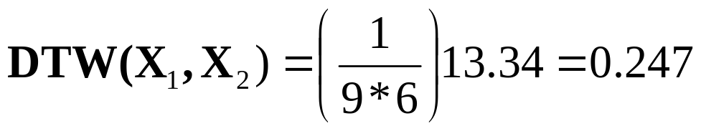
DTW: Illustration
x₁₉
30.55
25.61
19.95
16.25
14.45
13.34
13.34
x₁₈
24.15
20.20
15.80
13.31
12.33
12.14
x₁₇
18.39
15.39
12.28
10.86
10.59
11.84
x₁₆
13.40
11.27
9.31
8.71
9.51
11.95
x₁₅
9.40
8.15
7.31
8.07
10.16
13.46
x₁₄
6.74
6.31
6.63
8.76
11.99
16.44
x₁₃
5.06
1.61
5.16
6.27
9.57
13.61
15.32
x₁₂
3.55
2.24
4.30
3.26
7.56
4.42
9.82
5.20
10.06
6.41
17.01
x₁₁
2.06
5.09
9.29
5.40
14.69
22.09
x₂₁
x₂₂
x₂₃
x₂₄
x₂₅
x₂₆
Normalized DTW distance:

Slide 12
DTW: Illustration – Optimal Path
x₁₉
30.55
25.61
19.95
16.25
14.45
13.34
13.34
24.15
20.20
15.80
13.31
12.33
12.14
x₁₈
12.14
x₁₇
18.39
15.39
12.28
10.86
10.59
10.59
11.84
X₁
13.40
11.27
9.31
8.71
x₁₆
8.71
9.51
11.95
x₁₅
9.40
8.15
7.31
7.31
8.07
10.16
13.46
X₂
6.74
6.31
x₁₄
6.31
6.63
8.76
11.99
16.44
x₁₃
5.06
5.06
1.61
5.16
6.27
9.57
13.61
15.32
x₁₂
3.55
3.55
2.24
4.30
3.26
7.56
4.42
9.82
5.20
10.06
6.41
17.01
x₁₁
2.06
2.06
5.09
9.29
5.40
14.69
22.09
x₂₁
x₂₂
x₂₃
x₂₄
x₂₅
x₂₆

