Slide 1

Project report on Movies dataset
by Swapnil Mali

Slide 2
Introduction
Analysis is done for the movies released in between 2006-2016. This data includes which genre has performed well, who have earned more profits, relationship between ratings and metascore.
We can further analyze which director has given movies with good rating always, which actors have been a part of movies which have done well at box office.

Slide 3
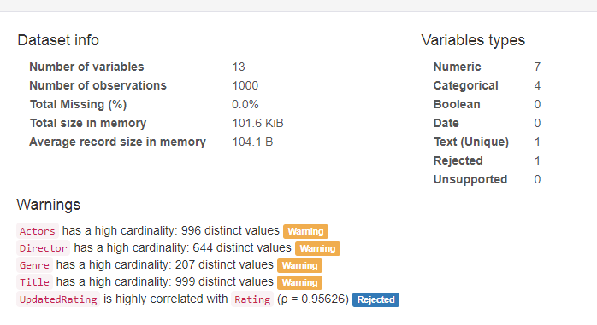
Data information
Dataset is having 128 missing values for Revenues field and 64 missing values for Metascore

Slide 4
Problem statement
To analyze what are the important factors which are responsible for any movie to perform better on box office.

Slide 5
Activities performed on data
Data cleaning
Dataset is having 128 missing values for Revenues field and 64 missing values for Metascore
Remove missing values
Replace mean/median for the missing values
Analyze the patterns between the data

Slide 6
Movie with highest Income, votes and Rating
Movie with Highest gross income:
Star Wars: Episode VII - The Force Awakens is having highest earning movie released between years 2006-2016
Highest Rating:
The Dark Knight is having highest rating for movies released between years 2006-2016
The Dark Knight also the movie which received highest number of votes from public.

Slide 7
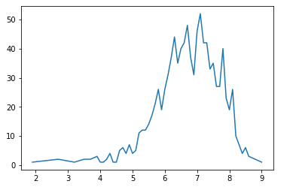
Performance based on Ratings
As can be seen from graph, most of the movies has got rating > 5.5. This means people have liked most of the movies.

Slide 8
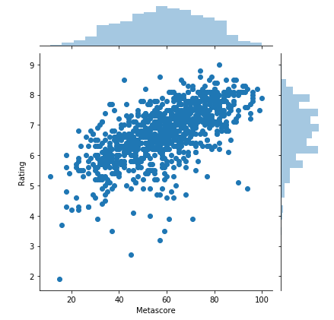
Relation between public rating and Metascore
As can be seen in plot, Rating received for movie goes positively with the Metascore this means most of the times ratings received by critics and received by users are same.

Slide 9
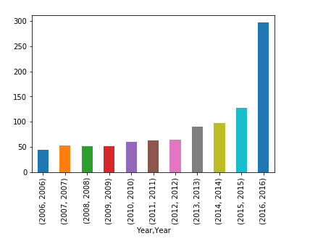
How many movies released each year?
More number of movies are getting releases every year compared to previous year. Alone 2016 holds 30% of the movies releases in last 10 years.

Slide 10
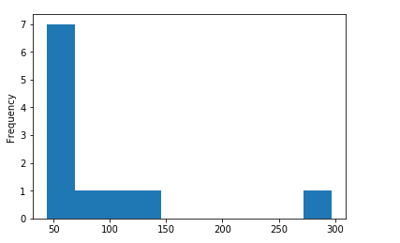
How many movies released each year?
It has happened 7 times that only 50 movies are releases in a year, while only once 100, 150 and 300 movies are released in a year.

Slide 11
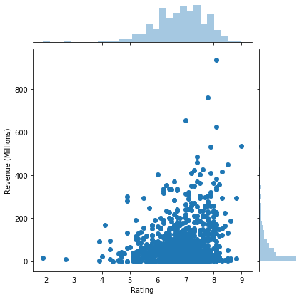
Are ratings and earned revenues align?
There are many films which has good Rating but they have earned revenues around < 200 mln. Movies who have rating =8 have earned more revenues than movies having rating 9

Slide 12
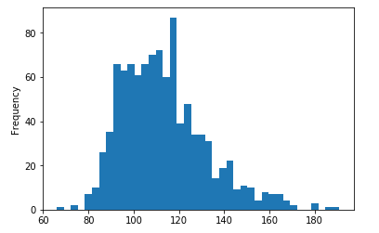
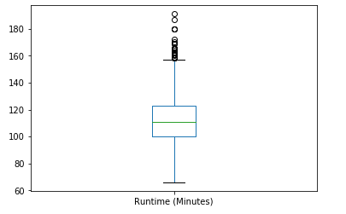
Runtime comparison for the released movies?
Most of the movies had a runtime of > 90 mins and < 130 mins. Some movies were of only 60 mins while few with > 180 mins.

Slide 13
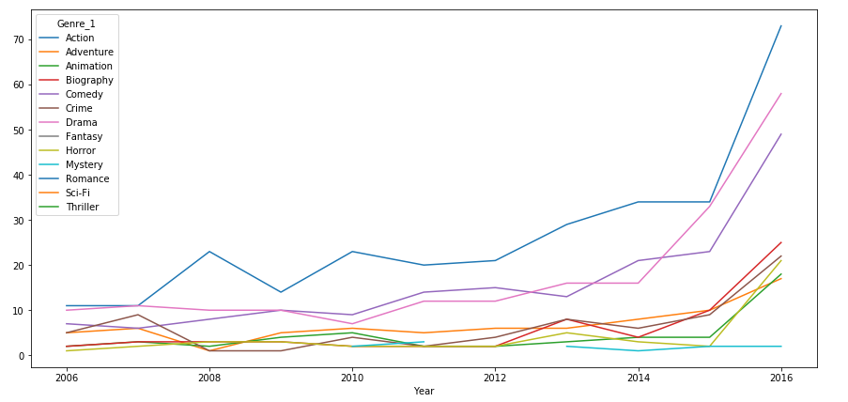
How many movies released each year with same Genre?
From the data of last 10 years, it can be concluded that more action movies are released each year followed by Drama and Comedy while Mystery, Horror genre are having least number of movies released during the same period.

Slide 14
Conclusion
More movies are getting released each year compared to previous year.
> 70% movies have received good ratings which means most of the time movies have perform better.
Action movies have received highest rating where as horror/mystery movies are worst performer.

