Slide 1
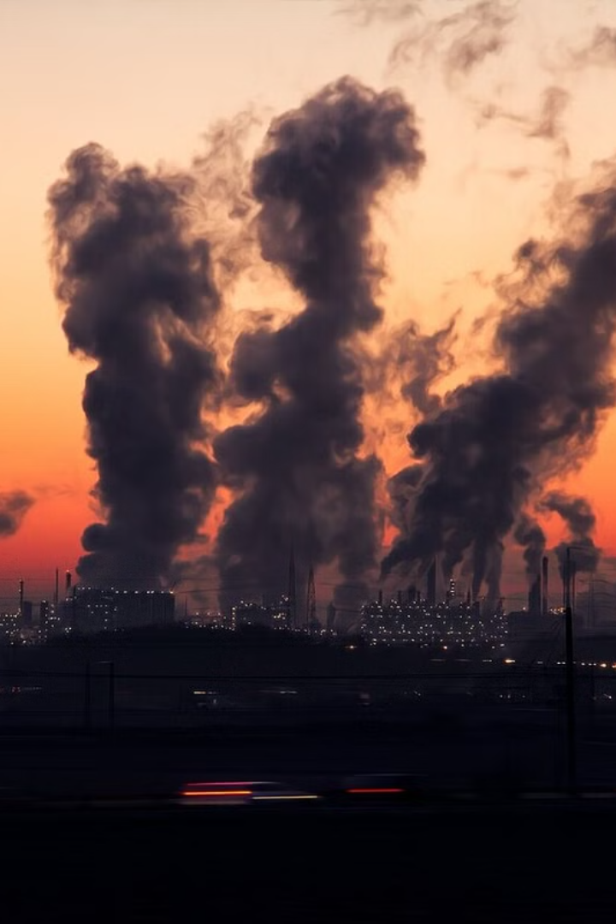
MECE Framework For Air Pollution Analysis And Mitigation In The US (2000 – 2022)
The MECE (Mutually Exclusive, Collectively Exhaustive) framework provides a comprehensive approach to understand and mitigate air pollution in the United States. By analyzing various aspects of pollution, this framework aims to provide a deep understanding of the issue and guide effective interventions.
by Aditya Swarnakar
Aa

Slide 2
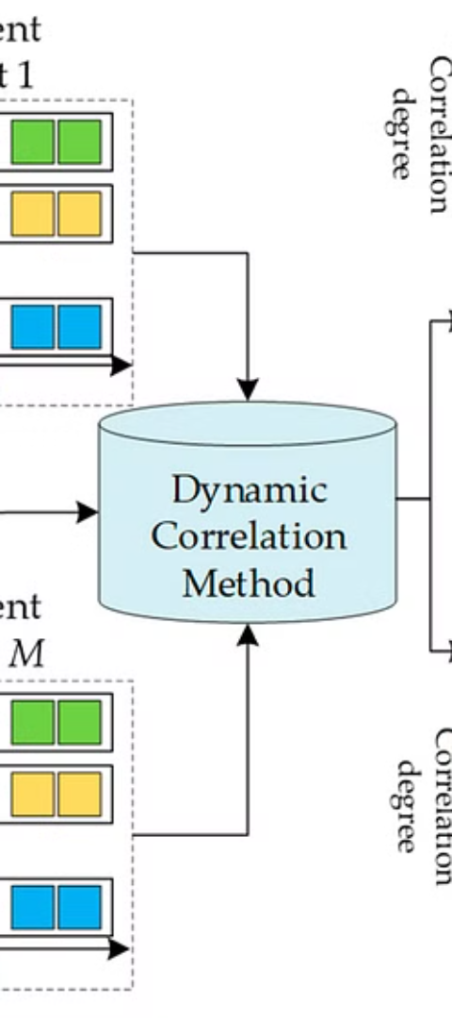
1.Temporal and Longitudinal Analysis
1
Yearly Trends
Examining changes in pollutant levels over the years 2000-2022 allows for identifying long-term patterns and trends.
2
Seasonal And Monthly Variations
Analyzing differences in pollution levels across seasons provides insights into seasonal trends and the impact of weather on air quality.
3
Daily Fluctuations
Conducting an in-depth analysis of daily data helps to identify peak pollution hours and understand daily variations.

Slide 3
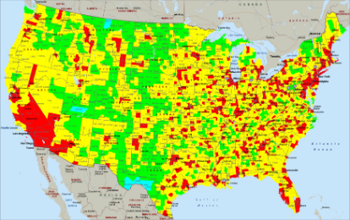
2. Spatial Analysis
National Overview
State-Specific Analysis: Pollution Trends by State
Urban vs. Rural
Evaluating general air quality trends across the United States provides a broader understanding of geographic patterns.
Conducting state-specific analyses helps identify pollution hotspots and areas requiring targeted interventions.
Comparing air quality in cities versus rural areas offers insights into the impact of urbanization on pollution levels.

Slide 4
3. Pollutant-Specific Analysis
2
SO2
(Sulphur Dioxide)
3
CO (Carbon Monoxide)
1
NO2
(Nitrogen Dioxide)
Conducting a detailed analysis of trends, peak times, and AQI levels of CO provides crucial information for pollution control measures.
Analyzing trends, peak times, and AQI levels of NO2 provides insights into the impact of this pollutant on air quality.
Evaluating trends, peak times, and AQI levels of SO2 helps in understanding the dynamics of this pollutant.
4
O₃ (Ozone)
Analyzing trends, peak times, and AQI levels of O₃ provides insights into the impact of this pollutant on air quality.

Slide 5
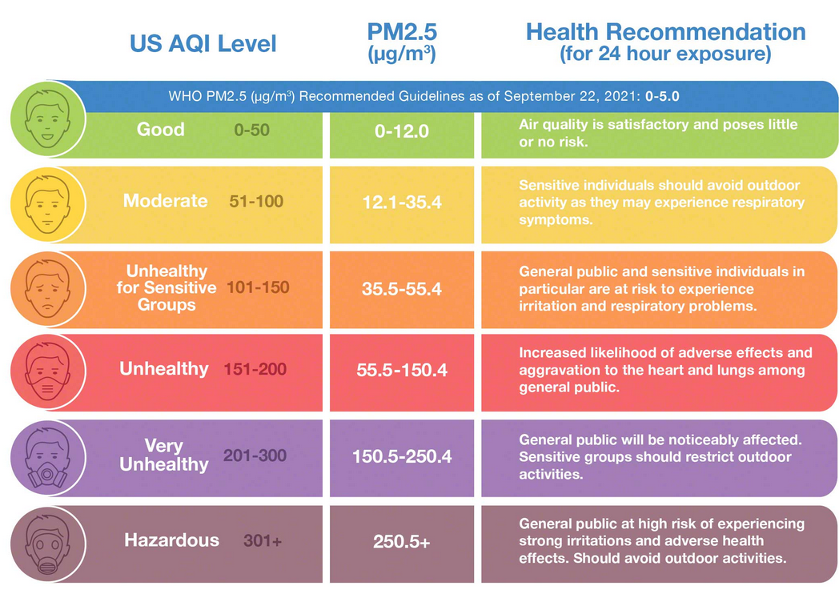
4. Air Quality Index (AQI) Analysis (1 of 2)

Slide 6
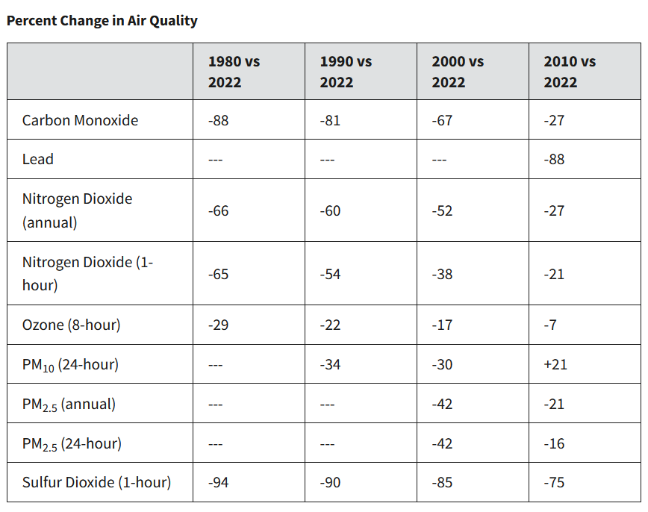
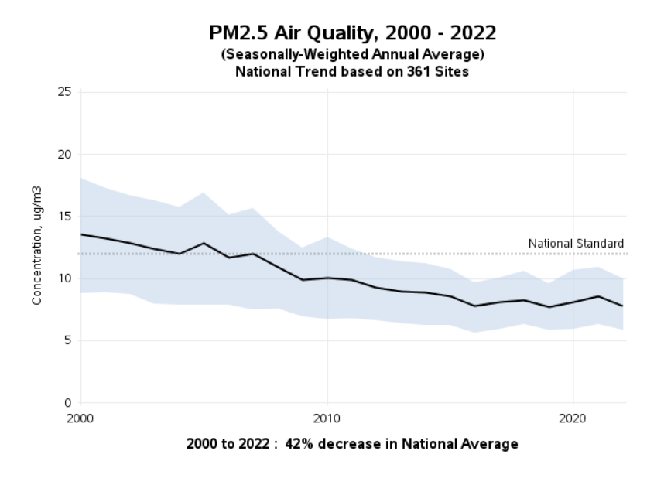
4. Air Quality Index (AQI) Analysis (2 of 2)
AQI Distribution
Evaluating the distribution of AQI levels helps in understanding the prevalence of varying air quality conditions.
AQI Trends Over Time
Tracking AQI trends over time provides insights into the effectiveness of pollution control measures.
AQI By Region
Tracking AQI by region provides insights of urbanization and various types of sources contributing to pollution

Slide 7
5. Pollution Levels Analysis
Average Daily Levels
Maximum Daily Levels with Hourly
Peaks
Analyzing average daily pollution levels gives a comprehensive view of the overall air quality situation.
Identifying the maximum daily pollution levels helps in understanding extreme pollution events and their impact.

Slide 8
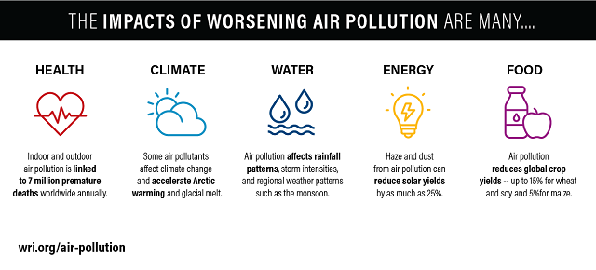
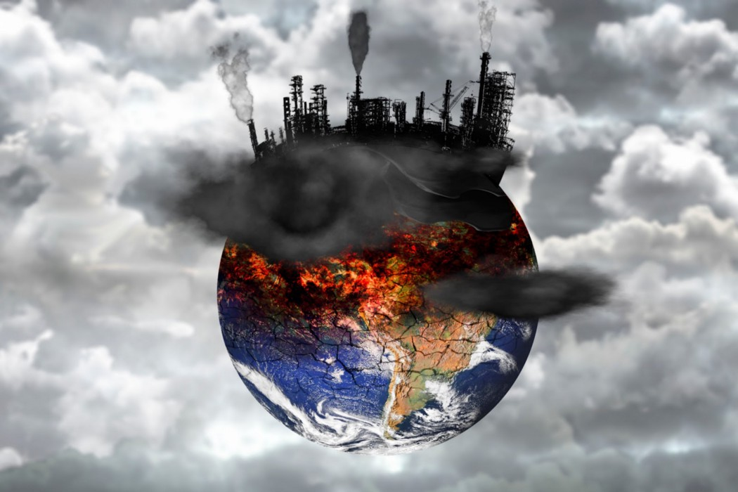
6. Health and Environmental Impact Analysis
Correlation with Health Data
Ecosystem Impact
Linking pollutant levels to health outcomes such as hospital admissions and respiratory illnesses helps in understanding the impact on public health.
Evaluating the effects of pollutants on flora and fauna provides insights into the broader environmental impact of air pollution.

Slide 9
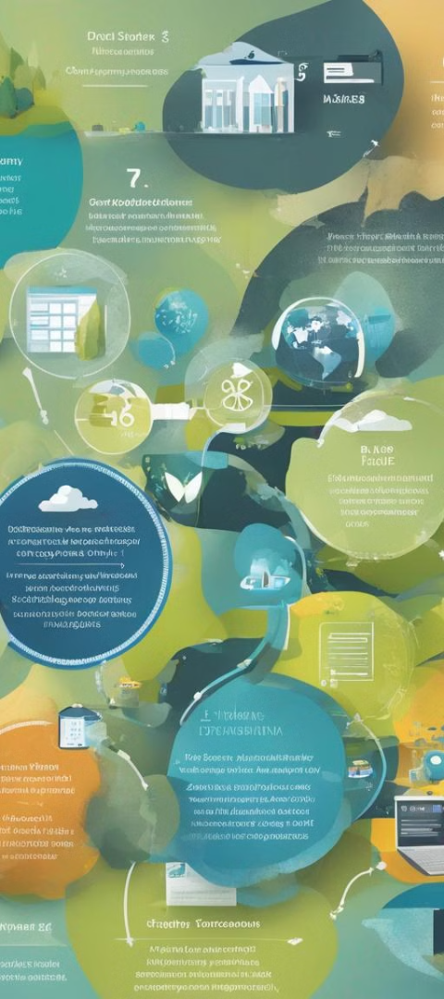
7. Policy and Regulatory Analysis
1
Pre and Post Legislation
Examining the impact of environmental policies helps in evaluating the effectiveness of regulations in reducing pollution.
2
Compliance with Standards
Analysis of data against Environmental Protection Agency (EPA) standards provides insights into areas for policy interventions and enforcement.

Slide 10
8. Urban Development and Pollution
Population Density
Industrial Activities
Evaluating the impact of population density on pollution levels provides insights into urban planning for pollution control.
Assessing the impact of industrial activities on air quality helps in targeted pollution control and regulation.
Traffic Volume
Evaluating the impact of traffic volume and type of vehicles emitting pollutant gases into air provides insights which helps in vehicular traffic movement, managing and controlling area-wise pollution in a city and pollution emission checking of different vehicles by government

Slide 11
9. Weather Conditions
Temperature and Humidity
Wind Speed
Evaluating the impact of temperature of various seasons and humidity on pollution levels provides insights into weather-related pollution dynamics.
Analyzing the influence of wind speed on pollution dispersion and accumulation helps in understanding air quality patterns.

Slide 12
10. Correlation Analysis
Relationship between Pollutants
Correlation with Weather Variables
Examining the relationship between different pollutants can help identify correlations and potential sources of pollution. This analysis can contribute to the development of targeted strategies for pollution control and regulation.
Furthermore, exploring the correlation between pollutant levels and weather variables such as temperature, humidity, and wind speed helps in understanding the intricate relationship between air pollutants and weather, and can aid in the design of effective pollution control policies.

Slide 13
11. Technical Analysis
Statistical Methods:
Use of statistical tools to
analyze the dataset
Predictive Modelling:
Forecasting future pollution levels
Identification of trends, patterns, and outliers is an essential component of technical analysis. By employing statistical methods such as regression analysis, time series analysis, and clustering techniques, we can uncover valuable insights and make data-driven decisions in pollution control and regulation.
Understanding the potential impact on air quality is crucial for effective pollution control. Predictive modeling techniques, such as machine learning algorithms and time series forecasting, can help in predicting future pollution levels based on historical data and weather variables. This information can be used to implement proactive measures and develop strategies to mitigate pollution before it becomes a significant issue.

