Slide 1


Sales Analysis
Identify the top-selling products based on sales volume and revenue. Analyze sales trends over time to identify seasonal patterns or fluctuations. Determine the most profitable product lines and prioritize them for marketing and inventory management.
by Aditya Swarnakar

Slide 2

Product Analysis
Evaluate Product Performance
Analyze Product Line Performance
Analyze sales, quantity in stock, and profitability to evaluate the performance of each product. Identify underperforming products and take necessary actions such as adjusting pricing or discontinuing them.
Understand which categories are driving sales and profitability by analyzing the performance of product lines. Use this insight to make informed decisions and optimize your product offerings.

Slide 3

Customer Analysis
Segment customers based on purchasing behavior, demographics, or geographic location to gain a deeper understanding of their needs.
Identify high-value customers and develop tailored strategies to retain and upsell them, maximizing their lifetime value.
Analyze customer preferences to personalize marketing campaigns and improve overall customer experiences, increasing loyalty and satisfaction.

Slide 4
Demographic Analysis
Understanding Customer Distribution
Targeting Specific Demographics
Evaluating Marketing Effectiveness
Analyze customer data to understand the distribution of customers across different demographics such as age, gender, and location. Gain insights into your target audience and adjust your marketing strategies accordingly.
Identify target demographics for specific products or marketing campaigns. Tailor your messaging and offers to effectively reach and engage these specific customer groups.
Evaluate the effectiveness of your marketing efforts in reaching and engaging different demographic groups. Use the insights to refine and optimize your marketing strategies for maximum impact.

Slide 5
Inventory Analysis
1
Optimize Inventory Levels
Analyze product demand and sales patterns to optimize inventory levels. Avoid stockouts and minimize carrying costs by having the right products in stock at the right time.
2
Identify Slow-Moving or Overstocked Products
Identify slow-moving or overstocked products and take appropriate actions such as offering promotions or adjusting procurement. Keep your inventory lean and ensure the profitability of your business.

Slide 6

Marketing Analysis
1
Evaluate Marketing Campaigns
Analyze the sales uplift and customer response generated by your marketing campaigns. Measure their effectiveness and make data-driven decisions to improve future campaigns.
2
Identify Successful Marketing Channels
Determine the most successful marketing channels that resonate with your target audience. Allocate your resources effectively to maximize reach and engagement.

Slide 7
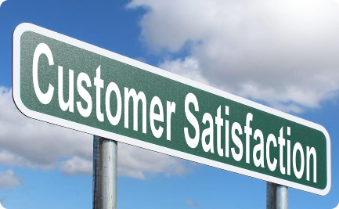


Enhancing Customer Experiences
Personalize Experiences
Improve Customer Satisfaction
Build Customer Loyalty
Use customer segmentation data to tailor marketing messages and offers to specific customer groups. Enhance personalization and provide exceptional experiences.
Deliver exceptional experiences to build long-lasting customer loyalty. Nurture relationships and create brand advocates who will continue to choose your business.
Understand customer preferences and improve overall satisfaction by incorporating feedback. Continuously refine your products and services to exceed expectations.

Slide 8
Conclusion
These actionable insights enable retail stakeholders to make data-driven decisions, optimize sales strategies, and enhance customer experiences. Stay ahead of the competition by utilizing the power of comprehensive analysis and continuously adjusting your approach based on customer needs and market trends.

