Slide 1

Enhancing “Mitron Bank” Credit Card using Data Insights
P
Presented by : Swaraj Singh

Slide 2
INTRODUCTION
Mitron Bank has been at the forefront of financial innovation, and in this presentation, we'll leverage the power of data to enhance and refine the credit card experience for both the bank and its customers.
Let's dive deep into the wealth of information at our disposal and discover how data insights can drive strategic decisions for Mitron Bank's credit card services.

Slide 3
Topics Been Covered
DEMOGRAPHIC CLASSIFICATION
SPEND INSIGHTS
TOP CUSTOMERS

Slide 4
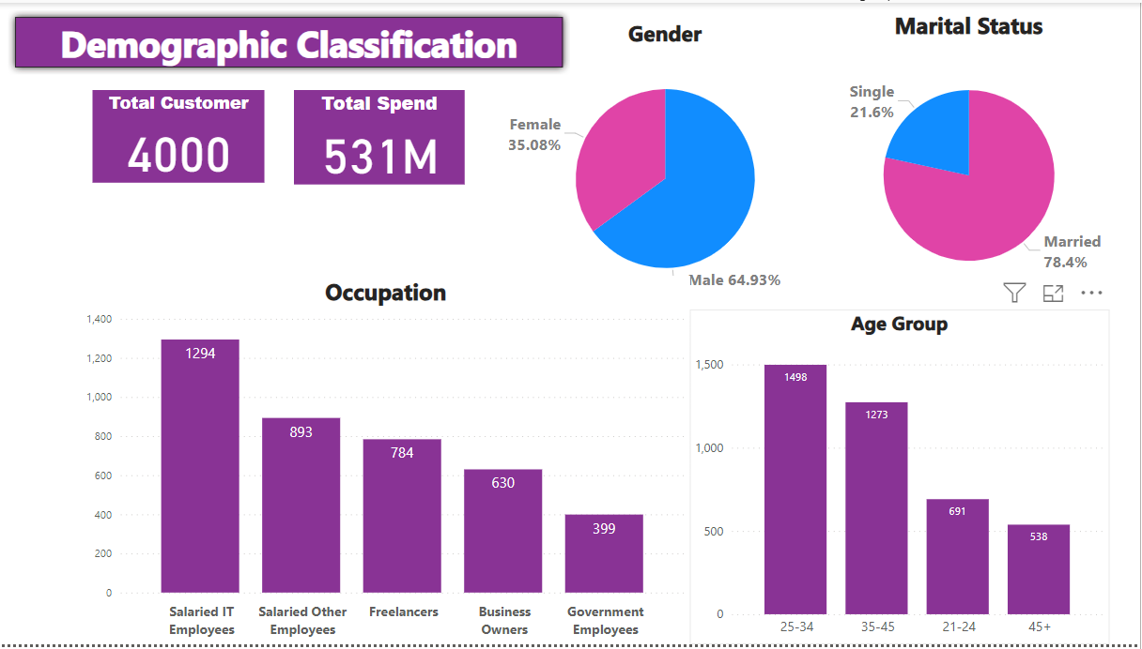
Demographic Classification

Slide 5
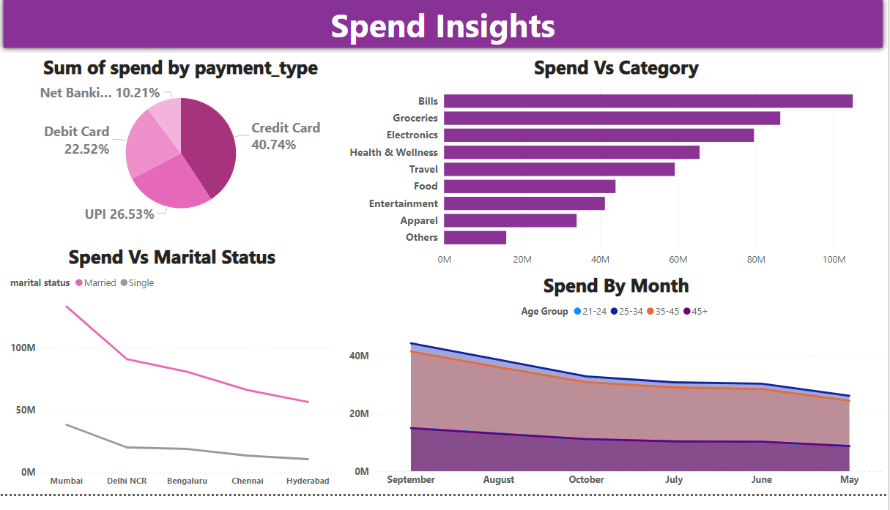
Spend Insights

Slide 6
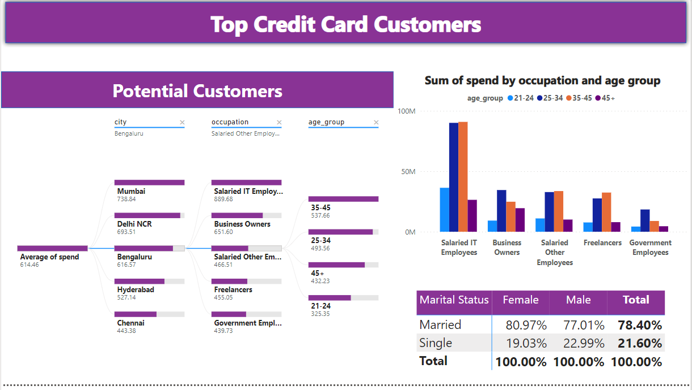
Top Credit Card Customers

Slide 7
INSIGHTS
Gender Distribution: The customer base is predominantly male, with males making up 64.93% of the total customers.
Occupation: The largest group of customers are salaried IT employees, followed by other salaried employees, freelancers, business owners, and government employees.
Payment Type: Credit Card is the most used payment method, accounting for 40.74% of total spending.
Spending Category: The highest expenditure is on Bills, followed by Groceries, Electronics, Health & Wellness, Travel, Food, Entertainment, Apparel, and Others.
Top Credit Card Customers: The cities with the highest average spend by credit card customers are Mumbai (73.8K), Delhi NCR (65.9K), Bengaluru (61.5K), Hyderabad (52.7K), and Chennai (44.3K). The majority of these customers are salaried IT employees and business owners.
Age Group: The majority of customers fall within the 25-34 age range, followed by the 35-45 age range, the 21-24 age range, and the 45+ age range. This suggests that the customer base is relatively young.
-THANK YOU

