Slide 1
Speeding Through the Lens: Unveiling the Power of Object Detection

Slide 2
Unveiling Object Detection
Road Safety is an integral part of modern roads. This is why speed limits are given for a particular road depending on the quality of the road and the how prone the road is to accidents. Speed Cameras are set up at intervals of the road in order to catch speed-limit violators. Just like any other technology, speed cameras have progressed over the years. This project will focus on making a speed camera without sensors and only with Image processing of videos

Slide 3

Problem statement
Video Aquisition
A video with good clarity and good fps (30-60) would be taken to record vehicles passing by on a road.
Object Recognition
Deep learning would be used to identify vehicles with Tensorflow using faster RCNN or Yolo. Multiple vehicles are to be detected at a time on a road segment.
Classification of vehicles into cars and trucks are also to be done

Slide 4





Real-World Applications
From autonomous vehicles to surveillance systems, object detection plays a crucial role in various industries. Its applications range from enhancing safety to optimizing logistics and retail operations.

Slide 5
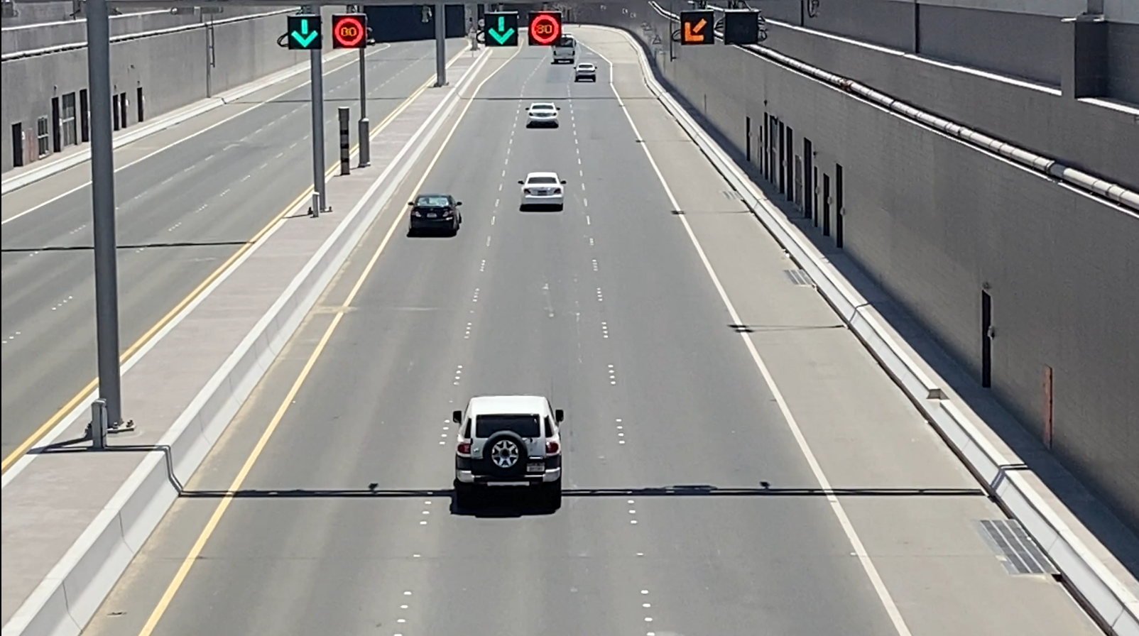
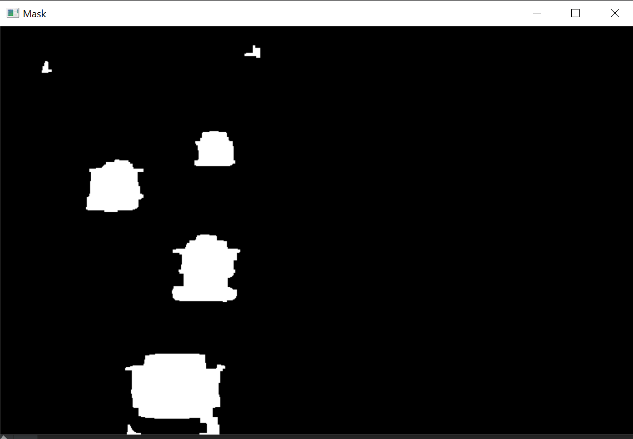
PROJECT MODEL – Object Tracking
DETECT CONTOURS
OBJECT TRACKER
ELIMINATE
BASED ON AREA

Slide 6
Challenges and Future Trends
Multiple vehicles speeds were unable to be detected
This was sorted by saving speed timers in an array format instead of an single integer format
Vehicles close together were clubbed as single object
Eroded Masked Image to better differentiate close objects
Moved detection lines further back

Slide 7


Empowering the Future
As we conclude our journey through the lens of object detection, let's embrace the potential of this technology to revolutionize industries and drive innovation. Together, we can unleash the power of object detection and shape a faster, smarter future.

