Slide 1



Team ID: I4I 249 Team Name: InnoVision Team Leader Name: Samruddhi Birajdar
University/Institute/College: Vishwakarma Institute of Technology, Pune P.S Category: Both (Software + Hardware)
P.S ID: PS-B13

Slide 2
Team Members
Team Leader: Name: Samruddhi Birajdar Department: Department of Electronics & Telecommunication Engineering Role: Hardware Lead | Team Member-2: Name: Manasvi Dhawale Department: Department of Computer Science and Engineering (Data Science) Role: ML Engineer / Data Pipeline
Team Member-3: Name: Swaraj Gaikwad Department: Department of Computer Science and Engineering (Data Science) Role: Backend + GNN Developer | Team Member-4: Name: Aditi Kulkarni Department: Department of Mechanical Engineering Role: System Integration & Testing

Slide 3
IDEA TITLE
GridSentinel - AI-Powered Rural Feeder Fault Localization with Underground Infrastructure Intelligence
The Problem: - Rural feeders span 50-100 km → almost zero mid-point sensors
- Fault location is manual → crews walk the entire line
- Result: 6-24 hour outages for a fault fixable in 30 minutes
- Root causes: conductor damage, transformer overload, vegetation contact, illegal taps, underground corrosion
What GridSentinel Does:
- Detects real-time anomalies in voltage, current & temperature
- Localizes fault to a specific section via Graph Neural Network (GNN)
- Classifies root cause (5 fault types) with confidence %
- Maps affected villages + generates GIS crew priority route
- Guides safe switching to restore partial power immediately
- Integrates consumer complaints as a crowdsource signal
- TerraShield module — detects underground tower corrosion before it causes faults
Innovation & Uniqueness:
Aspect | Existing System | GridSentinel
Data Sources | 1-2 Sensors | 6+ (sensors + weather + complaints + underground)
Fault Logic | Fixed threshold rules | Graph Neural Network (topology aware)
Underground health | Not monitored | TFR/ERT via TerraShield
Explainability | Black Box | SHAP - “Why Section 3?”
Sparse data support | Needs Dense Sensor | Works with 1 sensor + complaints
Restoration | Stops at detection | Switching guide + crew navigation

Slide 4
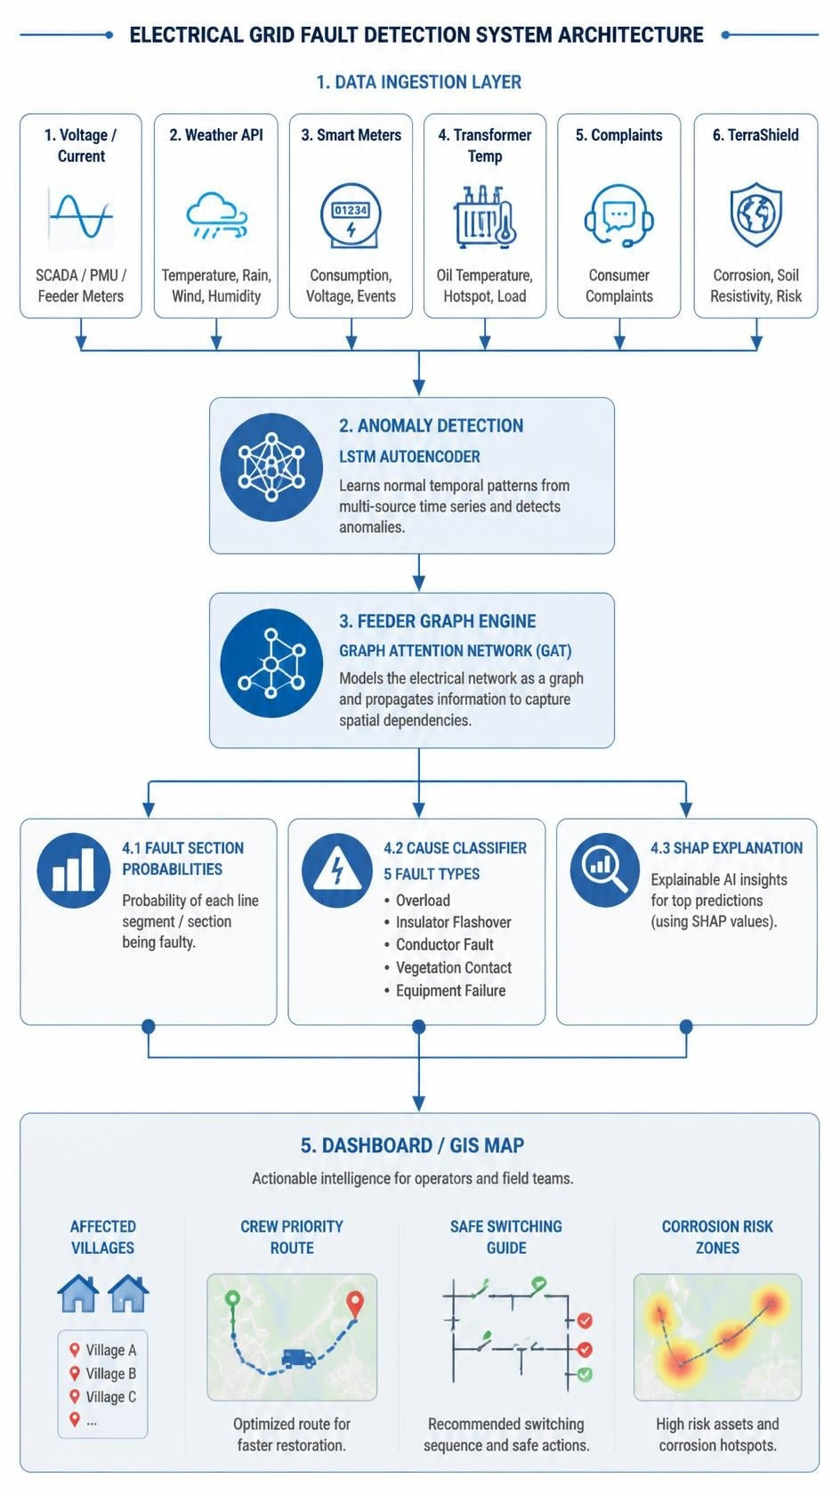






TECHNICAL APPROACH
Tech Stack:
Layer | Technology
Anomaly Detection | PyTorch – LSTM Autoencoder
Fault Localization | PyTorch Geometric – Graph Attention Network (GAT)
Cause Classification | XGBoost / LightGBM
Explainability (XAI) | SHAP
NLP (Complaints) | spaCy + multilingual sentence-transformers
Backend API | FastAPI (Python)
Database | PgSQL + TimescaleDB
GIS / Maps | Leaflet.js
Frontend | React + Vite
Power Simulation | Pandapower
Hardware (TerraShield) | Arduino Uno + AD620 + ADS1115 + 4-electrode ERT
Deployment | Docker + Docker Compose
System Flow:

Slide 5
FEASIBILITY AND VIABILITY
What makes GridSentinel Feasible:
Challenges & Mitigation:
Area | Evidence
All open-source | PyTorch, FastAPI, React, Leaflet – zero licensing cost
No real grid needed | Pandapower simulates realistic rural feeders – no real grid access needed
Hardware Ready | TerraShield prototype already built (Arduino + AD620 + ADS1115)
Free data sources | IEEE PES Test Feeders + Open-Meteo API (no key needed)
Easy deployment | Docker compose – one command, runs on a single laptop
Challenge | Risk | Mitigation
No real DISCOM sensor data | High | pandapower synthetic data + IEEE feeder benchmarks
Small feeder graph | Medium | Data augmentation: fault injection at every node variant
Multilingual complaints | Medium | MiniLM supports 50+ languages incl. Hindi
Sensor Deployment Cost | High | Phased model: 3 priority sensors per feeder (head/mid/tail)
TerraShield time-scale mismatch | Medium | TFR/ERT as slow-changing background risk score (weekly)
Live hardware demo risk | Medium | Python serial mock fallback for Arduino simulation

Slide 6
IMPACT AND BENEFITS
Social Benefits
Faster power restoration for schools, health centres, irrigation pumps
Prevents crop loss for farmers dependent on electric pump irrigation
Gives rural consumers a voice via complaint integration
Economic Benefits
Reduces crew patrol cost (currently ₹500-₹2000/km/inspection)
Addresses ₹1,500-₹4,000 crore/year rural economic loss from outages
Proactive maintenance – fewer emergency replacements
Environmental Benefits
Fewer diesel generator hours during outages (less emissions)
Extended infrastructure life via early corrosion detection
Operational Impact:
Metric | Before | After GridSentinel
Fault search time | 6-24 hours | < 1 hour
Inspection zone | 50-100 km | 3-5 km section
Data sources used | 1-2 | 6+
Outage prediction | Reactive | Predictive

Slide 7




RESEARCH AND REFERENCES
SDG Alignment:
Key References:
IEEE PES Test Feeders: https://cmte.ieee.org/pes-testfeeders/
pandapower: https://www.pandapower.org/
SHAP (NeurIPS 2017): https://arxiv.org/abs/1705.07874
Open-Meteo API: https://open-meteo.com/
MoP RDSS Scheme 2021 | CERC Smart Grid Vision 2030
SDG | How
SDG 7 – Affordable & Clean Energy | Reliable rural electricity access
SDG 9 – Innovation & Infrastructure | Smart grid AI for underserved areas
SDG 11 – Sustainable Communities | Resilient power for rural villages
SDG 13 – Climate Action | Reduces diesel backup + infrastructure waste

