Slide 1

HPE NA Storage “ PUNE “
Pune Storage Current Status and Efficiency Gain.
Status & Action
Confidential | Authorized HPE Partner Use Only

Slide 2
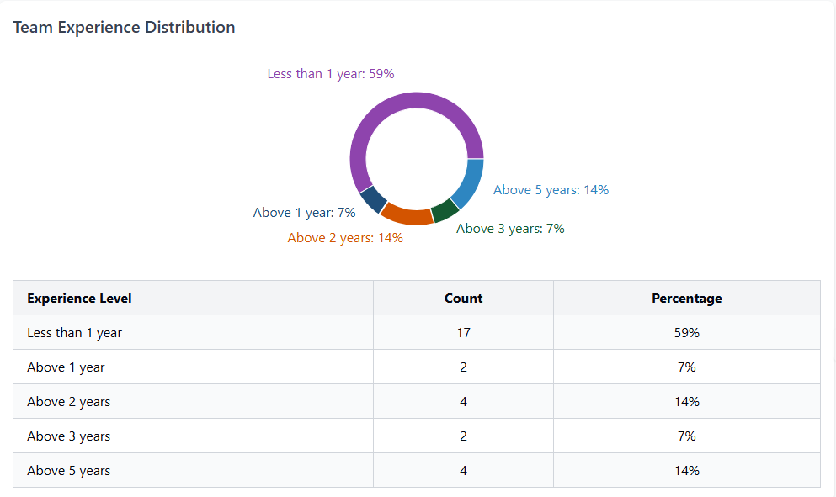
Key Insights:
Entry-level positions dominate the team structure (72%)
Experience gap: 59% have less than 1 year experience

Slide 3
Current Concern
Problem Statement
1.Gaps in Technical Expertise Current skill levels are insufficient to consistently meet customer expectations for issue resolution.
2. Narrow Case Handling Approach Interactions often focus on resolving a single instance, with limited attention to the broader process.
3. Lack of End-to-End Accountability A proactive ownership mindset for driving complete resolution is missing in most cases.
4. Inadequate Case Documentation Case notes and updates often fall short of internal quality standards.
5. Gaps in Diagnostic Questioning There is a noticeable need to improve the ability to ask the right, investigative questions during troubleshooting.

Slide 4
Actions Implemented
1. Case Reviews with Engineers and Managers Regular joint reviews to drive alignment and performance improvement.
2. Solo Case Reviews Evaluations to foster individual ownership and accountability.
3. Recorded Call Listening Audit of customer interactions to identify service quality gaps and coaching opportunities.
4. Manager & Team Lead Accountability Ownership of all Total Customer Ownership (TCO) pending cases.
5. Emphasis on First Contact Resolution Managers occasionally handle direct calls to reinforce the importance of initial customer engagement.
6. Soft Skills & Quality Training Programs planned in collaboration with Pune site teams to enhance communication and service delivery.
7. Labrat Program Hands-on "Break and Fix" exercises with weekly reviews under RTCC for technical skill-building.
8. On-Floor, Issue-Based Training Real-time training sessions tailored to specific challenges observed on the floor.

Slide 5
Report Available at : https://swaraj691.github.io/Pune-storage-stats/
Activity for Efficiency Gain | Count
Case Reviews Conducted | 105
Recorded Call Evaluations | 11
Proactive Customer Engagements (Manager-led) | 5
TCO Calls by Managers & Team Leads | 98
On-the-Floor Training Sessions | 2
Mindset/Case Documentation Training | 0 (Planned)

Slide 6
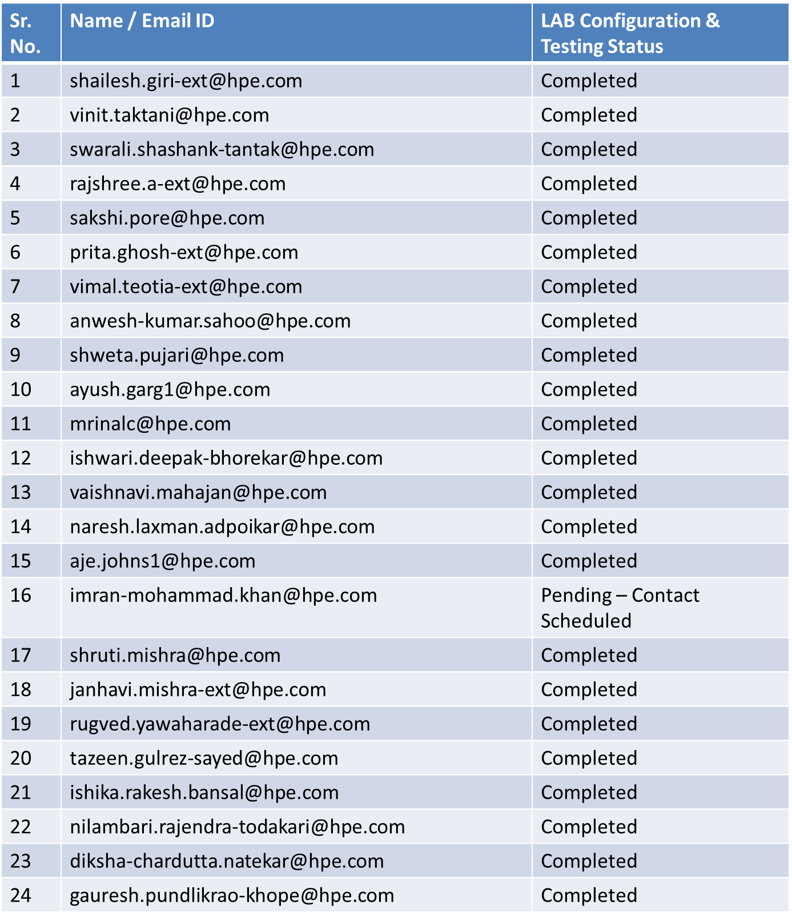
Lab Activities – Progress Overview

Slide 7

THANK YOU

Slide 8
Key Action Stats in “ April FY25
Link to access details : “ https://amitvarma6.github.io/Key-action-stats/ “
Lab-Actions so far
Count of Case Reviews : 105
Recorded Call Listening Count : 11
Proactive Manager Connect to Customer : 05
TCO Call by Manager & Team Lead : 98
On Floor Based Training : 02
Training around Mindset/Case Documentation : 00 ( Planned)

Slide 9
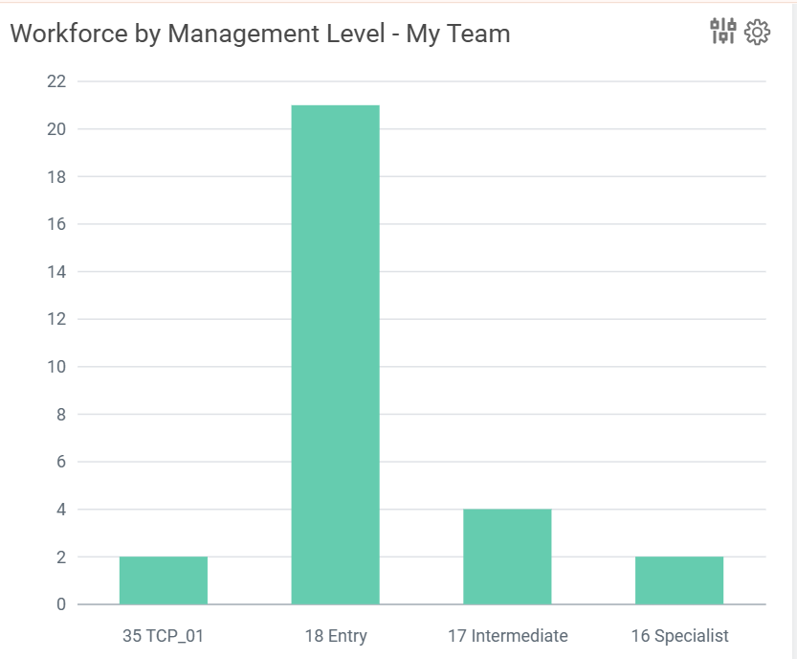
Team Stats

Slide 10




Applications and workloads need to follow the growing data everywhere
Public cloud is only part of the solution
On-prem data center
80%
~50%
60%
of organizations, hybrid and multicloud environments are a reality for modern IT¹
of applications are on-premises²
of enterprises will fund LOB and IT projects through opex budgets, matching how vendors provide their services with a focus on outcomes³
People and processes
Technologies
Data gravity
Regulatory requirements
Sources:
IDC, multiple reports
IDC, “The Evolution of Cloud Infrastructure: Multicloud to Hybrid Cloud; Shared to Dedicated”, March 2023
IDC’ FutureScape: Worldwide Future of Digital Infrastructure 2023 Predictions, October 2022

Slide 11

HPE GreenLake momentum
~$16B
>36K
1350+
600
TCV booked
customer organizations
partners
data centers in 30 countries, HPE colo partners
96%
>4.4M
3000+
customer retention rate
connected devices
integrations
Total Contract Value (TCV) represents the total value of one-time and recurring revenue for the period defined by the contract
Confidential | Authorized HPE Partner Use Only

