Slide 1
Google Play Store Data Analysis
Detailed Project Report
Swaraj Ranjan Behera 25 April 2025

Slide 2
Problem Statement
The Google Play Store hosts thousands of apps across diverse categories.
Users rely on ratings, reviews, and install counts to choose apps, but trends and insights are not always obvious.
Businesses and developers need data-backed decisions to optimize app development, marketing, and pricing.
Objectives
Analyze app performance based on key metrics: installs, reviews, ratings, and pricing.
Compare how Free vs Paid apps perform across categories.
Identify the most popular and highest-rated app genres.
Use Power BI to visualize trends and uncover hidden patterns in user engagement and app growth.
Executive Summary
Analyzed Google Play Store app data
Used Power BI for data transformation & visualization
Explored installs, ratings, reviews, app types
Built a dashboard to identify top categories & trends
Delivered key insights for data-driven decisions

Slide 3
Dataset Overview
Source: Public dataset (Kaggle)
Rows: 11,000+ app entries
Key Columns:
App, Category, Rating
Reviews, Installs, Type, Price
Last Updated, Android Version
Preprocessed to remove nulls, duplicates & outliers

Slide 4
Tools & Methodology
🛠 Tools Used:
Python
Power BI
Excel (for cleanup)
Power Query Editor
Methodology (ETL):
Import data (CSV)
Clean & transform in Power Query
Create calculated columns
Build visuals & publish dashboard

Slide 5
Data Modeling & Transformation
Removed duplicates and null values
Cleaned incorrect data types (e.g. Ratings > 5)
Extracted year from “Last Updated”
Created new columns:
Install Range (binned installs)
App Age (optional)
Simple model — flat table
Added Date Table (optional) for time analysis

Slide 6
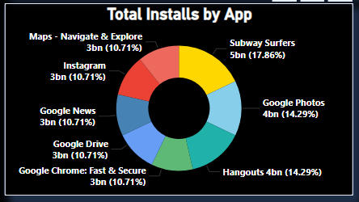
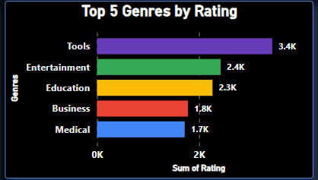
Total Installs by App vs Top 5 Genres by Rating
➔ Insight: "Subway Surfers and Google Photos are among the most installed apps."
➔ Insight: "Tools and Entertainment apps receive the highest user ratings."

Slide 7
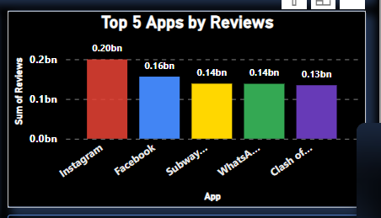
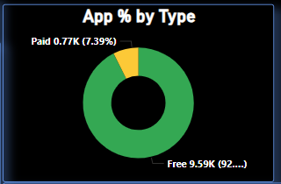
Top 5 Apps by Reviews
App % by Type
➔ Insight: "More than 90% of the apps are free on the Play Store."
➔ Insight: "Instagram and Facebook lead in total user reviews."

Slide 8
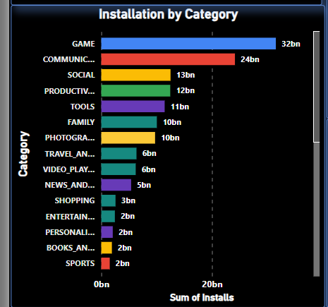
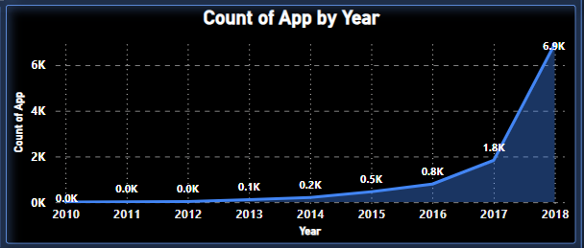
Installation by Category
➔ Insight: “Games are most Installed Category followed by Communication."
Count of Apps by Year
➔ Insight: number of apps surged rapidly after 2016."

Slide 9
🔍 Key Findings:
Most apps on Play Store are free (~92%).
Categories like Family and Games dominate app counts and installs.
Apps targeting Everyone and Teen age groups have the highest installations.
Subway Surfers and Google Photos are among the top installed apps.
Instagram and Facebook received the most user reviews.
App launches surged sharply after 2016.

Slide 10
Recommendations:
Focus app development on popular categories (e.g., Games, Family).
Consider offering free apps with in-app purchases to attract users.
Optimize apps for broader content ratings (Everyone, Teen) for wider reach.
Maintain high ratings and reviews to boost app visibility.

Slide 11
🏁 Conclusion:
Successfully analyzed Google Play Store data using Power BI.
Identified key trends in app installs, ratings, pricing, and content ratings.
Built an interactive dashboard for better business understanding and decision-making.

Slide 12
⚡ Challenges Faced:
Handling missing or inconsistent data entries (e.g., missing ratings).
Cleaning text-based data types (e.g., "Varies with device" in size/version).
Choosing the most impactful visuals for dashboard storytelling.

