Slide 1





AirFly Insights
Data Visualization and Analysis of Airline Operations
Transforming large-scale airline flight data into actionable visual insights for operational excellence
5M+
2015-2019
366
Flights Analyzed
Data Period
Airports Covered

Slide 2










Project Overview and Objectives
The AirFly Insights project aims to analyze large-scale airline flight data to uncover operational trends, delay patterns, and cancellation reasons through data visualization.
Goals and Objectives
Expected Outcomes
Understand and preprocess aviation datasets for analysis
A comprehensive visual report detailing findings
Explore trends in flight schedules, delays, cancellations, and routes
Interactive dashboards for exploring flight data
A final presentation summarizing insights and recommendations
Visualize key metrics using various chart types
Provide actionable insights for stakeholders

Slide 3


















Dataset Overview and Methodology
Dataset Source & Scope
Analysis Methodology
Source: U.S. DOT Bureau of Transportation Statistics (BTS) archive of historical US flights
Data Collection
Acquisition of flight data from BTS archive for analysis
Data Preprocessing
5M+
5,512,904
Cleaning, handling missing values, and removing duplicates
Commercial Flights (2015)
Flights (May-Dec 2019)
Feature Extraction
Creating new variables like Delay_Category, Day_of_Week, Total_Delay_Time
366
10
Airports
Airlines
Visual Analysis
Exploring trends through charts, heatmaps, and geographical maps
Key Dataset Columns:
Airline Name
Flight Number
Origin/Destination
Insights Generation
Departure/Arrival Times
Delays & Cancellations
Transforming visual findings into actionable intelligence

Slide 4


















Data Preprocessing and Feature Extraction
Data Preprocessing
Feature Extraction
Comprehensive data cleaning process to ensure data quality and reliability for analysis.
Creating new, meaningful variables from the raw dataset to enhance analytical depth.
Remove Canceled Flights
Delay_Category
Day_of_Week & Month
Canceled flights (2% of total data) were removed from the dataset to focus on actual operations.
Categorizing delays into types (minor, major)
Extracting temporal components for pattern analysis
Handle Missing Values
Total_Delay_Time
Flight Time Duration
Addressed null values and errors to ensure data integrity and reliability for analysis.
Calculating cumulative delay minutes for flights
Time difference between current and previous point
Data Transformation
Previous Flight Delay (PFD)
Converted categorical data into numerical formats to facilitate machine learning model training.
Delay of preceding flight on same path, used to predict subsequent delays and understand delay propagation

Slide 5




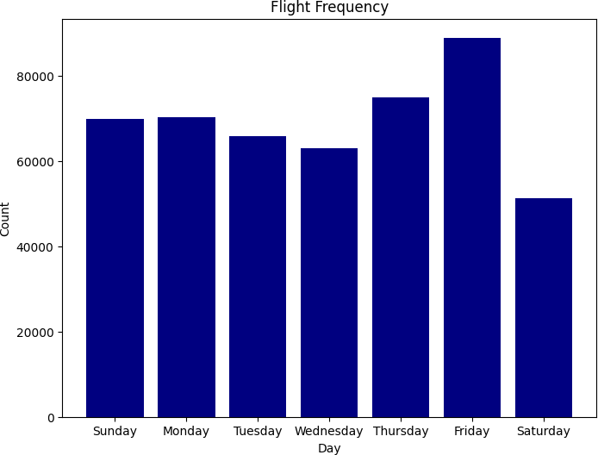
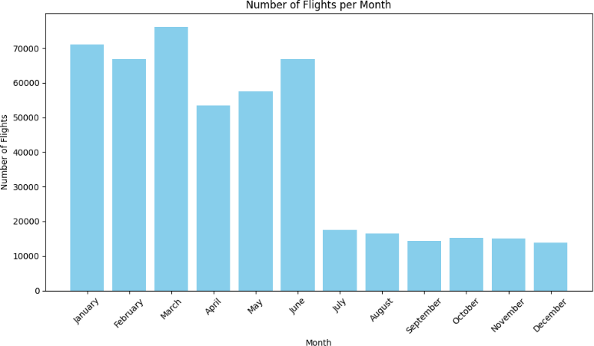




Flight Volume Analysis
Analyzing flight volume provides insights into airline activity and operational scale, revealing market share and seasonal patterns.
Seasonal Variations
Weekly Patterns
Monthly flight volumes show highest activity in July and lowest in February
Weekends, particularly Saturdays, have lower flight volumes
Key Insights
Market share visible through relative flight volumes
Larger airlines operate disproportionately
July shows highest volumes, February lowest

Slide 6





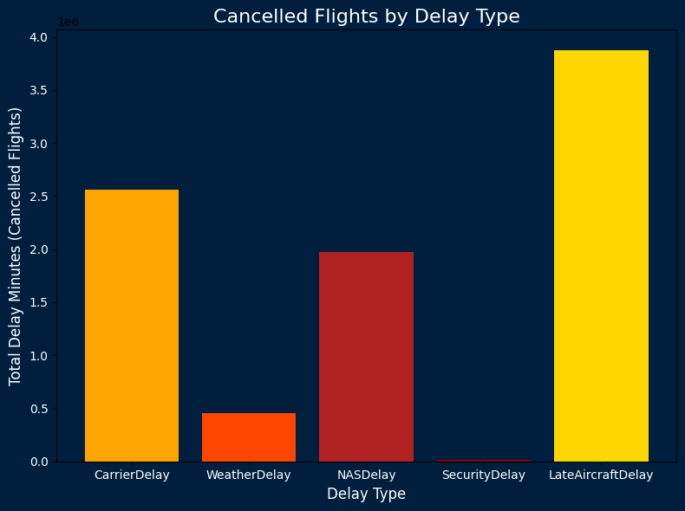




Cancellation Analysis and Patterns
Primary Reasons for Flight Cancellations
Key Insights
Weather is the leading cause of cancellations at 39%, followed by airline/carrier issues at 33.4%
Southwest Airlines has the highest number of canceled flights due to its extensive operations
American Eagle Airlines exhibits the highest cancellation rate at 5.1%
examining cancellation rates provides a more accurate measure of unreliability than raw numbers
Based on analysis of 5,512,904 flights from May to December 2019
Takeaway: Weather and airline issues are the primary drivers of cancellations, with significant differences in cancellation patterns between airlines of different sizes and routes.

Slide 7




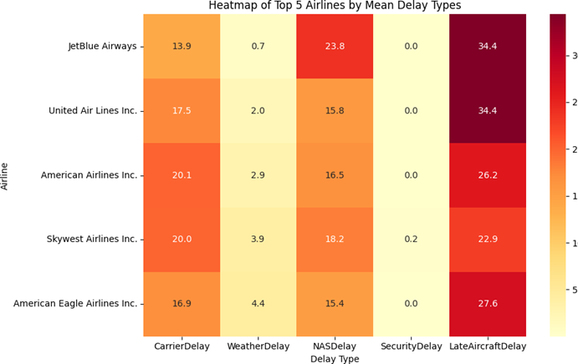



Delay Pattern Analysis
Top 5 Airlines by Mean Delay Types
Key Insights
Spirit Airlines has the highest average departure delay at 16 minutes
United Air Lines Inc. shows a higher percentage of delayed flights
Flights departing later in the day are more susceptible to delays
Delay Propagation
Delays tend to increase later in the day due to cascading effects, where initial delays ripple through the flight network.
Data shows average departure delay in minutes
Heatmaps can visualize how average departure delays vary by time of day and day of the week

Slide 8




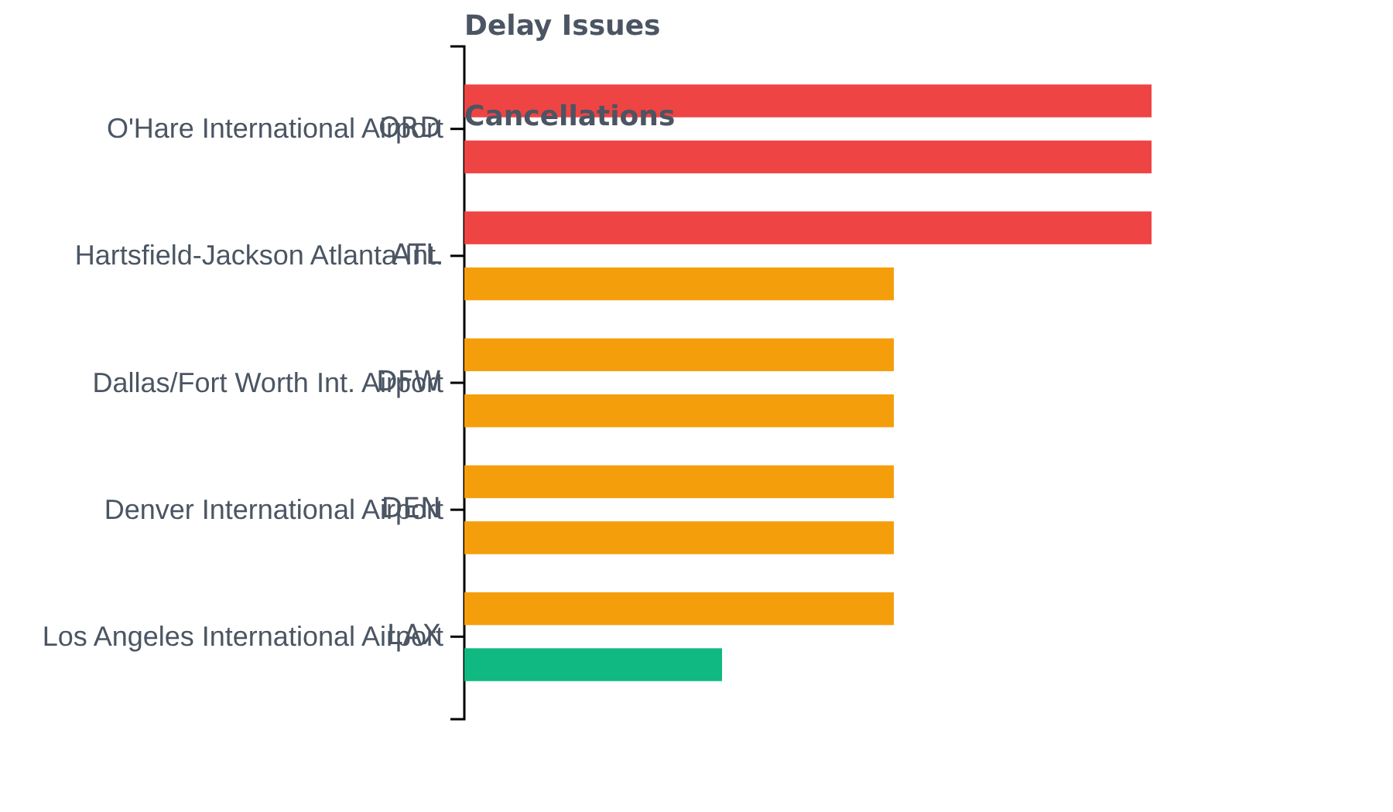







Airport Performance Assessment
Top Problematic Airports
O'Hare International Airport (ORD)
Ranks highest in both flight cancellations and delays
Serves as a significant operational bottleneck
Consistently appears in top delay/cancellation rankings
Key Insights
Major hubs like ORD often experience higher volumes
Other significant airports also show operational challenges
Geographic maps could help visualize problematic airports
High Issues
Moderate Issues
Few Issues

Slide 9











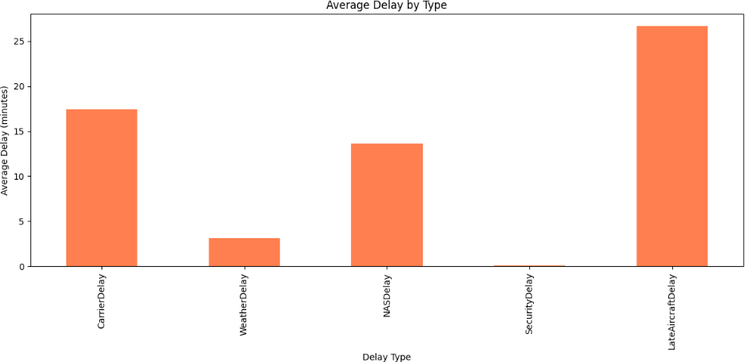
Key Insights and Challenges
Key Insights
Project Challenges
Weather is the leading cause of flight cancellations (39%)
O'Hare International Airport ranks highest in both cancellations and delays
Managing a vast dataset of over 5 million flight records
Ensuring accuracy and consistency of data from various sources
Airline/carrier issues are the second major reason (33.4%)
Effectively integrating disparate data types
Southwest Airlines has high volume but also high cancellations/delays
Transforming complex analytical findings into clear visualizations
Peak delays occur during summer months, particularly July
Avoiding information overload while maintaining accuracy and relevance

Slide 10












Conclusion and Future Scope
Conclusion
Future Scope
Successfully transformed complex airline flight data into actionable strategic insights
Develop predictive models for flight delays and cancellations
Integrate real-time weather data and air traffic control information
Provided clear understanding of airline and airport-level performance
Create live, interactive dashboard for continuous monitoring
Visual analysis empowers stakeholders to make informed decisions
Expand analysis to include passenger sentiment data
Project Completion
Thank you for your attention

