Slide 1
Crop Production Analysis
Good afternoon, everyone. My name is Swaraj and I am here to present my data analysis project on Crop Production Of India.
The purpose of this project was to analyze Crop Production and gain insights that can help us to Produce Agri Products By seasons and improve its production. Using Python, Power BI I was able to extract, clean, and analyze the data to identify patterns and trends that can help us make more informed decisions.
Throughout the analysis process, I used various techniques such as filling Nan values to uncover insights and develop meaningful visualizations. I then exported the data Power BI to create interactive dashboards and reports that are easy to understand and act upon.
Today, I will share with you the key findings from my analysis and how they can help to which Crop Product we have to produce and in which season it will more effective. I will also walk you through some of the visualizations and explain how they can be used to gain a deeper understanding of the data.
Thank you for joining me today, and I hope you find this presentation informative and engaging.

Slide 2
We Have Data Of Crop Production Of India
We have data of All State’s with having District wise.
124 different types of Crops was under Production.
2.95 Billion Land was under Prodection
141.18 Billion is total of Production
Here we have 6 Seasons which has Kharip, Whole Year, Autum, Rabi, Summer, Winter.
Data is starting from year 1997 to 2015.

Slide 3
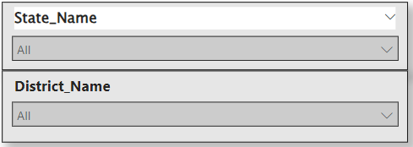
Lets First Understand The Dashboard
From Drawdown
Select State
Select District name

Slide 4
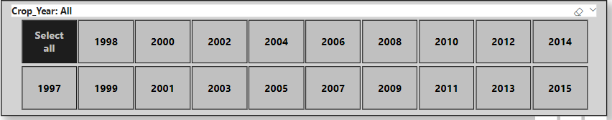
Select Year
Now we fulfilled our requirements

Slide 5
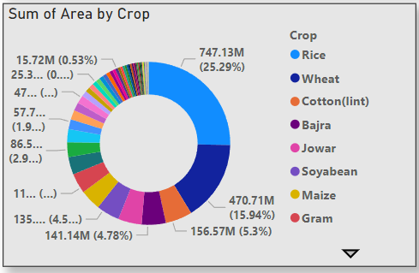
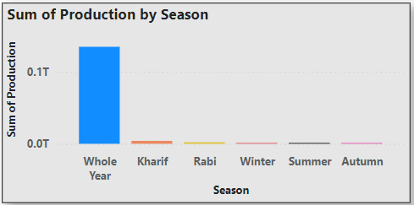
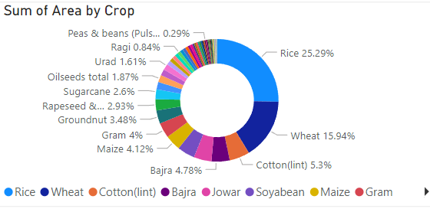
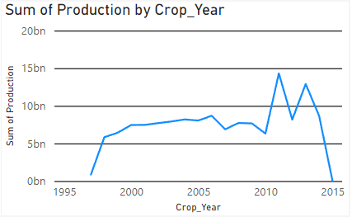
On Left Side We are able to see that
Sum of Area By Crop.
Where 22.29% Area Under
Rice Crop.
In Which according to seasons wise
Whole Years season Given Maximum
Production

Slide 6
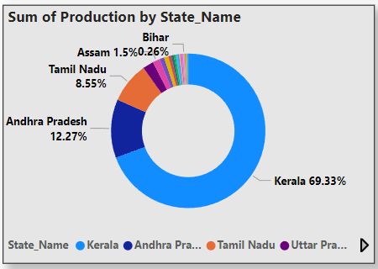
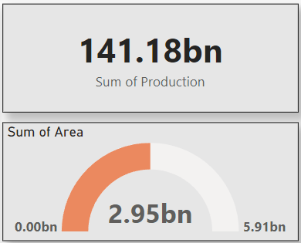
In Production by State Name
We are able to see that
69.33% Production is given
By One Kerala State.
Here is Total Number of Production
Here in middle
We can see the
Total area
Under Production

Slide 7
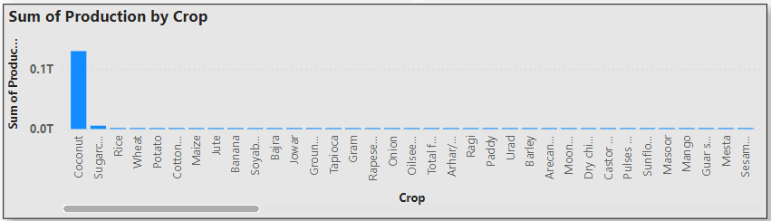
In Production By Crop
We can see that out of all Crops
Coconut has the maximum
Production

Slide 8
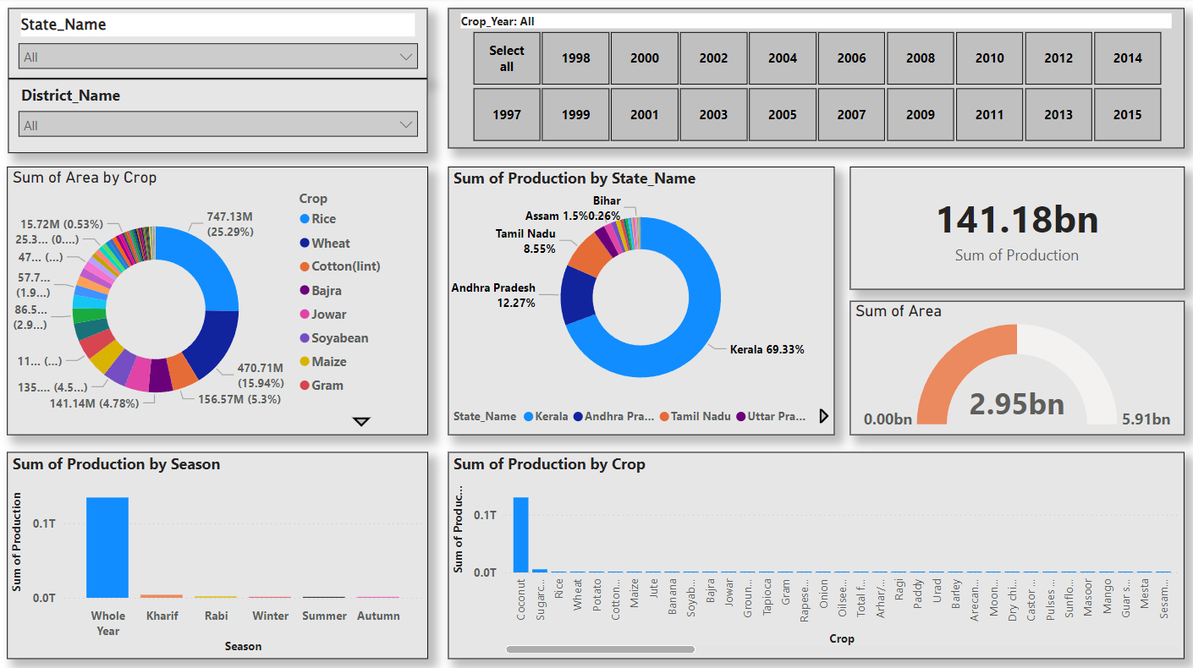
Now Our Dashboard is Ready

Slide 9
Now We Understood the Dashboard Lets see the Dashboard On Power BI, Where We will see Reports

