Slide 1
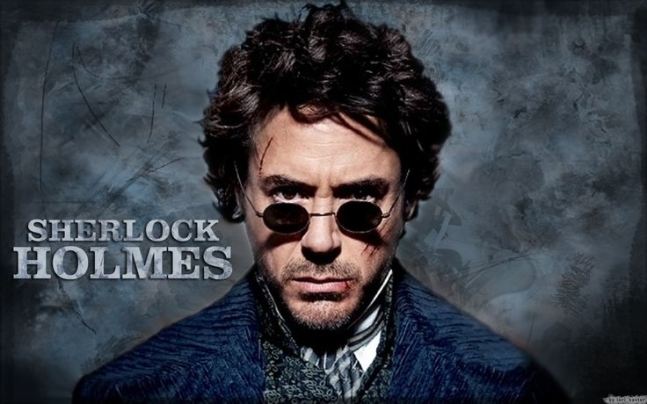
CAPTURE THE FLAG

Slide 2
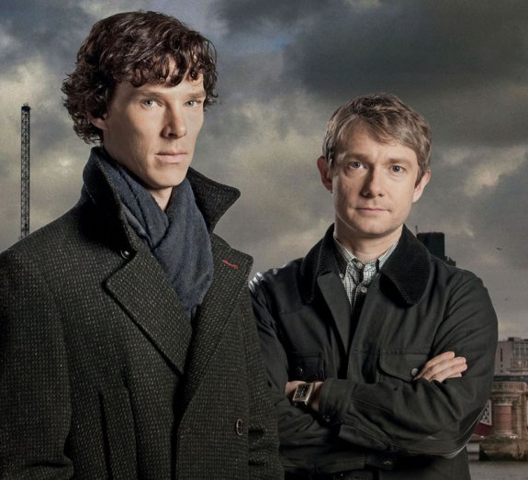
Looks can be deceiving (10 pts)
The PNG file is not what it seems. See if you can figure out what it really is!

Slide 3
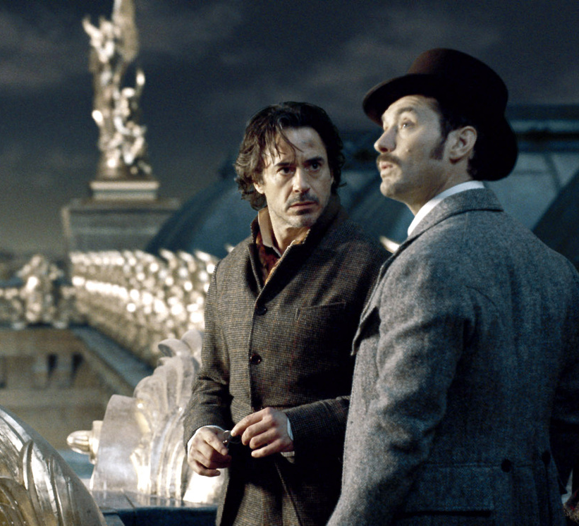
Python playground (15 pts)
Sherlock loves to use Python but even he can’t crack this one. Determine the machine’s hostname to reveal the flag!

Slide 4

Turing (20 pts)
Alan Turing is on a journey to break Enigma. But first, he must learn the basics. The script asks for a password. Can you crack it?

Slide 5
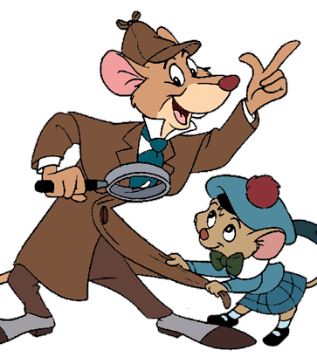
Mouse and wire (30 pts)
The Great Mouse Detective is doing an experiment. A mouse will chew the wire unless it gets what it wants. Can you figure out what it wants?

Slide 6
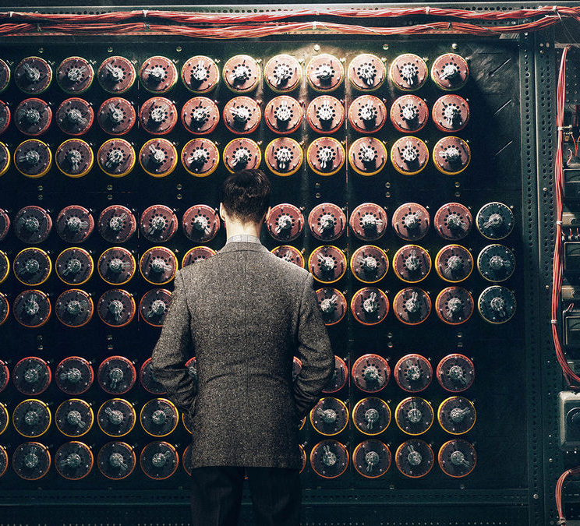
Enigma (100 pts)
Alan Turing is ready to break Enigma. The script asks for a password. Can you crack it?

Slide 7

tfw no sql (40 pts)
Nothing ever goes according to plan. This system doesn’t have SQL. Try and hack it regardless!

Slide 8
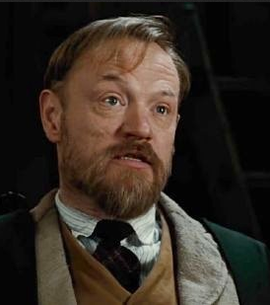
Cross cook (60 pts)
Are you sure you want to play this game? Very well. Professor Moriarty has given you the flag. Remember to never trust anyone. Could it really be that easy?

Slide 9

Hide and seek (15 pts)
A great detective is always searching for answers. A flag is hidden somewhere within the images. Can you find it?

Slide 10
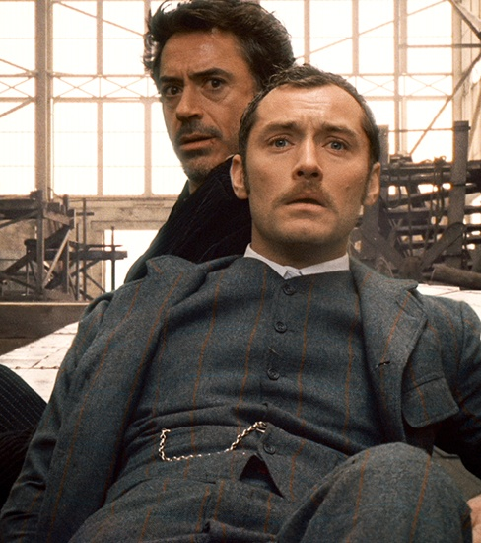
Network forensic (15o pts)
What have you done this time, Holmes? You are given an RSA Private Key. Try and figure out what the message says!

Slide 11
Crypto questions (60 pts)
Q1 (10 Pts): Detectives Cipher
Can you crack this ciphertext:
Ciphertext: NYOT ASYTG ERZ AGVGR QGETA EUY YOT NEHBGTA LTYOUBH NYTHB YR HBIA SYRHIRGRH, E RGC REHIYR, SYRSGIVGZ IR DILGTHQ, ERZ ZGZISEHGZ HY HBG FTYFYAIHIYR HBEH EDD KGR ETG STGEHGZ GMOED.
Q2 (15 Pts): Unlucky
Can you crack this ciphertext:
Ciphertext: dvxai elwiwii oceeii ucg wii jftl qvuhxdrvk hwt tyyoht "hviivvmen" wc ilvpf adkj, avt rejl kph lvsr ph ee pbhieejs du pzasgpp "ulpjvkzuu." iwi klfb qyx oos qivu wc jwv mcg beef mtpvj pb tckzustgmen.
Q3 (15 Pts): Hold On To The
Can you crack this ciphertext:
T ai h lcir ieatsn t dtr.vuhsi rcycpe.Terifnecpe sdfntl o eskonadqieabthre ocak aefnistkirhae hieiyll wnu iar cH !
Q4 (20 Pts): Play This Way
Can you crack this ciphertext:
Siht dhnkbu ht eagkohudov zatw iommhdqpy. Oi vpt dbs xpmza oy G yfom aa zbud onlubyyae! Poc khoz zfcr okhis ca qtakqp (ops omy li dnqsuc) ht sidq sia pduudt G ht ogyyhoh!W

Slide 12
Quiz questions (20 pts)
Q1 (5 Pts): Disguised From Detective
What is another word for a "UI redress attack“?
Q2 (5 Pts): Look In the Mirror
What kind of XSS occurs when an attacker injects browser executable code within a single HTTP response?
Q3 (5 Pts): Valentines
What was the virus that spread through email back around May 5th, 2000?
Q4 (5 Pts): Poppin Caps
What utility is used to sniff packets?

