Slide 1

CAPTURE THE FLAG

Slide 2
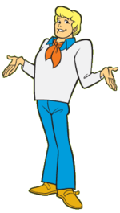
Back in a bit (10 Pts)
Fred’s Python script uses bitwise ops to verify the password. If you can get the length right, you might be able to figure out the pattern and discover the flag!

Slide 3

Picture worth a thousand (10 pts)
For Scooby and the gang, even the smallest detail could be a clue. A flag is hidden somewhere within the picture. Can you find it?

Slide 4

scrappy tell em (15 pts)
Scrappy likes his privacy and is always secretive about his files. This flag is located in a hidden file. Can you figure out where it is?

Slide 5
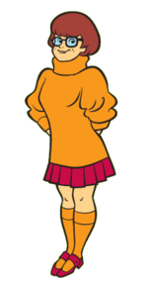
Python playground (30 pts)
Velma always writes her code in Python. This time, she underestimated your hacking skills. Determine the machine’s hostname to reveal the flag!

Slide 6
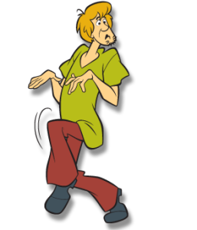
Where it at (20 pts)
Shaggy is usually left in charge of all of the gang’s files. Clumsy as he is, he made a huge mistake. If you upload the right file, the flag may be exposed!

Slide 7

crypto questions (20 pts)
Q1 (5 Pts): Check Your Software
Can you crack this ciphertext:
f9fa10ba956cacf91d7878861139efb9
Q2 (5 Pts): Protect the Fort
Can you crack this ciphertext:
c29tZSBwZW9wbGUgY2FsbCBmb3J0cyBiYXNlcyB0b28=
Q3 (5 Pts): Role Reversal
Can you crack this ciphertext:
Dszg dlfow szkkvm ru Hsviolxp zmw Dzghlm hdrgxsvw kozxvh? Gsvm Dzghlm dlfow hzb, "Vovnvmgzib, nb wvzi Hsviolxp." Zmw gszg dlfow qfhg hlfmw dvriw.
Q4 (5 Pts): Breakfast Food
Can you crack this ciphertext:
BAABBAABBBABAAABAABA BAABAAABBBABBBABABAAABABBAAABB AAAABAABAA AAAAABAABA AABAAAAAAABAABABBAAA AAAAABAABA AABAAAAAAABAABBABAAAABBABAABBA AAAABAAAAAAAABAABBBAABBAB

Slide 8

Quiz questions (20 pts)
Q1 (5 Pts): Bill To High
What is the attack called when an attacker has encrypted all of the victim's information and is willing to decrypt it for a price?
Q2 (5 Pts): Catch Sherlock Roasting Fools
What does CSRF stand for?
Q3 (5 Pts): Stephen
What is called when you send emails that look like they're from real websites, but in reality it's fake and you're gathering information about others, such as passwords or credit card numbers?
Q4 (5 Pts): Try Try Again
What is it called when you try a whole list of passwords on a website, knowing the username?

