Slide 1
Market Entry Analysis Project
-Submitted By
Dr. V . Swaroopa Rani

Slide 2
PROBLEM STATEMENT :
This Project is based on a mobile company ‘XYZ Mobiles’ from China.
XYZ Mobiles wants to enter Indian Market as it believes that the Indian market is very similar to China, in which the company is successfully running.
Before entering the new market, the company wants to be sure that the whole process will be profitable for them.
My task is to check for the following conditions that must be fulfilled in the Indian market for the company to enter:
Sale of a minimum of 12,000 phones over the sample data in one year .
Collection of at least Rs. 20 crores over the sample data in one year .

Slide 3
Segmentation and Model Development
Gender was classified into binary data as male (1) and female(0). The annual income was converted into INR for matching the situation of Indian currency.
From the Chinese customer data it is clear that purchase decision depends on 4 factors. Customer Age, Gender, Phone Age, and Annual Income.
The Phone Age was classified into 4 segments.
The data was divided into training and test set with 70:30 Rule and then Logistic Regression was applied on training and testing datasets.
And then ROC Curve, Beta Values(Coefficients) and Confusion Matrix (Including Accuracy, Sensitivity, Precision etc.)were computed from train and test data through K-means Clustering.
Days | Segment
<200 | 1
200-360 | 2
360-500 | 3
>500 | 4

Slide 4
Task1: PIVOT ANALYSIS AFTER CLEANING OF DATASET:
Table: 1
Row Labels | Sum of PURCHASE | Count of Lead | Conversion rate
0 | 9836 | 17715 | 55.52
1 | 13195 | 22285 | 59.21
Grand Total | 23031 | 40000 | 57.58
Row Labels | Sum of PURCHASE2 | Count of PURCHASE | Conversion rate
1 | 2351 | 6459 | 36.40
2 | 7023 | 16545 | 42.45
3 | 9208 | 11697 | 78.72
4 | 4449 | 5299 | 83.96
Grand Total | 23031 | 40000 | 57.58
Table: 2
Note :
From Table 1 it is clear that conversion rate for Males is high As compared to Females that is, 59.21 %.
From Table 2 it is clear that categories 3 and 4 (i.e., Phone Age > 365 and >500) are having highest Conversion Rates, 78.72% 83.96 %.

Slide 5
Statistical Analysis
CURR_AGE |  | ANN_INCOME |  | AGE_PHN
Mean | 44.99745 | Mean | 359398.9 | Mean | 359.0803
Standard Error | 0.0591 | Standard Error | 875.5463 | Standard Error | 1.015319
Median | 45 | Median | 337656.8 | Median | 331
Mode | 46 | Mode | 108632 | Mode | 326
Standard Deviation | 11.82008 | Standard Deviation | 175109.3 | Standard Deviation | 203.0637
Sample Variance | 139.7143 | Sample Variance | 3.07E+10 | Sample Variance | 41234.88
Kurtosis | -1.20187 | Kurtosis | -0.3465 | Kurtosis | 1.437027
Skewness | 0.00607 | Skewness | 0.590983 | Skewness | 1.060834
Range | 40 | Range | 729881.7 | Range | 1019
Minimum | 25 | Minimum | 70089 | Minimum | 1
Maximum | 65 | Maximum | 799970.7 | Maximum | 1020
Sum | 1799898 | Sum | 1.44E+10 | Sum | 14363210
Count | 40000 | Count | 40000 | Count | 40000

Slide 6
Data Visualisation and EDA

Slide 7
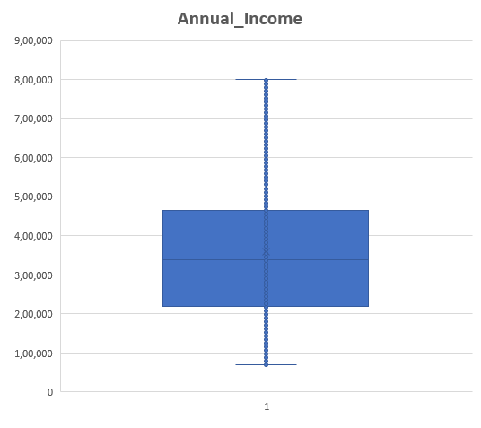
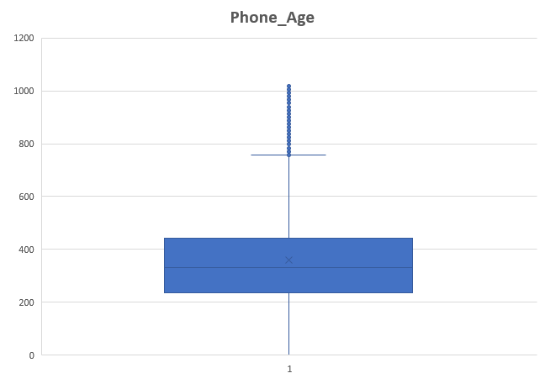
Box-plots Annual_income and Phone_Age

Slide 8
Task1: CLASSIFICATION MODEL BASED ON CHINESE DATASET:
The logistic regression was applied on the train data by considering the factors like age, gender, income, phone life and purchase.
The coefficients B0 to B4 and ROC Curve of training Data are computed as follows:
Coefficients
B0 | -1.53387
B1 | -0.01181
B2 | 0.211286
B3 | 2.29E-06
B4 | 0.004219
 | Confusion_matrix
 | predicted
actual | no(0) | yes(1)
no(0) | 7201 | 6412
yes(1) | 4080 | 14307
 | Performance Metrics
Accuracy | 0.672125 | (TP + TN) / TP+TN+FP+FN
Precision | 0.690526 | TP / (TP + FP)
Recall | 0.778104 | TP / (TP + FN)
Specifivity | 0.52898 | TN / (TN + FP)
Sensitivity | 0.778104 | TP / (TP + FN)
F1_Score | 0.731704 | 2 * (Precision * Recall) / (Precision + Recall)
TPR | 0.778104 | True Positives / (True Positives + False Negatives)
FPR | 0.611132 | False Positives / (False Positives + True Negatives)

Slide 9
Task1: CLASSIFICATION MODEL ON CHINESE TEST DATASET AND PERFORMANCE METRICS ASSOCIATED:
The coefficients B0 to B4 and ROC Curve of test Data are computed as follows:
From the coefficient it is clear that age has a negative impact. Old people are less likely to buy a phone.
Gender plays a significant role, which is evident in the pivot analysis.
The annual income plays an insignificant role as the coefficient is very small.
The phone life also plays an important role and the categorial variation has an impact of its own.
 | Confusion_matrix
 | predicted
actual | no(0) | yes(1)
no(0) | 1799 | 1557
yes(1) | 999 | 3645
 | Performance Metrics
Accuracy | 0.6805 | (TP + TN) / TP+TN+FP+FN
Precision | 0.700692 | TP / (TP + FP)
Recall | 0.784884 | TP / (TP + FN)
Specifivity | 0.536055 | TN / (TN + FP)
Sensitivity | 0.784884 | TP / (TP + FN)
F1_Score | 0.740402 | 2 * (Precision * Recall) / (Precision + Recall)
TPR | 0.784884 | True Positives / (True Positives + False Negatives)
Coefficients
B0 | -1.66007
B1 | -0.01285
B2 | 0.293556
B3 | 2.81E-06
B4 | 0.00412

Slide 10
5 Number Summary (Indian Dataset)
CURR_AGE |  | GENDER |  | ANN_INCOME |  | AGE_PHN
Mean | 45.08229 | Mean | 0.500934 | Mean | 1146029 | Mean | 576.1679
Standard Error | 0.066686 | Standard Error | 0.002814 | Standard Error | 2249.446 | Standard Error | 1.077481
Median | 45 | Median | 1 | Median | 1123316 | Median | 486
Mode | 56 | Mode | 1 | Mode | 1171669 | Mode | 388
Standard Deviation | 11.84938 | Standard Deviation | 0.500007 | Standard Deviation | 399699.3 | Standard Deviation | 191.4554
Sample Variance | 140.4077 | Sample Variance | 0.250007 | Sample Variance | 1.6E+11 | Sample Variance | 36655.19
Kurtosis | -1.21016 | Kurtosis | -2.00011 | Kurtosis | -0.68412 | Kurtosis | -0.60677
Skewness | -0.00116 | Skewness | -0.00374 | Skewness | 0.136363 | Skewness | 0.87612
Range | 40 | Range | 1 | Range | 1699791 | Range | 652
Minimum | 25 | Minimum | 0 | Minimum | 300054 | Minimum | 368
Maximum | 65 | Maximum | 1 | Maximum | 1999845 | Maximum | 1020
Sum | 1423383 | Sum | 15816 | Sum | 3.62E+10 | Sum | 18191348
Count | 31573 | Count | 31573 | Count | 31573 | Count | 31573
Confidence Level(95.0%) | 0.130708 | Confidence Level(95.0%) | 0.005515 | Confidence Level(95.0%) | 4409.001 | Confidence Level(95.0%) | 2.111906

Slide 11
Task1: Data Modelling Considering Indian Dataset
The data set is formatted such that gender is converted into a binomial model and the phone age is calculated by considering the purchase date as 1st July 2019.
The phone life, age, income are segmented accordingly for further studies
The probability is computed based on coefficients (B0 to B4) obtained from the Chinese dataset and the no of potential customers in India based on a cut-off 0.5 is 31573 with a conversion ratio of 45.10%.
Applied k-means clustering on the potential customers in India dataset.
3 scenarios were considered in the study. One with 3 clusters, 4-clusters and standardized dataset.
1. Low Income:
Minimum income: ₹3,00,054
Maximum income: ₹7,67,967
2. Medium Income:
Minimum income: ₹7,67,968
Maximum income: ₹12,34,880
3. High Income:
Minimum income: ₹12,34,881
Maximum income: ₹19,99,845
DAYS | SEGMENT
<200 | 1
200-360 | 2
360-500 | 3
>500 | 4
Male | 1
Female | 0
Purchase
1 | Yes
0 | No
 | Segments | Age Criteria
Young Age | 1 | 25-35
Mid Age | 2 | 35-55
Old Age | 3 | 55-65

Slide 12
T2: JUSTIFICATION DURING CLUSTERING :
Clustering is performed on 3 & 4 Clusters and their error terms ( For more scaled and standardized data) is also found and with that centroid values were generated.
In our analysis 3 clusters results were taken for further analysis and predicting results and then EDA is performed on each cluster & Centroid values and following results were obtained:
Centroid values (For Potential Customers)
 | 1 | 2 | 3
CURR_AGE | 44.294 | 42.918 | 49.241
GENDER | 0.436 | 0.477 | 0.609
ANN_INCOME | 696419.45 | 1151544.67 | 1655736.147
AGE_PHN | 574.39 | 575.75 | 578.84
Centroid values (Error Terms)
 | 1 | 2 | 3
CURR_AGE | 0.460 | 0.525 | -1.212
GENDER | 0.998 | -1.002 | -0.072
ANN_INCOME | 0.343 | 0.086 | -0.539
AGE_PHN | -0.002 | 0.005 | -0.004
From the table above, centroid value 3 is to be taken for business decision -0.539 and and It has error terms in negative as well which is good so most peoples were clustered (i.e., their centroid) around with current age of 49, Annual income around 1655736 and age of phone around 579 days is to target For through our clustering analysis and EDA analysis of that is also done in further slides.

Slide 13
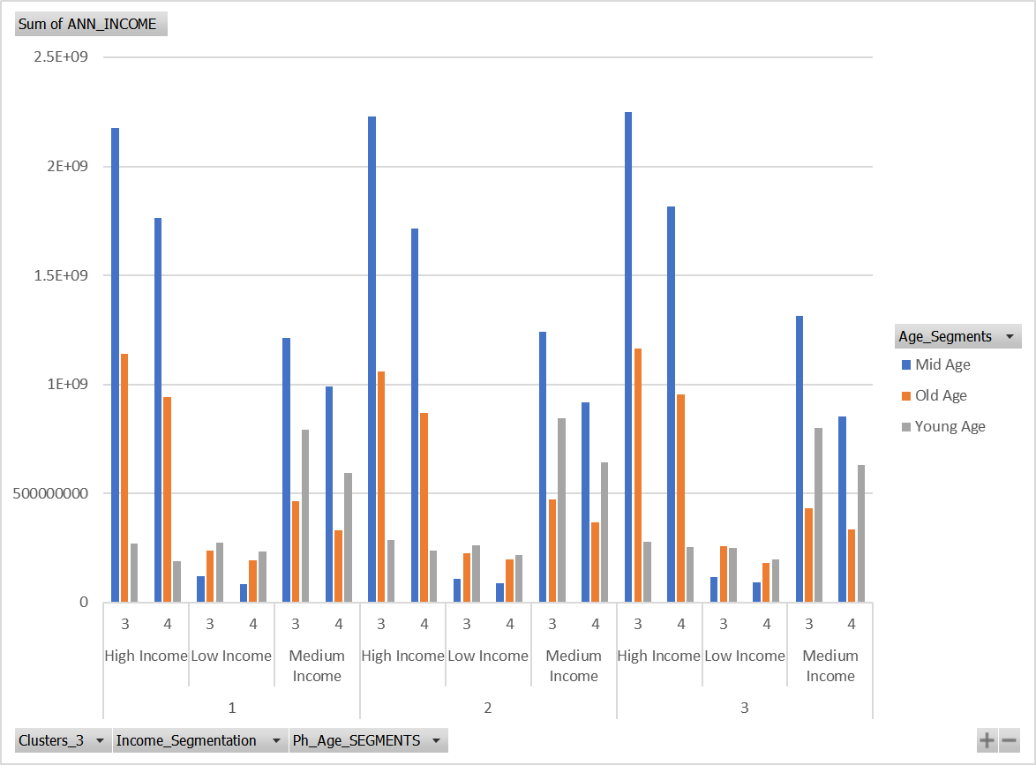
Potential Customers for all 3 clusters

Slide 14
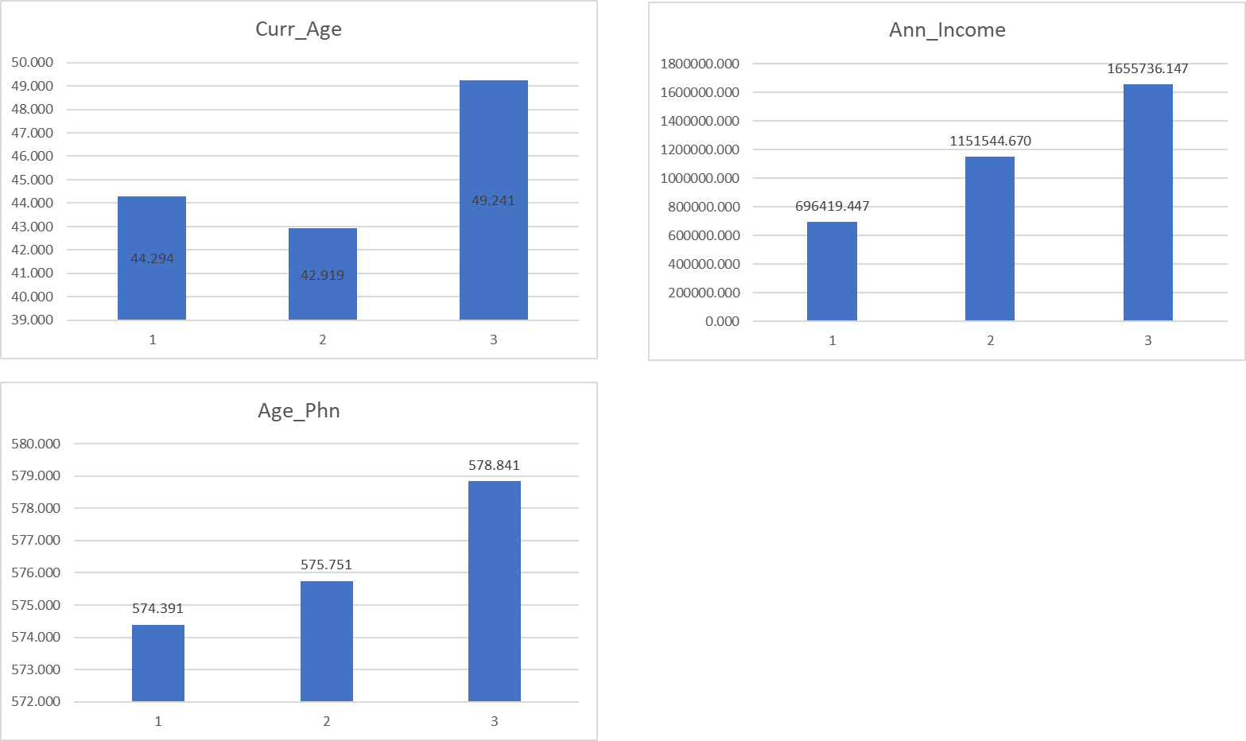
T2 : EDA ANALYSIS :
From the table above,
centroid value 3 is to be taken for business decision, with current age of 49, Annual income around 1655736 and age of phone around 579 days is to target.

Slide 15
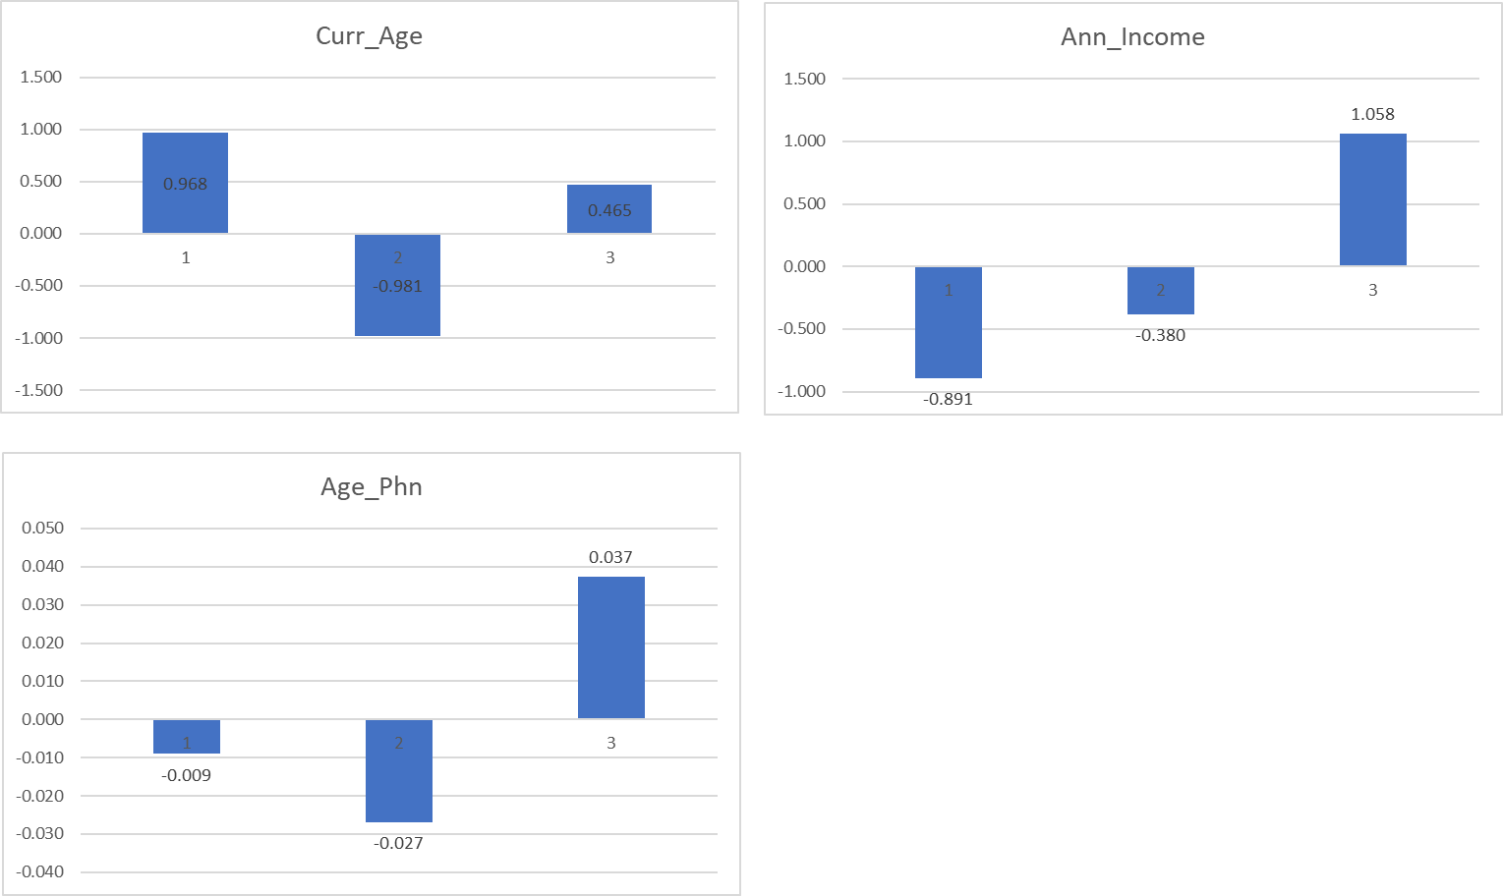
K-means Clustering on Standardized dataset(Clusters-3)

Slide 16
T3: JUSTIFICATION FOR FINAL RESULTS:
Now we need to segment our customers through their ages to check for our final results i.e.,
Sale of a minimum of 12,000 phones over the sample data in one year .
Collection of at least Rs. 20 crores over the sample data in one year .
 | Segments | Age Criteria
Young Age | 1 | 25-35
Mid Age | 2 | 35-55
Old Age | 3 | 55-65

Slide 17
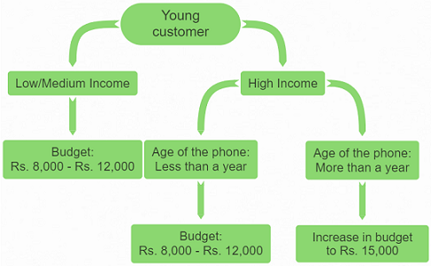
Task 2 : EDA ANALYSIS : Segmentation(Young Age Customers) and EDA Analysis(Clusters-3)

Slide 18
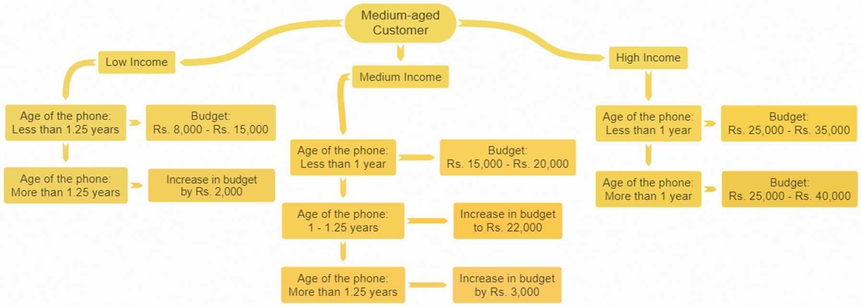
Segmentation(Medium Age Customers) and EDA Analysis (Clusters-3)

Slide 19
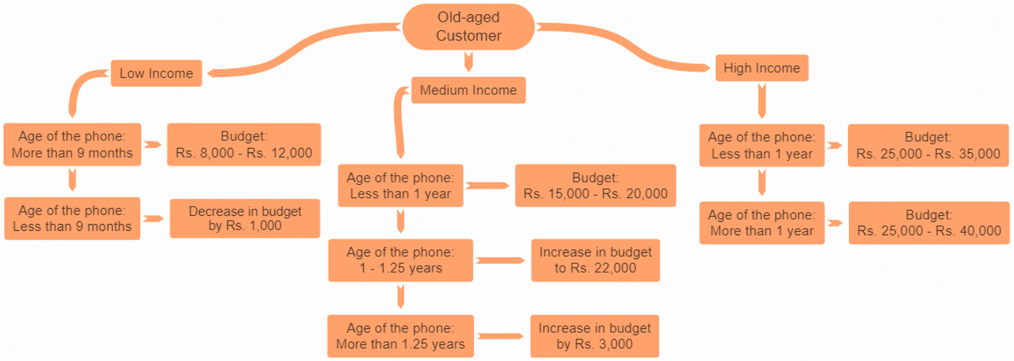
Segmentation(Old Age Customers) and EDA Analysis (Clusters-3)

Slide 20
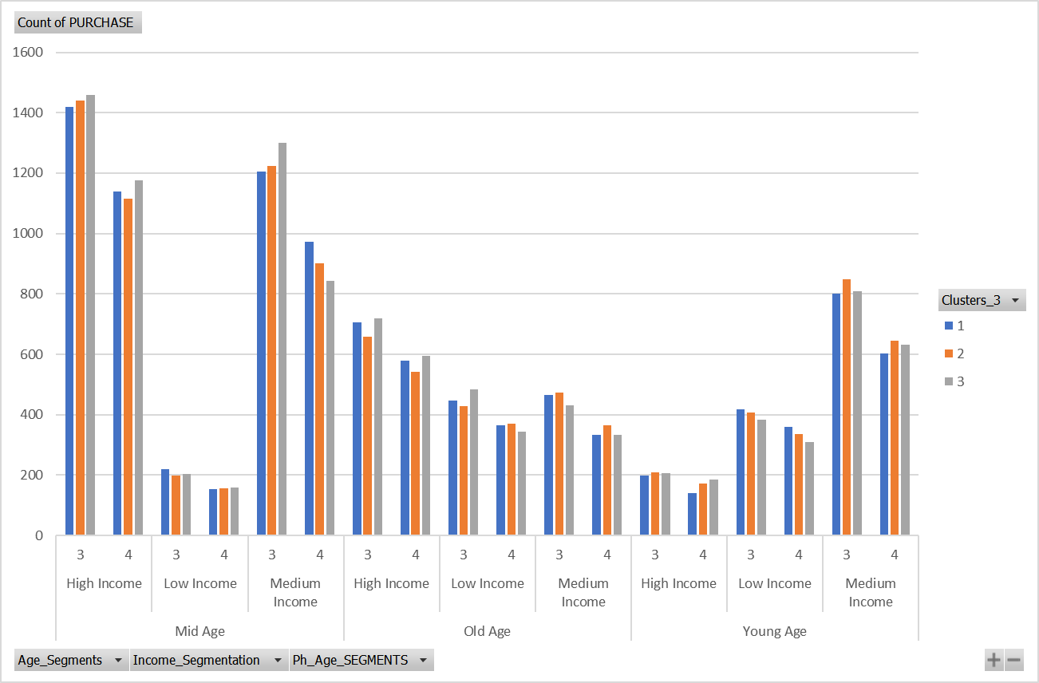
Business Decision
Looking at the table beside we can conclude that Customer Age Segment 2 ,count of purchase is 15283 which is way over our required result that is minimum 12000 Phones, sum of their ages is very high as 31573 and their Conversion rate is also high of 48.40 % in INDIA as compared to other segments so XYZ company must target Middle aged customers and so, yes they can enter in INDIAN market as there is no loss for XYZ Mobile Company.

Slide 21
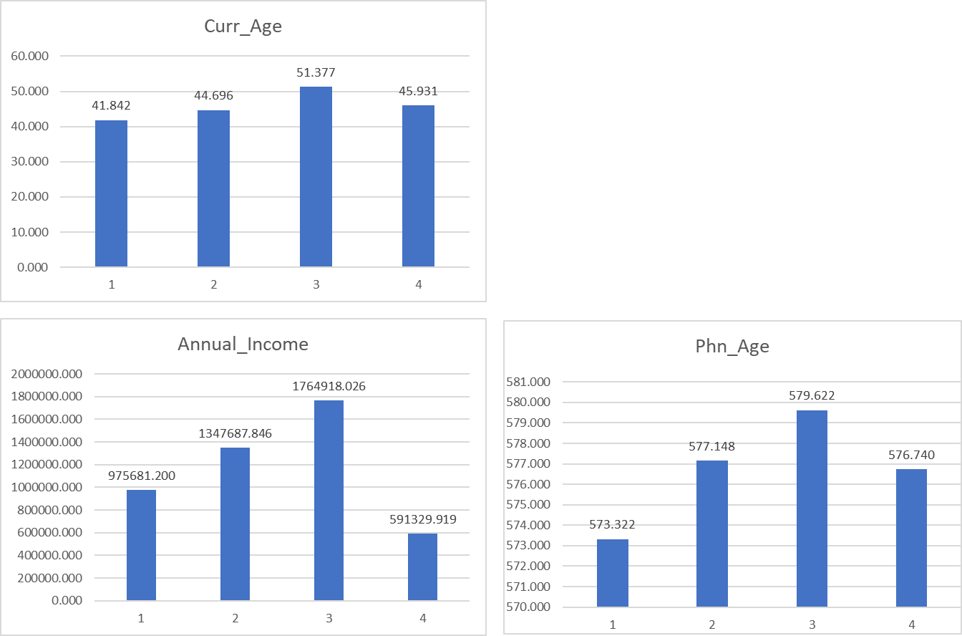
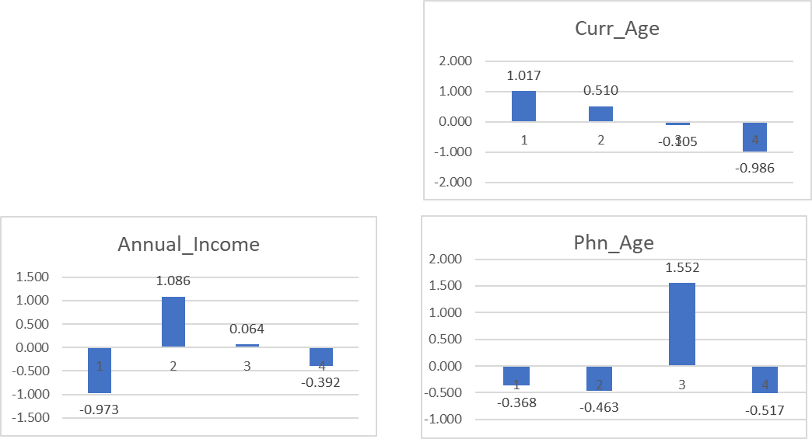
Cluster Centroids and error terms

Slide 22
Task3: Model Evaluation (4 Clusters):
From the table below we can Conclude that revenue collection is way over Rs. 20 Crores for segments i.e. Middle Age and Old Age with Medium Income and High income and Phone age >1year.

Slide 23
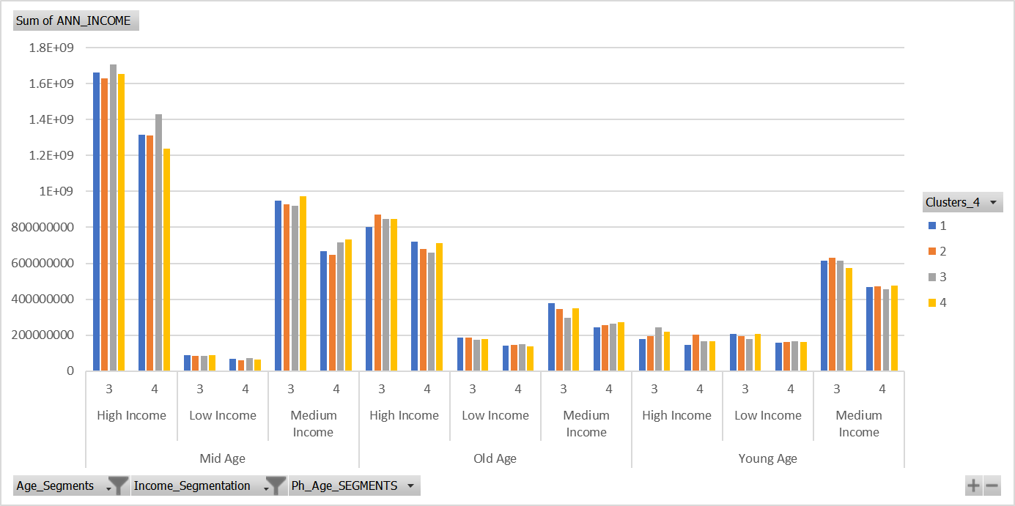
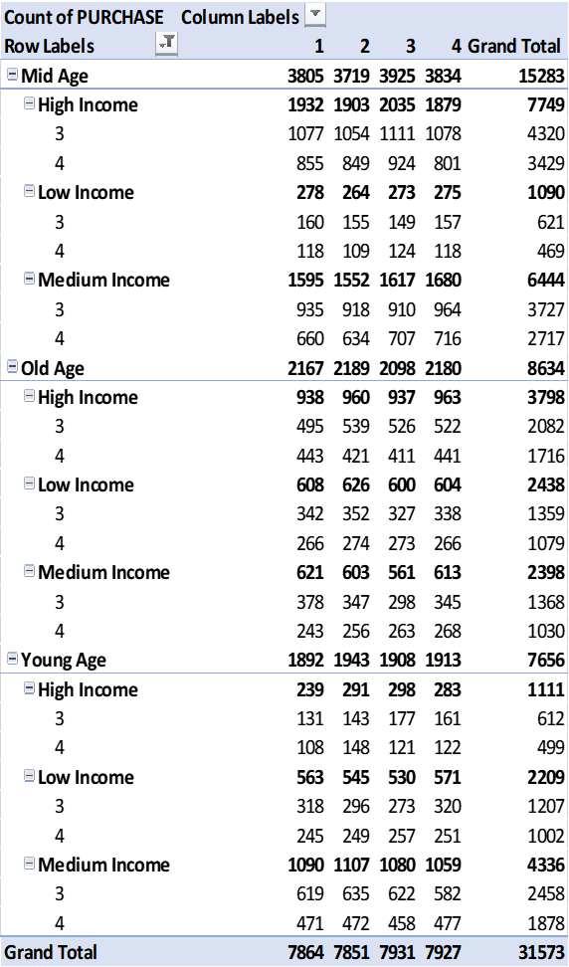
Suggestion for Business Decision
From the Table we can conclude that Customer Age Segment 2 ,count of purchase is 15283 which is way over our required result that is minimum 12000 Phones, sum of their ages is very high as 31573 and their Conversion rate is also high of 48.40 % in INDIA as compared to other segments so XYZ company must target Middle aged customers and so, yes they can enter in INDIAN market as there is no loss for XYZ Mobile Company.

