Slide 1

ASSIGNMENT GUIDELINES
Make the changes in the PPT as you solve the parts
This file contains the template for the EDA part of the project.
Check the instructions added in the note section of every slide for clarity.
Don’t move around any image or text box
If you require more/lesser elements, be careful when you copy/delete the existing ones.

Slide 2
ASSIGNMENT Name: Dr. V. Swaroopa Rani
Problem Statement
Bank of Corporate conducted a telemarketing campaign for one of its financial products ‘Term deposits’ to build a long-term relationship with the existing customers. These campaigns need to be cost efficient such that the bank not only increases their overall revenues but also the total profit.
Assignment Objective
To identify the target customers and the driving factors behind the successful conversion of a customer and optimize future marketing campaigns.
Notes:
Problem Statement

Slide 3
Exploratory Data Analysis (EDA)
Exploratory Data Analysis (EDA) is a critical step in the data analysis process. The goal of EDA is to understand the characteristics of the data, detect patterns and relationships between variables, identify outliers, and determine the appropriate statistical techniques for the data analysis. Here are the general steps involved in EDA:
Data Collection: Gather the data from various sources such as online databases, web scraping, surveys, or sensors.
Data Cleaning: Clean the data to ensure that it is accurate, complete, and consistent. This includes handling missing values, removing duplicates correcting data errors, and removing outliers.
Data Visualization: Create visualizations to summarize the key characteristics of the data. This includes histograms, box plots, scatter plots, and heatmaps.
Data Transformation: Transform the data if necessary to make it easier to analyze. This includes scaling, normalizing, or standardizing the data.
Data Exploration: Explore the data to identify patterns, trends, and relationships between variables. This includes calculating descriptive statistics such as mean, median, and standard deviation, and identifying correlations between variables.
Hypothesis Testing: Test hypotheses to determine if there are statistically significant differences between groups or if a relationship exists between variables.
Model Building: Build statistical models to predict or explain the relationship between variables. This includes regression analysis, time-series analysis, and clustering.
Communication of Results: Communicate the results of the analysis using appropriate visualizations, tables, and graphs.
Overall, EDA is an iterative process that involves multiple steps. The goal is to gain insights into the data and prepare it for further analysis. EDA is a crucial step in the data analysis process as it lays the foundation for the subsequent analysis and decision-making.

Slide 4
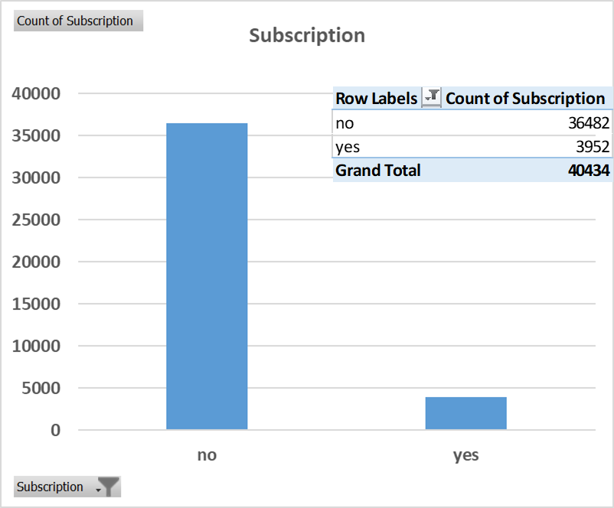
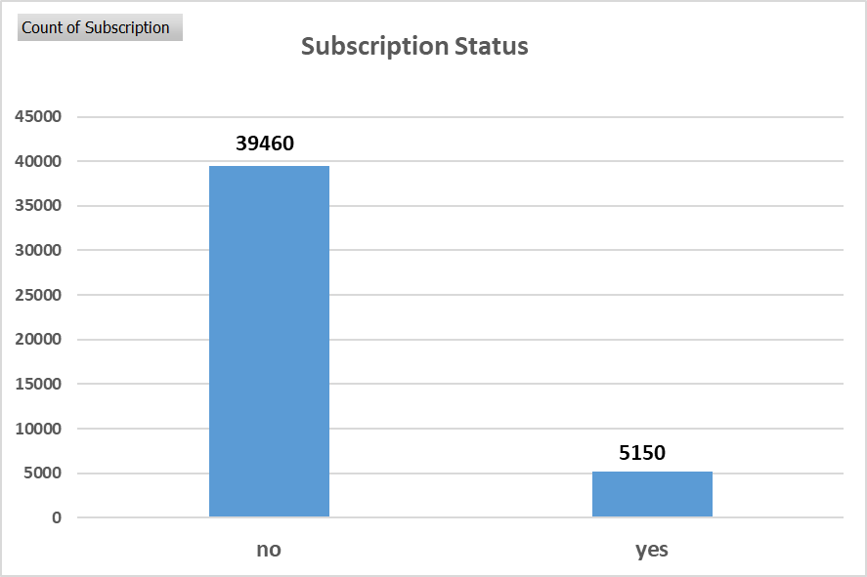
PART I : Univariate Analysis Marketing Campaign Optimization
Variable under consideration: [Subscription]
Notes:
5150 customers have taken the subscription and responded.
39460 customers did not respond or have not taken any subscription.
Subscription Status after the removal of outliers:
3952 customers have taken the subscription and responded.
36482 customers did not respond or have not taken any subscription.

Slide 5
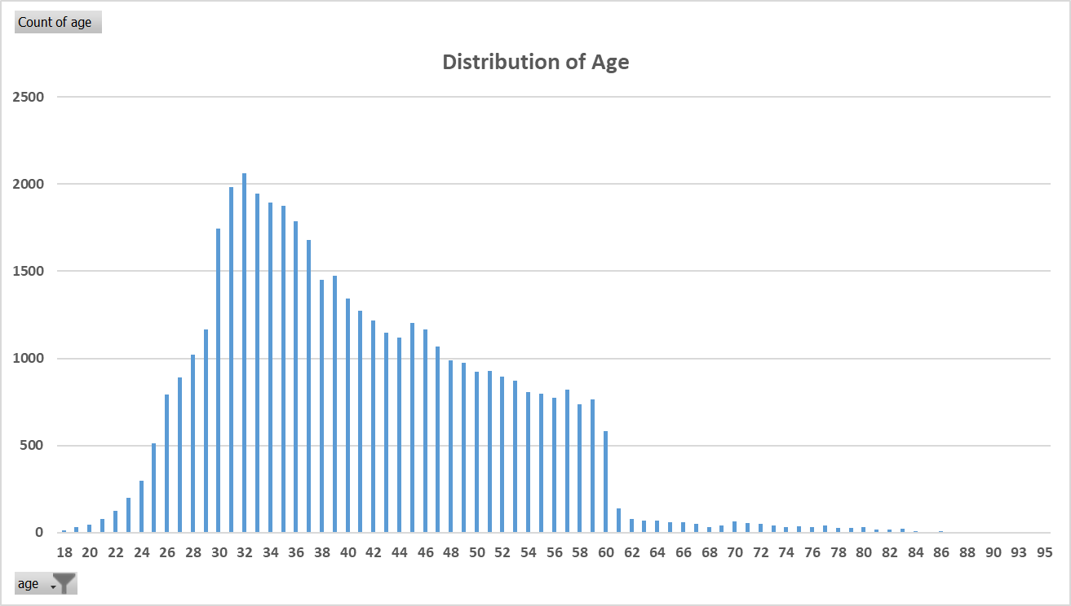
PART I : Univariate Analysis Marketing Campaign Optimisation
Variable under consideration: [Age]
Statistics:
count 44610.000000
mean 40.923268
std 10.593706
min 18.000000
25% 33.000000
50% 39.000000
75% 48.000000
max 95.000000
Notes:
The distribution of age:
In its telemarketing campaigns, clients called by the bank have an extensive age range, from 18 to 95 years old. However, a majority of customers called is in the age of 30s and 40s (33 to 48 years old fall within the 25th to 75th percentiles). The distribution of customer age is fairly normal with a small standard deviation.

Slide 6
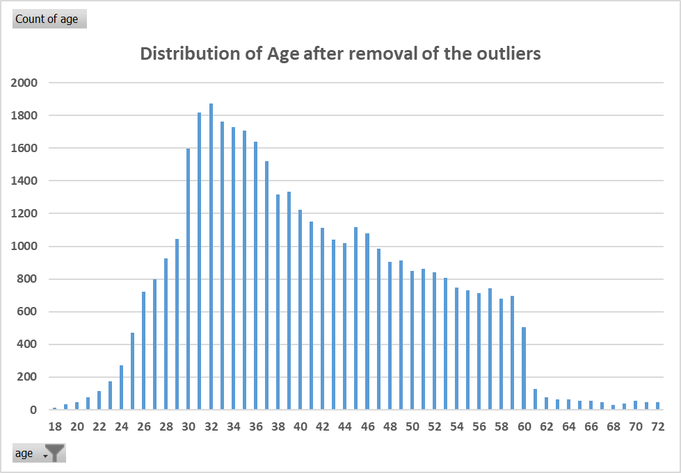
PART I : Univariate Analysis Marketing Campaign Optimisation
Variable under consideration: [Age]
Notes:
The distribution of age:
In its telemarketing campaigns, clients called by the bank have an extensive age range, from 18 to 95 years old. However, a majority of customers called is in the age of 30s and 40s (33 to 48 years old fall within the 25th to 75th percentiles). The distribution of customer age is fairly normal with a small standard deviation.

Slide 7
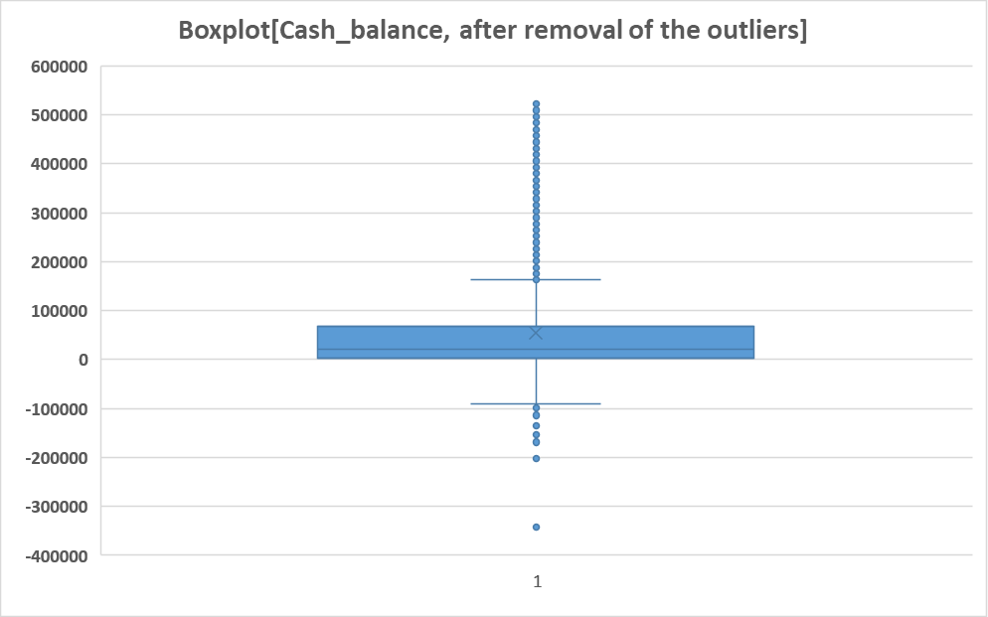
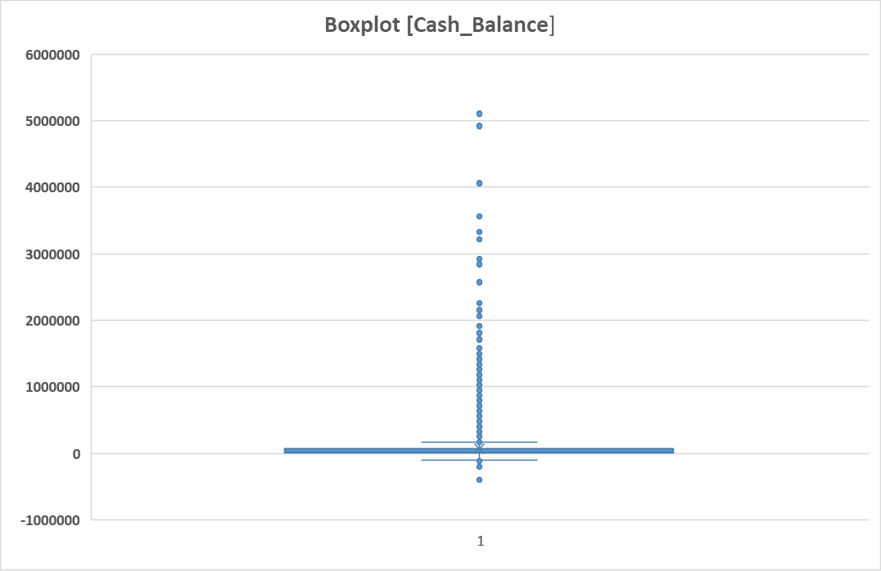
PART I : Univariate Analysis Marketing Campaign Optimisation
Variable under consideration: [Cash Balance]
Statistics:
Notes:
The distribution of balance:
The range of cash balance is very huge, from a minimum of -400950 to a maximum of 5106350, giving a range of 5507300 . The distribution of balance has a huge standard deviation 152603.6483
relative to the mean 68162.17 , suggesting large variabilities in customers' balance levels. There is a scope to remove outliers.

Slide 8
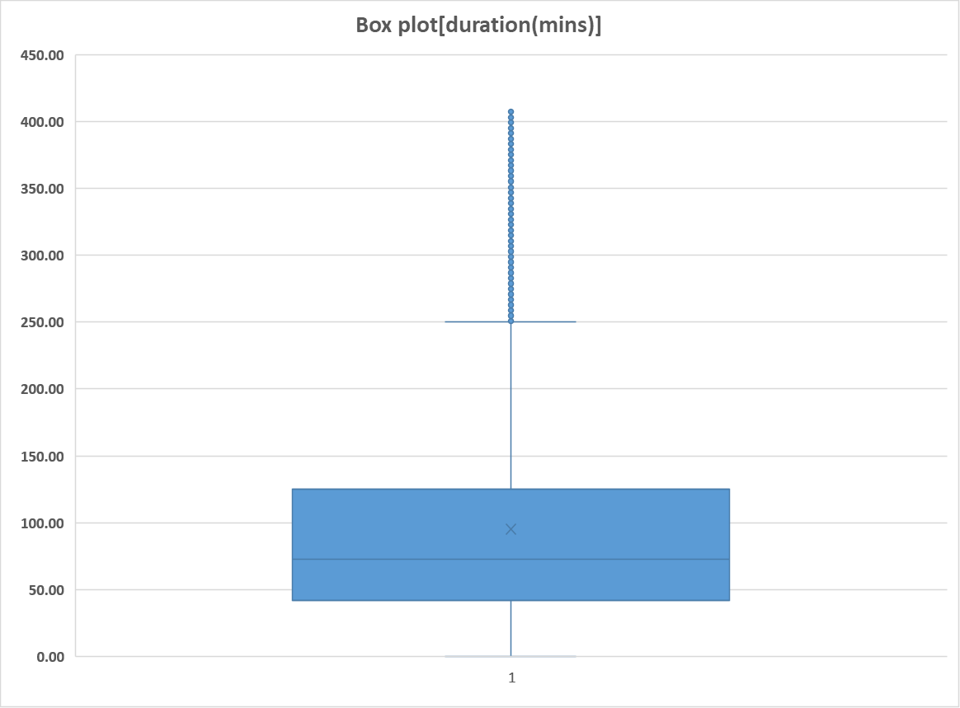
PART II : Bivariate Analysis Marketing Campaign Optimisation
Variables under consideration:
[duration]
count 40434.000000
mean 93.157739
std 76.033695
min 0.000000
25% 40.400000
50% 70.000000
75% 121.600000
max 410.400000

Slide 9
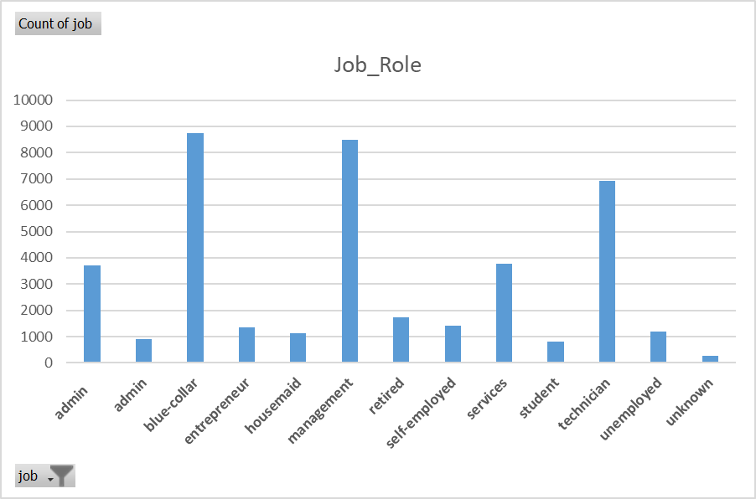
PART I : Univariate Analysis Marketing Campaign Optimization
Variable under consideration: [Job Role]
Row Labels | Count of job
admin | 3695
admin | 919
blue-collar | 8728
entrepreneur | 1350
housemaid | 1133
management | 8478
retired | 1740
self-employed | 1417
services | 3768
student | 824
technician | 6933
unemployed | 1180
unknown | 269
Grand Total | 40434
Notes:
Most of the customers are from blue-collar, management and technician job roles.

Slide 10
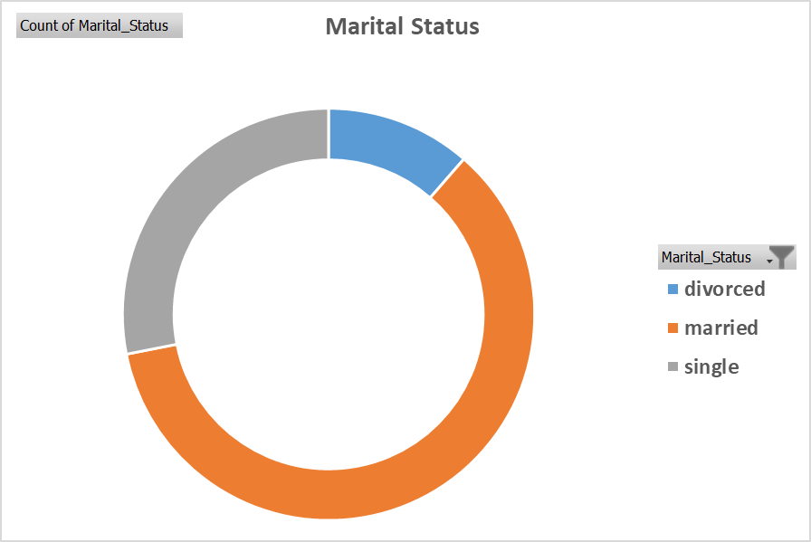
PART I : Univariate Analysis Marketing Campaign Optimisation
Variable under consideration: [Marital Status]
Notes:
Maximum No. of customers are married.

Slide 11
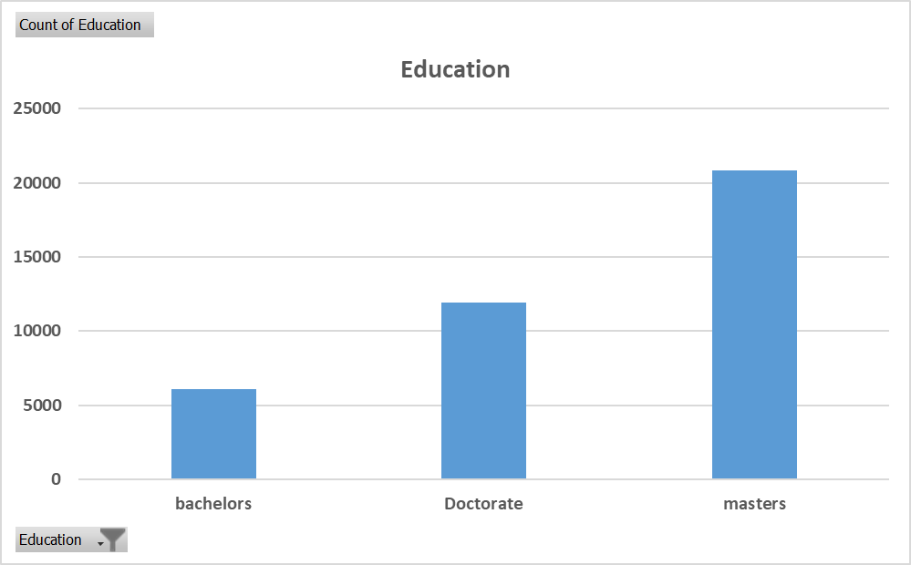
PART I : Univariate Analysis Marketing Campaign Optimisation
Variable under consideration: [Education]
Notes:
Maximum customers have Master’s as their educational qualification.

Slide 12
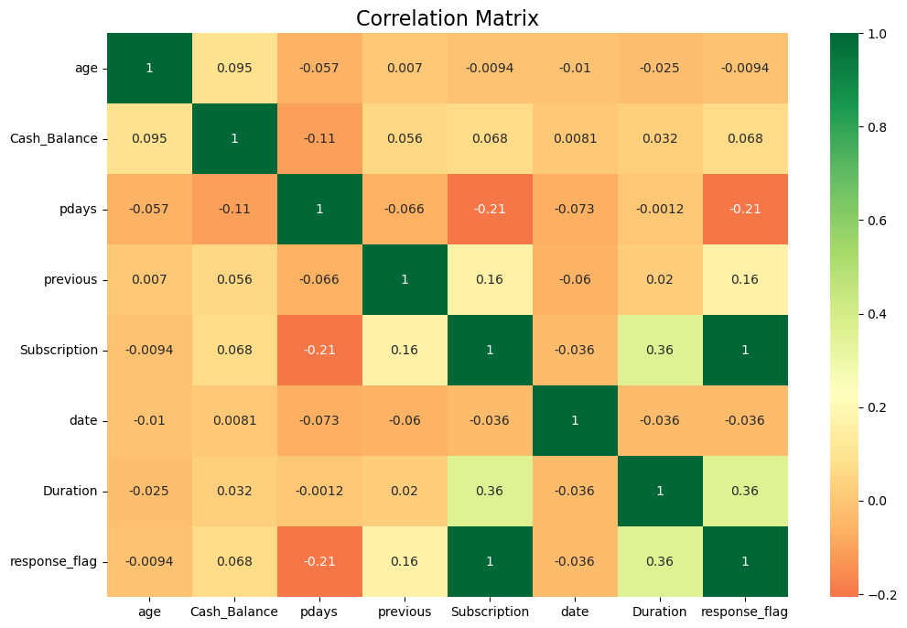
PART I : Univariate Analysis Marketing Campaign Optimisation

Slide 13
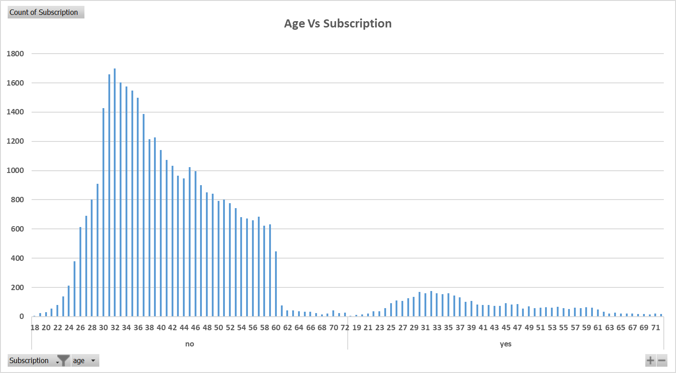
PART II : Bivariate Analysis Marketing Campaign Optimisation
Variables under consideration: [Age, Subscription]
Notes:
Majority of customers age group between 25 – 47 are responding and showing interest to take subscription.
Very few Customers, age between 48 and above are responding and showing interest.

Slide 14
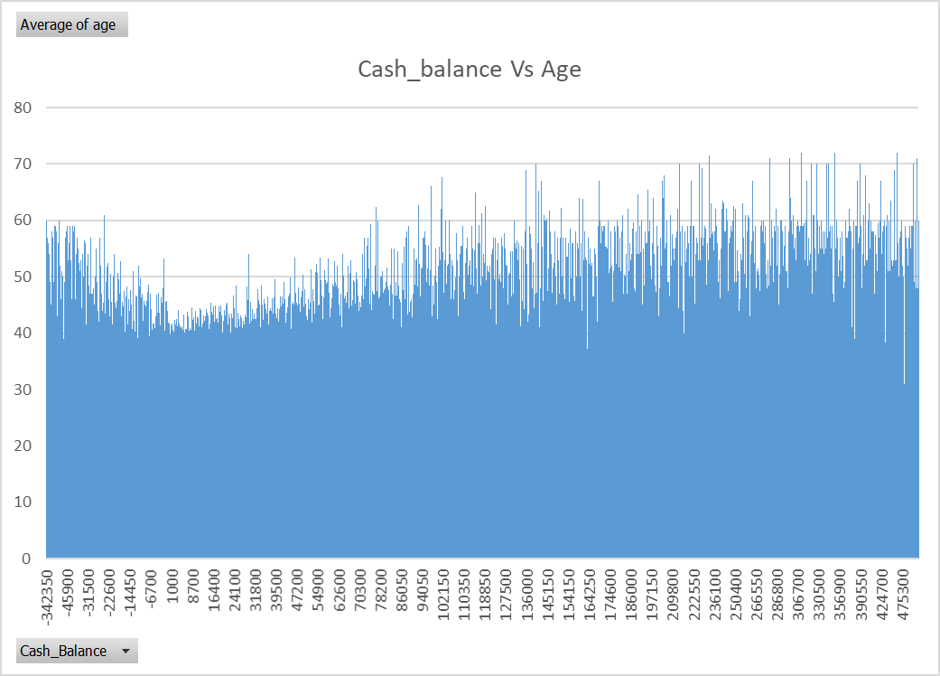
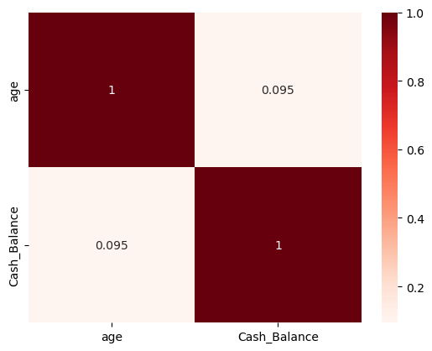
PART II : Bivariate Analysis Marketing Campaign Optimisation
Variables under consideration: [Cash balance, Age]
Notes:
Over the age of 60, clients tend to have a significantly lower balance. This is due to the fact that most people retire after 60 and no longer have a reliable income source.

Slide 15
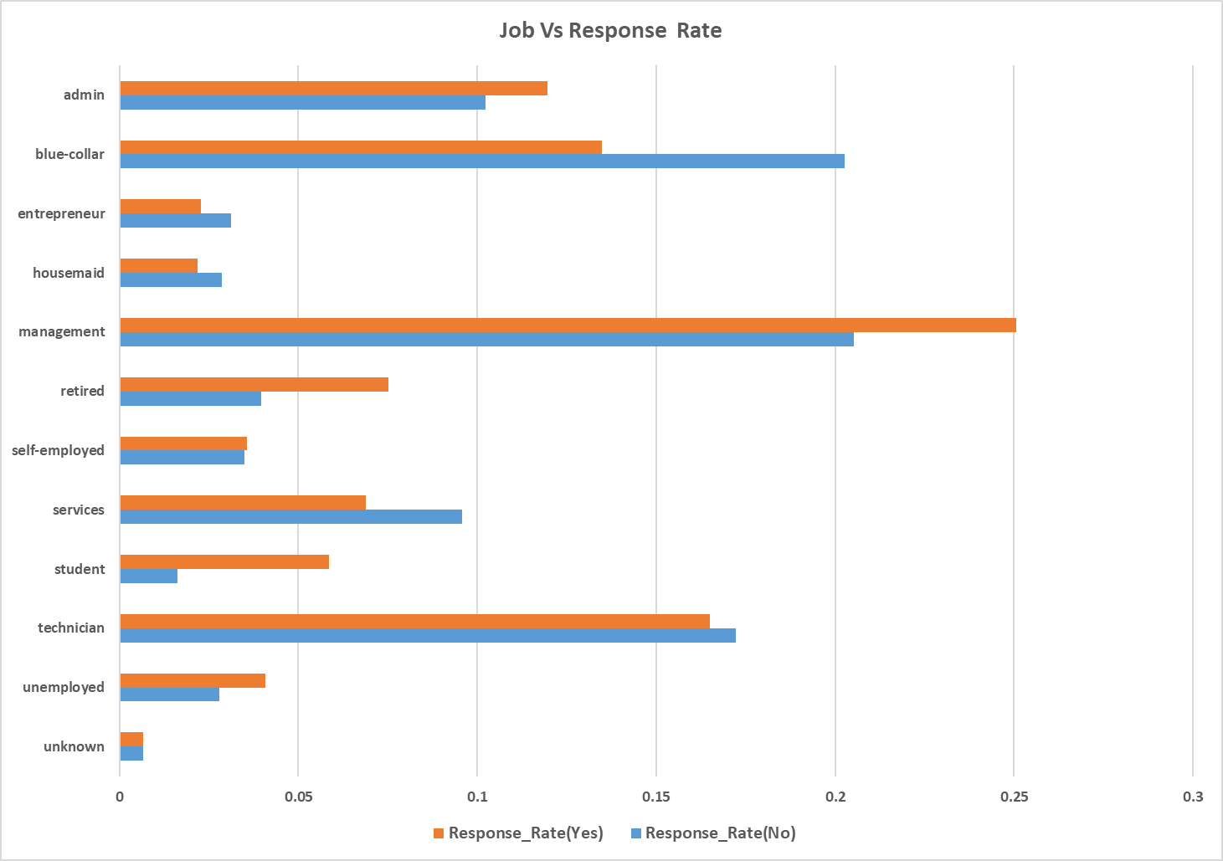
PART II : Bivariate Analysis Marketing Campaign Optimisation
Variables under consideration:
[Job Vs Subscription/Response rate]
Notes:
The customer response rate for the job roles, Unemployed, Students , self employed, entrepreneurs, housemaid, retired is very less when compared to management, blue-collar, technician.

Slide 16
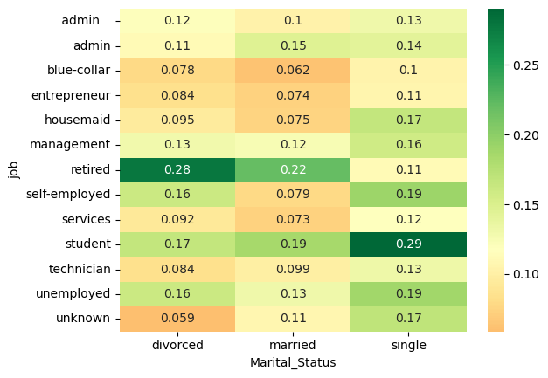
PART II : Bivariate Analysis Marketing Campaign Optimisation
Variables under consideration:
[Job Vs Subscription/Response rate]
Notes:
The customer response rate for the job roles, Unemployed, Students , self employed, entrepreneurs, housemaid, retired is very less when compared to management, blue-collar, technician.

Slide 17
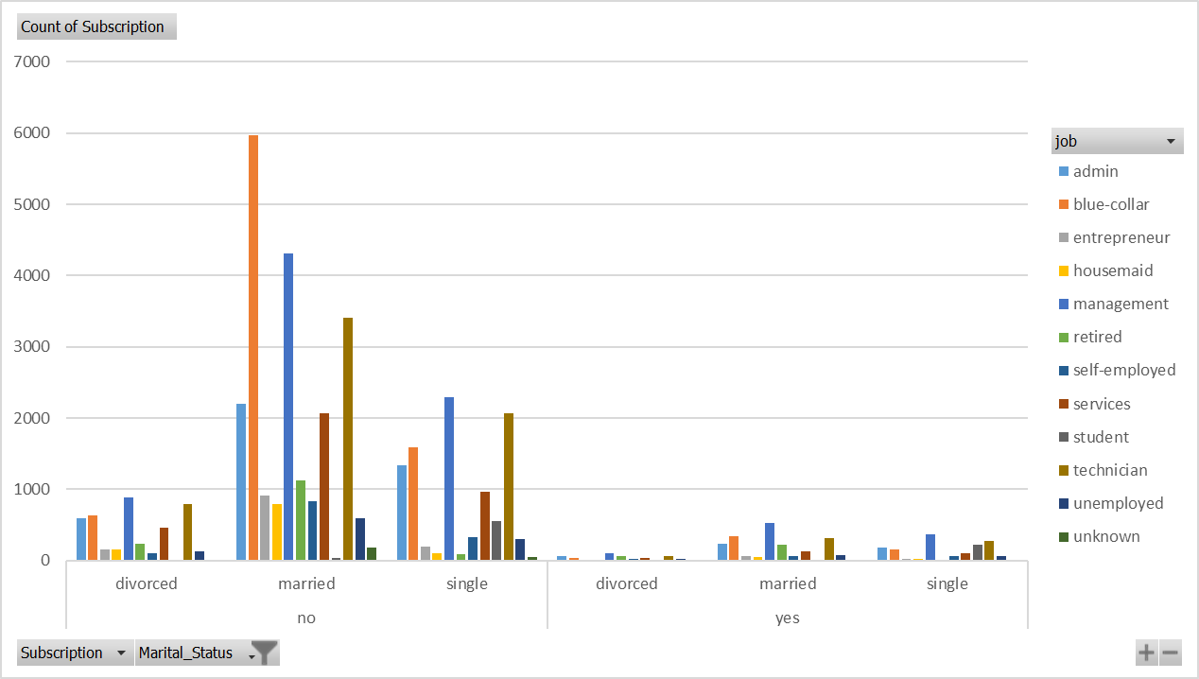
PART II : Bivariate Analysis Marketing Campaign Optimisation
Variables under consideration: [Job Vs Subscription/Response rate]
Notes:
The largest group of customers is those who are married, with a total subscription count of 24,465. The second-largest group is single customers with a total subscription count of 11,359, and the smallest group is divorced customers with a total subscription count of 4,610.
For married customers, the largest job category is blue-collar with a subscription count of 6,311, followed by management with a count of 4,839.
For single customers, the largest job category is also blue-collar with a subscription count of 1,750, followed by management with a count of 2,649.
For divorced customers, the largest job category is management with a subscription count of 990, followed by blue-collar with a count of 667.
There is a notable difference in the distribution of job categories among the different marital status groups, with blue-collar being the largest job category for single and married customers, while management is the largest for divorced customers.

Slide 18
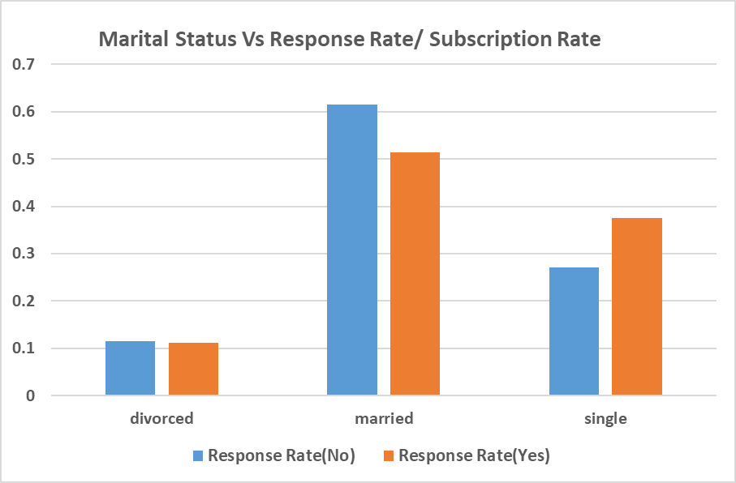
PART II : Bivariate Analysis Marketing Campaign Optimisation
Variables under consideration:
[Marital Status Vs Subscription Rate]

Slide 19
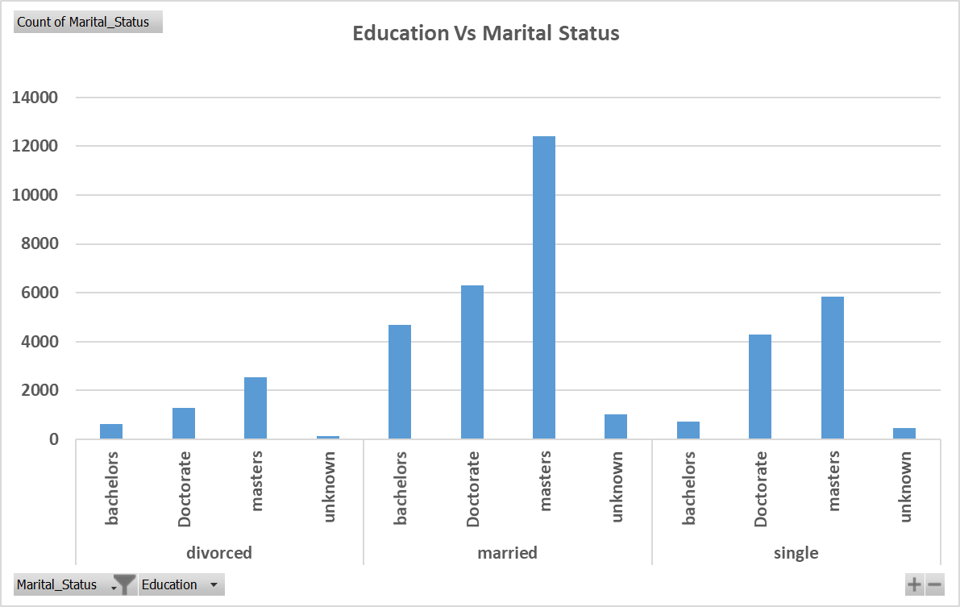
PART II : Bivariate Analysis Marketing Campaign Optimisation
Variables under consideration:
[Education Vs Marital Status]
Notes:
Maximum customers who took the subscription are married and have Masters degree.

Slide 20
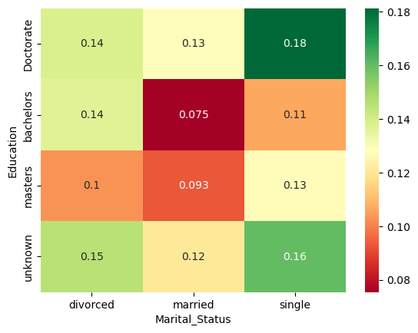
PART II : Bivariate Analysis Marketing Campaign Optimisation
Variables under consideration: [Correlation between Marital Status and Education]

Slide 21
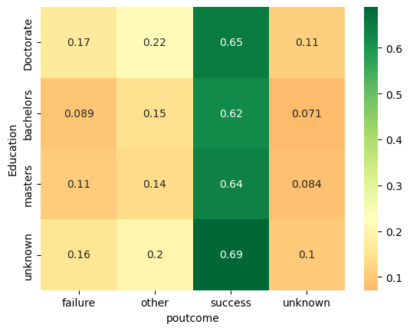
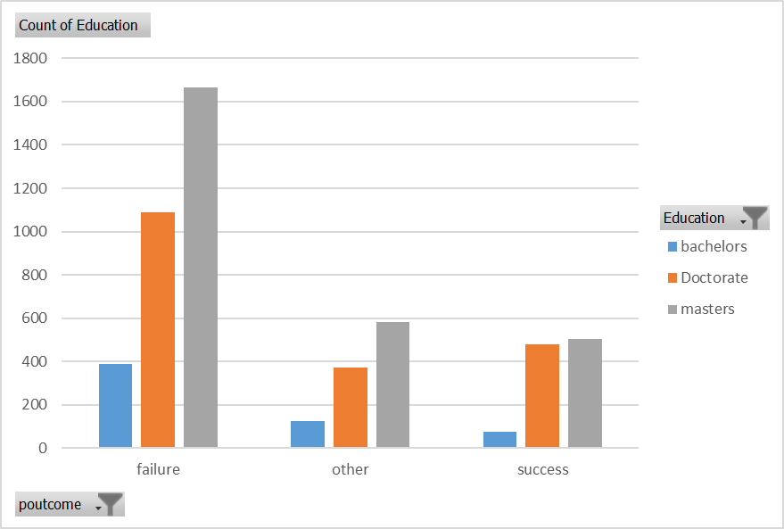
PART II : Bivariate Analysis Marketing Campaign Optimisation
Variables under consideration: [poutcome, Education]

Slide 22
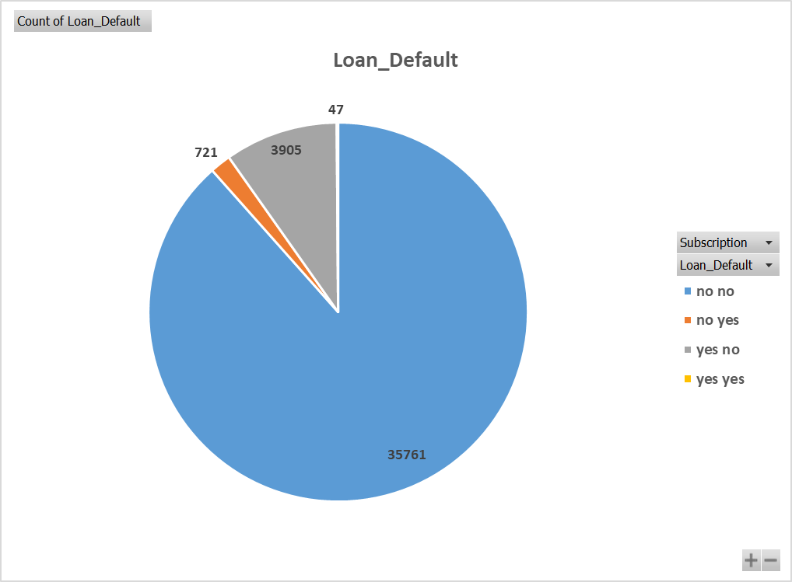
PART II : Bivariate Analysis Marketing Campaign Optimisation
Variables under consideration:
[Loan default Vs Subscription]
Notes:
Here are some possible insights based on the data:
Out of the total 40,434 individuals in the sample, 4,673 (or about 12%) have defaulted on a loan.
The majority of individuals (around 88%) have not defaulted on a loan.

Slide 23
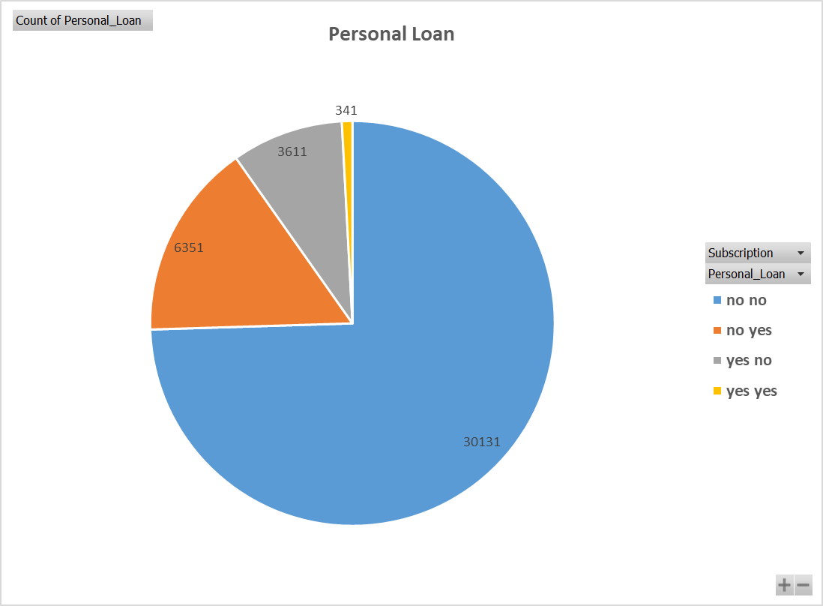
PART II : Bivariate Analysis Marketing Campaign Optimisation
Variables under consideration:
[Personal Loan Vs Subscription]
Notes:
Here are some possible insights based on the data:
Out of the total 40,434 individuals in the sample, 9,303 (or 23%) have taken a personal loan.
The majority of individuals (around 90%) have not taken a personal loan.

Slide 24
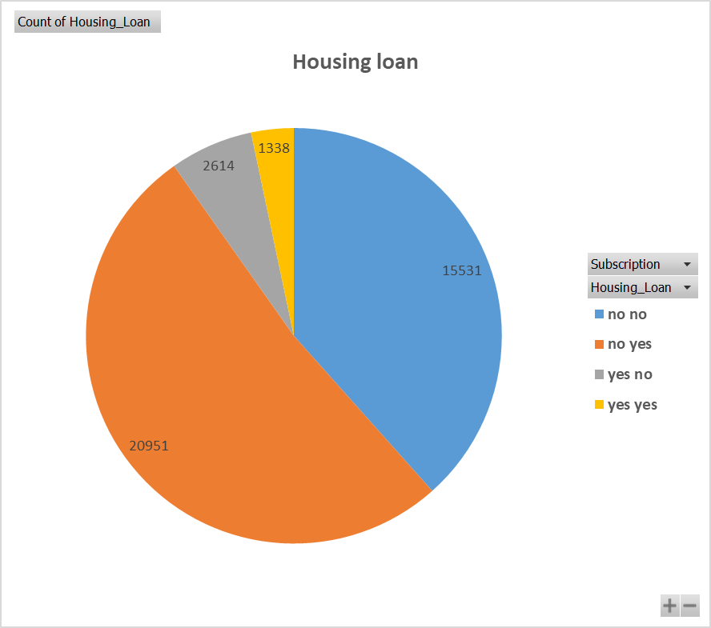
PART II : Bivariate Analysis Marketing Campaign Optimisation
Variables under consideration:
[Housing Loan, Subscription]
Notes:
Out of the total 40,434 individuals in the sample, 22,289 (or about 55%) have a housing loan.
The majority of individuals with a housing loan have responded "yes" to the variable (around 94%), while the majority of individuals without a housing loan have responded "no" (around 69%).

Slide 25
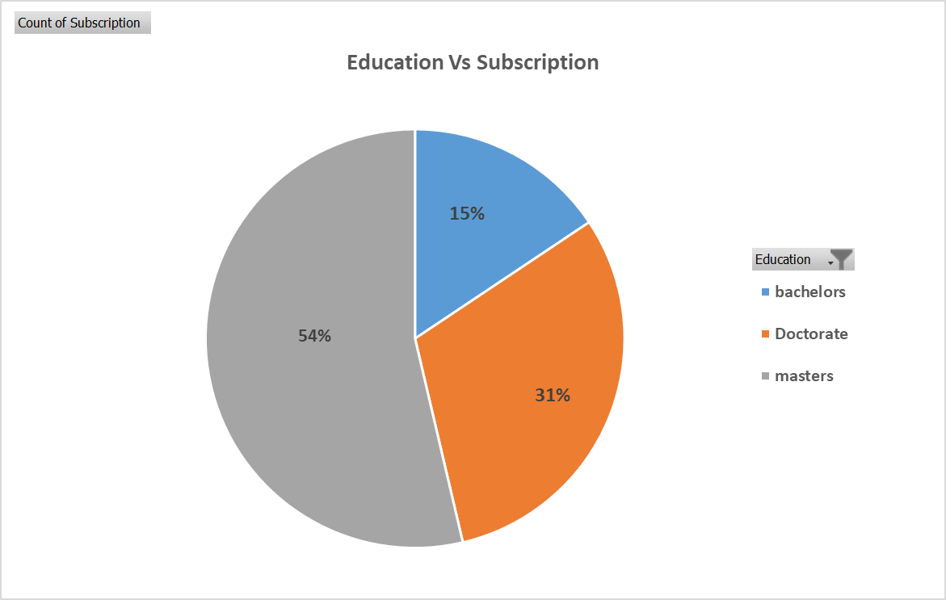
PART II : Bivariate Analysis Marketing Campaign Optimisation
Variables under consideration:
[Education Vs Subscription Rate]
Notes:
Here are some possible insights based on the data:
Out of the total 38,788 individuals in the sample, 35.7% (i.e., the sum of subscription rates for all education levels) have subscribed to a service.
The highest subscription rate is among individuals with a master's degree (54%), followed by those with a doctorate degree (31%), and those with a bachelor's degree (16%).

Slide 26
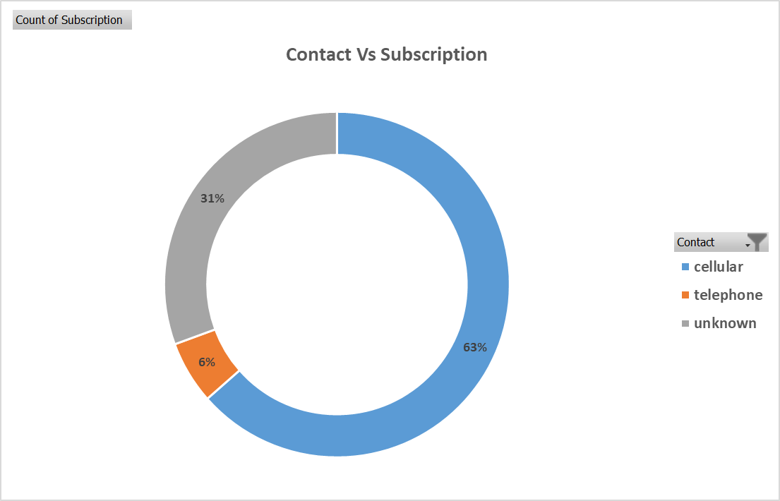
PART II : Bivariate Analysis Marketing Campaign Optimisation
Variables under consideration:
[Contact Vs Subscription]
Notes:
Most of the costumers are contacted through cellular(63%) by the bank executives. Through telephone only 6% were contacted.
From the given data, we can see that out of 40434 customers, 25678 were contacted through a cellular network, 2378 through a telephone network and 12378 have an unknown contact method.
The subscription rate for customers contacted through a cellular network is 0.64, which is higher than the rate for those contacted through a telephone network (0.06) and those with unknown contact method (0.31).
This could mean that cellular networks are more effective in reaching customers for subscription than telephone networks or other unknown methods.

Slide 27
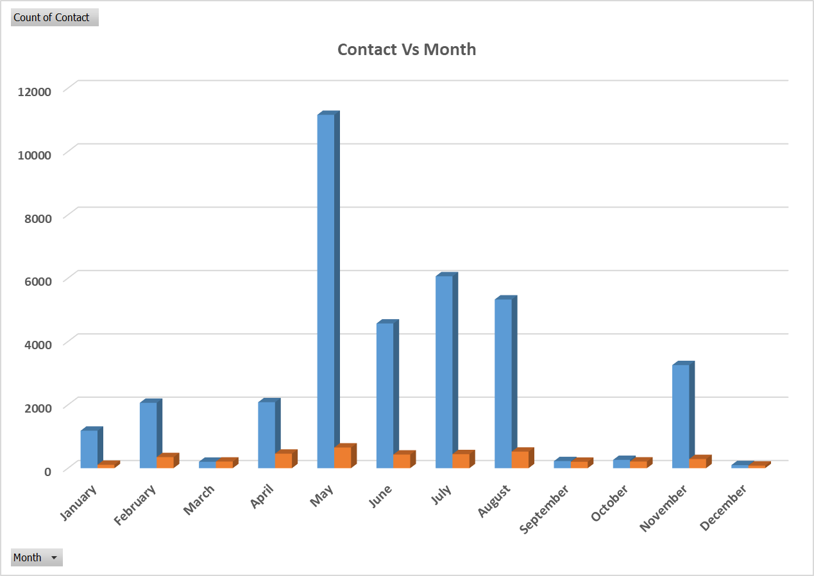
PART II : Bivariate Analysis Marketing Campaign Optimisation
Variables under consideration:
[Contact Vs Subscription]
Notes:
The largest number of contacts were made in May (11,157), followed by July (6,060) and June (4,569).
The months with the highest subscription rates were February (14.5%), March (16.1%), and September (32.2%), but these rates were based on relatively low numbers of contacts.
The months with the lowest subscription rates were January (8.3%), April (9.6%), and November (7.9%).
Overall, there were more contacts made with customers who did not subscribe to the term deposit (36,482) than with those who did (3,952).

Slide 28
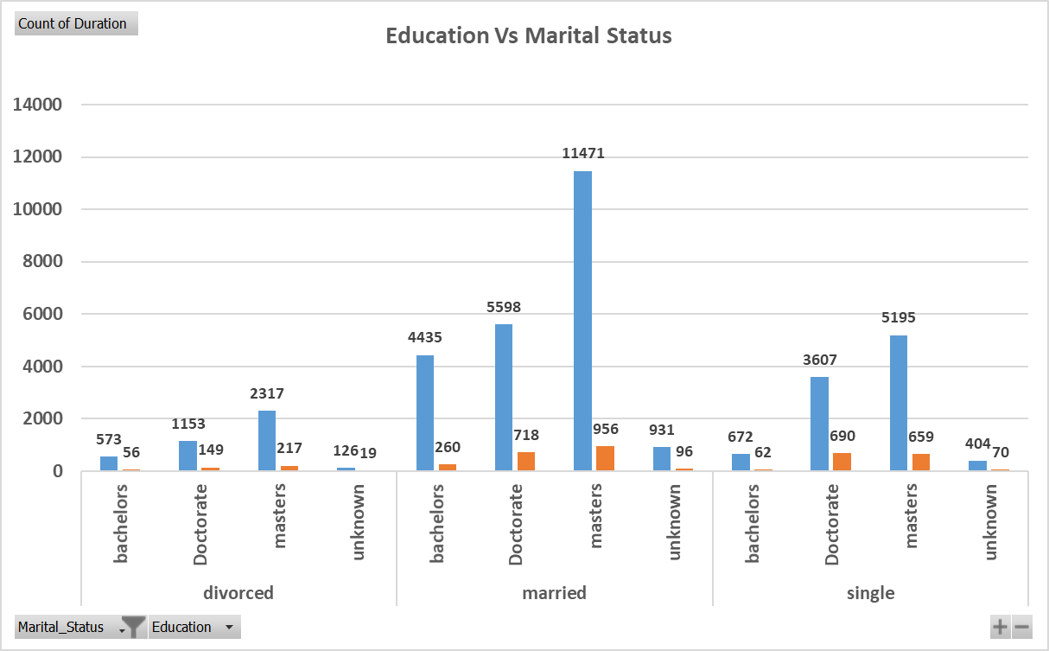
PART II : Bivariate Analysis Marketing Campaign Optimisation
Variables under consideration:
[Customer Segmentation
Marital Status and Education]
Notes:
Individuals who are "married" have the highest count of "no" (22,435) and "yes" (2,030) compared to other categories, while individuals who are "divorced" have the lowest count of "yes" (441) compared to other categories.

Slide 29
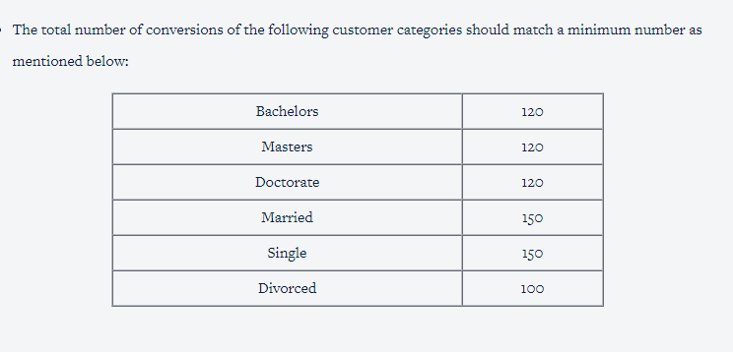
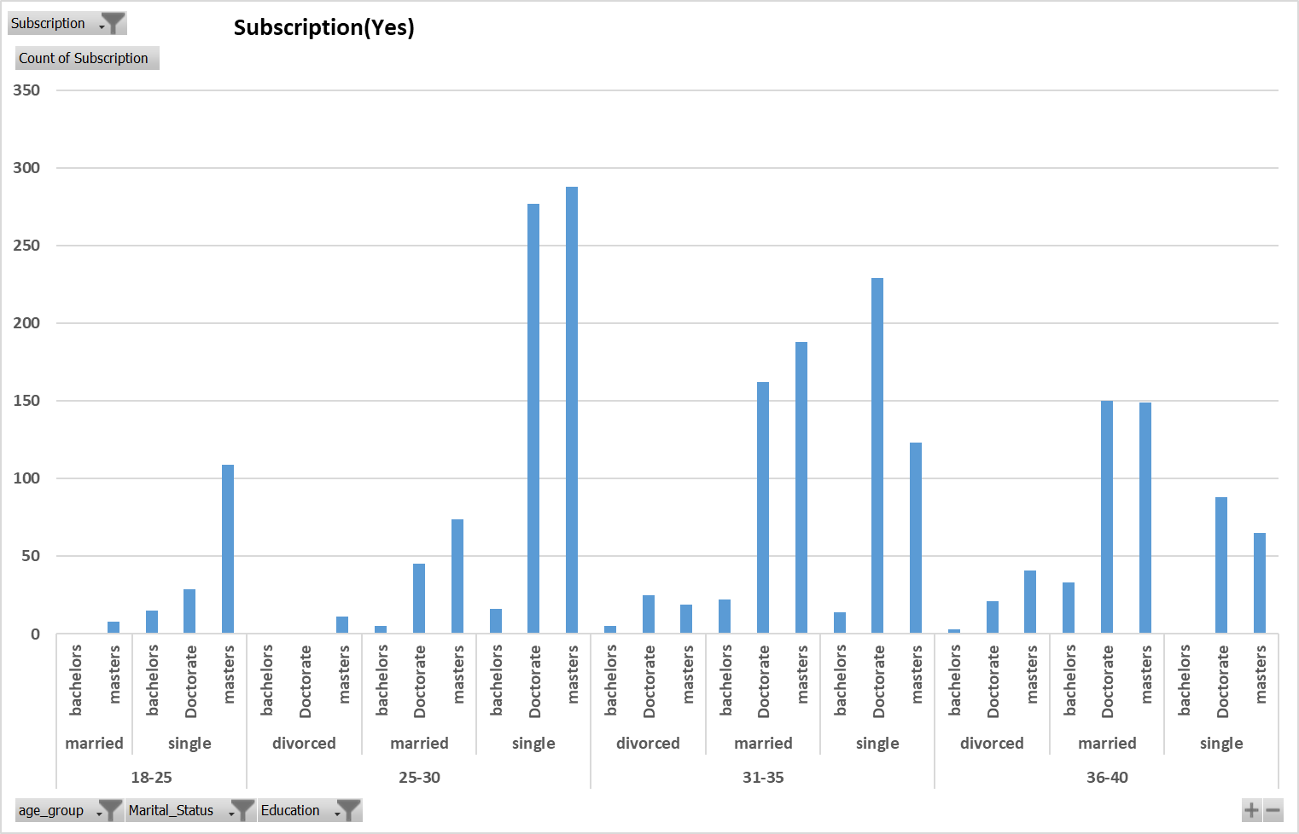
PART II : Bivariate Analysis Marketing Campaign Optimisation
Variables under consideration: [Segmentation of customers based on Age, Marital Status, Education and Subscription]

Slide 30
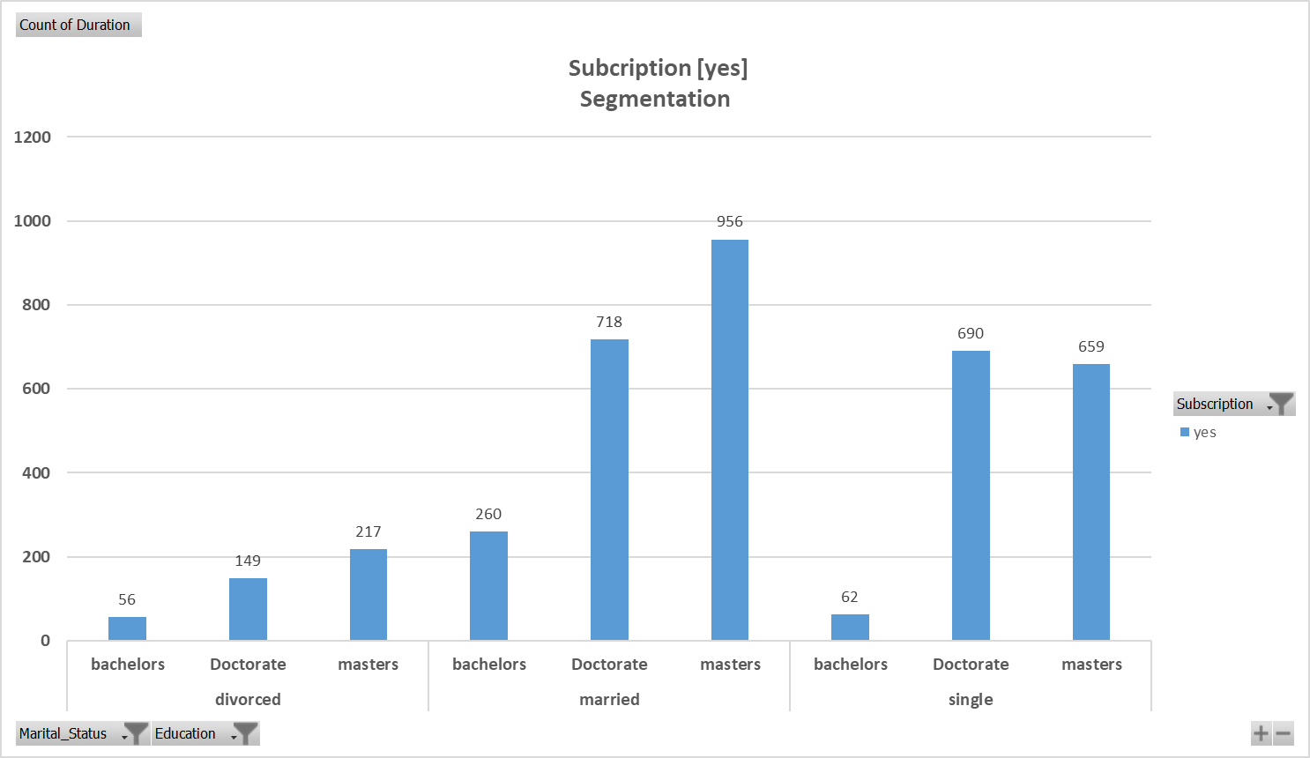
PART II : Bivariate Analysis Marketing Campaign Optimisation
Variables under consideration:
[Subscription, duration]

Slide 31
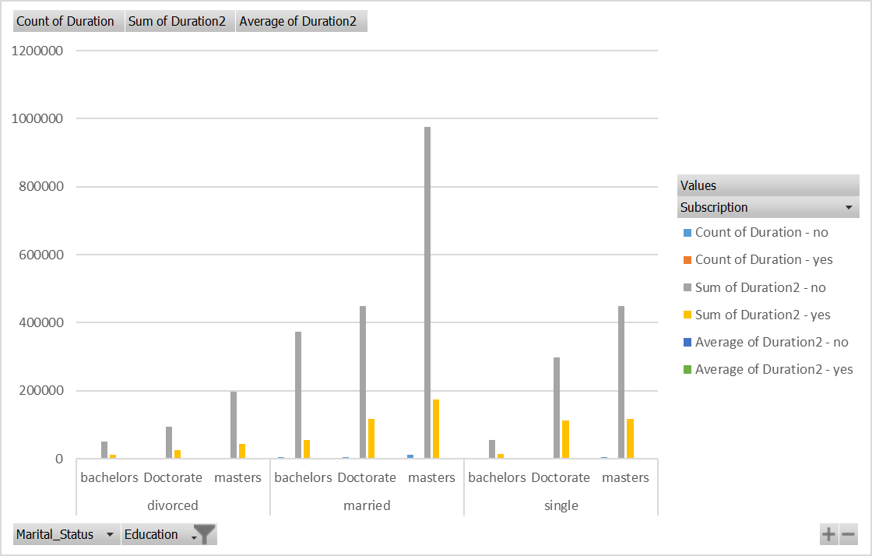
PART II : Bivariate Analysis Marketing Campaign Optimisation
Variables under consideration:
[Subscription, duration Segmentation
considering Marital Status and Educational]]

Slide 32
Notes:
Some insights that can be derived from this table are:
The majority of customers who were contacted were married and did not subscribe to the term deposit.
On average, customers who subscribed to the term deposit had a higher duration of contact compared to those who did not subscribe.
Customers with a doctoral degree had the highest average duration of contact, followed by those with a master's degree and then those with a bachelor's degree.
Divorced customers who subscribed to the term deposit had a higher average duration of contact compared to those who did not subscribe.
The total count and sum of the duration variables are higher for customers who did not subscribe to the term deposit, while the total count and sum of the duration squared variables are higher for customers who did subscribe to the term deposit.

Slide 33
PART III: Optimisation Results Marketing Campaign Optimisation

Slide 34
PART III: Optimisation Results Marketing Campaign Optimisation
Based on the given data and constraints, the total estimated number of converted calls for all customer segments is Rs 94,579. The total budget is limited to Rs150,000.
To meet the constraints, there are minimum requirements for the number of converted calls for each customer segment and the number of calls within certain sub-segments. For example, there must be at least 120 converted calls for the Bachelor customer segment and at least 150 converted calls for the Single customer segment. Additionally, there are minimum requirements for the number of calls within certain sub-segments, such as 50 converted calls for the Single-Bachelor sub-segment.
To optimize the marketing campaign, it is important to consider the cost per call and the conversion rate for each customer segment. For example, the cost per call is highest for the Married customer segment, but the conversion rate is also the highest for this segment. Therefore, it may be worth investing more in this segment to achieve higher conversion rates.
Overall, the marketing campaign should aim to balance the cost per call and the conversion rate across all customer segments and sub-segments to maximize the number of converted calls within the budget constraints.

Slide 35
PART IV: Major insights Marketing Campaign Optimisation
The majority of customers in the dataset are married (60.4%), followed by single (28.1%) and divorced (11.5%).
The most common contact month is May, followed by July and August.
The subscription rate is higher among customers who have a cellular phone (64%) compared to those who have a telephone (6%) or unknown (31%).
Among the customers who were contacted, the majority did not subscribe to the term deposit (90.1%).
Customers who have a higher education level (bachelors, masters, and doctorate) have a higher average duration of contact compared to those who have a lower education level (divorced, married, and single).
Management is the job type with the highest count of subscription, followed by technician and blue-collar.
The majority of customers who subscribed to the term deposit are married (64.9%), followed by single (23.3%) and divorced (11.8%).
The most common job type among customers who subscribed to the term deposit is management (29.7%), followed by technician (16.7%) and blue-collar (14.7%).

