Slide 1



Cutting the Cord: Trust Without the TA
Four contributions for UAV-assisted infrastructure-less IoVs: TA-offline authentication, TUAV handover, quorum eviction and a tether-split key
Phase 2 · Final presentation · Team 6
Swaraj Kumar
Hritik Ranjan
Harsh Raj
2025202016
2025202031
2025202005
.
Base paper: H. Tan, W. Zheng, P. Vijayakumar, “Secure and Efficient Authenticated Key Management Scheme for UAV-Assisted Infrastructure-Less IoVs,” IEEE Transactions on Intelligent Transportation Systems, vol. 24, no. 6, 2023
Notes:
[Part 1 · 0:20]
Good morning. We are Team 6. Our base paper is “Secure and Efficient Authenticated Key Management Scheme for UAV-Assisted Infrastructure-Less IoVs” by Tan, Zheng and Vijayakumar, published in IEEE Transactions on Intelligent Transportation Systems in 2023.
Our title is “Cutting the Cord: Trust Without the TA”. In Phase 2 we built four contributions that let this system work securely with the trusted authority offline, and we show the three weaknesses in the base scheme that motivated them. I will give the overview, then we move to the mathematics, and then to the security results.

Slide 2






Phase 1 recap: a tethered drone replaces the broken roadside unit
PART 1 · OVERVIEW
UAV network (battery, < 1 h)
TUAV + ECRV
Satellite + TA
Who does what
TA: issues each UAV's ⟨id_{i}, s_{i}⟩, keeps a copy, and checks every login with pairings.
TUAV: local base station; checks UAVs and hands out the group key.
UAVs: extend coverage; vehicles talk through them.
TUAV
tether:
power + data
Vehicles (V2V)
TA (far away)
ECRV (fire truck)
✗ roadside units (RSUs) down
Notes:
[Part 1 · 0:55]
First, a short reminder of Phase 1. After a disaster, the roadside units often stop working. The paper replaces them with a tethered UAV, the TUAV: a drone connected by a cable, the tether, to a fire truck called the ECRV, so it gets power and can fly for hours.
Normal battery UAVs extend the coverage, and vehicles talk through them. The trusted authority, the TA, is far away and is reached through a satellite link. The TA gives every UAV an identity and a secret s_i, and keeps a copy.
The paper claims all eleven security properties of its Table II, including key-escrow resilience, forward secrecy, non-repudiation and secure revocation.

Slide 3
How the base scheme works: five phases (Section IV)
PART 1 · OVERVIEW
IS1–IS5 · Setup
US1–US3 · UAV signs
GA1–GA4 · Authenticate
GD1–GD6 · Group key
DU1–DU2 · Update
TA
each UAV
TUAV ⇄ TA (satellite)
TUAV → UAVs
TUAV
TA → UAV i:
⟨id_{i}, s_{i}⟩
the TA keeps a copy
ξ_{i} = h₁(r_{i}) (public)
Γ_{i} = [s_{i}h₃(…)R_{tu} − h₁(s_{i}ξ_{i})]P
− υ_{i}ξ_{i}Q_{tu}
TA: 3 pairings per UAV
TUAV: ∏ψ_{i}(∏δ_{i})^{h2} = ∏μ_{i}^{Rtu}
Λ(x) = κ·Σω_{i}φ_{i} + ∏(x − σ_{i})
κ = Λ(σ_{i}) mod σ_{i}
join / leave → new Λ*(x)
members keep their σ_{i}
The CRT trick (Chinese Remainder Theorem)
What the paper claims (Sec. IV-D, Table II)
At a member's own key the product is 0, so Λ(σ_{i}) = κ·Σω_{i}φ_{i} — a number that leaves remainder κ modulo every σ_{i}.
Example: σ = 7, 11, 13 and κ = 5 → Λ(x) = x³ − 31x² + 311x + 9014.
Λ(7) = Λ(11) = Λ(13) = 10015, and 10015 mod 7 = mod 11 = mod 13 = 5 = κ.
“…the malicious entities that successfully collect the coefficient set {a_{i}} can not acquire the κ_{tu} without the correct decrypting key σ_{i}.”
Table II: ✓ key-escrow resilience · ✓ forward secrecy · ✓ non-repudiation · ✓ multi-device revocation
Notes:
[Part 1 · 1:05]
The protocol has five phases. In IS, the TA issues the secrets and stores them. In US, each UAV computes a credential Gamma_i from its secret s_i and sends it. In GA, the TUAV uploads the request over the satellite; the TA computes three pairings per UAV, and the TUAV checks one product equation for the whole group.
In GD, the TUAV builds a polynomial Lambda of x with the Chinese Remainder Theorem. Each member puts its own key sigma_i into the polynomial and takes the remainder modulo sigma_i. For example, with keys 7, 11 and 13 every member gets 10015, and 10015 mod each key is 5, the group key. In DU, when UAVs join or leave, a new polynomial is built and members keep their old sigma_i.
The paper says in Section IV-D that anyone who collects the coefficients cannot get the key without a correct sigma_i. We tested exactly these claims.

Slide 4
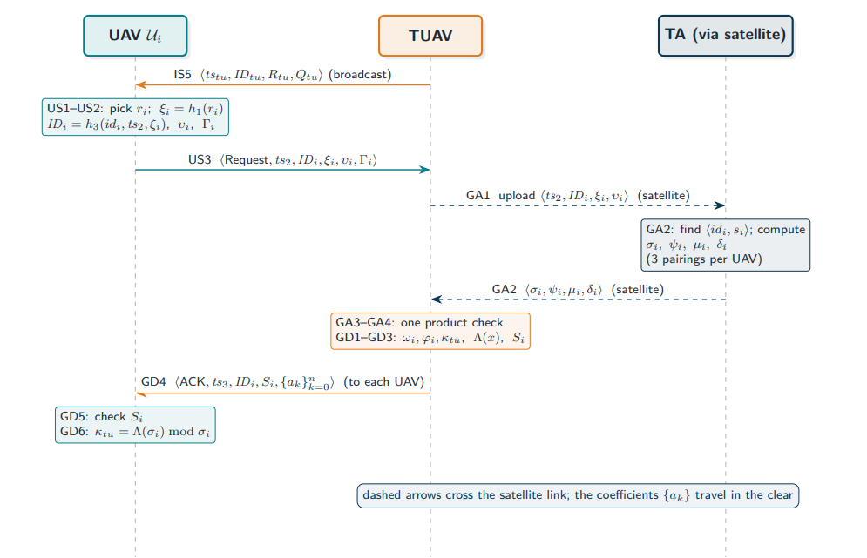
.

Slide 5
Phase 2: three flaws we proved, four things we added
PART 1 · OVERVIEW
F1 · The TA can sign as any UAV
C2 · Handover between TUAVs
the TA keeps every s_{i}; the rest of Γ_{i} is public
gap: one TUAV “covering the entire region” (IS4)
C1 · TA-offline authentication
F2 · The CRT key leaks — even to outsiders
certificateless keys, Schnorr-type signatures, batch check, one sealed key per member
→ removes F1, F2, F3
C3 · Voting out a compromised TUAV
one subtraction (member) or two broadcasts (anyone) reveal every σ_{i}
gap: no way to revoke a TUAV with the TA offline
F3 · No forward secrecy
C4 · Tether-split key
one leaked s_{i} opens every past group key
Once the TA leaves the field, the TUAV holds the trust → C2–C4 protect it
gap: a captured TUAV keeps its whole key
A1–A7 · we attacked our own first design and fixed seven flaws — one of them (A7) was found only by formal verification
Notes:
[Part 1 · 0:50]
Here is what we did in Phase 2. We proved three flaws, each as a theorem from the paper's own equations. F1: the TA can sign as any UAV. F2: the CRT group key leaks — to members, and even to an outsider who only listens. F3: there is no forward secrecy.
All three are fixed by our first contribution, C1: authentication with the TA offline and a separate sealed key for every member. Once the TA leaves the field, the TUAV holds all the trust, so we added three more: C2, handover between TUAVs; C3, voting out a compromised TUAV; and C4, splitting the TUAV's key across the tether. Finally, A1 to A7: we attacked our own design and fixed seven flaws.

Slide 6




Our framework at a glance
PART 1 · OVERVIEW
C2 · ticket + signatures both ways
Beforehand: setup by the TA
t votes
The TA issues certificateless credentials: sk = x + d.
x never leaves the device.
During the mission the TA is offline.
C1 · join in one local round trip: batch check + a sealed key per member
C4 · cut the tether → the drone's half key is useless
C3 · a hacked TUAV is voted out — TA still offline
In the field: no TA, no satellite
Notes:
[Part 1 · 0:45]
This is our whole framework in one picture. Before the mission, the TA gives every UAV and every TUAV a certificateless credential, and then it goes offline.
In the field, a UAV joins its TUAV in one local round trip, with no satellite. When a UAV flies to the next cell, it carries a signed ticket. If a TUAV's software is hacked, its neighbours vote it out. And if a TUAV is physically captured, its key is useless, because half of the key stays in a chip inside the fire truck.
Now Hritik will show the mathematics behind the three flaws and our first fix.

Slide 7
Flaw 1 · The TA can sign as any UAV (key escrow)
PART 2 · MATHEMATICS
Γ_{i} = [ s_{i}·h₃(ID_{i}, ts₂, s_{i})·R_{tu} − h₁(s_{i}ξ_{i}) ]·P − υ_{i}·h₁(r_{i})·Q_{tu} (US2)
The only secret is s_{i} — and the TA issued it and stored a copy (IS2).
Input of Γ_{i}
UAV
TA
Public
Why
Theorem 4.1 (TA forgery)
s_{i}
✓
✓
✗
issued + stored by TA
Whoever knows ⟨id_{i}, s_{i}⟩ logs in as UAV i:
1. pick any ξ′ (no r′ needed) and a fresh ts′
2. ID′ = h₃(id_{i}, ts′, ξ′), υ′ = h₄(…)
3. Γ′ = the same formula with ξ′
4. GA1–GA4 accept → it also gets κ (GD6)
ξ_{i} = h₁(r_{i})
✓
✓
✓
sent in clear (US3)
ID_{i}, υ_{i}, ts₂
✓
✓
✓
sent in clear (US3)
R_{tu}, Q_{tu}
✓
✓
✓
TUAV beacon (IS5)
Breaks Table II: key-escrow resilience ✗ · non-repudiation ✗ (Girault level 1). The paper's Theorem 4 calls r_{i} the UAV's “partial key” — but r_{i} appears only as ξ_{i} = h₁(r_{i}), which is sent in the clear.
Notes:
[Part 2 · 0:55]
Thank you. Flaw 1: the TA can sign as any UAV. Look at the credential Gamma_i from step US2. The only secret in it is s_i — but in step IS2 the TA issued s_i and kept a copy.
Every other value is public: xi_i equals h1 of r_i and is sent in the clear, and ID_i, upsilon_i, the timestamp, R_tu and Q_tu are public too. So the TA — or anyone who steals the TA's database — picks any xi, computes the same formula, and the TUAV accepts. We prove this as Theorem 4.1, TA forgery; the forger even gets the group key.
This breaks two claims of Table II: key-escrow resilience and non-repudiation. The paper calls r_i the UAV's partial key, but r_i only appears as xi_i, which is public.

Slide 8
Flaw 2 · One subtraction reveals every member's key
PART 2 · MATHEMATICS
GD2 — only the constant term is masked
Λ(x) = κ·Σω_{i}φ_{i} + ∏(x − σ_{i})
Lemma 5.1: Λ(σ_{j}) = C for every member j (the product is 0 there)
Λ(x) − C = ∏ (x − σ_{i})
Theorem 5.2: integer roots (Rational Root Theorem, LLL) give every σ_{i} — a routine computation, not brute force.
(a) Revocation fails
(b) Backward secrecy fails
Λ(x) = x³ − 31x² + 311x + 9014 meets C = 10015 at 7, 11, 13.
Insider (σ = 7): Λ(x) − 10015 = (x − 7)(x − 11)(x − 13).
After it is removed: Λ*(x) = x² − 24x + 1439 → Λ*(11) mod 11 = 9 = the new key ✗
removed UAV:
κ* = Λ*(σ_{k}) mod σ_{k}
with a stolen σ_{k}
new UAV:
old κ = Λ(σ_{j}) mod σ_{j}
from a recorded broadcast
Notes:
[Part 2 · 0:55]
Flaw 2 is in the group key. The polynomial is Lambda of x equals kappa times the CRT sum, plus the product of x minus sigma_i. Only the constant term is masked.
At every member's key the product is zero, so Lambda of sigma_j is the same number C for everybody. A member computes C, subtracts it, and gets the product of x minus sigma_i. Its roots are every member's key, and finding integer roots is a routine computation, not brute force. In our example the polynomial minus 10015 factors as x minus 7, x minus 11, x minus 13.
Two results follow. A removed UAV still computes the new key, so revocation fails. And a new UAV reads the old keys, so backward secrecy fails.

Slide 9
Flaw 2 · Even a passive outsider gets every key
PART 2 · MATHEMATICS
Vieta's formulas (Lemma 5.5)
Example: keys 5, 7, 11 — the UAV with key 5 leaves
a_{n−1} = −(σ₁ + σ₂ + … + σ_{n}) — not masked!
before: Λ(x) = x³ − 23x² + 167x + 1928
after: Λ′(x) = x² − 18x + 389
① σ = 23 − 18 = 5
② q₀ = 167 + 5·(−18) = 77
③ x² − 18x + 77 = (x − 7)(x − 11) → keys 7, 11
④ new key: 389 − 77 = 312, 312 mod 7 = 4 ✓
old key: 2313 mod 7 = 3 ✓
Theorem 5.6 (passive outsider key recovery)
1. Record two broadcasts: before and after one UAV leaves (or joins).
2. Compare the sums: σ = S − S′ is the leaver's key.
3. Remove the mask: q₀ = a₁ + σ·a′₁ (leave), p₀ = a′₁ + σ·a₁ (join).
4. Roots → every σ_{i} → the old and the new group key.
Also checked at the paper's size: 160-bit keys, 12 UAVs, join and leave. Works for several leaves or joins at once (Prop. 5.7). Open: a single broadcast; mixed updates.
Paper, Sec. IV-D: “…the malicious entities that successfully collect the coefficient set {a_{i}} can not acquire the κ_{tu} without the correct decrypting key σ_{i}.” → contradicted word for word.
Notes:
[Part 2 · 1:10]
Now our strongest result: even an outsider who never registered gets every key. By Vieta's formulas, the second coefficient of the polynomial is minus the sum of all keys, and it is not masked.
So the attacker records two broadcasts, before and after one UAV leaves. Before: minus 23. After: minus 18. 23 minus 18 is 5 — the key of the UAV that left. One more line removes the mask: q0 equals 167 plus 5 times minus 18, which is 77. So the new product is x squared minus 18x plus 77, that is x minus 7 times x minus 11. Now the attacker has every key and computes both group keys, 3 and 4.
This contradicts the paper's own sentence in Section IV-D word for word. We checked it at the paper's size, 160-bit keys with 12 UAVs, for join and leave, and it also works when several UAVs leave at once. Two cases are still open: a single broadcast, and an update that mixes joins and leaves.

Slide 10
Flaw 3 · One leaked secret opens every past session
PART 2 · MATHEMATICS
σ_{i} = h₁(s_{i}·ξ_{i})·P
s_{i}: long-term secret · ξ_{i}: sent in the clear · nothing fresh and secret
session 1
session 2
session 3
later: s_{i} leaks
recorded: ξ⁽¹⁾, {a_{k}⁽¹⁾}
recorded: ξ⁽²⁾, {a_{k}⁽²⁾}
recorded: ξ⁽³⁾, {a_{k}⁽³⁾}
captured UAV or breached TA
time
κ⁽¹⁾ recovered ✗
κ⁽²⁾ recovered ✗
κ⁽³⁾ recovered ✗
κ^{(t)} = Λ^{(t)}(σ_{i}^{(t)}) mod σ_{i}^{(t)} for every past session t
Theorem 6.1 (retroactive key recovery)
Table II claims forward secrecy ✓ → ✗
one leak of s_{i} → every past group key of that UAV; with Flaw 2, every other member's σ too
and the TA, which stores every s_{i}, can open the past at will
Notes:
[Part 2 · 0:40]
Flaw 3: no forward secrecy. The decrypting key sigma_i is h1 of s_i times xi_i, times P. s_i is a long-term secret and xi_i is public; nothing fresh and secret is used.
So if s_i ever leaks — for example from a captured UAV — the attacker takes the recorded broadcasts and recomputes the group key of every past session. That is our Theorem 6.1. And the TA, which stores every s_i, can do this at any time. Yet Table II claims forward secrecy.

Slide 11
Contribution 1 · Authentication with the TA offline
PART 2 · MATHEMATICS
① Keys: certificateless
② Sign + batch check
③ One sealed key per member
TA, before the mission:
Y = yP, h = H₁(PID‖ep‖X‖Y)
d = y + s·h
UAV adds its own secret x:
sk = x + d
pk = X + Y + h·P_{pub}
the TA never sees x
R = rP, c = H₂(m‖…‖R)
v = r + c·sk
check: vP = R + c·pk
many at once, random 64-bit λ_{i}:
(Σλ_{i}v_{i})P = Σλ_{i}R_{i}
+ Σλ_{i}c_{i}(X_{i} + Y_{i}) + (Σλ_{i}c_{i}h_{i})P_{pub}
batch fails → check one by one
K_{i} = KDF(e_{a}E_{i} ‖ PID_{i} ‖ …)
C_{i} = Enc(K_{i}, GK ‖ ν)
one broadcast: all C_{i}
fresh GK on every join and leave
e_{a}, e_{i} erased after use
F1 → the TA never sees x
F2 → no public polynomial
F3 → fresh e, erased
Notes:
[Part 2 · 0:50]
Our first contribution removes all three flaws. One: keys are certificateless. The TA gives a partial key d, and the UAV adds its own secret x, so sk equals x plus d and pk equals X plus Y plus h times P_pub. The TA never sees x, so it cannot sign: that fixes F1.
Two: each request carries a Schnorr-type signature, and the TUAV checks many of them at once with random 64-bit weights; if the batch fails, it checks them one by one.
Three: the group key goes to each member separately, encrypted under a fresh Diffie–Hellman key. Nothing public depends on the members' keys, so F2 is gone, and the Diffie–Hellman values are erased, so F3 is gone.

Slide 12
Contribution 1 · Security theorems and numbers
PART 2 · MATHEMATICS
Unforgeability (Thm 7.4)
0
≈230 ms
Forking Lemma ⇒ ECDLP, for an outsider (Type I) and a malicious TA (Type II)
pairings per login round
(base paper: 3n at the TA)
vs ≈3720 ms + satellite trip
(120 UAVs, paper's own constants)
Batch soundness (Thm 7.5)
Bellare–Garay–Rabin test: a bad batch passes with probability ≤ 2⁻⁶⁴
No key escrow (Thm 7.6)
the TA cannot sign as a UAV: Girault level 2 (base paper: level 1)
Group-key secrecy (Thm 7.7)
outsider, removed member, newcomer learn nothing: CDH + AEAD
Forward secrecy (Thm 7.8)
old keys need e_{a}e_{i}P: CDH on erased exponents
Notes:
[Part 2 · 0:55]
Here are the security results for C1. Unforgeability reduces to the elliptic-curve discrete logarithm through the forking lemma, both for an outsider and for a malicious TA. A batch that contains a bad request passes with probability at most 2 to the minus 64, by the Bellare–Garay–Rabin test. The TA cannot sign as a UAV, so we move from Girault level 1 to level 2. Group-key secrecy, revocation and backward secrecy follow from CDH and authenticated encryption, and forward secrecy from erasing the exponents.
In numbers, using the paper's own cost constants: zero pairings instead of 3n; about 230 milliseconds instead of about 3.7 seconds plus a satellite trip for 120 UAVs; and 9.6 kilobytes of key traffic instead of 17.4 megabytes.
Now Harsh will show how we protect the TUAV, and the security results.

Slide 13
Contribution 2 · Handover between TUAVs
PART 3 · SECURITY
old TUAV T_{a}
member M
new TUAV T_{b}
Gap in the paper
HO0 · signed ECDH → shared link key K_{ab}
IS4: one TUAV “covering the entire region” — every move means a new login via the TA
HO1 · ticket Tk (under K_{ab}) + hk
Why it is secure
• hk, not K_{M}: the new TUAV never learns the old key
• fresh ECDH → forward secrecy
• nonce + expiry: a ticket works once
• signatures both ways (A2, A7)
HO2 · Tk, E = eP, signed by M (A2)
HO3: check expiry, nonce, MAC, signature; K′ = KDF(e_{b}E‖hk‖…); rekey
E_{b}, Enc(K′, GK_{b}), signed by T_{b} (A7)
Theorem 8.1 · formal verification
rekey after M leaves
HO4: check signature, derive K′
Dolev–Yao model, old TUAV captured: all 5 properties hold. No TA; saves the beacon wait (≈500 ms at a 1 s beacon).
Notes:
[Part 3 · 0:55]
Thank you. After C1 the TUAV holds the trust in its cell, so the next three contributions protect it. C2 is handover. The paper assumes one TUAV covering the entire region, so a UAV that moves must log in again through the TA.
In C2, neighbouring TUAVs share a link key. The old TUAV gives the moving UAV a one-time ticket with a handover key hk. The UAV shows the ticket to the new TUAV with its own signature and a fresh Diffie–Hellman value, and the new TUAV replies with its own signature.
Formal verification in the Dolev–Yao model, with the old TUAV captured, showed that both signatures are needed; with both, all five properties hold. There is no TA and no wait for a beacon.

Slide 14
Contribution 3 · Vote out a compromised TUAV
PART 3 · SECURITY
T₁
A valid certificate
V1 ≥ t distinct TUAV signers
V2 the target is not a signer
V3 every vote names the same target
V4 weighted batch check holds (TUAV role ep = 0)
evidence
T₇
compromised
certificate
≥ t distinct votes
“evict T₇”
T₂
Theorems 9.2 and 9.3
Safety: ≤ t − 1 compromised ⇒ an honest TUAV is never evicted.
Liveness: t honest voters ⇒ the certificate forms.
Choose t = f + 1; liveness needs n_{T} ≥ 2f + 1.
T₃
members check V1–V4, block T₇ for ever, re-join a neighbour (full join, C1)
T₇'s members
Known pattern, new use
PBFT view change (Castro–Liskov 1999) — here for key management with the TA offline
Notes:
[Part 3 · 0:50]
C3: voting out a compromised TUAV. With the TA offline, nobody can revoke a TUAV whose software is hacked. In C3, neighbouring TUAVs that see evidence each sign a vote.
A certificate is valid if it has at least t distinct signers, the target is not a signer, all votes name the same target, and the batch check passes. Every UAV can check it with public keys alone.
Our safety theorem: if at most t minus 1 TUAVs are compromised, an honest TUAV is never evicted. The liveness theorem: t honest voters are enough. It is the same pattern as the view change in PBFT, used here for key management with the TA offline.

Slide 15

Contribution 4 · Split the TUAV's key across the tether
PART 3 · SECURITY
drone: a = x_{A}
Joint Schnorr signature over the tether
alone it signs nothing
sk = a + g
R = R_{A} + R_{G}, c = H₂(m ‖ … ‖ R)
v = (r_{A} + c·a) + (r_{G} + c·g)
vP = R + c·pk ✓ an ordinary signature: UAVs see no change
cut → chip refuses + pre-signed kill notice
Theorem 10.2 · half a key is useless
chip in ECRV:
(v − c·a)P = R + c·G with G = gP ⇒ forging with a = forging under G ⇒ needs the ECDLP
g = x_{G} + d
Safe protocol
Cost
Known vs new
pk = aP + gP — unchanged; nobody holds a + g
commit-then-reveal (no ROS attack) or FROST, RFC 9591
drone +0.012 ms; chip 0.90 ms in parallel; ≈200 bytes
mediated crypto (2001), FROST; new: helper = ECRV, switch = tether
Notes:
[Part 3 · 0:55]
C4 is our most original idea: the tether-split key. The TUAV's key is split in two, sk equals a plus g. The drone keeps a, and a small secure chip in the fire truck keeps g. To sign, both work together over the tether, and the result is an ordinary Schnorr signature, so UAVs see no change.
If the drone is captured, it has only a. Our theorem shows that forging with a is as hard as forging with no key at all, which needs the discrete logarithm. When the tether is cut, the chip refuses to sign and the truck broadcasts a pre-signed kill notice.
We use commit-then-reveal, or the FROST standard, to avoid the ROS attack. The cost is tiny: 0.012 milliseconds extra for the drone.

Slide 16
We attacked our own design first: A1–A7
PART 3 · SECURITY
Flaw in our first design
Fix in the final design
Found by
A1
one forged packet naming a UAV got that UAV evicted
a failed signature never evicts anybody
review
A2
a captured TUAV could mint handover tickets
the member signs its own request (HO2)
review + formal
A3
a captured TUAV could frame a member at a neighbour
evictions cross cells only with checkable evidence
review
A4
a credential for one role could claim another
the role is bound into the identity (ep inside h)
review
A5
a replayed old rekey could roll the key back
key versions may only increase
review
A6
a newcomer received the key already in use
rekey on every arrival
review
A7
a captured old TUAV could pose as the new TUAV
the new TUAV signs its reply (HO3)
formal verification
A7 survived three careful readings and was found only by the symbolic model — that is why we report formal verification.
Notes:
[Part 3 · 0:40]
Before finishing the design, we attacked our own first version, the way a reviewer would, and found seven flaws, A1 to A7.
For example, A2: a captured TUAV could create handover tickets, so now the member signs its own request. A5: an old rekey could be replayed, so versions only increase. A6: a newcomer got the key already in use, so we rekey on every arrival. And A7 — a captured TUAV pretending to be the new TUAV — was found only by formal verification.

Slide 17
Results · base paper vs our design
PART 3 · SECURITY
Property
Base paper
Our design
6 of 6
The TA cannot sign as a UAV
✗ level 1
✓ level 2
attacks that apply to the base paper succeed — every one fails on ours
A removed UAV cannot read new keys
✗
✓
A new UAV cannot read old keys
✗
✓
0 vs 3n
An outsider learns nothing from broadcasts
✗
✓
Forward secrecy
✗
✓
pairings per login round
Login works with the TA offline
✗
✓
≈1800×
Handover between TUAVs
—
✓
Remove a compromised TUAV
—
✓
less key traffic (9.6 KB vs 17.4 MB, 120 UAVs)
A captured TUAV cannot impersonate the TUAV
✗
✓
Notes:
[Part 3 · 0:45]
Here are the results side by side. Against the base paper, all six attacks we studied succeed: the TA forges a UAV, a removed UAV reads new keys, a newcomer reads old keys, an outsider compares two broadcasts, a stolen secret opens the past, and a captured TUAV keeps acting as the TUAV.
Against our design each one fails, and each failure is backed by a theorem. It is also cheaper: zero pairings, and about eighteen hundred times less key traffic for 120 UAVs.

Slide 18
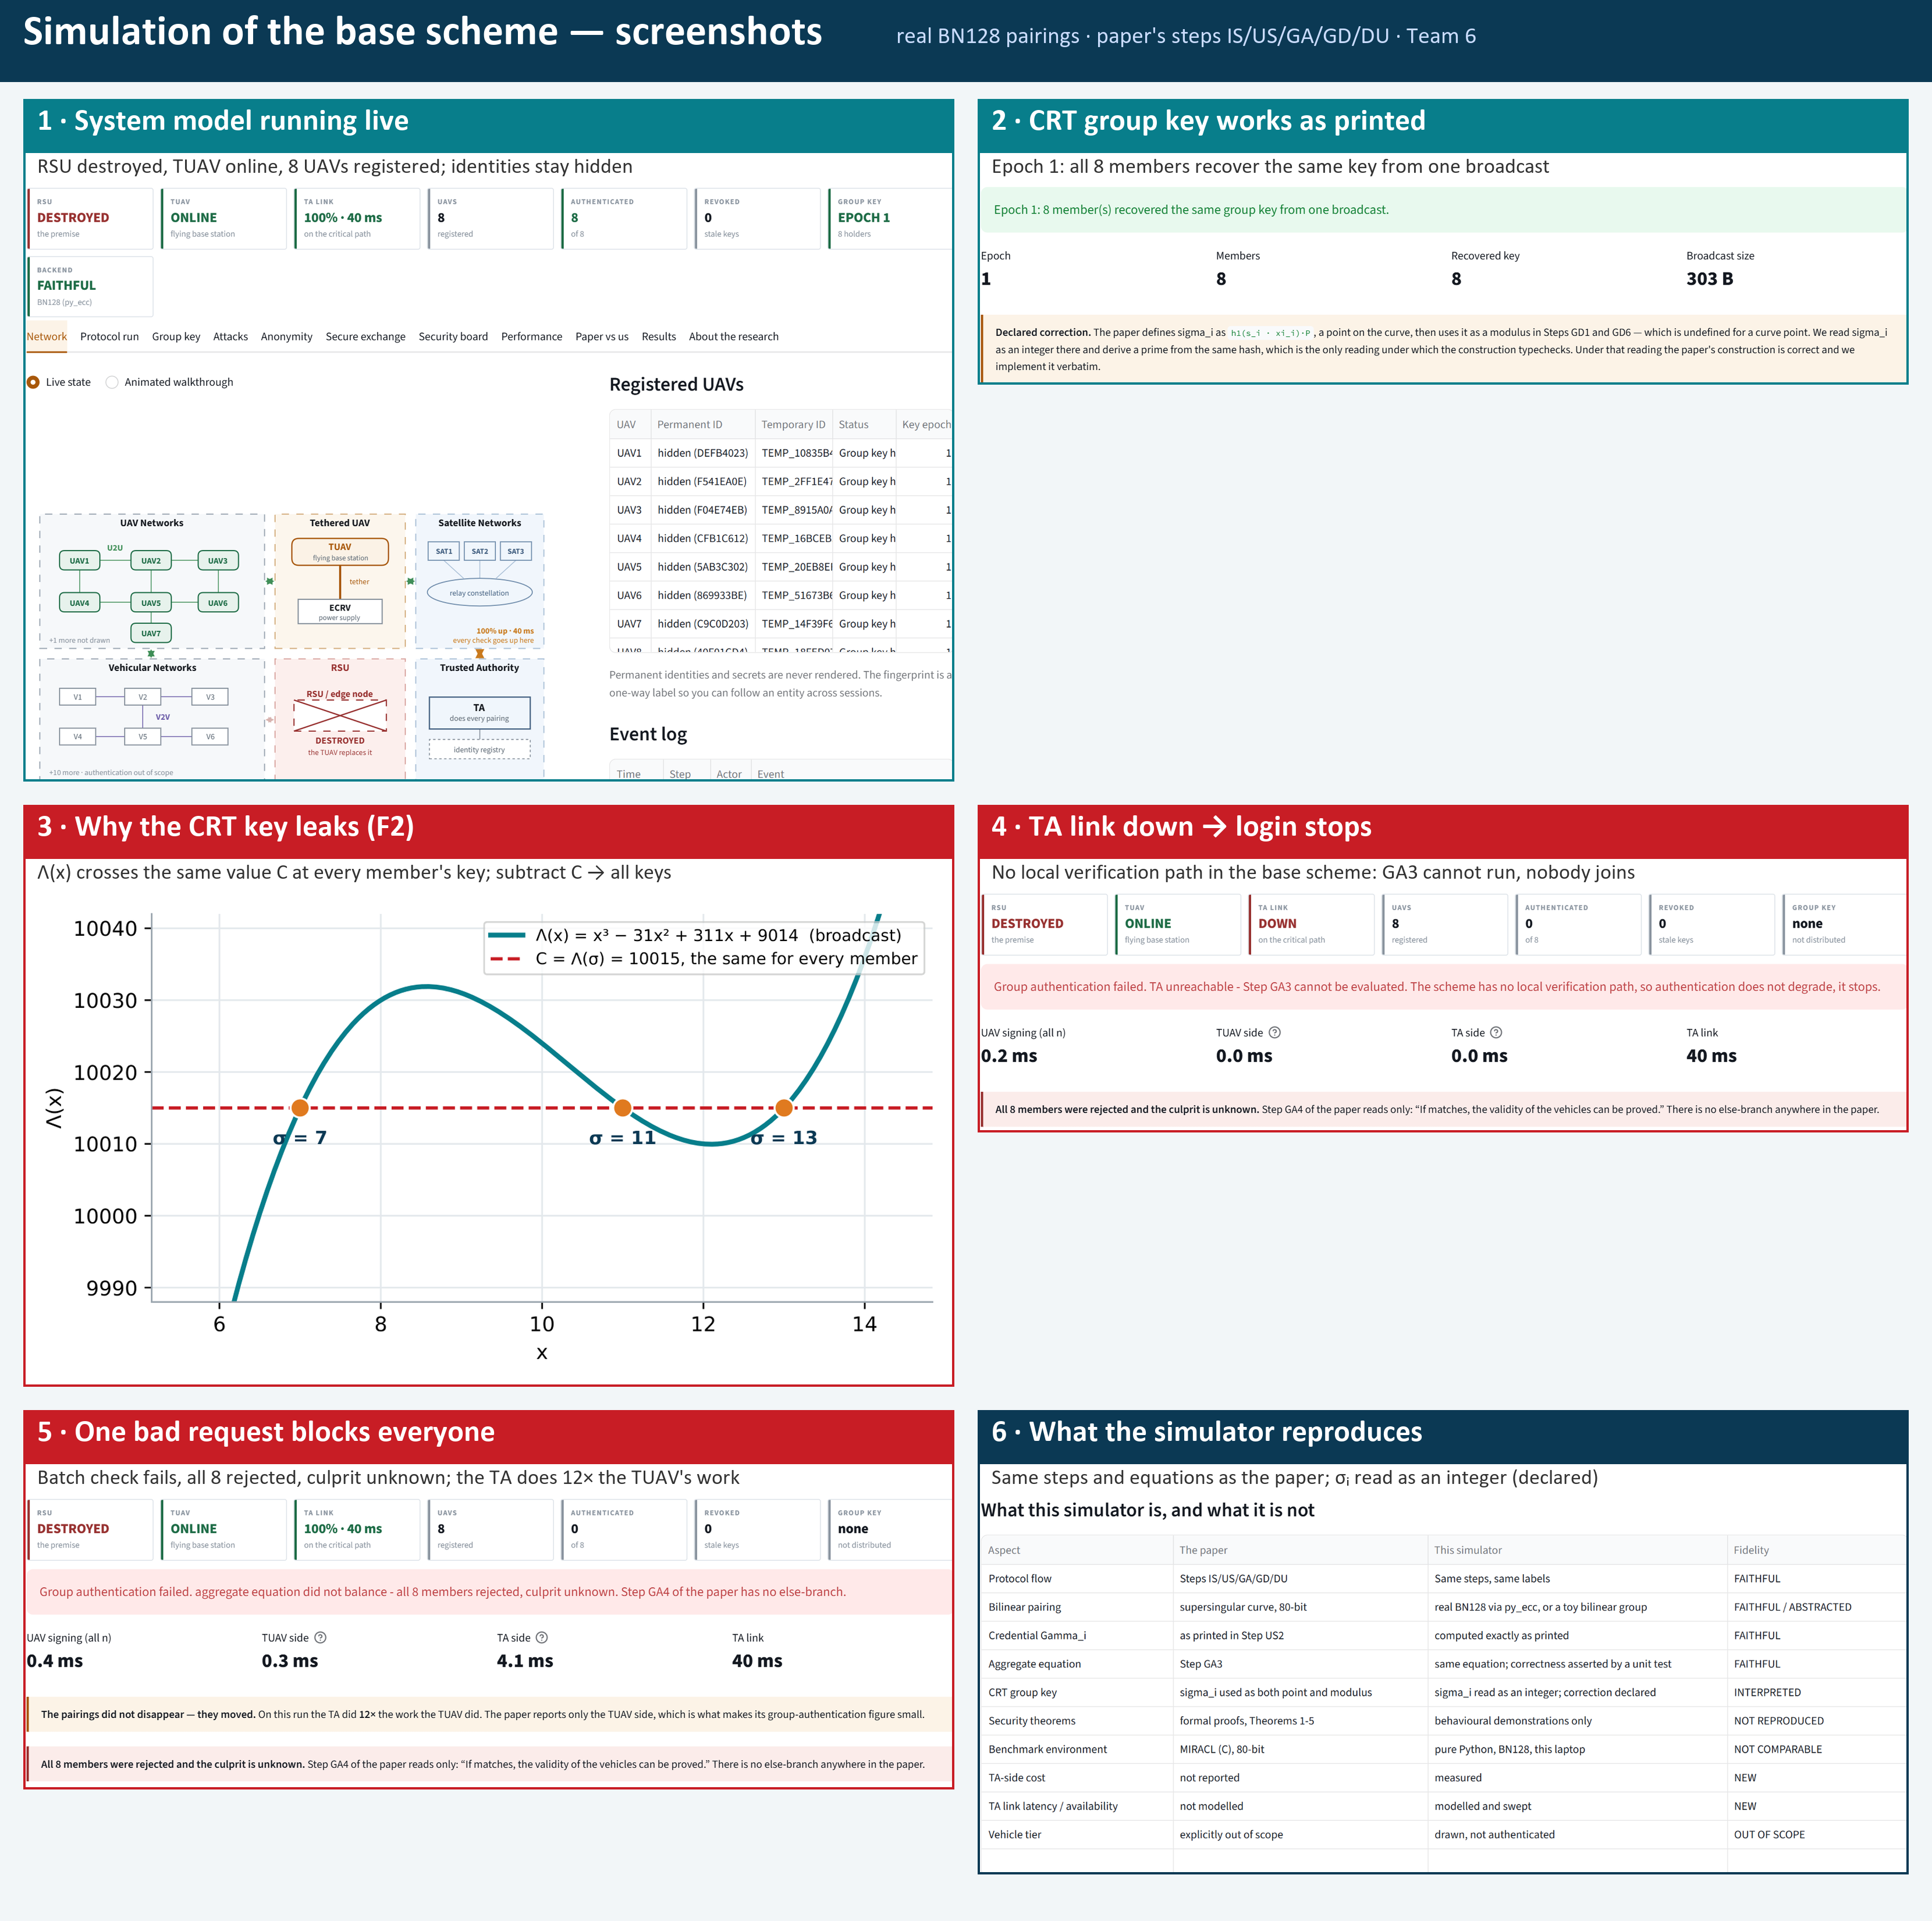
.

Slide 19
Conclusion
PART 3 · SECURITY
What we showed
Future work
• Three flaws, each a theorem with a worked example: TA impersonation, CRT key leakage (insider and passive outsider), no forward secrecy.
• A design that keys UAVs with the TA offline (C1), and protects the TUAV that inherits the trust: handover (C2), quorum eviction (C3), tether-split key (C4).
• Security backed by named results: Forking Lemma, Small-Exponent Test, CDH, PBFT-style quorum, formal verification.
• outsider attack from a single broadcast, or mixed joins and leaves
• a formal model of the tether-split signing protocol
• a test on a real tethered drone and ECRV
The paper cut the cable to the roadside unit but kept a far-away authority and a leaky polynomial inside every key. We take the authority out of the field, seal each member's key separately, and protect the drone that inherits the trust.
Thank you — questions?
Notes:
[Part 3 · 0:30]
To conclude: the paper had a good idea — a tethered drone instead of a broken roadside unit — but it kept the authority inside every key and used a polynomial that leaks.
We took the authority out of the field, sealed each member's key separately, and protected the drone that holds the trust: by handover tickets, by voting, and by splitting its key across the tether. Thank you; we are happy to take questions.

