Slide 1
Dublin Business School
Masters in Artificial Intelligence
Module - Machine Learning and Pattern Recognition (B9AI102_2122_TMD2)
Lecturer - Dr Shahram Azizi

Slide 2
Fraud Detection Model for Insurance Claims
Submission - Class Assessment - 1 (CA_1)
Submission by - Group 1 1. Swaraj Shaw
2. Kumari Anjali
3. Gautam Upadhyaya

Slide 3
What is Insurance Fraud?
Fraud affects every type of insurance, whether it is non-life insurance, life and protection cover or health insurance. It includes:
providing untruthful or incomplete information in applications for insurance or answers on an insurance proposal form;
submitting a claim for a loss based on misleading or untruthful circumstances, including exaggerating a genuine claim; and
otherwise being misleading or untruthful in dealings with an insurer with the intention of gaining a benefit under the insurance contract.
Insurance fraud may be committed by the policyholder or by a third party claiming against an insurance policy. It can range from opportunistic claims, through claims for phantom passengers and fictitious injuries in road accidents, to highly organized crime rings.
Source - InsuranceEurope.eu

Slide 4
Example
In Slovenia, three individuals took out several life and injury insurance policies each before travelling to Canada on holiday. While there, they allegedly sustained personal injuries in a car accident and claimed for their injuries under their policies. It was later discovered that all three had made insurance claims for other accidents during the period of injury. Criminal and civil charges were brought and the individuals were made to pay all the costs of investigating the fraud and to repay the sums already paid out under the insurance policies.
Source - InsuranceEurope.eu

Slide 5
Business Problem
Vehicle insurance fraud ranges from misrepresenting facts on insurance applications and inflating insurance claims to staging accidents and submitting claim forms for injuries or damage that never occurred, to false reports of stolen vehicles.
Fraud accounted for between 15 percent and 17 percent of total claims payments for auto insurance bodily injury in 2012, according to an Insurance Research Council (IRC) study. The study estimated that between $5.6 billion and $7.7 billion was fraudulently added to paid claims for auto insurance bodily injury payments in 2012, compared with a range of $4.3 billion to $5.8 billion in 2002.
Source : Insurance Information Institute

Slide 6
Problem Statement
The objective is to use Machine Learning algorithm to detect and classify insurance claims as fraudulent or non fraudulent based on the customer/policy holder records.
Also, to propose a solution which can automate the claim settlement process and help in faster decision making and hence reducing the manpower cost incurred with respect to manual processing of insurance claims.

Slide 7

Proposed Solution & Approach
aws documentation
The end solution is proposed to be a cloud based Machine Learning model built by utilizing AWS services to predict fraudulent insurance claims. The solution includes automating and building a robust ML Pipeline which then is deployed at a web interface.
Amazon Sagemaker: Amazon SageMaker is a fully managed service that enables developers and data scientists to quickly and easily build, train, and deploy machine learning models at any scale.
Amazon Sagemaker Clarify: Amazon SageMaker Clarify helps improve your machine learning models by detecting potential bias and helping explain how these models make predictions. The fairness and explainability functionality provided by SageMaker Clarify takes a step towards enabling AWS customers to build trustworthy and understandable machine learning models.
Amazon Sagemaker Feature Store: Amazon SageMaker Feature Store is a fully managed, purpose-built repository to store, update, retrieve, and share machine learning (ML) features.

Slide 8
Proposed Solution & Approach
aws documentation
Amazon S3: Amazon Simple Storage Service (Amazon S3) is an object storage service offering industry-leading scalability, data availability, security, and performance.
AWS Identity Access Management : AWS Identity and Access Management (IAM) provides fine-grained access control across all of AWS. With IAM, you can specify who can access which services and resources, and under which conditions. With IAM policies, you manage permissions to your workforce and systems to ensure least-privilege permissions.
AWS Lambda: AWS Lambda is a serverless, event-driven compute service that lets you run code for virtually any type of application or backend service without provisioning or managing servers.
Amazon API Gateway: Amazon API Gateway is a fully managed service that makes it easy for developers to create, publish, maintain, monitor, and secure APIs at any scale.

Slide 9
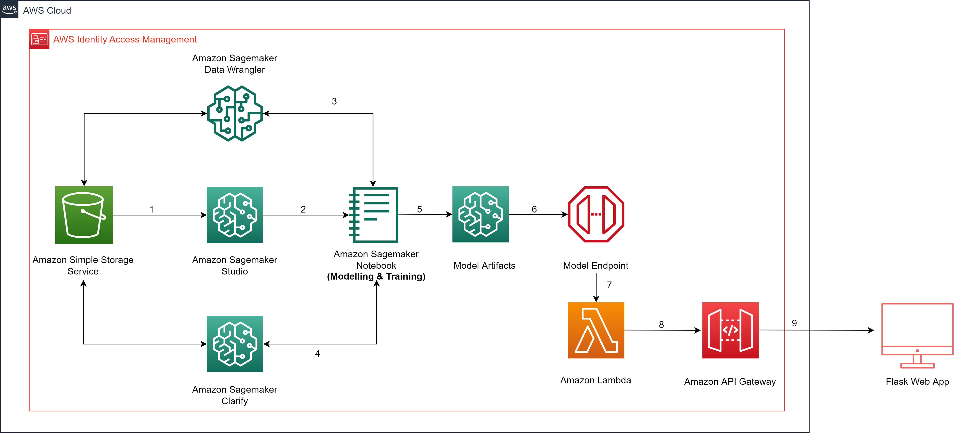
Architecture

Slide 10
Dataset
The dataset in sourced from the internet and contains both customer and claims data.
The ‘claims’ dataset have 5001 records excluding the headers and contains 11 features.
The ‘customer’ dataset have 5001 records excluding the headers and contains 13 features respectively.
Both the dataset was joined before modelling.
Source: Insurance Dataset

Slide 11
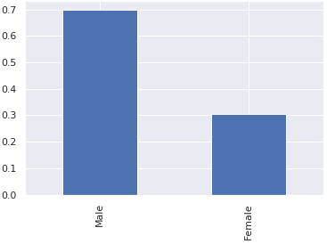
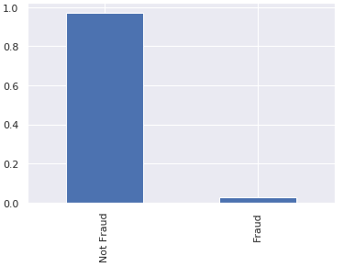
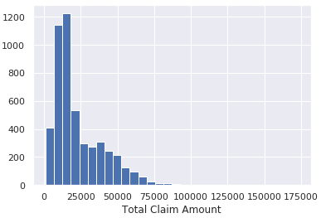
Data Insights
Gender Imbalance was observed in the customer dataset.
Class Imbalance was observed in the claims dataset as most records tend to be ‘not frauds’.
The claim amount is found to be in range up to (max) $80000 (outlier). But 1200 claims are found to be below amount $25000.

Slide 12
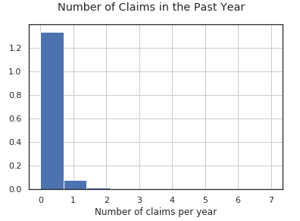
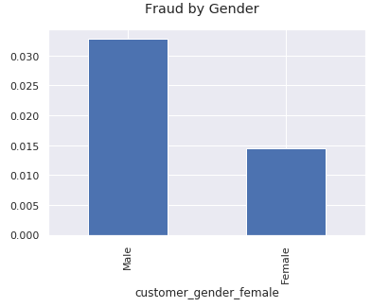
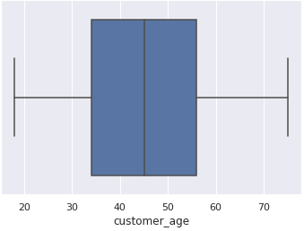
Data Insights
No claims were filed for last year, very less people have filed more than 3 claims per year from the sample size
The dataset comprises of records of customers from 18-75 years of age.
Males commit more fraud due to less data samples for females.

Slide 13
Data Wrangler Pre Processing
One hot and ordinal encoding was applied on both datasets for expressive representation of categorical features in the dataset.
All nulls were handled by AWS DataWrangler.
Both the datasets are uploaded on a Amazon S3 bucket.
In preprocessing step the raw dataset is prepared and transformed for any datatype mismatch, encoding issues, one hot encoding in Amazon Sagemaker DataWrangler.
After preprocessing the output flow steps are stored back to S3 bucket in .flow format.

Slide 14
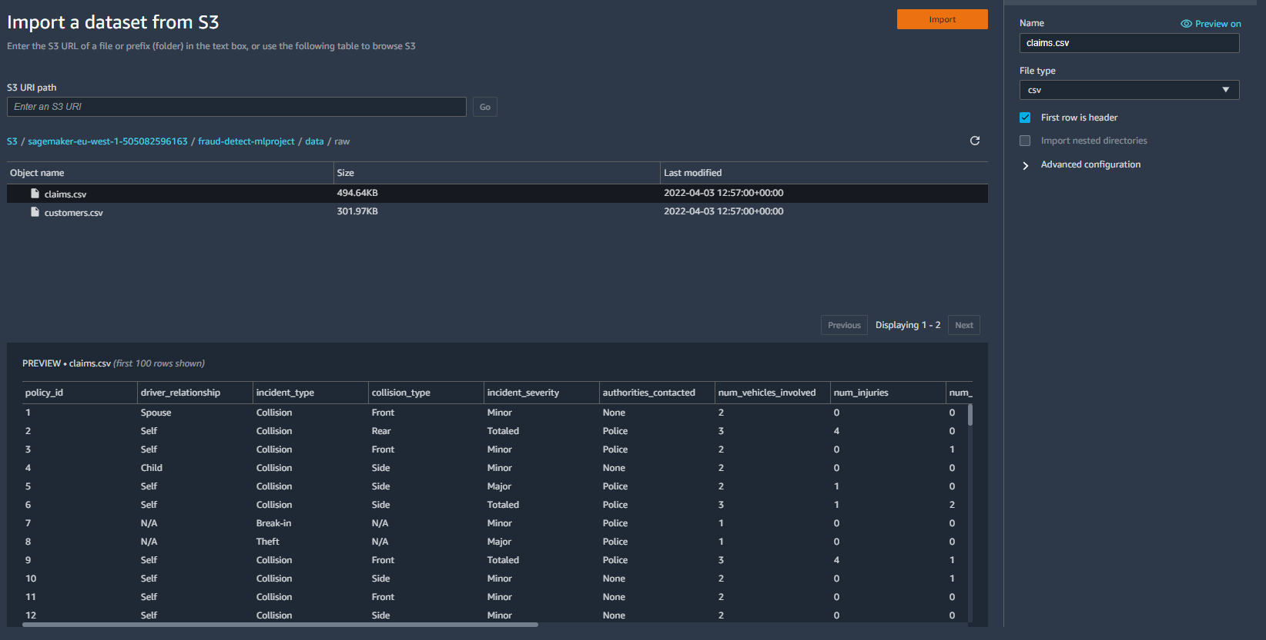
DataImportJob - DataWrangler

Slide 15
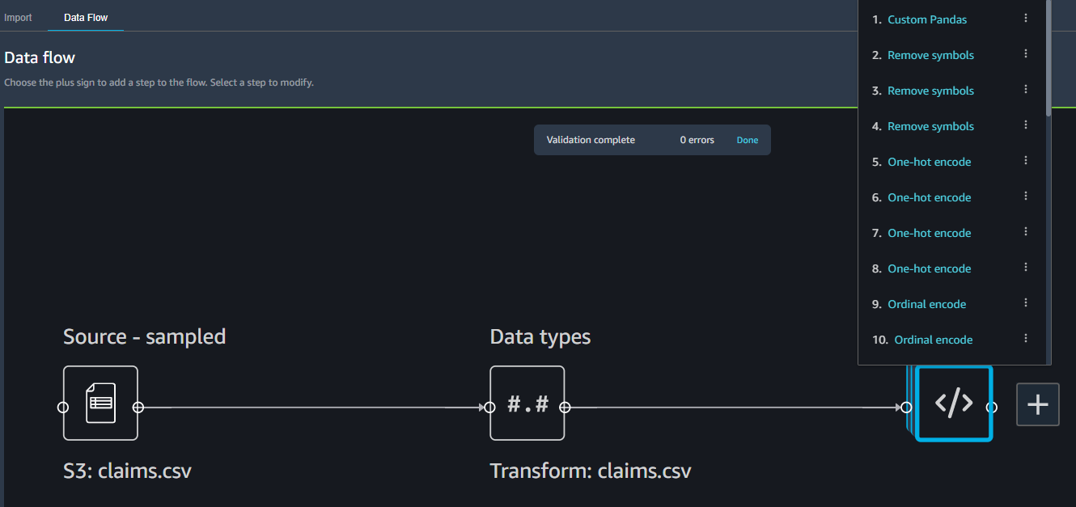
DataWrangler - Claims

Slide 16
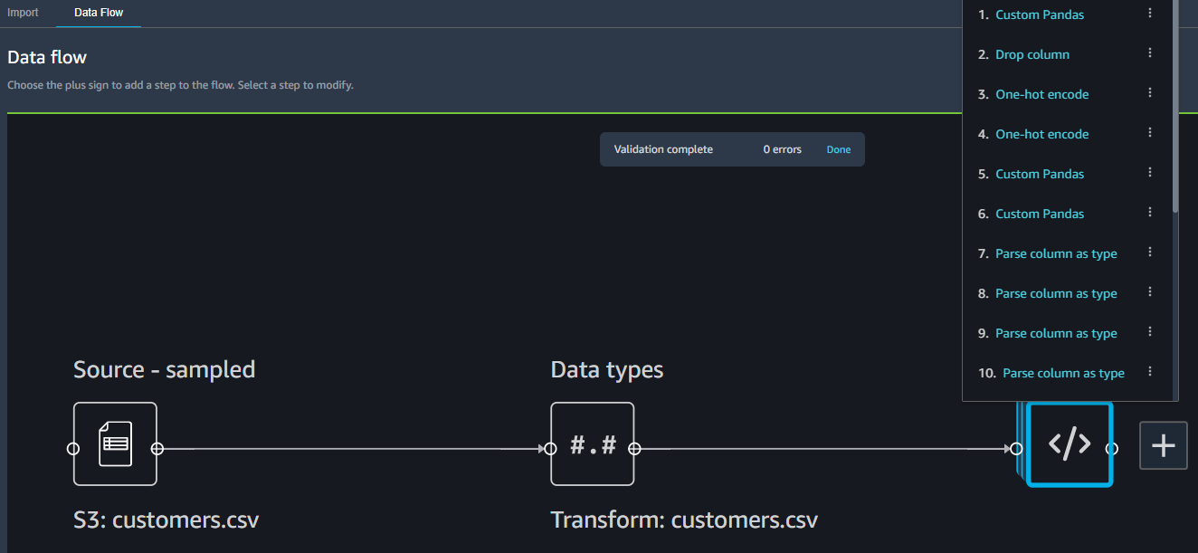
DataWrangler - Customer

Slide 17
Amazon Feature Store
All metadata was stored in Sagemaker Feature Store.
It acts like an intermediatory database for storing features for inference.
Step 1: Configure Feature Group
Step 2: Create Feature Group
Step 3: Catalog and Load Records to the Feature Store
Step 4: Query dataset from feature Store tables using SQL via Athena.
Step 5: Store queried table to S3 for ML modelling

Slide 18
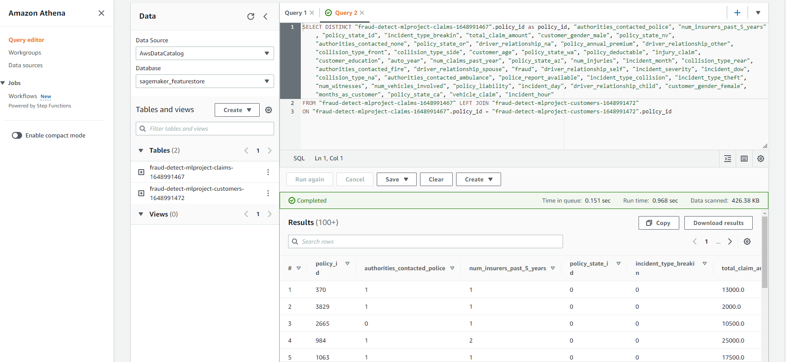
Athena Query

Slide 19
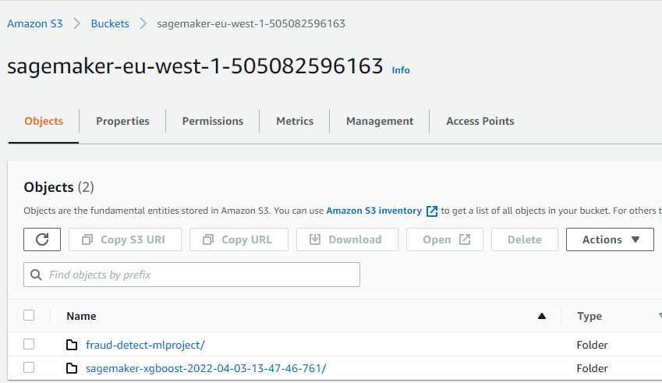
S3 Bucket

Slide 20
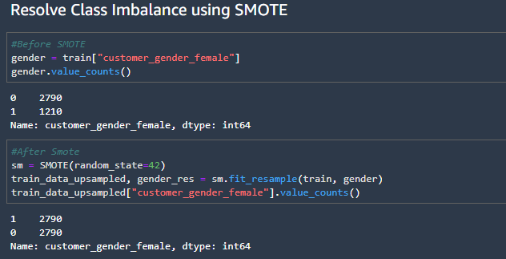
Train ML Model
Step 1: Split preprocessed data into train and test sets.
Step 2: Resolve data imbalance using SMOTE

Slide 21
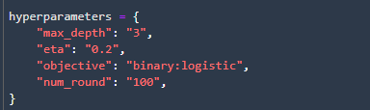
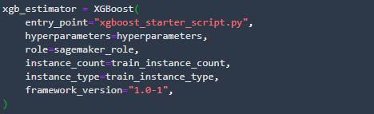
Train ML Model
Step 3: Set Hyperparameters
Step 4: Configure XGBoost Model estimator

Slide 22
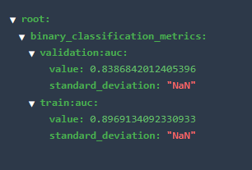
Training Metrics

Slide 23
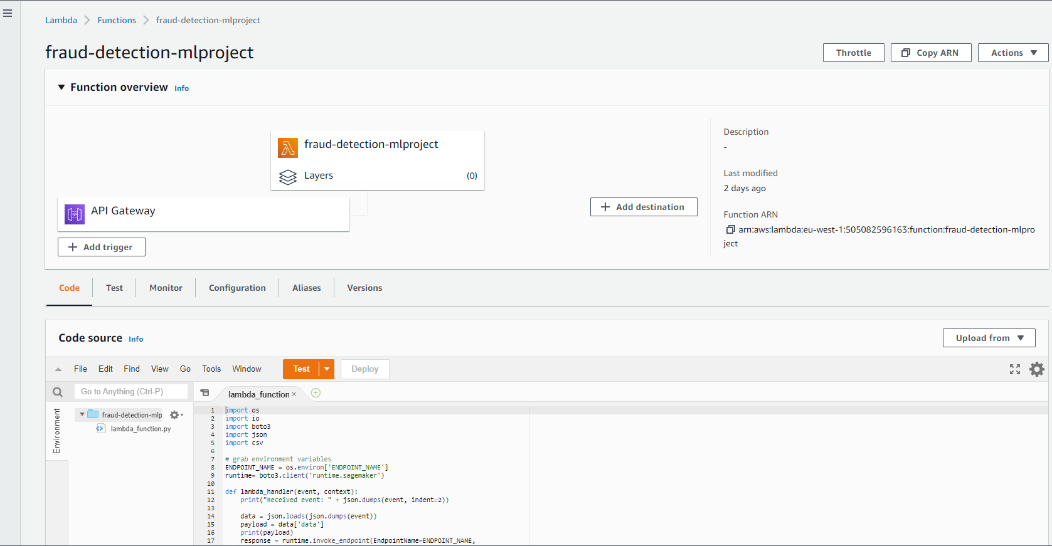
Lambda Function

Slide 24
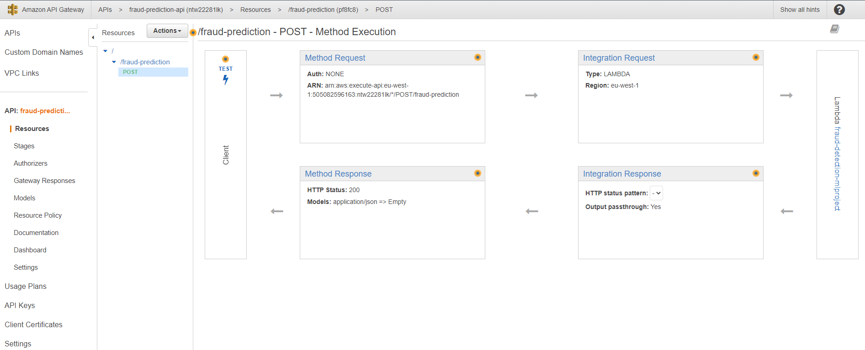
API Gateway

Slide 25
Risk & Challenges: Data Imbalance
One of the main challenges of these fraud is that only a small percentage (much less than 1%) of transactions is fraud: an imbalanced machine learning problem.
As a consequence, it is difficult to learn how to identify fraud cases with high accuracy, and at the same time to limit the false positive rate (FPR). Merely focusing on increasing the fraud detection (or true positive) rate results in a higher FPR.
If a normal transaction is predicted by mistake to be fraud (i.e., false positive), this will result in lost sales, but more importantly it leads to customer churn followed by further investigation which implies higher labor costs.

