Slide 1
Dublin Business School
Masters in Artificial Intelligence
NLU Chatbots
Module - Natural Language Processing (B9AI109_2122_TMD3)
Lecturer - Terri Hoare
Submission - Class Assessment - 1 (CA_1)
Submission by - Group 1 1. Swaraj Shaw (10592394)
2. Kumari Anjali (10592521)

Slide 2
Enhancing Service Interactions Using Virtual Assistants And AI-chatbot
Chatbots are a clear manifestation that Artificial Intelligence (AI) is moving the hype. We see more and more business applications where chatbots with self-learning capabilities can interact with humans in a more natural way. We can also observe growing sophistication and accuracy of AI which makes chatbots more robust and suitable for a broader range of applications. At the same time, there are also still challenges to overcome. Improvements in natural language understanding or moving towards a more flow-based conversations instead of only “single shot” dialogues are steps that will require more time, investment and research.
“By 2020, the average person will have more conversations a day with bots than they do with their spouse”
L. HEATHER PEMBERTON | GARTNER

Slide 3

Key Benefits
Improve customer acquisition
Reduce churn
Show your potential customers your advanced digital capabilities and experience with cognitive technologies.
Rapidly scale up and down, always being able to serve new customers.
Chat interfaces are everywhere. customers are ready for the next step: automated chatting.
24/7 customer support
High degree of accuracy and high-throughput.
Provide high quality support, whenever the customer demands it.
Increase customer satisfaction by effectively solving their issues
Increase revenue per user
Minimize cost to serve
The supporting tasks will be performed by the Chatbot. Use your people to do what they do best; sell products and services.
Gather, analyze and act on the customer’s preferences and irritations.
15 – 90% cost reduction opportunity depending upon the characteristics of the functions selected for automation.
Short payback period with low integration costs and
high potential ROI.
Mitigate security risks
Easily scale up and down depending on customer’s demand.

Slide 4




What is a Chatbot ?
Chatbots offer a conversational experience using artificial intelligence and natural language processing to mimic conversations with real people.
Intelligent
Advanced software learns from past interactions, improving responses over time
Engaging
Enables human-like interaction delivered through a channel that is easily scalable
Effective
Let users perform tasks efficiently and accurately through conversational self-service
90%
Consumers who want
to use messaging to talk to businesses
Source: Twilio Global Mobile Messaging Consumer Report 2016
80%
Companies that already
use or plan to use chatbots by 2020
Source: Business Insider
90%
Consumers who want
to use messaging to talk to businesses
Source: Twilio Global Mobile Messaging Consumer Report 2016
90%
Consumers who want
to use messaging to talk to businesses
Source: Twilio Global Mobile Messaging Consumer Report 2016
90%
Consumers who want
to use messaging to talk to businesses
Source: Twilio Global Mobile Messaging Consumer Report 2016
90%
Consumers who want
to use messaging to talk to businesses
Source: Twilio Global Mobile Messaging Consumer Report 2016
90%
Consumers who want
to use messaging to talk to businesses
Source: Twilio Global Mobile Messaging Consumer Report 2016
80%
Companies that already
use or plan to use chatbots by 2020
Source: Business Insider
80%
Companies that already
use or plan to use chatbots by 2020
Source: Business Insider
80%
Companies that already
use or plan to use chatbots by 2020
Source: Business Insider
80%
Companies that already
use or plan to use chatbots by 2020
Source: Business Insider
90%
Consumers who want
to use messaging to talk to businesses
Source: Twilio Global Mobile Messaging Consumer Report 2016
80%
Companies that already
use or plan to use chatbots by 2020
Source: Business Insider

Slide 5
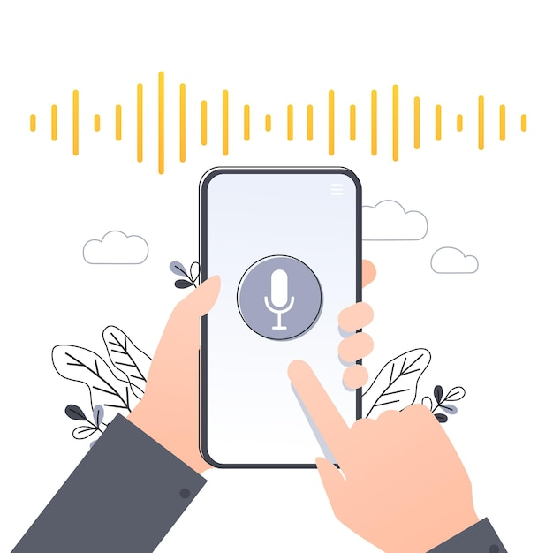
“Alexa, what is the status of my auto insurance claim?”
“Okay, Google, can you recommend me latest laptops under € 800 ?”
“Siri, what are the symptoms or Co-VID-19?”

Slide 6



































History of Chatbot ?
1900s
1950s
2010s
2020s
Tabulating system era
Mechanical devices assisted in organizing data and e.g. making calculations for employee sales performances evaluation purposes. Ex. Hollerith Tabulating Machine.
Programmable system era
Programmable systems enabled Space Exploration and the development of the internet. This era will continue indefinitely, and will underpin the era of computing that we are in now. E.g. Windows Desktops / ERP Systems.
Cognitive era systems
Cognitive systems are computer systems that have capabilities to emulate the human brain. Ex. Self- driving cars, Chatbots, Virtual Agents...
Amplified Intelligence
Future systems will be able to mimic human intelligence and entirely replicate human interactions.
Welcome to the Cognitive Era!
Key drivers
Big data technologies in conjunction with cognitive computing enable us to extract insight from data that was previously unused.
Exponential growth of Data
Smarter algorithms
Faster processing speed

Slide 7
Chatbot opportunities
Developments at both the side of supply and demand drive the added value of Chatbot technology.
Demand
Supply
Increasing pressure on contact centers High turnover rates, increased need for training and the necessity for reducing operating cost are putting pressure on the traditional contact center.
Technological advances in AI and NLP
Chatbots are going beyond keyword matching. Advancements in Natural Language Processing, processing speed, machine learning models and data availability have made this possible.
The Rise of the Chatbot
Rising demand for self-service
Customers are demanding self-service. No longer are they prepared to wait weeks, days, hours or even
minutes for an employee to help them. They need their problem fixed and they need it fixed now!
Chatbot platforms maturing
As Chatbot technology becomes more popular, their development platforms become more mature. They come with easy to grasp drag-and-drop interfaces, allowing business users to build and manage Chatbots themselves.

Slide 8
Evolution of Conversational AI
Chatbots are like apps that users interact with in a conversational way, through text or speech. As technology advances, Chatbots are able to better understand both written and spoken text.
A Chatbot may be as simple as basic pattern matching with a response, or it may be a sophisticated weaving of artificial intelligence techniques with complex conversational state tracking and integration into existing business services.
Human-like Advisor
General AI, also known as human-level AI or strong AI
The type of Artificial Intelligence that can understand and reason its environment as a human would
Virtual Agents
Able to understand what a human is trying to achieve and can hold an end-to-end conversation
Connects to other systems to leverage user data and insights
Learns and improves over time
Scripted Chatbots
Basic and scripted
Looks for key phrases & give pre-defined responses
Intent Recognizers
Machine learning capabilities
Greatly improved understanding of user intent, relationships between words are taken into account to extract meaning from a request

Slide 9
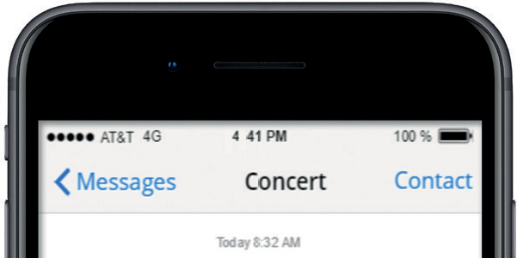
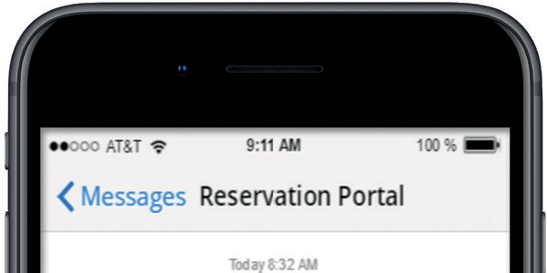
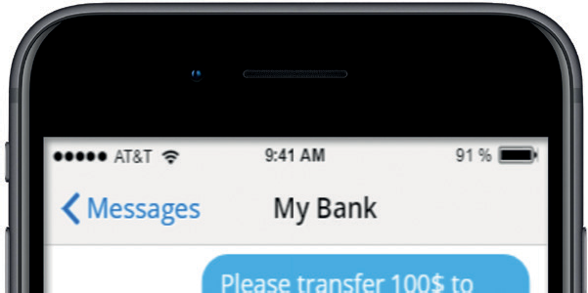
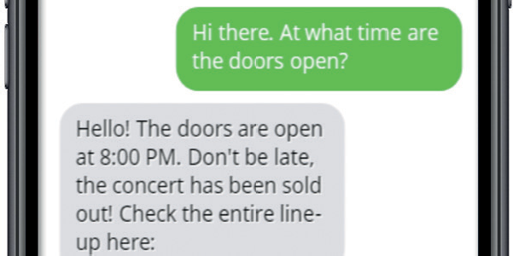
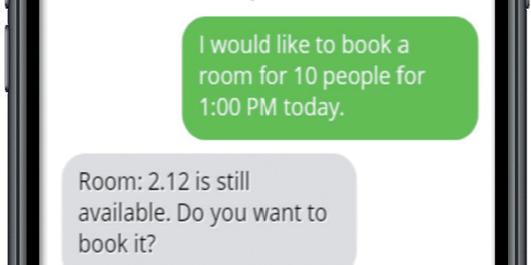
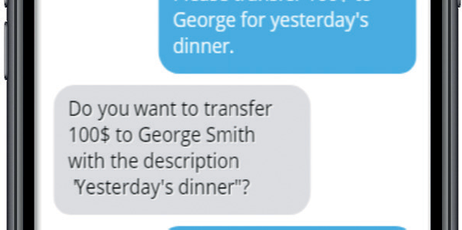
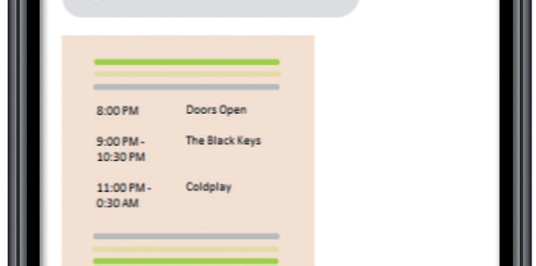
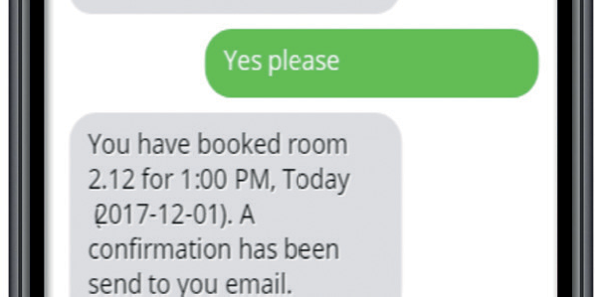
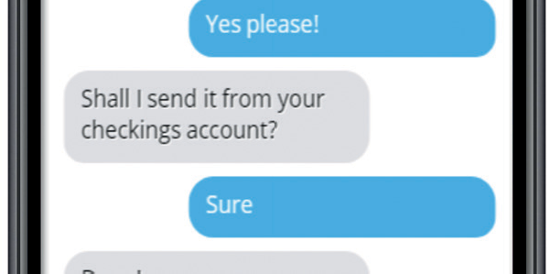
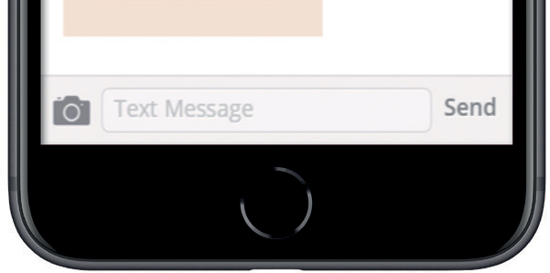
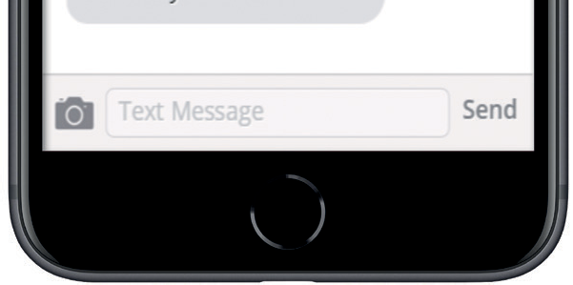
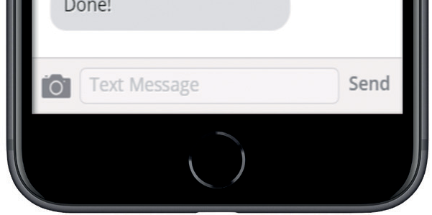
Chatbot Applications Chatbots have a broad range of applications; they help users with information requests, reservations or personalized tasks like money transfer.
You are in a hurry to catch a train to bring you to the concert of your favorite band. Quickly check if you are going to make it!
You have just heard about an important meeting but are not at the office. Use the Chatbot to quickly identify free rooms and book it instantly.
Instantly transfer money. Use a familiar interface to transfer money, request account information and much more…

Slide 10
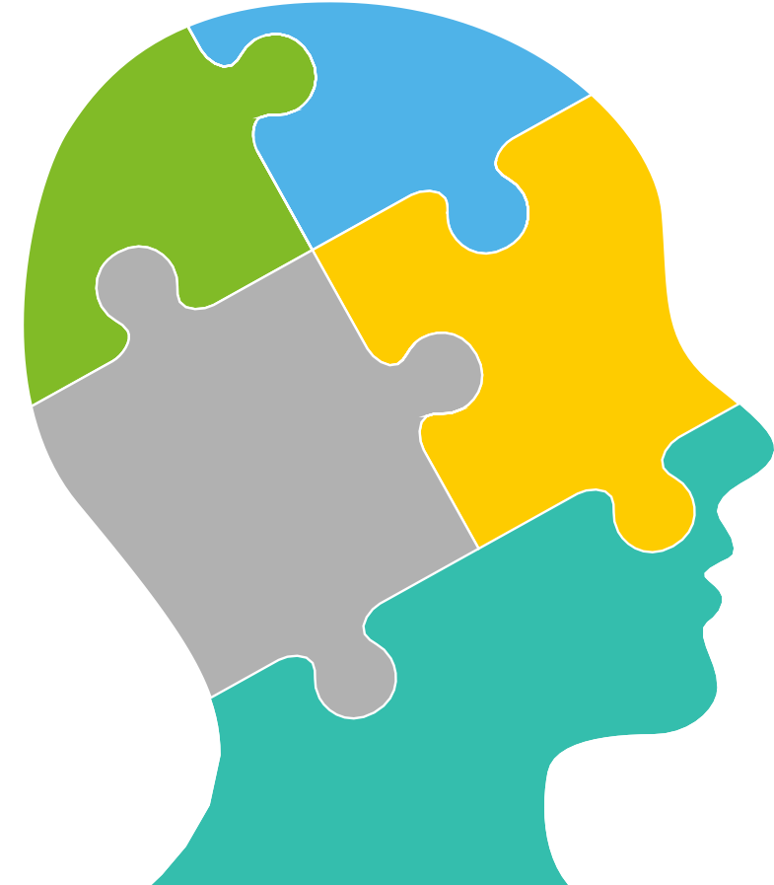
Understanding Language & Context
Chatbots mimic different functions of the human brain.
Reinforcement Learning
Natural Language Processing
Ability to accept user “corrections” over time to improve suitability of responses. Allows the Chatbot to improve and learn off of user inputs.
Ability to “read” or parse human language text. Pre-requisite for understanding natural sentence structures vs. simple keyword “triggers”.
Reason
Learn
Entity Recognition
Understand that some text refers to informative abstract categories (entities) such as “February 2” = Date. Necessary
for more complex commands and analysis.
Preceive
Machine Learning
Learn how to respond to the user by analyzing human agent responses. Necessary for qualitative intent recognition.
Understand
Dialog Management
Ability to follow conversation history, recall and memorize over a single conversation, and across conversations. Necessary
for natural, human-like back and forth
conversation.
Intent Recognition
Interact
Ability to “guess” what the user is requesting, even if phrased unexpectedly. Necessary to enable natural conversation, reduce user frustration and enable the virtual agent to start a relevant dialog.
Q&A Pairs / Scripts
Is used to deliver facts, details or solutions to queries or requests. Benefits greatly from
good Intent Recognition.

Slide 11







Chatbot Characteristics
There is a big variety in Chatbot development platforms. Below are a number of characteristics that should be taken into account when choosing the suitable platform to implement with your Chatbot.
Intent Recognition
Ability to “guess” what the user is requesting, even if phrased unexpectedly. Good intent recognition is vital if you don’t want to annoy your users.
Dialog Management
Go beyond simple Q&A and enable your Chatbot to have complex and meaningful conversations with the user.
Humanization
Users get more engaged in conversation if a Chatbot acts more human- like. Some Chatbots are able to detect and show emotions.
Interaction Channels
How will users interact with your Chatbot? Choose a platform that connects easily with your webchat, app, social media platform or voice interface.
Task Automation Capability
Does your Chatbot need to perform tasks for users? Make sure it has enough dialog capabilities and that it can connect to your back-end systems
Reporting & Monitoring
Are your customers being helped? Are they happy? Does your contact center get less calls? Choose a Chatbot platform that tells you how it’s performing.
Ease of Implementation
Some platforms require custom software development, while others allow business users to configure the Chatbot themselves.
Security & Compliance
Do you have extra security requirements? Or do you need to be compliant with audit regulations? Security and logging capabilities vary amongst platforms.

Slide 12
Train your chatbot
Training a Chatbot or Virtual Agent is not so different from training a human employee: it requires time and investment. Retraining is required when processes or products change.
Untrained agent
A new Chatbot or Virtual Agent is not trained yet for your specific customer service domain
Initial training required in order to understand customer requests and to know how to solve them
Perform initial training
Train your agent to understand the subject matter
Teach them how to answer questions and process requests
Instruct how to access your knowledge and data systems
Evaluate and improve
Periodically evaluate your agent’s performance
Determine which requests aren’t handled properly
Improve performance with targeted additional training
Re-train
When products, processes or enterprise systems change, additional training is required

