Slide 1
CMPS-5443 Natural Language Processing
2020 U.S Presidential Election Sentiment Analysis
By: Arun Soma and Swaraj Chirumamilla

Slide 2
Motivation: The purpose of conducting sentiment analysis on the 2020 US presidential election is to gain insights into the public's opinions, emotions, and attitudes surrounding this significant political event.
Research : We plan to investigate about the prevalent sentiment on the former US presidential candidates on twitter by analysing their overall twitter data and classify them accordingly.

Slide 3
Methodology
We conducted exploratory data analysis using publicly available Kaggle data, gathering around 99,999 tweets for each candidate to ensure a substantial sample size.
Our toolkit included Vader for sentiment analysis, and Pandas/Matplotlib for data manipulation and visualization.
The choice of Vader, Pandas, and Matplotlib as primary tools was informed by their proven effectiveness in sentiment analysis, data manipulation, and visualization, respectively, with Vader's focus on social media language making it well-suited for our analysis.
Manual examination of individual tweets confirmed consistent alignment between sentiments expressed and the sentiment analysis library's results.

Slide 4
Results
Here are the stats for Trump and Biden from our analysis on tweets:
Stats for Trump:
Positive: 31631 Neutral: 31256 Negative: 37112
Stats for Biden:
Positive: 34357 Neutral: 35759 Negative: 29883

Slide 5
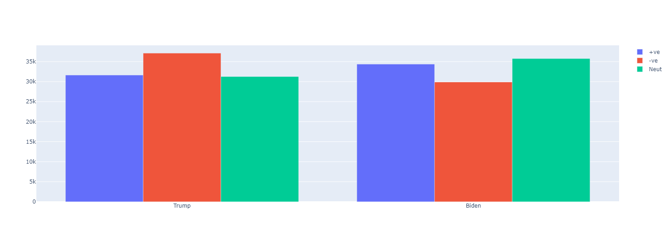
Results : Our Stats on a Bar Graph

Slide 6
Discussion
Based on the empirical findings derived from the sentiment analysis project, it was observed that President Biden received a higher volume of positive election-related tweets and a diminished frequency of negative ones compared to his counterpart, Mr. Trump.
This aligns with the outcomes we had anticipated prior to the commencement of the study.

Slide 7
References
Input dataset from Kaggle:- https://www.kaggle.com/datasets/manchunhui/us-election-2020-tweets

