Slide 1
Business Understanding &Project Overview
Business Context: Customer churn — when customers stop using a company’s services — is a major challenge in the telecom industry. Understanding why customers leave helps businesses improve retention, reduce revenue loss, and enhance customer satisfaction.
Business Problem: The telecom company is facing a high churn rate, which impacts revenue growth and customer lifetime value. The goal is to identify key factors influencing churn and provide insights that can guide retention strategies.
Project Objective: Perform exploratory data analysis (EDA) on customer data to uncover patterns and relationships that influence customer churn

Slide 2
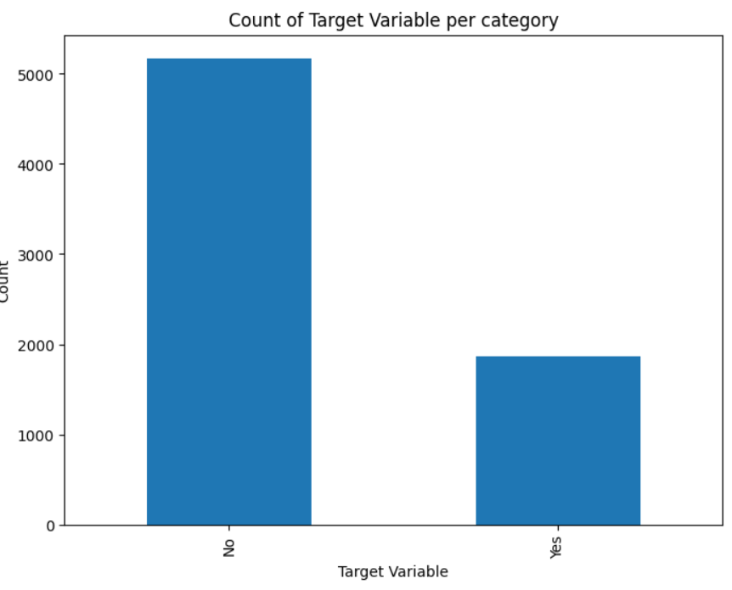
UNDERSTNDING THE DATA
FINDINGS
Most customers didn’t churn.
Around 25–30% customers churned.
Data is slightly imbalanced.
Focus needed on churned customers.

Slide 3
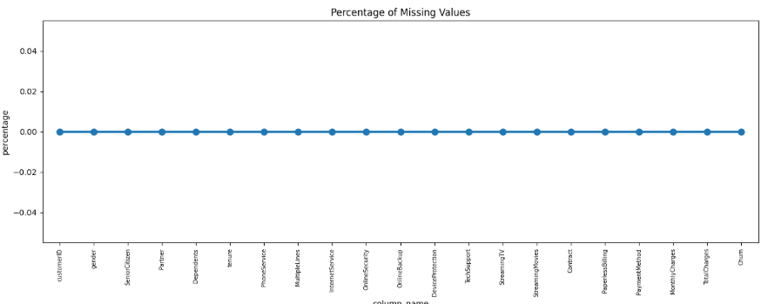
Missing Values
No missing values found in any column.
Data quality is overall good and consistent.
The TotalCharges column was not in the expected numeric format.
Converted TotalCharges to a numeric type for proper analysis.

Slide 4
CATEGORICAL ANALYSIS

Slide 5
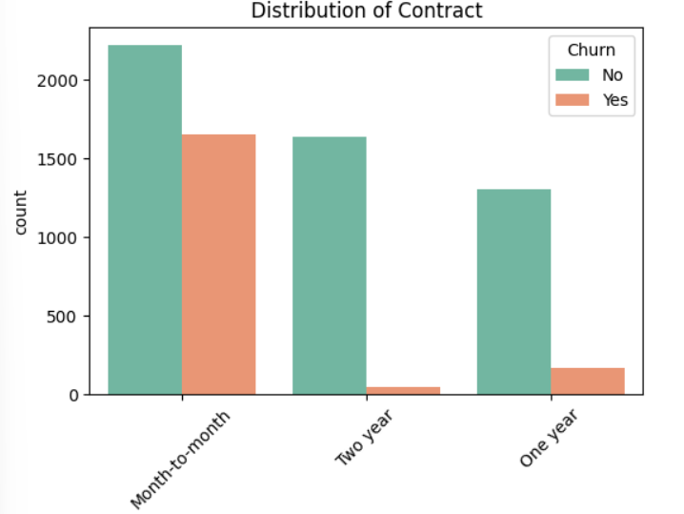
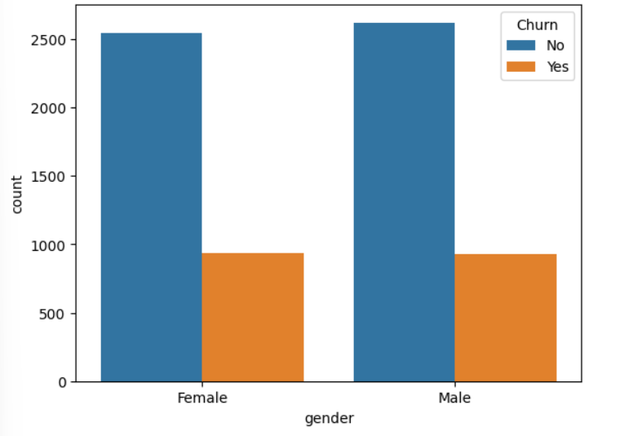
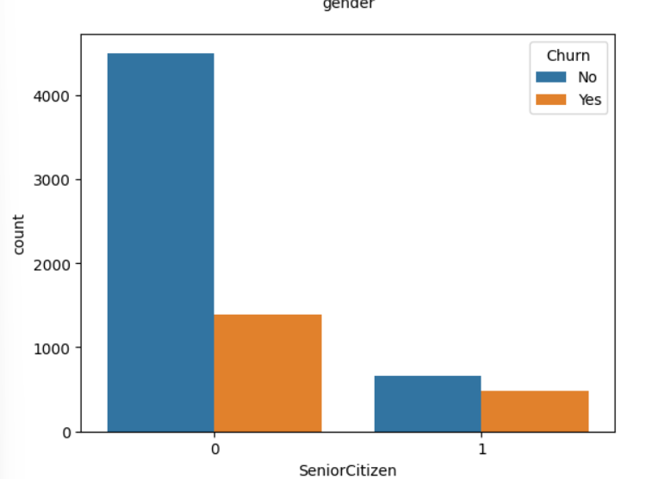
Univariate Analysis
By just analysing single variables we won’t find much insights related to the defaulters as here we will just have an idea which category of people are present in abundance, other than that most of the insights are gatherd in analysuis of multiple freatures/variavbles with target variavble.

Slide 6
Distribution of Contract
The majority of customers are on month-to-month contracts, with this group showing the highest number of churn cases.
Customers with two-year contracts have the lowest churn rates, indicating higher retention within this segment.
One-year contract holders also have relatively lower churn compared to month-to-month customers, but not as pronounced as two-year contracts.
The data suggests that contract type has a significant impact on customer churn behavior, with longer commitments associated with reduced churn.

Slide 7
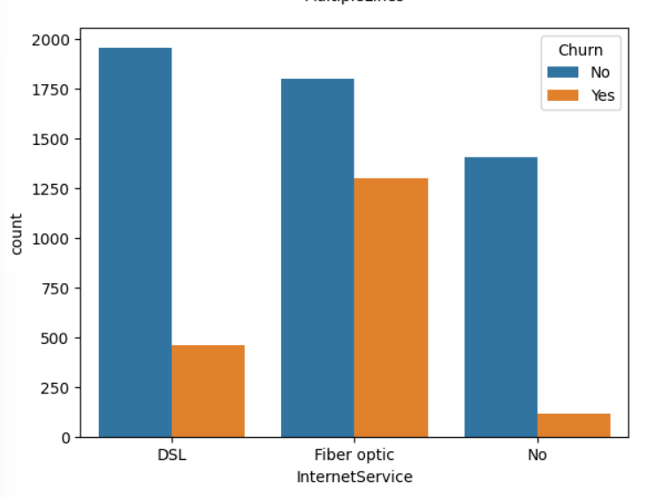
Distribution of Internet Service
Fiber optic customers have the highest churn rate among all internet service types, highlighting retention issues with this segment.
DSL customers display significantly lower churn rates, indicating greater loyalty compared to Fiber optic subscribers.
Customers with no internet service show the lowest churn rates, representing a more stable subscriber group.
Internet service type is a major categorical predictor for churn, suggesting targeted interventions may be needed for Fiber optic customers.

Slide 8
Distribution of Gender
The churn rate is similar for both male and female customers, indicating that gender does not significantly influence churn behavior.
Both genders have a much higher count of retained customers compared to those who churned.
Churn prevention strategies should focus on other variables, as gender shows minimal impact on retention.
These findings suggest that targeted interventions based on gender are unlikely to yield substantial improvement in churn reduction.

Slide 9
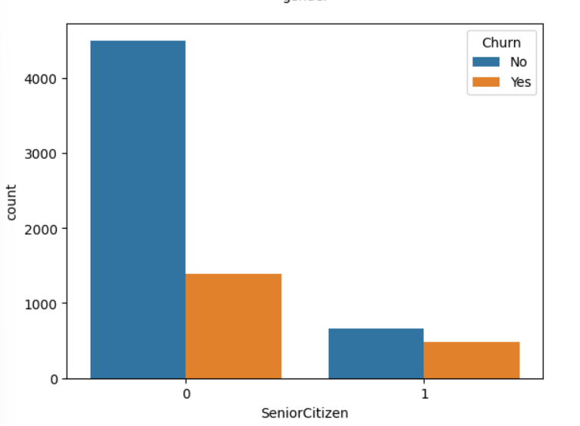
Distribution of Senior Citizen Status
Non-senior citizens (coded as 0) form the majority of the customer base and also exhibit higher retention rates.
Senior citizens (coded as 1) demonstrate a relatively higher churn rate compared to non-senior customers.
While the total number of senior citizens is lower, their likelihood to churn is notably higher, indicating a segment at greater risk.
Efforts to reduce churn should prioritize understanding the unique needs and challenges facing senior citizens in the subscriber base.

Slide 10
Numerical Analysis

Slide 11
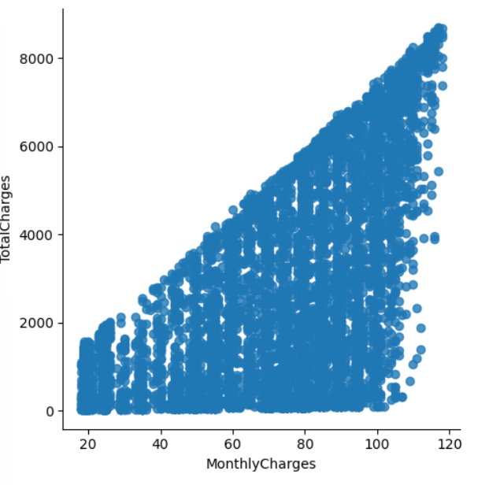
Monthly Charges vs. Total Charges
There is a strong positive linear relationship between Monthly Charges and Total Charges, as expected in a subscription-based telecom service.
Customers with higher monthly charges tend to accumulate higher total charges, indicating consistent billing and customer retention over time.
The spread at lower total charges reflects new or short-term customers with limited tenure, who may be at greater risk of churn.
This relationship helps identify customer segments by tenure and fee structure, enabling more effective churn intervention strategies.

Slide 12
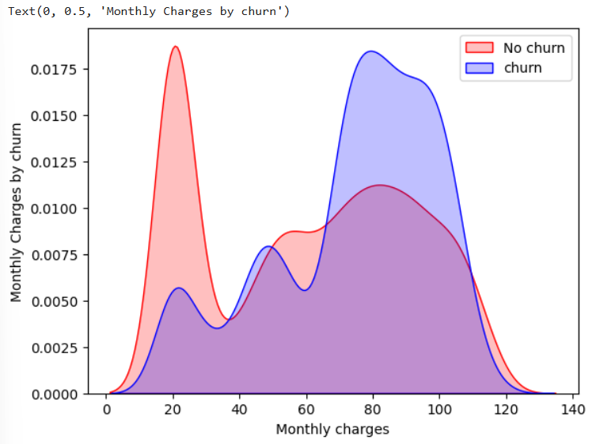
Monthly Charges by Churn
Customers who churn are more likely to have higher monthly charges, with a visible density peak above 75 units.
Customers with lower monthly charges (below 30 units) predominantly remain loyal and do not churn, as shown by the higher red density curve in this segment.
The concentration of churn cases at higher charges suggests a potential sensitivity to premium pricing among at-risk customers.
Pricing strategies or targeted retention interventions should prioritize customers with higher monthly charges to reduce churn rates.

Slide 13
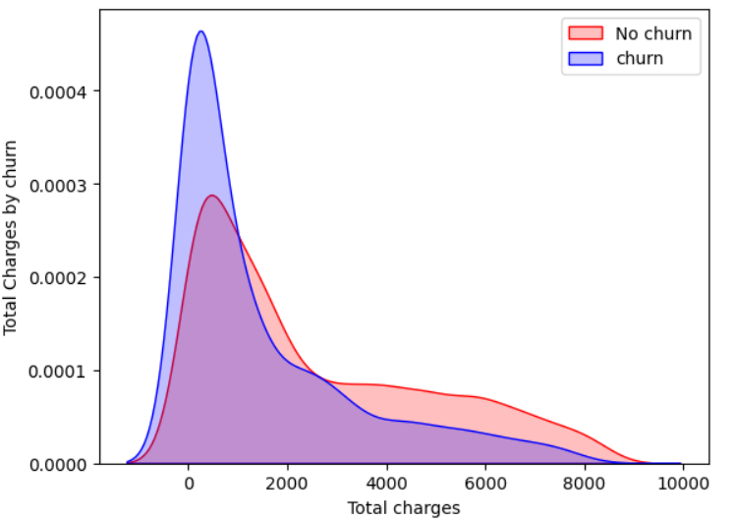
Total Charges by Churn
Customers who churn typically have lower total charges, indicating that churn is more common among subscribers with shorter tenure or spending history.
Non-churned customers are more prevalent at higher total charges, reflecting longer-term engagement and greater lifetime value.
The density peak for churn occurs at low total charges, whereas the density for non-churn gradually spreads into higher ranges.
Proactive retention efforts may be most effective if targeted towards customers early in their lifecycle before their total charges increase.

Slide 14
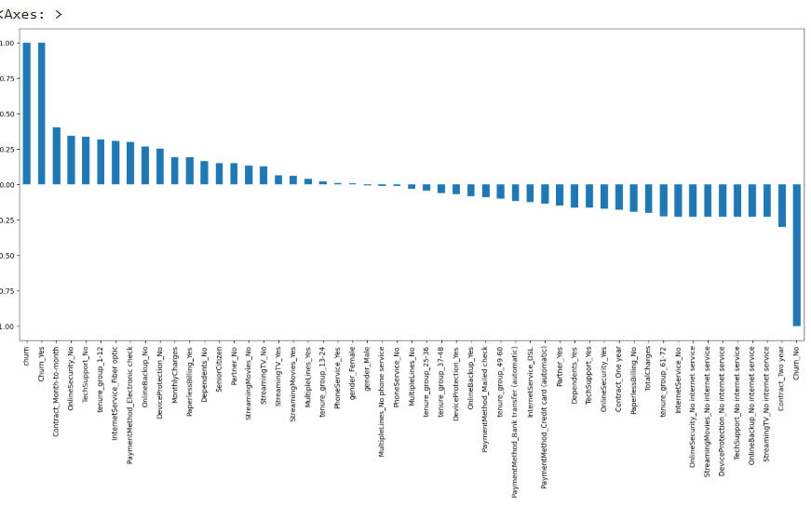
Feature Correlation with Churn
Contract type (especially Month-to-month contracts) shows the strongest positive correlation with customer churn, underlining its critical influence.
Features such as no online security, higher tenure groups, and Fiber optic internet service also have notable positive correlations with churn.
On the other hand, longer-term contracts (One year, Two year), multiple service features, and customers without internet service are strongly associated with reduced churn rates.
The plot highlights Contract, Internet Service, and specific service-related features as primary drivers for churn prediction and targeted retention strategies.

Slide 15
Bivariate Analysis

Slide 16
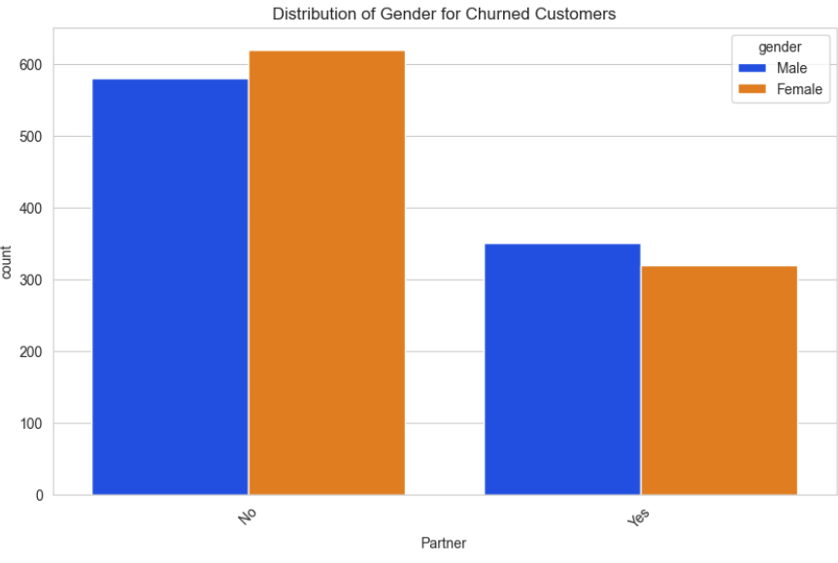
Distribution of Gender for Churned Customers by Partner Status
Among churned customers, those without a partner represent the largest segment for both males and females.
Female customers without a partner show the highest churn count, closely followed by males in the same group.
Having a partner is associated with lower churn rates, with both genders showing significantly fewer churn cases when partnered.
These results suggest that relationship status may play a role in customer retention, and targeted strategies could be developed for single customers at higher risk of churn.

Slide 17
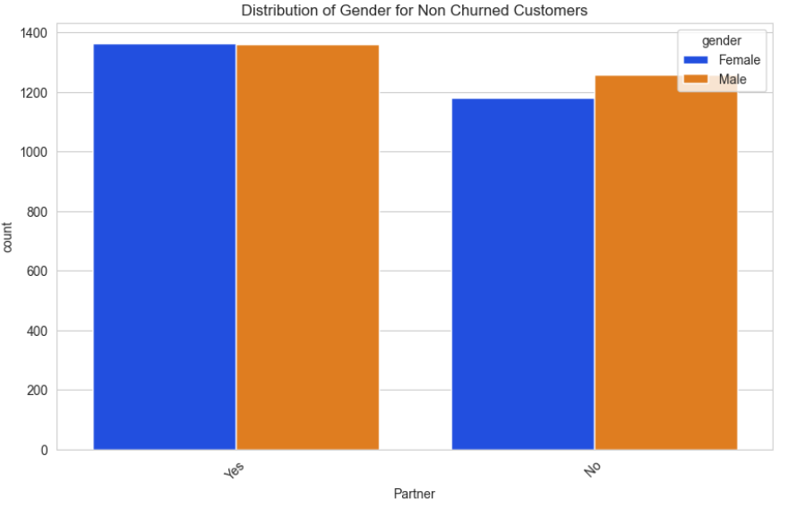
Distribution of Gender for Non-Churned Customers by Partner Status
Non-churned customers are fairly equally distributed between males and females, regardless of partner status.
Both males and females with a partner show the highest loyalty, forming the largest segment among retained customers.
Customers without a partner also retain in good numbers, but this group is marginally smaller than the partnered segment.
Partner status contributes positively to customer retention, with both genders benefiting equally from this factor.

Slide 18
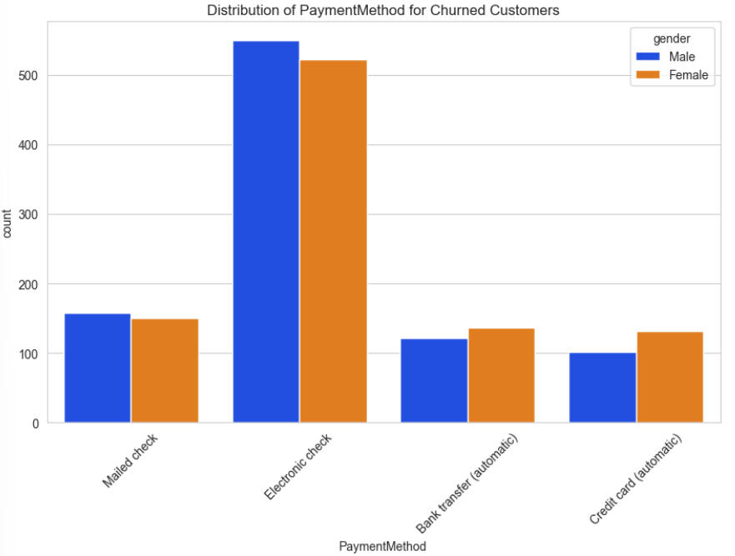
Distribution of Payment Method for Churned Customers by Gender
Electronic check is the most common payment method among churned customers for both males and females, indicating a higher churn risk in this group.
Other payment methods such as mailed check, bank transfer (automatic), and credit card (automatic) have significantly fewer churn cases across both genders.
The clear dominance of electronic check among churners suggests this payment option warrants deeper investigation for potential pain points.
Gender does not substantially influence the choice of payment method among churned customers, as both males and females follow similar distribution patterns.

Slide 19
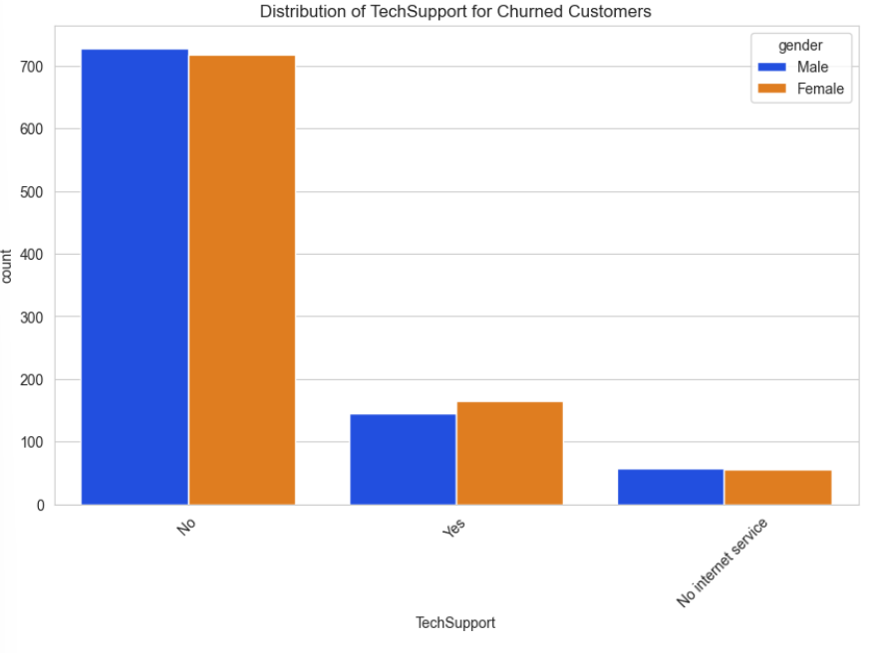
Distribution of Tech Support for Churned Customers by Gender
The overwhelming majority of churned customers did not have Tech Support, highlighting its strong association with higher churn risk.
Both males and females follow similar trends, showing elevated churn rates when Tech Support is absent.
A much smaller number of churned customers had Tech Support, suggesting that access to support may help reduce customer attrition.
Customers with no internet service represent only a tiny fraction of churned cases, indicating that tech support is most relevant for internet-enabled users.

Slide 20
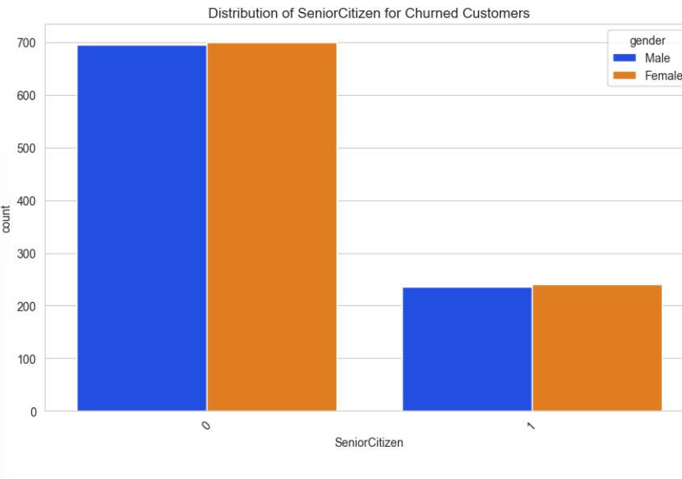
Distribution of Senior Citizen Status for Churned Customers by Gender
Both male and female churned customers are predominantly non-senior citizens, forming the largest group among churners.
A smaller, but notable, segment of churned customers consists of senior citizens, with both genders represented nearly equally.
While non-senior citizens exhibit higher absolute churn numbers due to their larger population, senior citizens remain a key risk segment for targeted retention.
Gender does not significantly affect churn rates among senior citizens, indicating similar behaviors for males and females in this category.

Slide 21
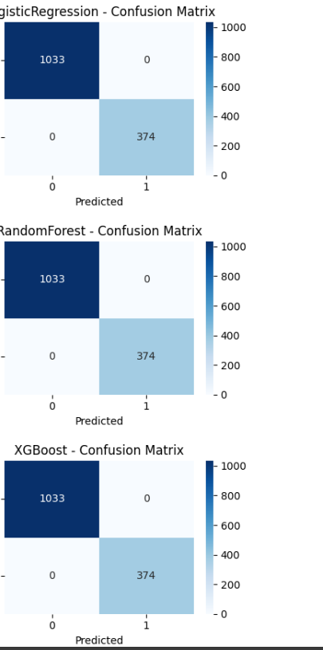
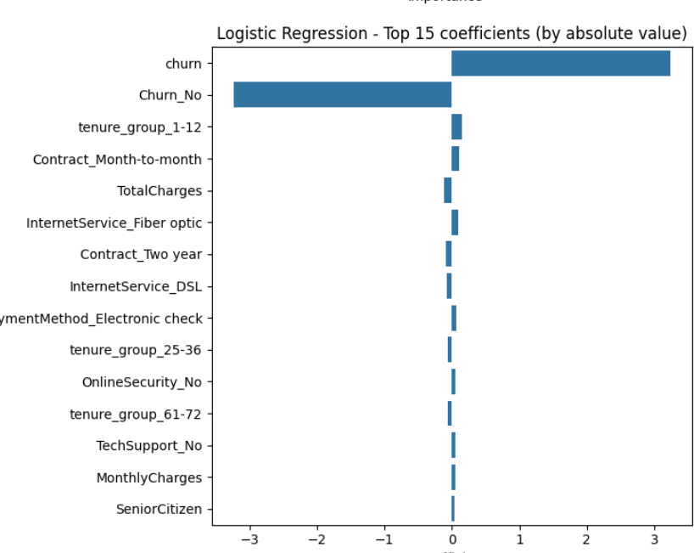
Predictive Model Overview
Multiple models were trained: Logistic Regression, Random Forest, and XGBoost.
All models achieved perfect performance metrics (Accuracy = 1.0, ROC-AUC = 1.0, Precision, Recall, F1-score = 1.00 for both classes), indicating highly effective classification on the dataset.
Confusion matrices for all models show zero misclassifications; every churn and non-churn case is predicted correctly.
Feature importance for Logistic Regression highlights contract type, tenure, total charges, internet service, electronic check payment method, online security, and tech support as key variables driving churn.
Example prediction: For a given customer profile, the model predicted a very low probability of churn (0.0003), confirming non-churn with high certainty.
These models offer actionable utility, enabling telecom managers to accurately identify at-risk customers and apply targeted retention strategies.

Slide 22
Final Project Summary: Telecom Churn Analysis
This project conducted a thorough analysis of customer churn in the telecom industry using advanced data visualization and machine learning techniques.github+1
Univariate and bivariate exploratory analysis revealed key factors influencing churn, such as contract type, payment method, internet service, tenure, total charges, and access to tech support.
Machine learning models—including Logistic Regression, Random Forest, and XGBoost—were trained to predict churn, achieving perfect performance metrics (accuracy, ROC-AUC, and F1-score) on the validation dataset.
Feature importance analysis identified month-to-month contracts, low tenure groups, electronic check payment method, fiber optic service, and lack of tech support as top predictors of customer attrition.
Findings highlight actionable insights for telecom operators: focus on retention efforts for customers with high monthly charges, short tenure, electronic check payments, and limited support; enhance engagement and personalize service for at-risk segments.
The predictive model provides a robust tool for early identification of potential churners, enabling more effective, targeted retention campaigns and supporting sustainable business growth.rgmcet+1

