Slide 1
MOBILE SHOPPING SITE
Guided by:
Mr. Milind Arjun
Presented by:
Chaitali Shinde (1125)
Swaranjali Muchwad (1163)

Slide 2
Presentation Outline
Introduction
Problem Statement
Functional Requirement
Hardware Requirement
Software Requirement
Screenshots
Conclusion

Slide 3
Introduction
This project is aimed at developing a web application that depicts online shopping of mobiles and purchasing using payment gateway.
This enables customer to buy mobiles or accessories from anywhere through online. To buy products, customer has to create an account.
Once the customer has created account , not only he can view the products ,he can also add the product to the cart and also ,he can place an order to buy those products.

Slide 4
Problem Statement and Benefit of Online Mobile Shopping:
The main reason behind developing this project is the problems which were faced by the customers because of shortage of time and convenience.
Convenience: Unlike your street markets ,online shopping sites never close; they are available 24 hours a day , seven days a week, and they are a mouse click away.
Accessibility: If you are out of state or even out of country, when money problem arises, you can logon instantly to online bank and take care of business 24/7.

Slide 5
Problem Statement and Benefit of
Online Mobile Shopping:
Efficiency: You can access and manage all your shopping from secure site.
Transaction: Online mobile shopping site generally execute and confirm transactions at or quicker than ATM processing speeds.

Slide 6
Functional Requirements
This site requires the facility for a non account holder to apply for opening an account.
Enable an account holder of the shopping site to registered to use the application.
Requires valid and accurate information of clients so checks for the authenticity of user at client end.

Slide 7
Functional Requirements
Store and retrieve data from the database.
Searches and display all relevant information related to gadgets.
Update the database regarding check-in and check-out of the customer.

Slide 8
Hardware Requirements
Intel Pentium 4 and higher
512 MB RAM and higher
40 GB Hard Disk
Monitor
Mouse
Keyboard

Slide 9
Software Requirements
Client Side Requirement
Operating System: Windows 7,Linux
Internet Browser: Any internet browser which supports images and javascript.

Slide 10
Software Requirements
Server side Requirement
HDD: Minimum 500GB Disk Space
RAM: Minimum 2GB
OS: Windows 8.1, Linux 6
Database: Oracle 11g

Slide 11
User Interface
Mobile Shopping Site:-

Slide 12
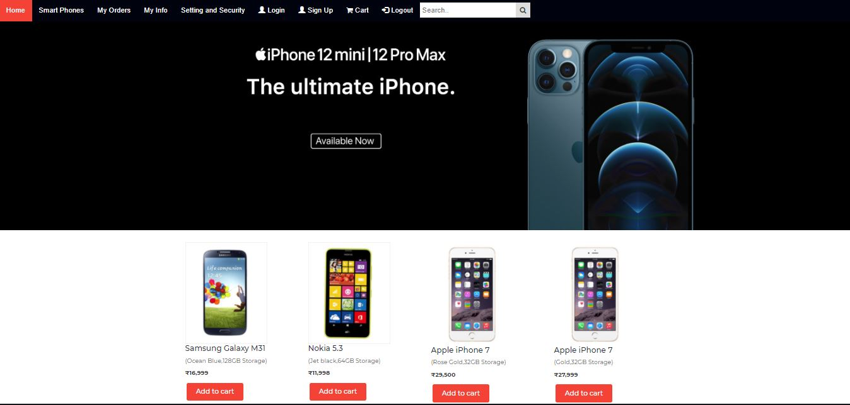
Home Page

Slide 13
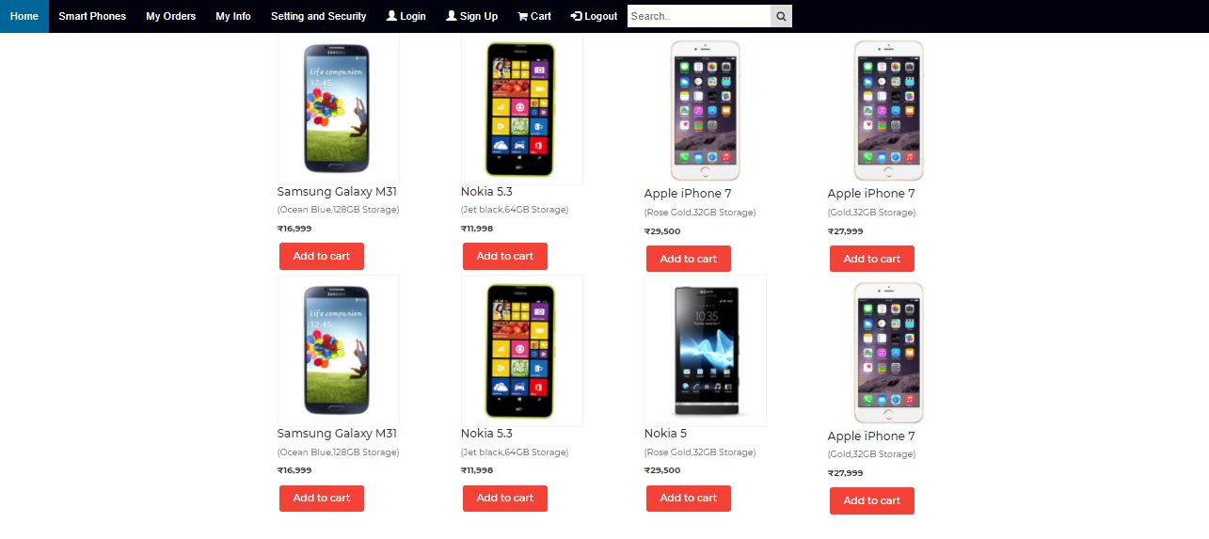
Smartphones

Slide 14
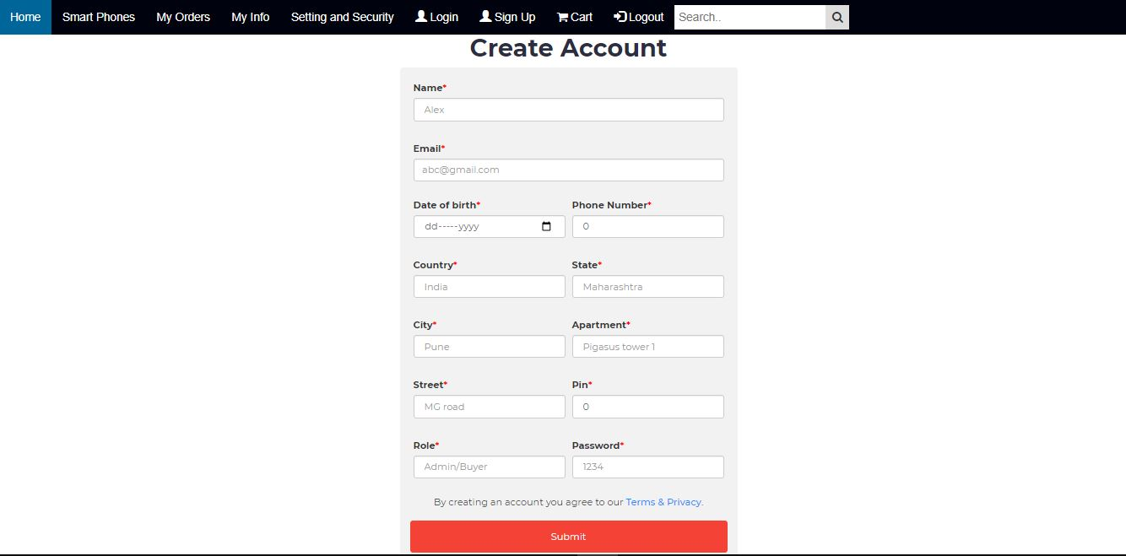
Signup

Slide 15
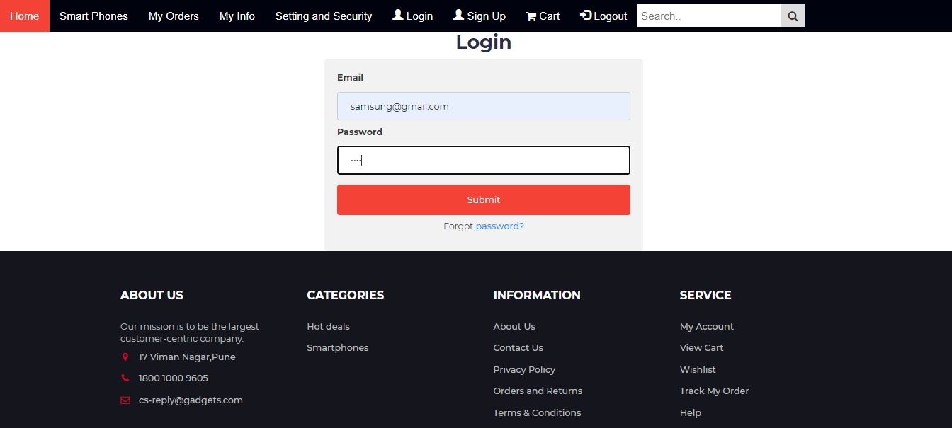
AdminLogin

Slide 16
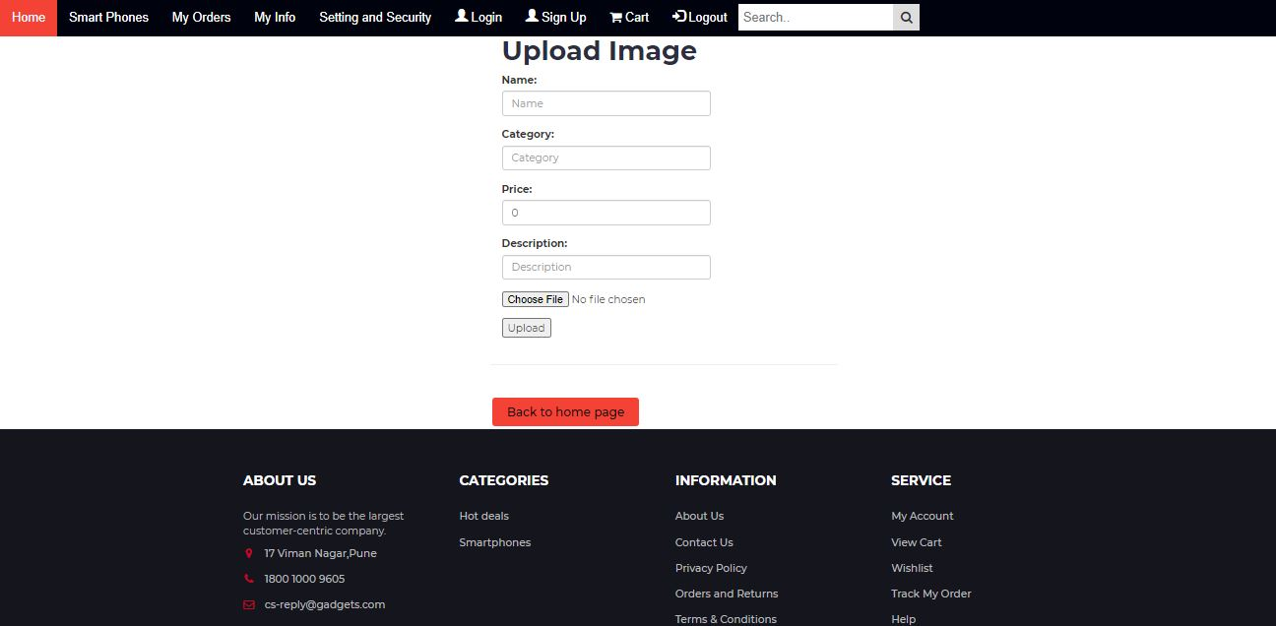
Add-Product

Slide 17
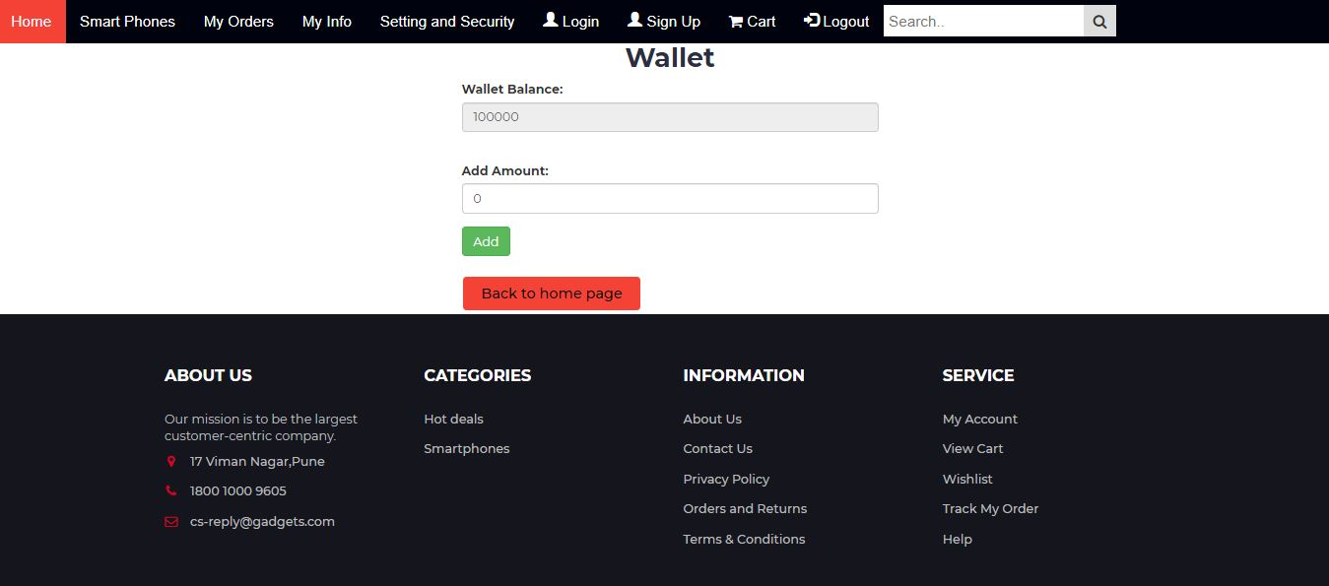
Wallet

Slide 18
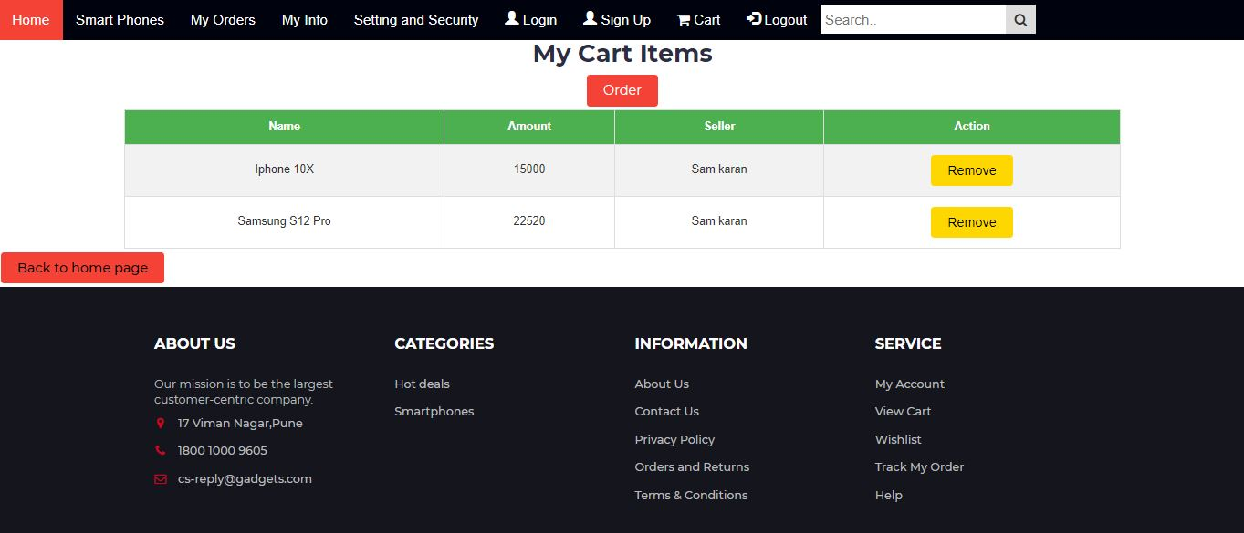
Cart

Slide 19
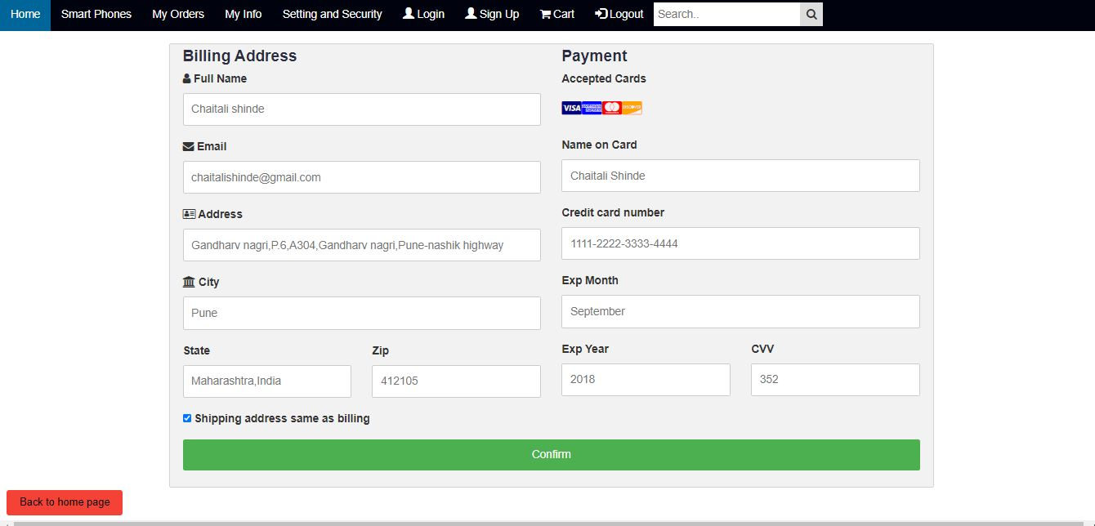
Order

Slide 20
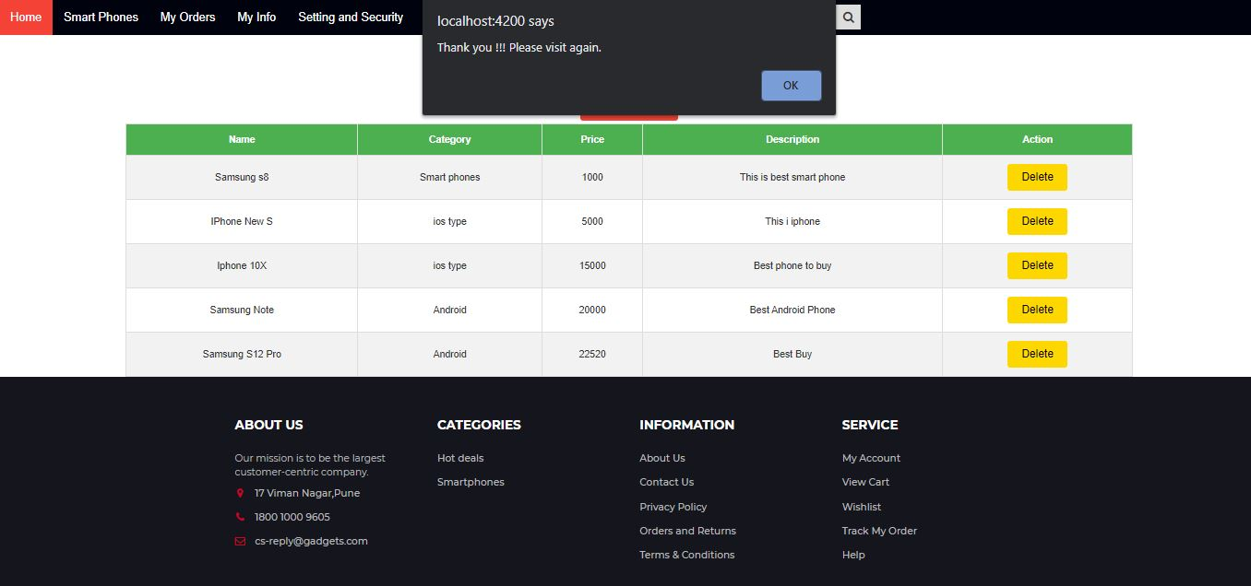
Logout

Slide 21
Conclusion:
It is an user friendly application and promotes user to purchase and shop faster.
With new technology comes better way of doing things. Being able to buy anytime anywhere.
Allows to place order before purchasing. Home delivery you don’t have to travel to shop.
Widespread effects on economy and e-commerce.

Slide 22
THANK YOU

