Slide 1



TITLE
Predictive Maintenance in Manufacturing using Sensor Data and Gradient Boosting
(with Model-Based Feature Selection)
PROJECT

Slide 2

ABSTRACT
In manufacturing, unexpected machine failures lead to costly downtime and reduced efficiency. Predictive maintenance uses sensor data and machine learning to detect failures in advance, enabling timely action. This project applies Gradient Boosting to the AI4I 2020 and NASA C-MAPSS datasets to classify machine states and predict breakdowns. Model-based feature selection identifies the most important sensors, improving accuracy and interpretability. Performance is compared with and without feature selection, and results are visualized using feature importance plots, confusion matrices, and ROC curves for clear insights.
03

Slide 3
PROBLEM STATEMENT
Manufacturing industries face significant challenges due to unexpected machine breakdowns, leading to unplanned downtime, financial losses, and reduced efficiency. Traditional maintenance strategies, such as reactive and scheduled maintenance, either respond too late or waste resources by replacing components prematurely. There is a need for an intelligent system that can predict equipment failures in advance using real-time sensor data, enabling timely and cost-effective maintenance actions.
01

Slide 4
OBJECTIVES
1.
To develop a predictive maintenance model using Gradient Boosting for accurate machine failure prediction.
2.
To apply model-based feature selection for identifying the most significant sensors influencing failure prediction.
3.
To evaluate model performance with and without feature selection using metrics such as Accuracy, F1-score, and ROC-AUC.
4.
To visualize and interpret model results for better decision-making in manufacturing maintenance planning.
02

Slide 5
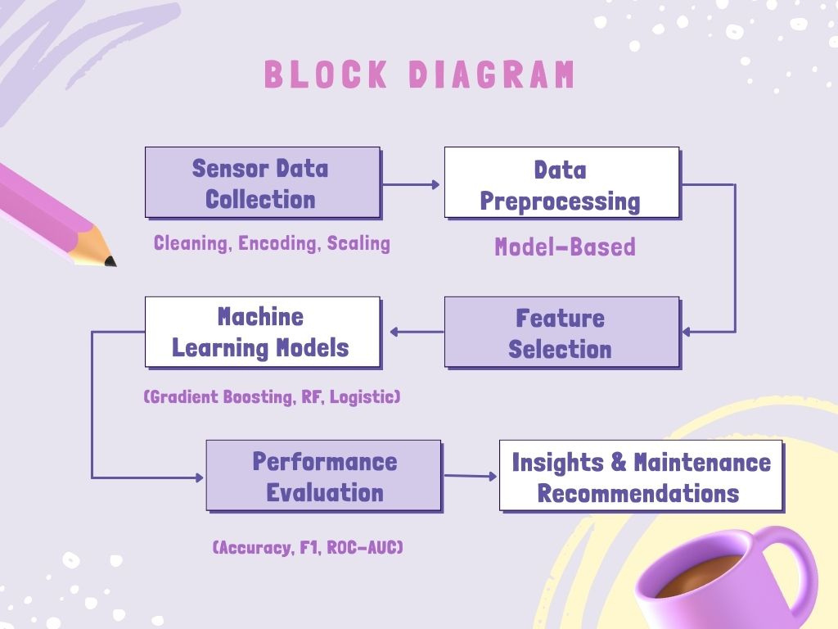
08

Slide 6
CONCLUSION
The project demonstrates that machine learning, particularly Gradient Boosting, can effectively predict equipment failures in manufacturing using sensor data. Model-based feature selection improves performance, reduces unnecessary computation, and highlights the most critical sensors. The results show that predictive maintenance can minimize downtime, optimize resource usage, and support data-driven decision-making for industrial operations.
09

Slide 7
THANK YOU
Team Members:
Mythili Anu keerthana
Swathi D
Anusri S
10

