Slide 1


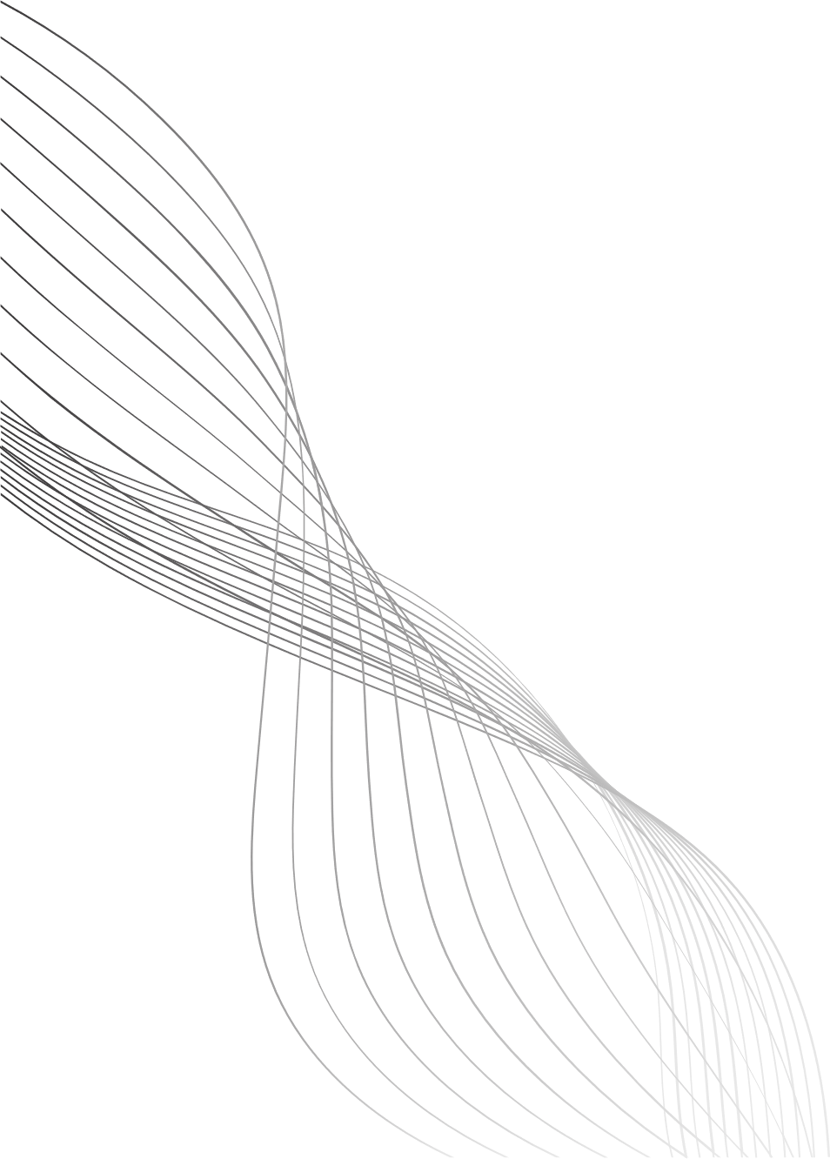
TITLE
Predictive Maintenance of Jet Engines Using RUL Estimation on NASA’s FD001 Dataset.
COURSE – MDI3003 ADVANCED PREDICTIVE ANALYTICS
PROJECT

Slide 2
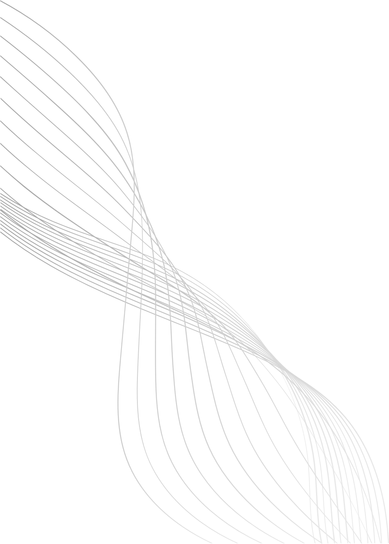
ABSTRACT
Predictive maintenance is a critical strategy for enhancing the reliability and safety of jet engines while minimizing operational costs. This project focuses on predicting the Remaining Useful Life (RUL) of engines using NASA’s FD001 dataset. By leveraging sensor data and advanced machine learning techniques, we aim to provide continuous predictions of engine health, enabling timely maintenance interventions. The system translates RUL predictions into actionable alerts, allowing operators to proactively plan maintenance schedules. The project integrates feature engineering, model development, and visualization, offering a comprehensive approach to predictive maintenance.
02

Slide 3
PROBLEM STATEMENT
Jet engine failures can lead to significant safety risks and operational disruptions. Traditional maintenance approaches, such as scheduled inspections, often result in unnecessary maintenance or unexpected failures. This project addresses the challenge of predicting the remaining operational lifespan of jet engines accurately, enabling a shift from reactive or scheduled maintenance to predictive maintenance. The goal is to provide a system that not only estimates RUL but also generates actionable alerts to prevent engine failures.
03

Slide 4
OBJECTIVES
1.
Preprocess and clean the NASA FD001 dataset to handle missing values, normalize data, and extract relevant features.
2.
Develop feature engineering strategies to enhance predictive power using sensor readings and operational settings.
3.
Train and evaluate machine learning models to predict the Remaining Useful Life (RUL) of each engine.
4.
Implement an alert system based on RUL predictions to signal upcoming maintenance needs.
5.
Visualize predictions and engine health trends to provide intuitive insights for maintenance planning.
04

Slide 5
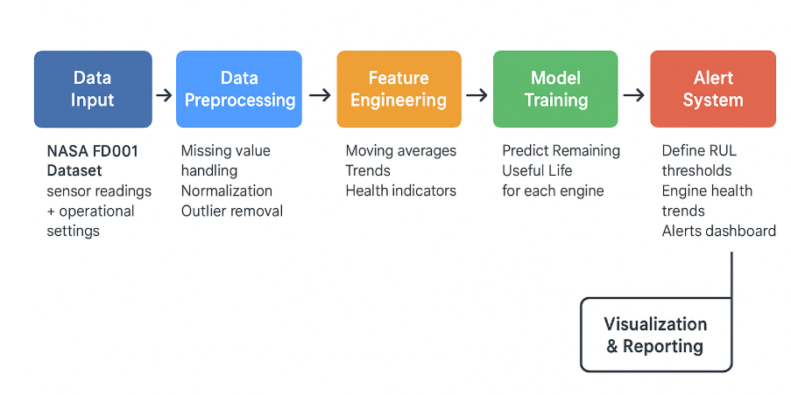
BLOCK DIAGRAM
05

Slide 6
DATASET OVERVIEW
The NASA FD001 dataset contains simulated run-to-failure data for multiple jet engines. Each engine is equipped with multiple sensors that record operational parameters over time. The dataset provides training data with full life cycles and test data with unknown failures, along with true RUL values. This allows for supervised learning approaches to estimate the remaining lifespan of engines.
06

Slide 7
CONCLUSION
This project demonstrates a practical approach to predictive maintenance by estimating the Remaining Useful Life of jet engines. By combining data preprocessing, feature engineering, and advanced machine learning, we can predict potential failures before they occur. The alert system translates these predictions into actionable insights, reducing downtime, improving safety, and optimizing maintenance schedules. This methodology not only provides operational efficiency but also showcases the impact of data-driven predictive maintenance in the aerospace industry.
07

Slide 8
THANK YOU
Team Members:
Mythili Anu keerthana
Swathi D
Anusri S
08

