Slide 1
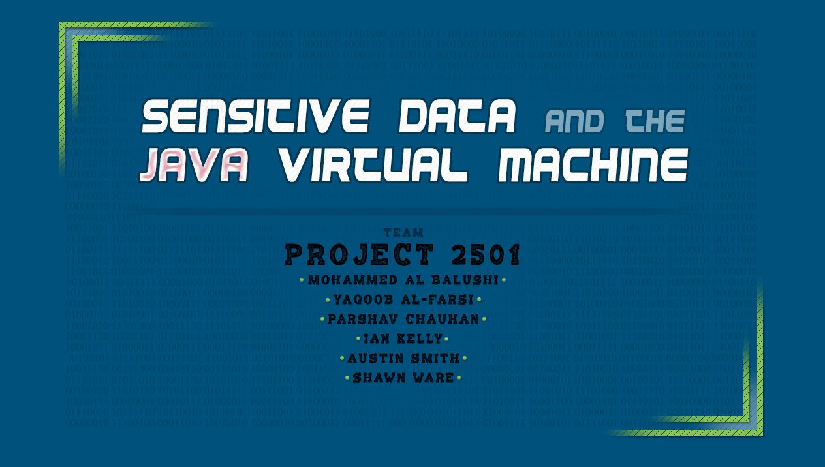

Slide 2
Project Goals
Test Java memory management procedures in the Hotspot Java Virtual Machine
Research the duration of dereferenced memory object “artifacts” in the JVM
Determine and report what, if anything, developers can do when creating applications that handle sensitive information to better protect that information.
Determine whether or not it is programatically possible to mark potentially sensitive data as free/releasable as soon as possible and whether or not such a process can be utilized to influence the behavior of the Oracle Hotspot JVM's Garbage Collector.

Slide 3
Methodology
Git Version Control System (GitHub) to share work.
Agile/Kanban mashup flow of work
Team members picked up backlog tasks as time and resources became available.
GroupMe application for up-to-date team communication
It’s simplicity avoided any confusion when it came to communications.
Provides well-developed mobile OS applications and an easy-to-use web interface
When documented communication was needed, email was used

Slide 4
Methodology
Development of code was performed in the IDE of choice of the coding team members.
All members used identical code formatting/stylers, regardless of IDE.
Each IDE (e.g. Eclipse, IDEA, etc.) has slightly different tools for debugging applications
All documentation was created with text editors
Notepad++, GitHub’s online MarkDown editor, etc.
Team members were granted Contributor status on the project repository to ease Pull Requests and merges.

Slide 5
Methodology
The work was divided among team members based about their interests and skills. This helped the group maintain a higher quality of work.
The team maintained regular meeting times outside of class to discuss progress of tasks and to collaborate better.

Slide 6
Research
Lifecycle Interceptor
Method Interceptors
Class Interceptors
Implementable Interfaces

Slide 7
Lifecycle Interceptors
The preferred method to define interceptors is using meta data annotations, which are shown in the table below:
Interceptor Metadata Annotation | Details
javax.interceptor.AroundInvoke | Assigns the interceptor method.
javax.annotation.PreDestroy | Assigns the method before destroying the lifecycle events
javax.interceptor.AroundTimeout | Assigns the interceptor method to timeout and impose it as enterprise bean method.
javax.annotation.PostConstruct | Assigns the method to intercept after construct lifecycle events.

Slide 8
Method Interceptors
Used for when you want your interceptor to be available to only one class.
The interceptor could be used to create a log message whenever any method within the class is entered or exited.
The scope this interceptor would be limited to the class itself.

Slide 9
Class Interceptors
Class Interceptors are used for separate classes so that the container can reuse the intercept on seperate class calls.
The basic idea is the same as a Method Interceptors, but the interceptions can now be reused among separate classes.

Slide 10
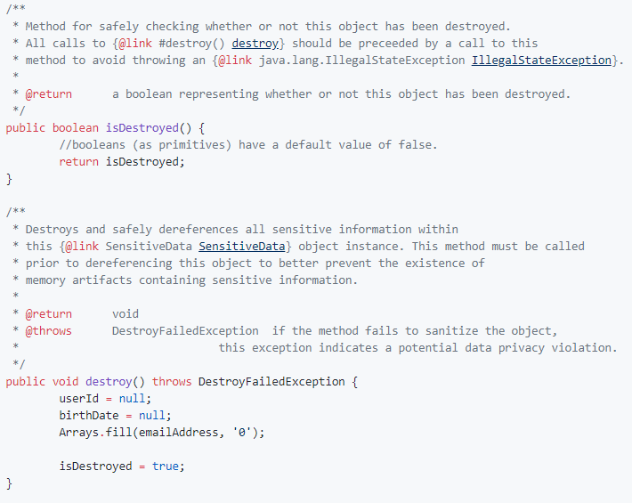
Interfaces
javax.security.Destroyable
Methods destroy() and
isDestroyed()

Slide 11
Development
Milestone 1 :
Improved on development process, finalized testing process.
Milestone 2 :
Tested individual components of the project, including the Garbage Collector, Heap, use of Interceptors and annotations.
Milestone 3 :
Combing the previous work and drawing conclusions from our findings.

Slide 12
Interceptors and Annotations
Interceptors are able to be interposed on method invocations or lifecycle events on a target class.
Trigger an implementation to dispose a resource or dereference an object.
Milestone 2 samples for Interceptors and Annotations displays its implementations and use cases.

Slide 13
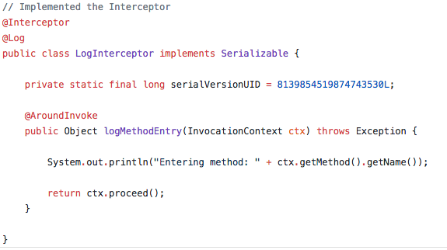
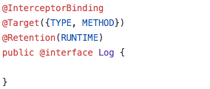

Slide 14
Heap
Milestone 2 included testing the heap in certain situations :
Data currently being used by the application code. Data residing in memory freed up by garbage collection. Data copied to another area in memory by garbage collection.
Milestone 3 implements multiple heap-intensive tasks to draw results.

Slide 15
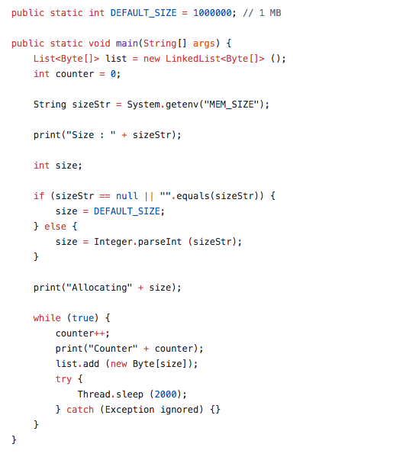

Slide 16
Garbage Collector
Milestone 2 included testing various types of garbage collection that can be applied to the Java program.
Sample Programs were tested with 4 variants of garbage collection.
Milestone 3 included implementation of various methods for the program to interact with garbage collection calls.

Slide 17
Milestone 3 Research and Development
Research on `finalize()` method for Java Objects.
Linking of Interceptor directly to invocation call of the `finalize()` method.
New tools for events to trigger heap dumps and analyze memory during program execution.
Usage of Java core libraries for memory usage.
Summation of topics of research in previous milestone into a single project for testing and drawing conclusions - “Project Instance”

Slide 18
Program Instance
Culmination of samples from research work.
No structure/architecture to actual program.
Implementation of multiple Garbage Collection roots.
Attempt to draw conclusions from this program.

Slide 19
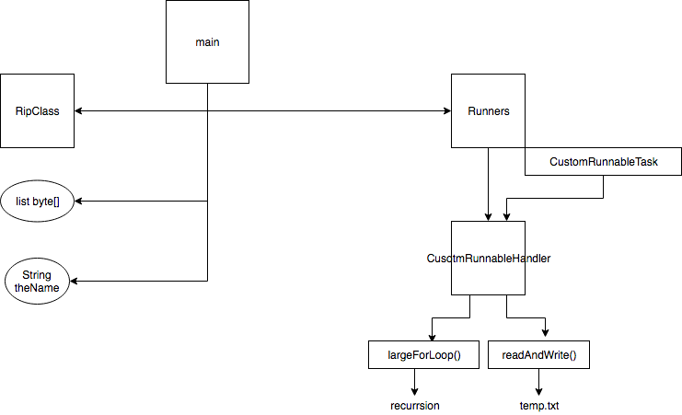
Instance program structure

Slide 20
Development Findings and Results.
String within the heap test program was present in heap even after dereferenced. Character array, or conversion of string to character array, was not.
Runnables and Threads worked as expected, however need to be properly disposed for GC to run as expected on objects being referenced.
Unpredictable occurrence of GC. If the program was let to run, RipClass which was set to null triggered the finalize method without any consistency.
Finalize method held reference to Main class but would get dereferenced without updating the reference (clean resources).
Out of memory error would not be resolved on random cases.

Slide 21
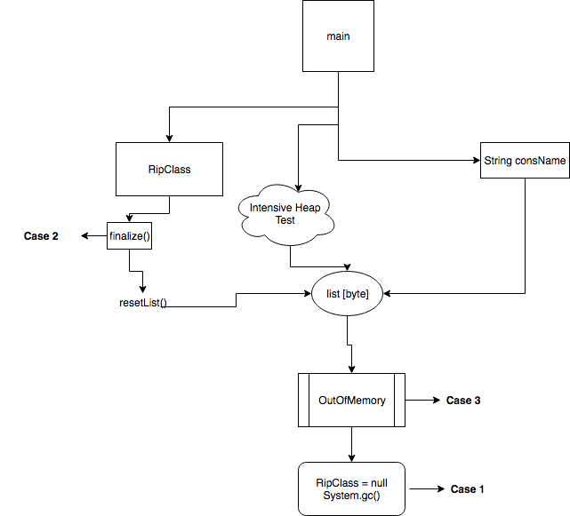
Structure of Instance without
Runners class

Slide 22
Case 1
Breakpoint once OOM occurred.
RipClass dereferenced.
System.gc() called.
Findings :
RipClass dereferenced appropriately.
No occurrence of String in list.

Slide 23
Case 2
Sleep thread of 200ms at finalize() method call on RipClass.
Similar handle of OOM as in Case 1.
Findings :
Exact same as Case 1.

Slide 24
Case 3
No breakpoint or Sleep for OOM Occurrence.
Similar handle of OOM as in Case 1 and Case 2.
Findings :
Finalized was unpredictably called.
Sometimes not called - String reside in list[] memory even after GC was called.

Slide 25
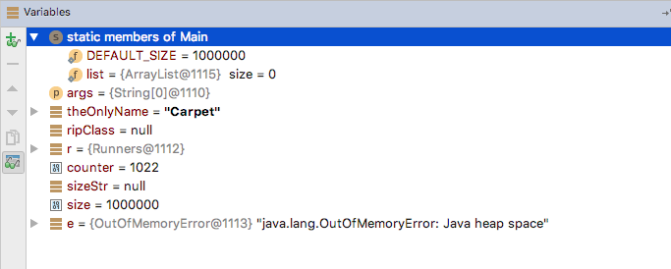
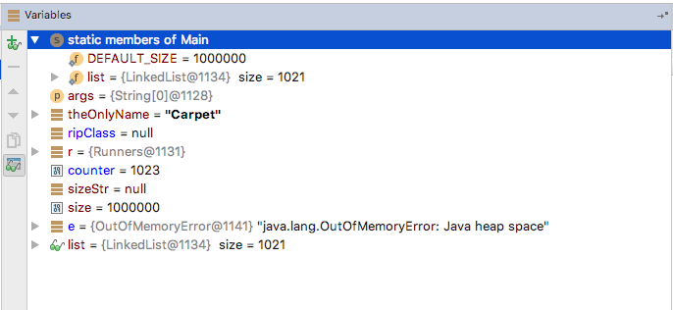
Case 1 and 2
Case 3

Slide 26
Conclusions
Recommendation 1: Don’t use Java
Recommendation 2: Seriously, don’t use Java.
...
Recommendation 3: Alright, but don’t use Strings.
Recommendation 4: Ingest, use immediately, then destroy

Slide 27
Conclusions / Future Work
More extensive application development
Better understanding of the underlying JVM (all parts; not just memory management)
Distributed / Clustered application testing

