Slide 1
Project 2501
Milestone 2 - Progress in sensitive data handling within the Java Virtual Machine

Slide 2
TESTING THE JAVA HEAP
THE HEAP AND GARBAGE COLLECTION
An operating system allocates a chunk of computer memory that the JVM uses to manage application data.
This chunk contains every piece of data used by a developer like class objects, static variables, and even the application code.
When objects are created, memory is allocated inside the chunk and data is written.
Garbage Collection works by periodically scanning for allocated items that are unreachable by application code.

Slide 3
TESTING THE JAVA HEAP
THREE POSSIBLE DATA VULNERABILITIES
Data currently being used by the application code.
Data residing in memory freed up by garbage collection.
Data copied to another area in memory by garbage collection.

Slide 4

TESTING THE JAVA HEAP
TESTING THESE VULNERABILITIES
HeapTester.java Code that creates data with a hidden message. 1. create a lot of random data, create hidden message, test. 2. dereference hidden message, perform operations, test.
TestPasswordAccounts.java (String array, char array) Code that creates UserAccount objects with a dispose method. 1. create queue filled with multiple account data objects, test. 2. pop and dispose every user account object, test.

Slide 5
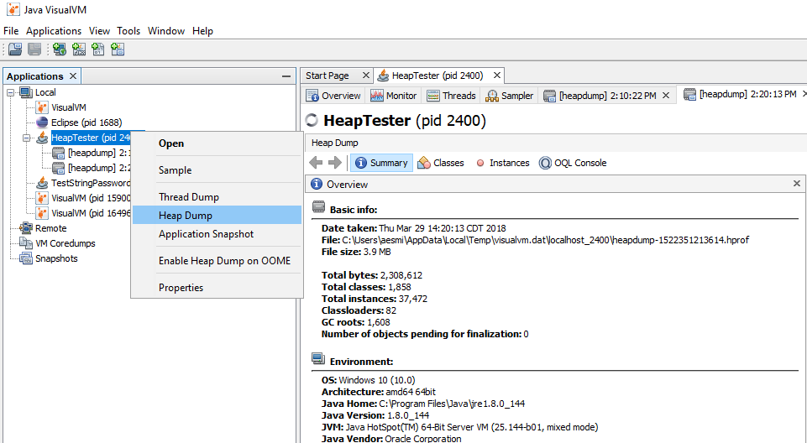
TESTING THE JAVA HEAP
TESTING TOOLS
The data can be tested by placing breakpoints at strategic points in the code and creating a heap dump.
The Eclipse IDE was used to run and debug the code.
VisualVM was used to create and analyze heap dumps.

Slide 6
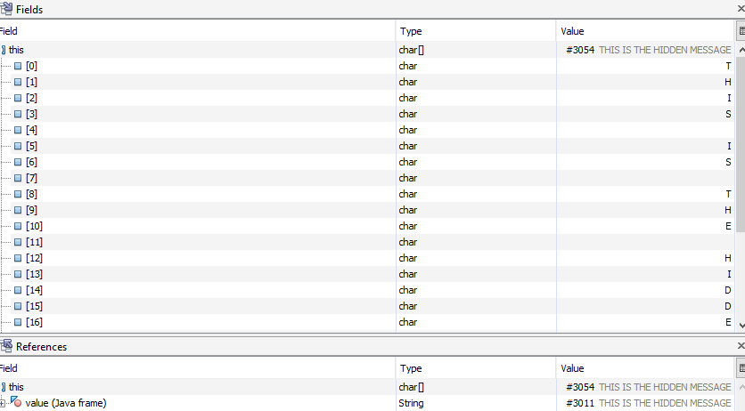
TESTING THE JAVA HEAP
FINDING 1: HEAP TESTER
Data currently in use by application code can be discovered within a heap dump.
The hidden message String was found in the heap dump.

Slide 7
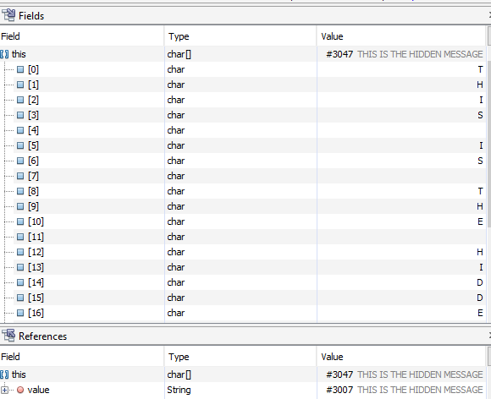
TESTING THE JAVA HEAP
FINDING 2: HEAP TESTER
Dereferenced data, no longer in user by application code, can still be discovered in a heap dump.
The hidden message could be discovered even after the String was dereferenced.

Slide 8
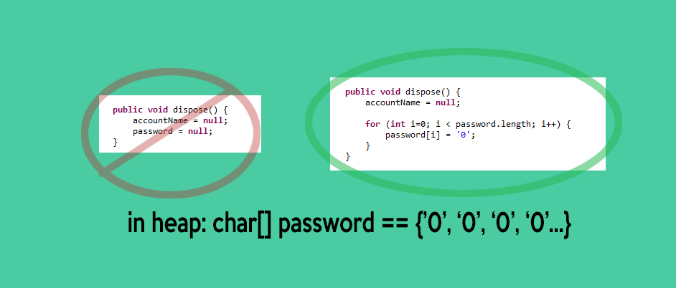
TESTING THE JAVA HEAP
FINDING 3: TEST PASSWORD ACCOUNTS
Since Garbage Collection does not overwrite before dereferencing, data can be securely disposed of by using mutable data types and overwriting them.
A char[] was used for password instead of a String, then overwritten with zeros, and the heap dump no longer contained sensitive information.

Slide 9
Interceptors in the Java Platform
Interceptors are used to implement cross-cutting concerns, such as logging, auditing, and security, from the business logic
These interceptors can be defined inside the target class as a method, or as an interceptor class.

Slide 10
Interceptors in the Java Platform
The preferred method to define interceptors is using meta data annotations, which are shown in the table below:
Interceptor Metadata Annotation | Details
javax.interceptor.AroundInvoke | Assigns the interceptor method.
javax.annotation.PreDestroy | Assigns the method before destroying the lifecycle events
javax.interceptor.AroundTimeout | Assigns the interceptor method to timeout and impose it as enterprise bean method.
javax.annotation.PostConstruct | Assigns the method to intercept after construct lifecycle events.

Slide 11
Method Interceptors
Used for when you want your interceptor to be available to only one class.
The interceptor could be used to create a log message whenever any method within the class is entered or exited.
The scope this interceptor would be limited to the class itself.

Slide 12
Class Interceptor
Class Interceptors are used for separate classes so that the container can reuse the intercept on seperate class calls.
The basic idea is the same as a Method Interceptors, but the interceptions can now be reused among separate classes.

Slide 13
Garbage Collection
Manages memory allocation and deallocation in the JVM.
GC Roots - Source of an Object
Local variables.
Static variables.
Active Java threads.
JNI References.
GC
Serial Garbage Collector
Parallel Garbage Collector
CMS Garbage Collector
G1 Garbage Collector

Slide 14
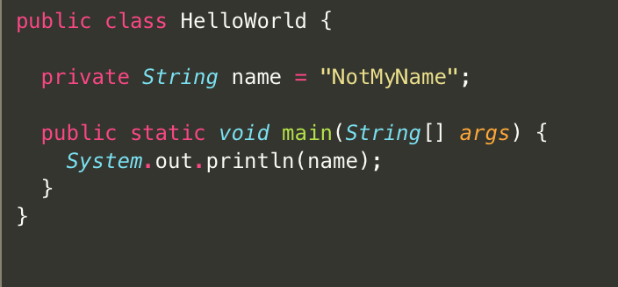
Local variables in the main method
The main thread
Static variables of the main class

Slide 15
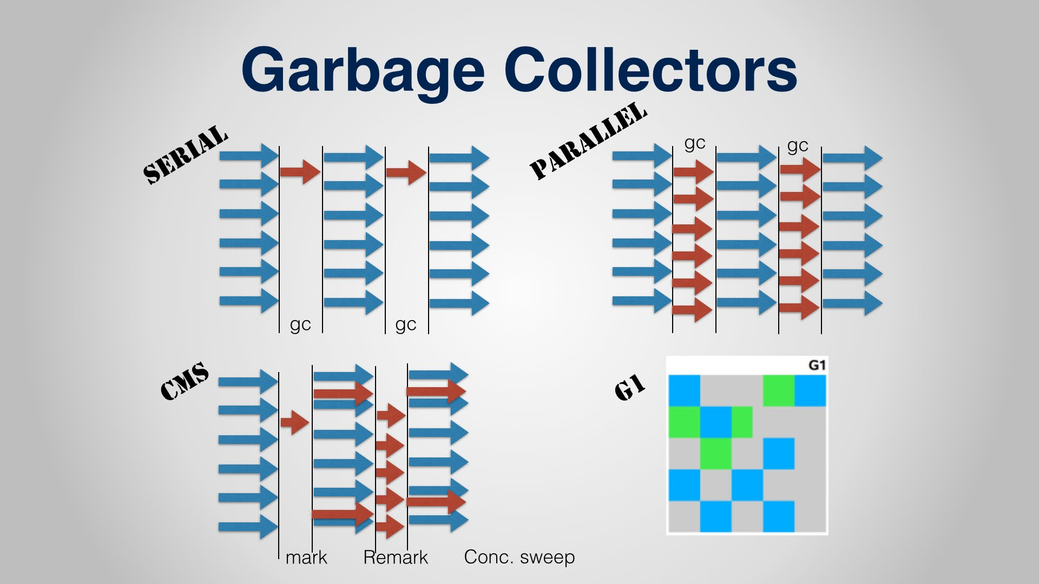
-XX:+UseSerialGC
// default
-XX:+UseParNewGC
-XX:+UseG1GC

Slide 16
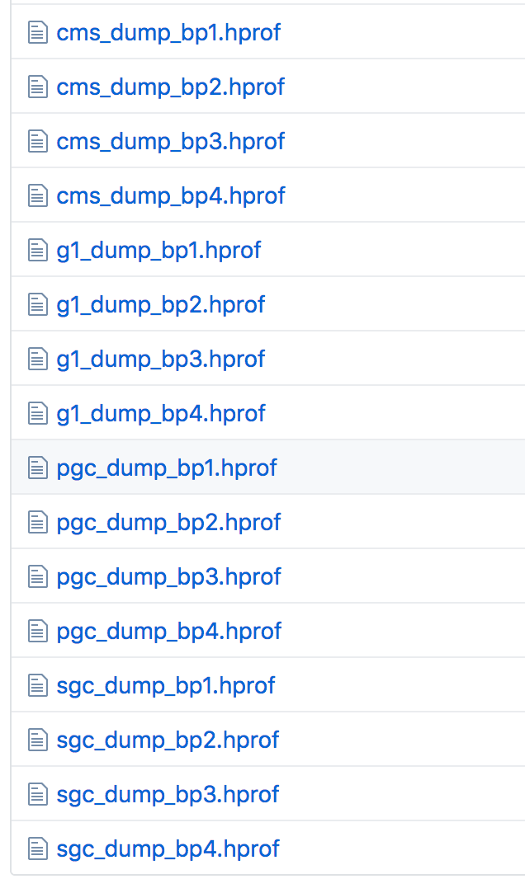
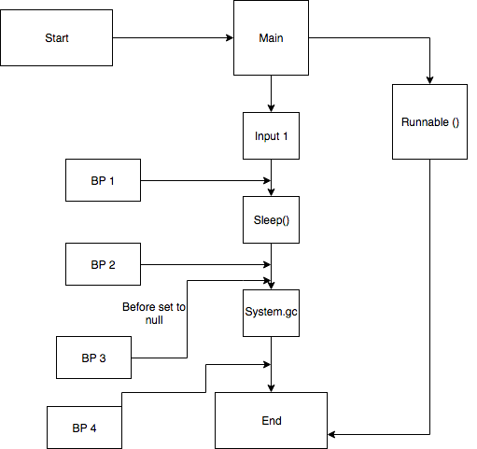

Slide 17
Next Steps -
Proper method to visualize differences.
Modify with results from Heap test.
Modify with Interceptors and Annotations.

