Slide 1
“Dude, where’s my car?”
April 2 2019
Shelly Garg, Geyang Ye and Dann Taylor

Slide 2
Questions to Answer
Using ”Chicago Towed Vehicles and Abandon cars data” we wanted to answer these questions:
Does the day of the week have an any impact?
What impact did holidays and cultural events have on towing?
How long does it take for an abandoned car to be towed?
What percentage of towed cars are abandoned cars?
To which Chicago Impound Lot facility is a car likely towed?
From which states are towed cars?

Slide 3
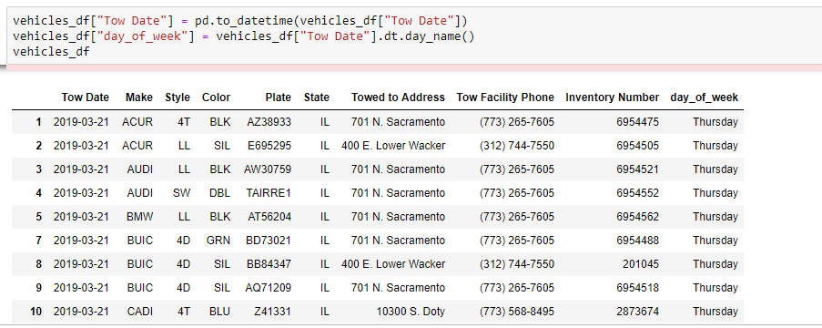
Does the day of the week have an any impact?

Slide 4
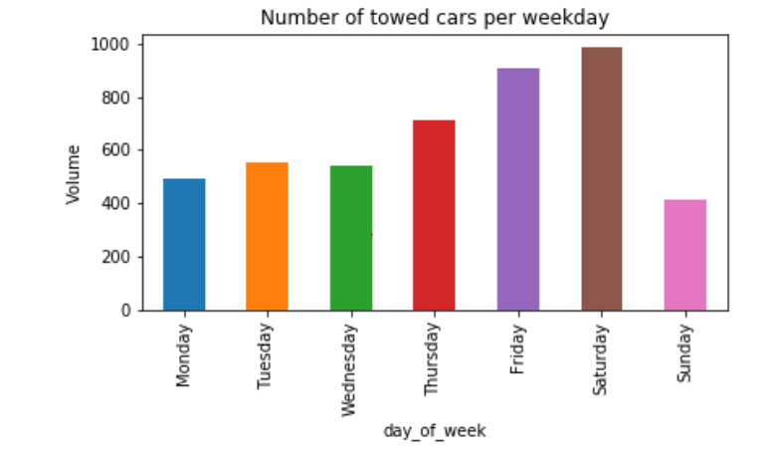
Does the day of the week have any impact?
Answer – Yes, we think the number of towed cars increased significantly during Friday and Saturday, the reason probably is people would like to go out during Friday night and Saturday.

Slide 5
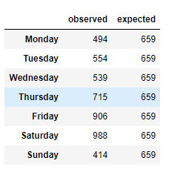


To verify our hypothesis which is the number of towed cars during the week is significantly different we use Chi-Square test to do the validation
Conclusion – Different day of week has significantly different impact on the number of towed cars

Slide 6
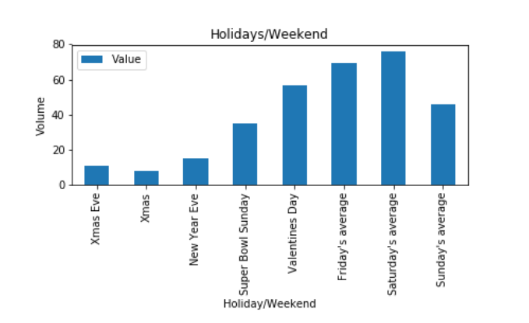
2. What impact did holidays and cultural events have on towing?

Slide 7
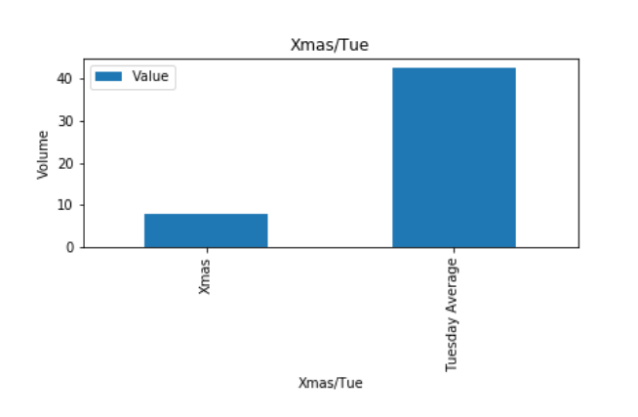
Then, we also compare this year’s Xmas data with the average Tuesday data
Conclusion – We believe the holidays like Christmas do have impact on the number of towed cars, because during this family holiday, people tend to stay home with family includes the police officer

Slide 8
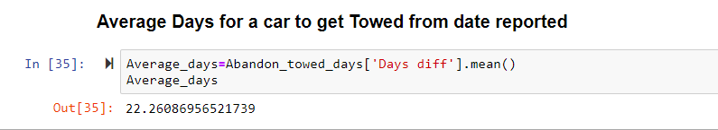
3. How long does it take for an abandoned car to be towed?
Conclusion: It takes about 23 days for a abandon car to be towed from it is reported. Also it was observed that cars reported abandon in November and December took longer to towed then the cars reported in February and March

Slide 9
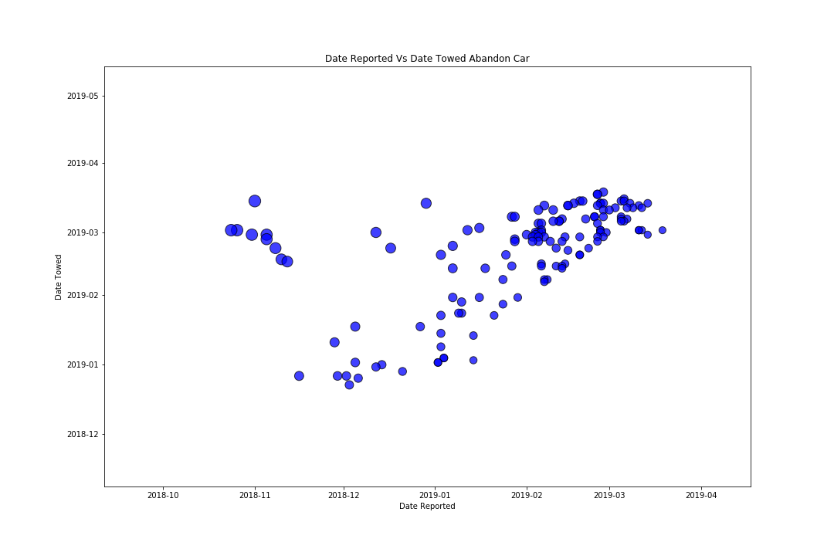
Scatter Plot for Abandon cars

Slide 10
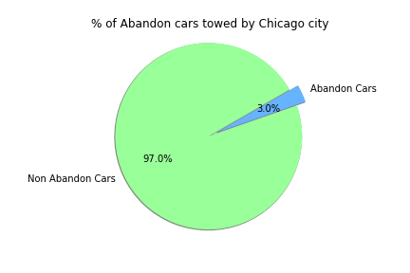
5. What percentage of towed cars are abandoned cars?
Only 3 % of towed cars are abandon cars over the 90 days but that is 138 cars are abandoned and towed .

Slide 11
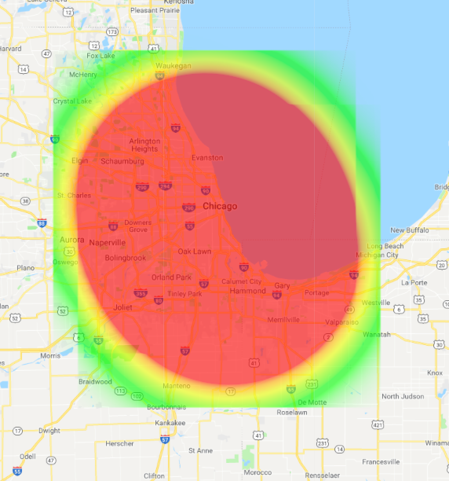
To which facility is a car likely towed?
Notes:
To figure this out, we counted how many cars went to each lot, and then using the address of the lot as provided in the dataset, geocoded the lots using Google’s geocoding API service. The heatmaps show the concentration of cars per lot, based on the total number of cars in the dataset. We’re confident we can assign any car in the dataset to the area in RED.
Here we looked at to which of the four locations in our data set a car could be towed:
10300 S Doty: 2,315 cars
701 N Sacramento: 2,203 cars
400 E Lower Wacker: 87 cars
ORD: five cars

Slide 12
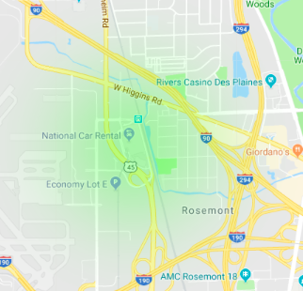
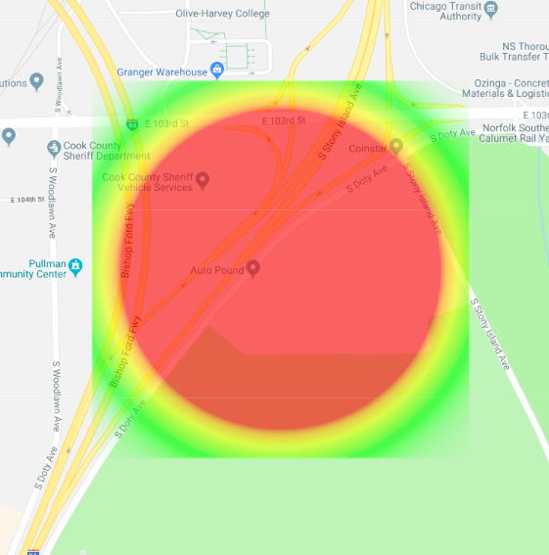
More specifically…
O’Hare
10300 S. Doty
Notes:
We wanted to know to which facility of the four are the cars towed?
Most of the cars were towed to the 10300 S Doty location (50%) and five cars to ORD.

Slide 13
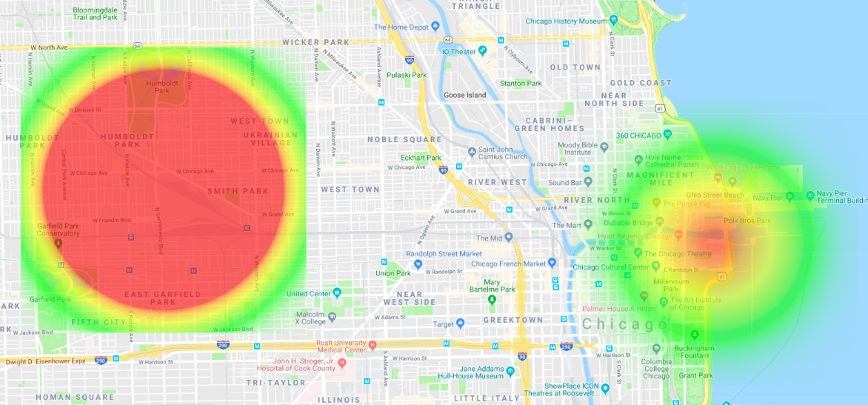
Or…
701 N. Sacramento
400 E. Lower Wacker
Notes:
The 701 N. Sacramento site received 48 percent of the towed cars in our data set and Lower Wacker received two percent.

Slide 14
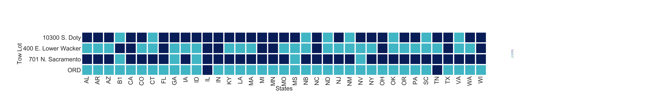
Plates
Notes:
Using the Plate variable in the dataset, we looked at to which lot each vehicle went. We see here in the states represented in each of the tow lots. The darker color represents at least one state plate.
Looking at this chart, we see 37 states different represented in Chicago tow lots. Illinois is represented most frequently and in each of the four lots. Indiana, Wisconsin, and Michigan are well represented by percentage as well as in each three of the four lots.
The 701 N Sacramento Lot contains the most diverse collection of cars by state (32 of the 37 total states are represented), Wacker has the least diverse collection, at least by license plate, excluding O'Hare of course.
Any comments, concerns or curiosities?

Slide 15
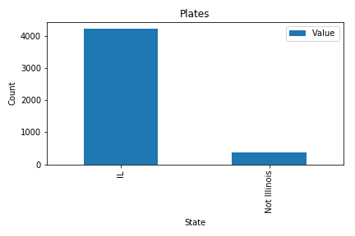
Plates
Notes:
Using the Plate variable in the dataset, we also looked at counts by state for plates towed. Here we can clearly see the counts of Illinois plates outweighs non-IL plates.

Slide 16
Comments, concern or curiosities?

