Slide 1

CASE STUDY
SHEIN

Slide 2
Group Members
Mohammed Swarim Khan
Sandhra Saju
Ch. Jahnavi

Slide 3
ABOUT shein
SHEIN is an international B2C fast fashion e-commerce platform. The company mainly focuses on women's wear, but it also offers men's apparel, children's clothes, accessories, shoes, bags and other fashion items.
SHEIN mainly targets Europe, America, Australia, and the Middle East along with other consumer markets.
SHEIN adheres to the concept that "everyone can enjoy the beauty of fashion."
SHEIN is able to stay on top of the latest fashion trends from around the globe while rapidly bringing these styles to market.
SHEIN is the ultimate one-stop-shop for the modern yet economical fashionista. It aims to promptly offer stylish quality products at appealing prices to every user in the world.

Slide 4
Shein products
Clothing
Accessories
Footwear
Home Decor
Lighting
Kitchen & Dining

Slide 5
Accessing Shein
To enter into SHEIN,
ENTER THE URL www.shein.in

Slide 6
ONLINE PURCHASING

Slide 7
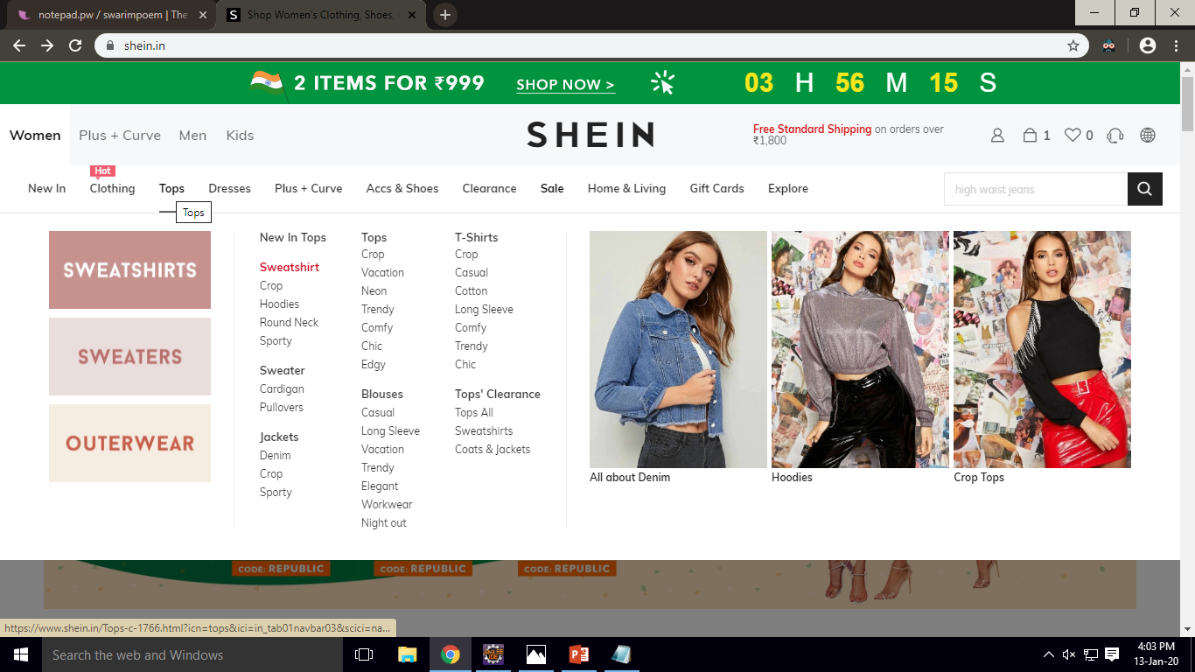
SELECT YOUR DEPARTMENT

Slide 8
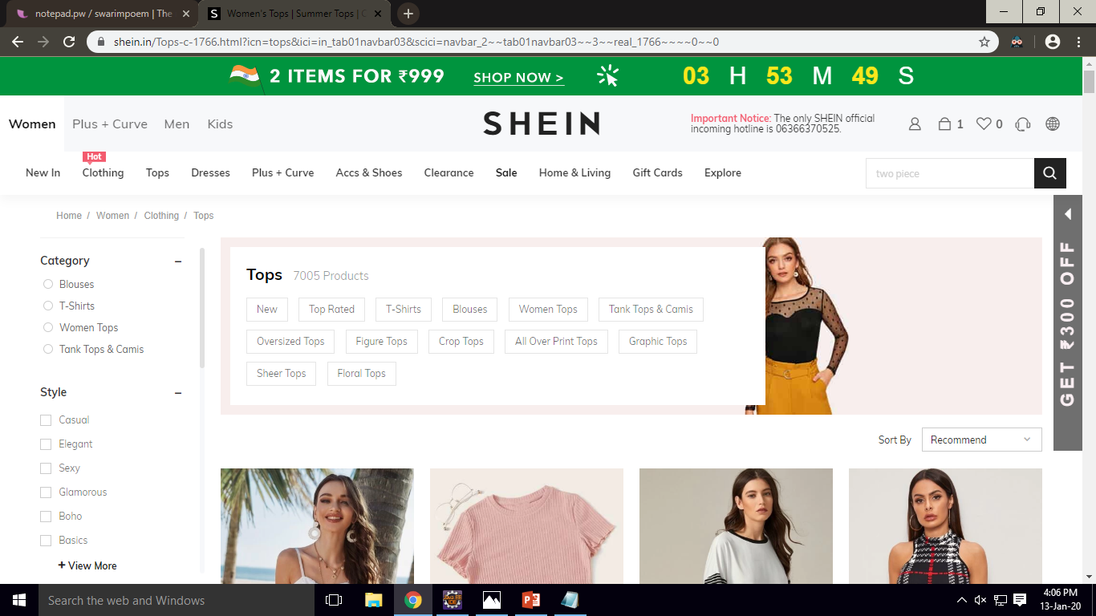
SELECT YOUR CATEGORY

Slide 9
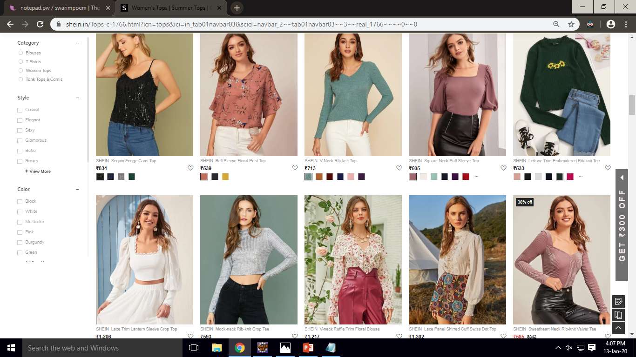
SELECT PRODUCT

Slide 10
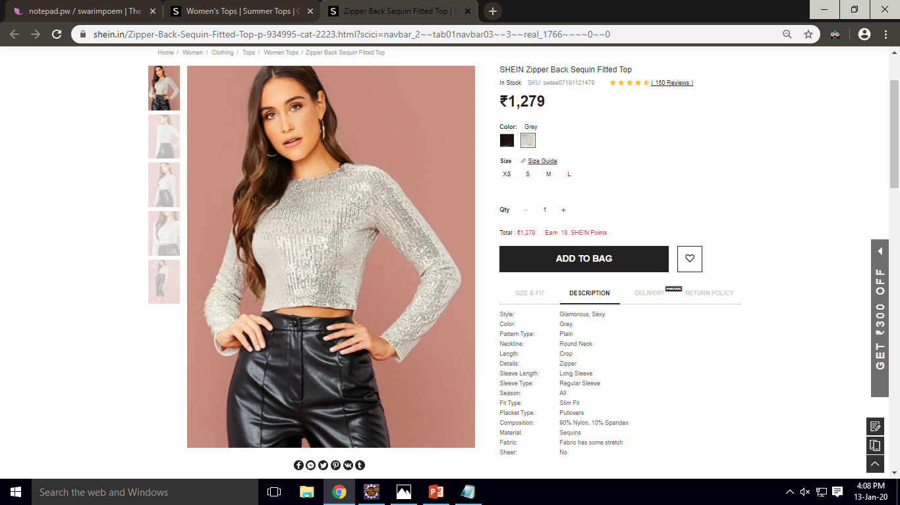
PRODUCT DESCRIPTION

Slide 11
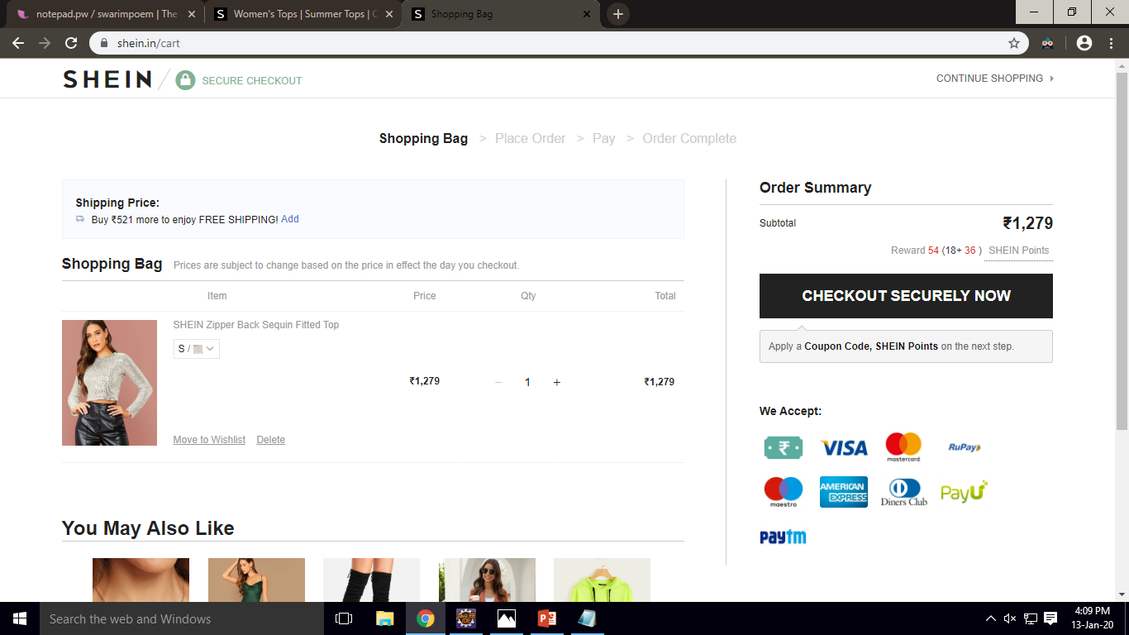
SHOPPING CART

Slide 12
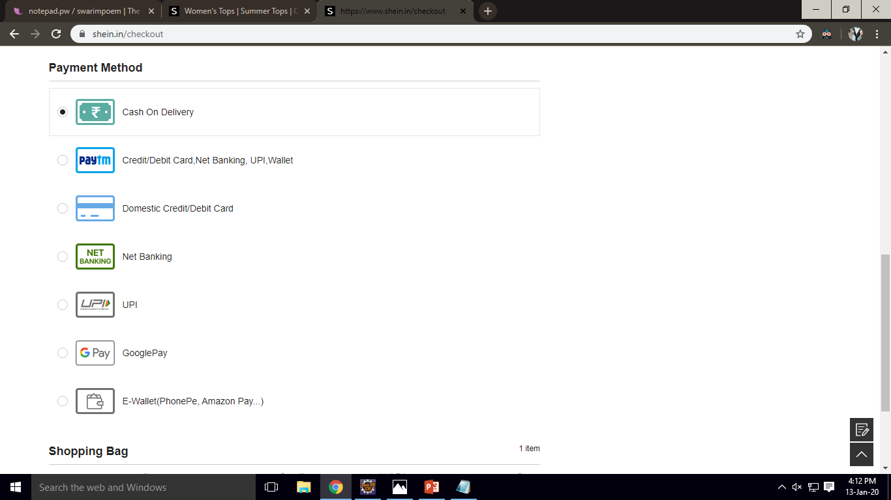
PAYMENT

Slide 13
THANK YOU!
- The Beatles

