Slide 1
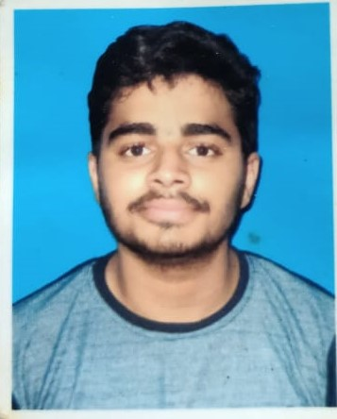
Swarinim Sudhanshu
Analyst/Software Engineer
Bachelor of Engineering
Computer Science : 2018 - 2022
Skills
C# | C# Basics,OOPS,Generics,Collections,Array,Loops
.NET | ADO.NET,ASP.NET with MVC and WEBAPI ,Entity Framework
.NETCORE | ASP.NETCORE MVC , .NETCORE WEBAPI wiith Entity Framework
Angular | Components, Services, Modules, Routing, Forms & Validation,Exception Handling
Database | Microsoft SQL Server
UI Tech | HTML5 & CSS3, Javascript,Basic UI Design
Cloud | Microsoft AZ 900 ongoing Training
Tools | Git,Postman,SSMS,Visual Studio,Visual Studio Code
Addonskills | Immersive Learning,Communications, Team management. Peer learning
Mumbai
swarinim.sudhanshu@capgemini.com
+91 7484903051
A4
Full Stack Developer
Hands on experience on C#,ADO.NET,SQL Server,.NET MVC with WEBAPI ANGULAR ASP.NETCORE WEBAPI
Proficient in creating Single page Web Application in Angular With ASP.NET COREWEBAPI
Hands on experience in developing web pages using HTML5,CSS3,Object Oriented Java script
Experience in creating documentation with Java docs and swagger and in unit testing using Junit, Mockito including code quality compliance using Sonar cube
Having Knowledge of Git and GitHub
Attended training on .NET and .NETCORE
Online Hotel Management System
[video link]-https://drive.google.com/file/d/1Kc88h4DArBQSOSr1z9vMgT53-MgRcjl-/view?usp=share_link
Case study of Online Hotel Management System developed using ASP.NET Core,Web API Core and SQL Server Management Studio, UserInterface created with HTML5,CSS3 and Angular.It is a web based application for Hotel staff(Owner,Manager,Receptionist)so that they can check Hotel Booking and other function easily.
Online Banking Management System
Case study of Online Banking Management System developed using ASP.NET MVC and Web API and SQL Server Management Studio UserInterface created with HTML5,CSS3 and MVC . It is a web based application for Admin and customer which majorly performs CRUD Operation to add update delete user record.

