Slide 1
How To Be Rich in Stock Market:
A data-mining approach
Wei Pan
Umang Bhaskar

Slide 2
Standard&Poor’s 500
Elementary Analysis
Clustering and Leading Stocks.
Predicting.

Slide 3
Data Source
06-07 Standard Poor’s stock, 253 exchange days, free online.
Eliminate all stocks that splitted during 06-07. 387 stocks remain.
Normalized prices.

Slide 4
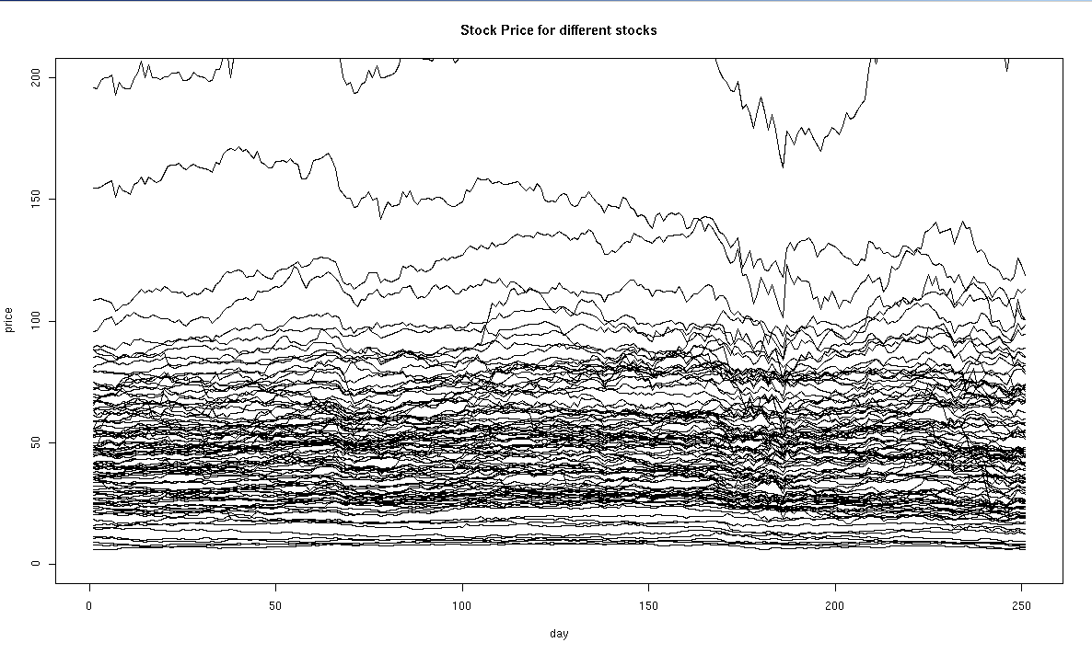
The Stock (100 out of 387)

Slide 5
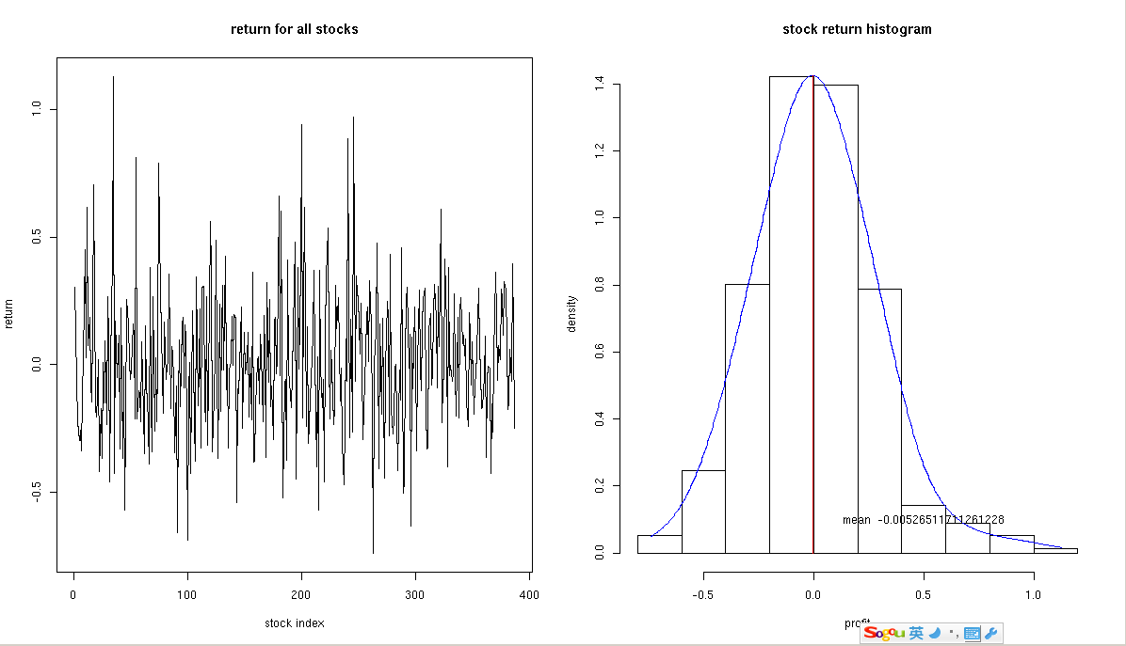
Investigate randomly, 0 returns

Slide 6
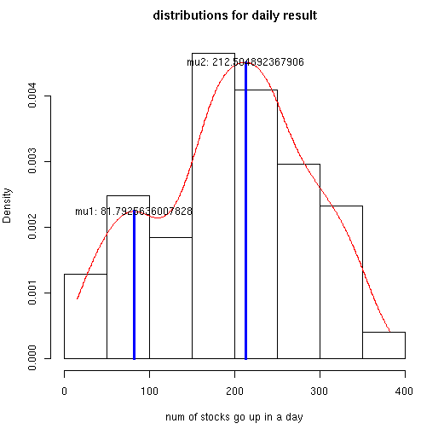
Every day

Slide 7

It’s hard to win money in a stock market

Slide 8
Variance and Classifications
After we normalize stocks, we calculate the derivative of the daily price of the stock. Then we calculate variances for the derivatives of the price of each stock.

Slide 9
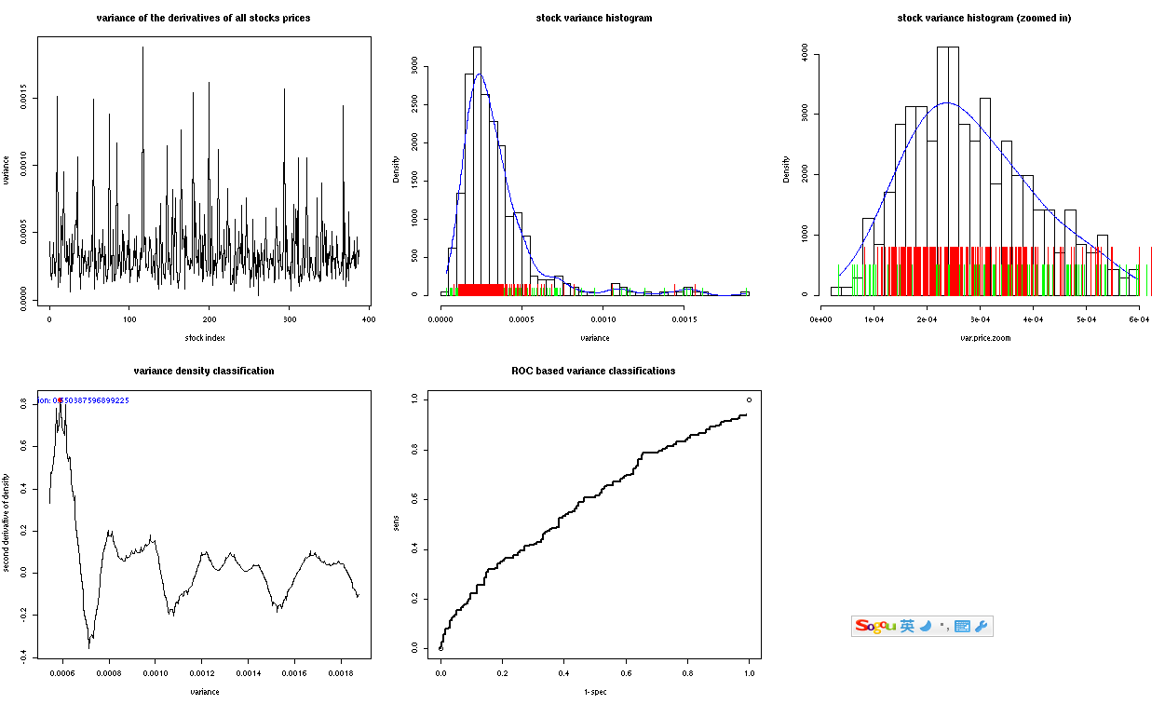

Slide 10
Slightly stocks that have a larger variance have a better change of positive return. (weak)
=> Risk goes with Potential Profit.

Slide 11
Standard&Poor’s 500
Elementary Analysis
Clustering and Leading Stocks
Predicting

Slide 12
Clustering
Why?
  “Group” stocks
  Better prediction
  Says something about the stocks
How?
  Preprocess the data
  kmeans clustering
  We try to find an “optimal” number of clusters

Slide 13
Clustering: Preprocessing
For each stock:
  Normalise the stock price
  Price on day d for stock i
  p(i,d) = p(i,d) - µ(i) / σ²(i)
  Calculate the 7-day moving average

Slide 14
Clustering: How many clusters?
Optimal clustering
We tried to use chi-square test for Mahalanobis distance
Too few stocks, too many attributes
Other methods to obtain non-singular matrix also did not work
We saw that about 30 clusters is good

Slide 15
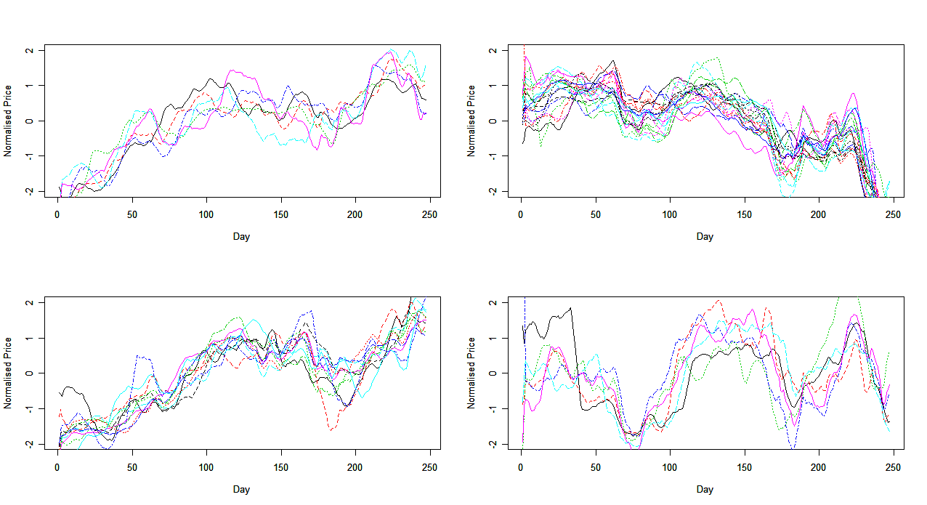
Clustering: Results

Slide 16
Prediction using Clustering
Objective: To predict behaviour of group for next 7 days
Find a “group leader”
  Find stock with maximum correlation with “future values” of other stocks
  Is this correlation is better than present-day correlation?
  This method is not optimal

Slide 17
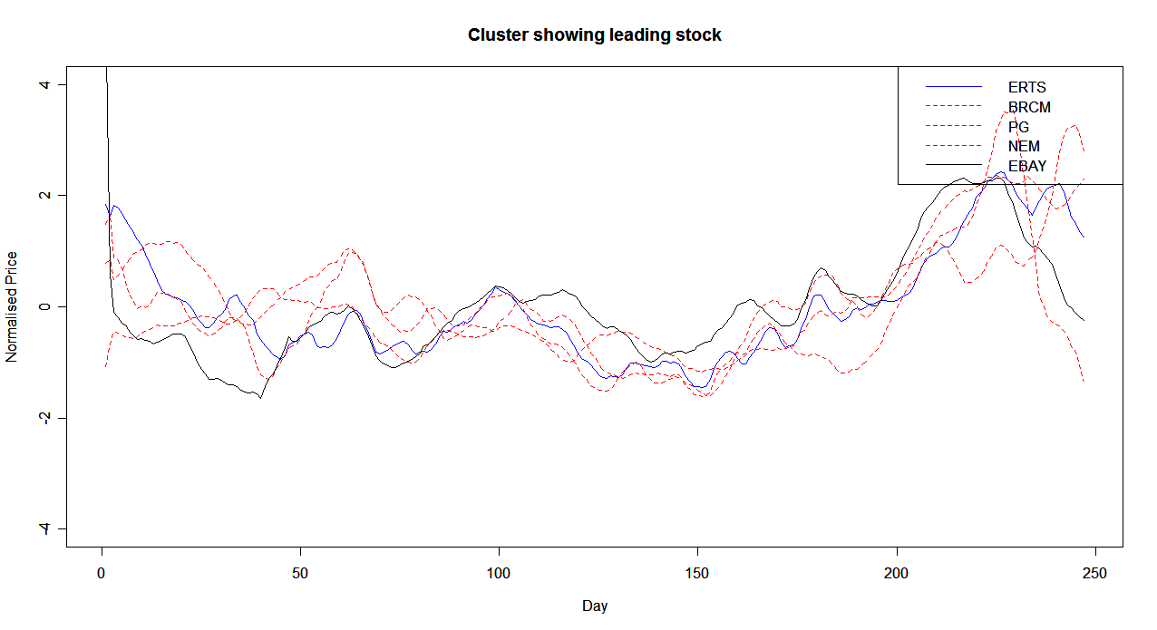
Prediction: Group Leader

Slide 18
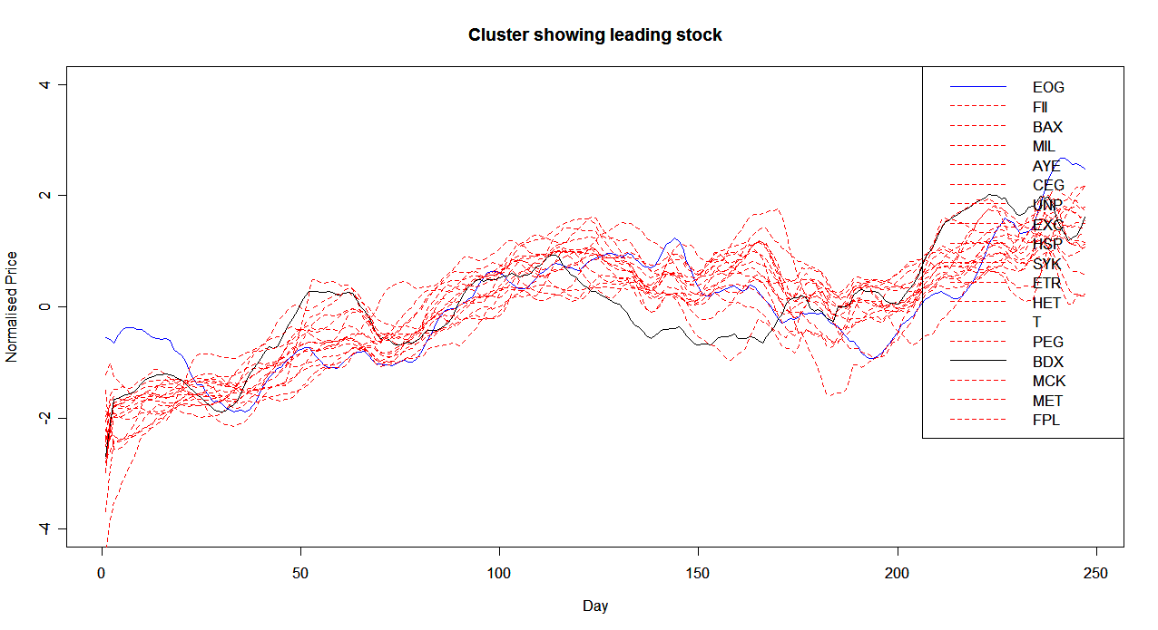
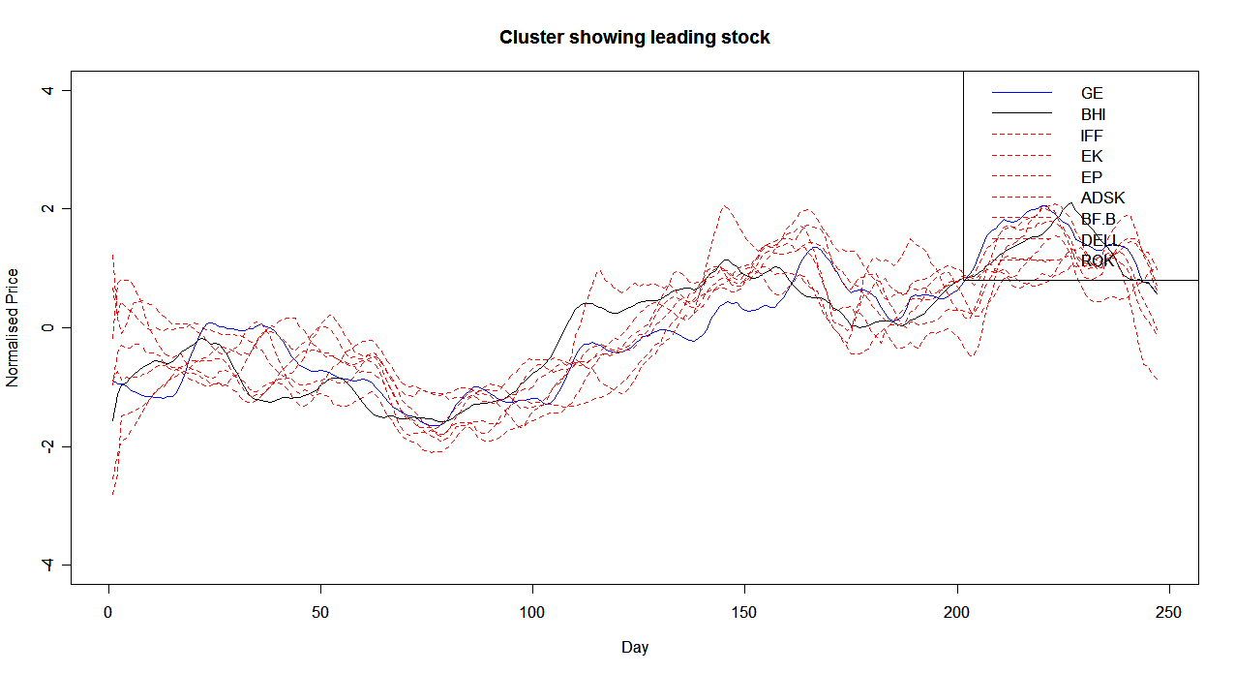
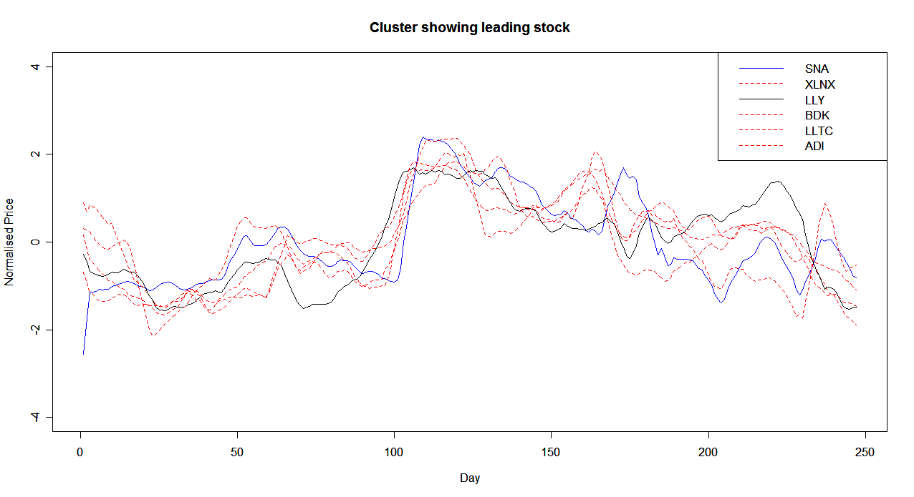
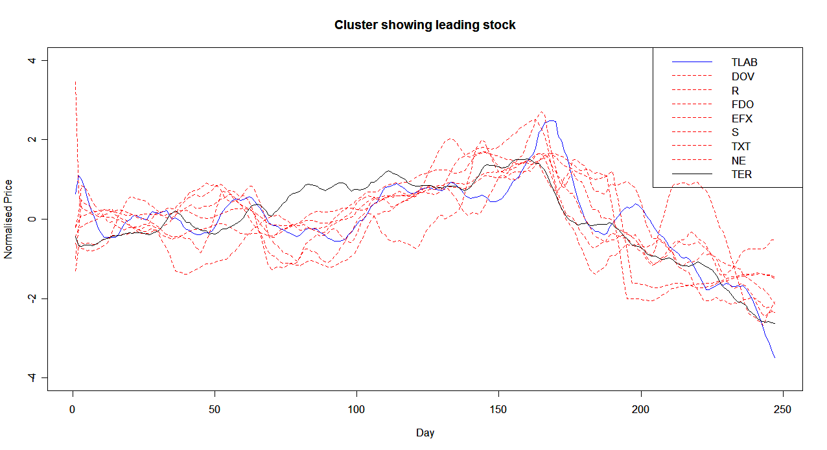
Prediction: Group Leader

Slide 19
How good is this prediction?
Question: how much money can we make?
Algorithm:
  Start with 100 stocks on day 1
  If leading stock goes up by 10%, buy if you can
  If leading stock goes down by 10%, sell if you can
  How much is return?

Slide 20
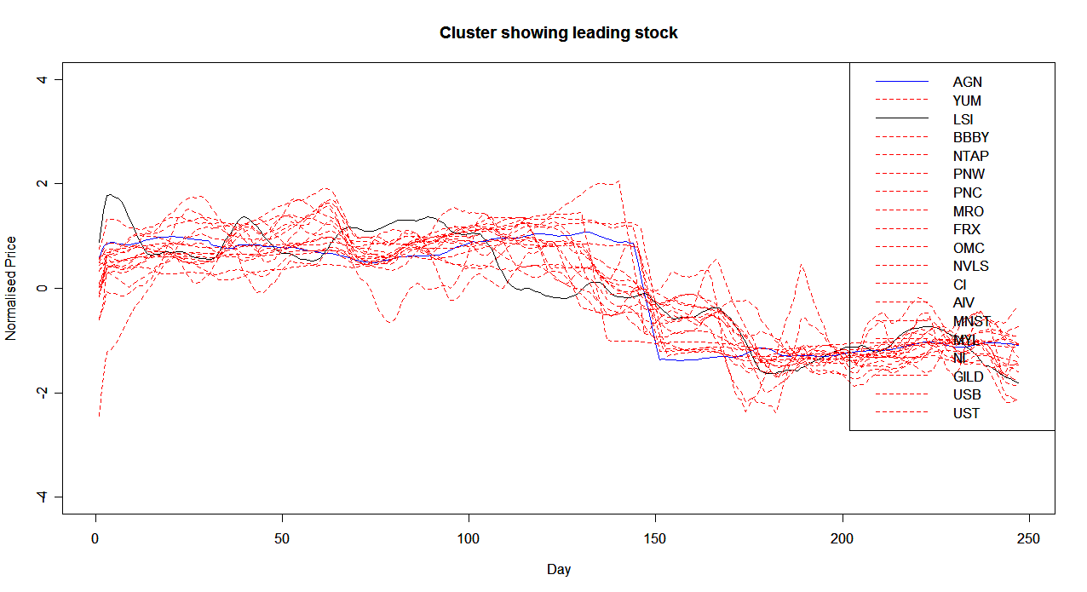
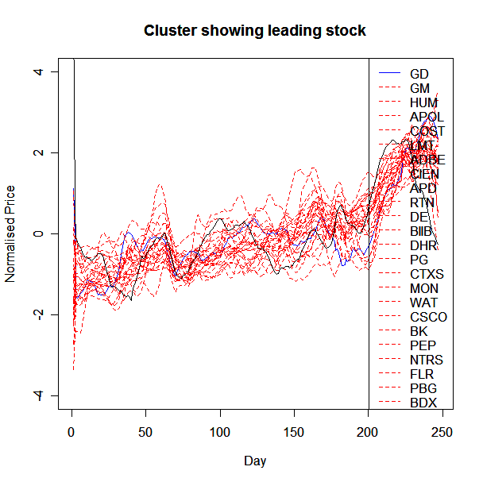
How much money can we make?
Cluster 1:
  Investment: $8051
  Returns: $14044
  Market: $6477
Cluster 2:
  Investment: $10518
  Returns: $12883
  Market: $8878

Slide 21
How much money can we make?
Over all the clusters, we have the following returns:
  Total Investment: $142297
  Total Returns: $158693
  Market: $148884
  We have made $9809 over the market!

Slide 22
Prediction with separate training set
We separate the training and test data sets
We obtain the clusters and the “leader” based on the first 100 days
We then buy 100 stocks on the 101st day, and then buy or sell based on prediction of the “leader” stock

Slide 23
Prediction with separate training set
Most stocks go down in the latter 150 days, but the performance is still good in some clusters.
We can still win money in this kind of market by following the leading stock even when mean of the clusters goes down eventually.
We display the good clusters

Slide 24
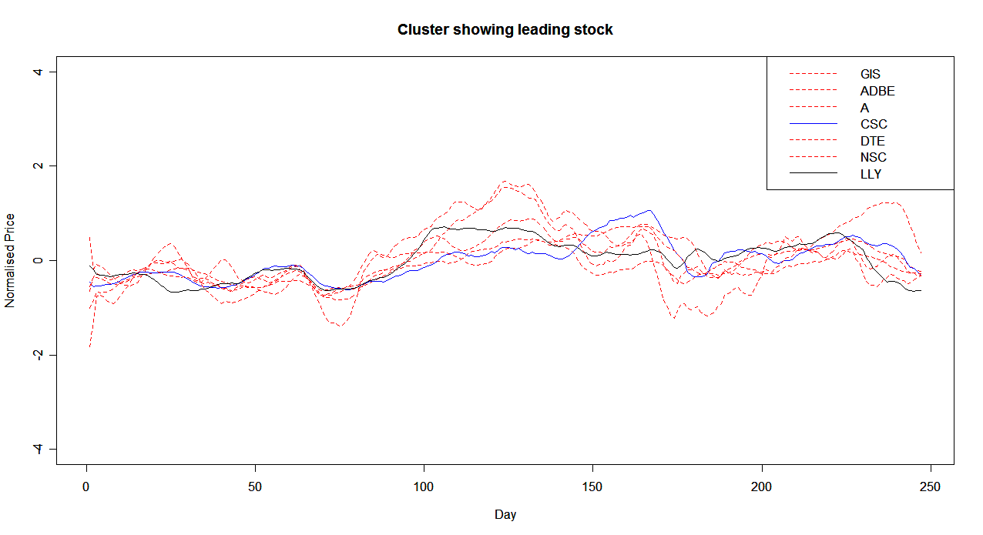
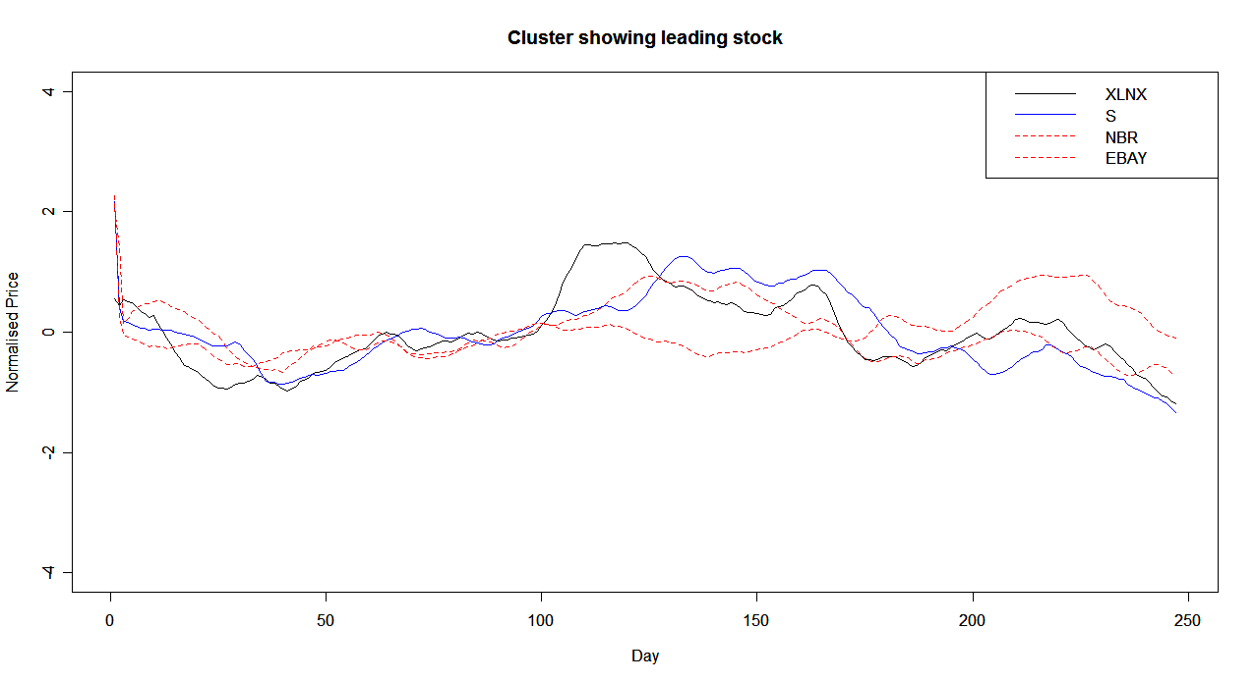
Prediction with separate training set
For cluster 1:
  Investment: $5403
  Returns: $5839
  Market: $5214
For cluster 2:
  Investment: $1990
  Returns: $2069
  Market: $1557
Rising Interval
(follow leading and make money)
By following leading stocks, you can win money within a small interval in which the stock goes up, while all stocks eventually go down in the cluster.

Slide 25
Prediction with separate training set
The problem with this approach is that from day 101 onwards, most stocks go down
In our algorithm, we enforce that 100 stocks are bought on day 101 (to be coherent with previous tests)
Hence, the returns as well as market value go down
  Total investment: $94154
  Total returns: $89732
  Total market value: $89426

Slide 26
Prediction with separate training set
A better strategy is not buying any stock until leading stocks go up.
Thus we can avoid losing money even all stocks go down.

Slide 27
Standard&Poor’s 500
Elementary Analysis
Clustering and Leading Stocks
Predicting

Slide 28
Predictions
We test ARIMA on all the clusters.

Slide 29
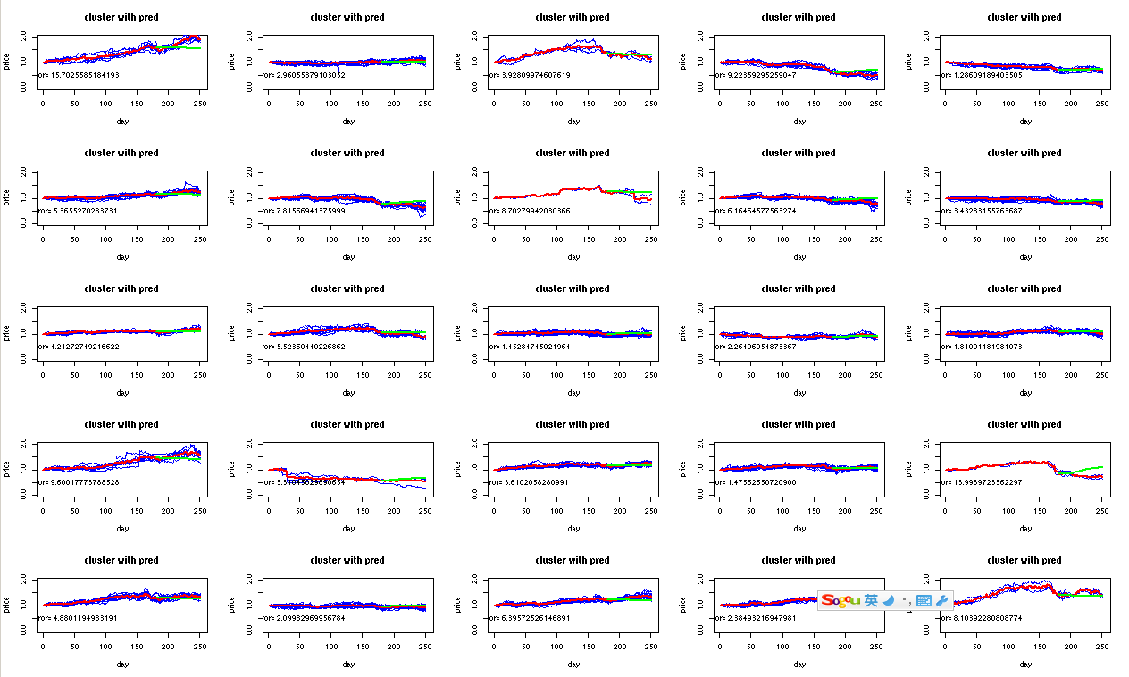

Slide 30
ARIMA is not very good.

Slide 31
Simplify the question
We just predict whether it is going up or down, rather than the price.
It’s a binary predictor.
In computer science research, we have a bunch of binary predictors.

Slide 32
A (2,2) predictor
4 DFAs for predictors, choose the DFA according to the previous two numbers in the binary time series.
We want to predict Pt,
(Pt-2, Pt-1) => (0 , 0) DFA 1
=> (0, 1) DFA 2
=> (1, 0) DFA3
=> (1,1) DFA4

Slide 33
Each predictor is a DFA
For a (2,2) predictor, each DFA has 4 states, and update its states by the actual result; each states has one prediction.

Slide 34
Benchmark
For 387 stocks, we train ARIMA and our binary predictor with price data of the first 252 days.
And we want to see which one predicts better on the stock price of the 253th day.
ARIMA: 52% wrong; Binary predictor: 38% wrong.

Slide 35
Error In Predicting:
 | ARIMA | (2,2) predictor
Training Set Length = 50 | 54.7% | 37.9%
Training Set Length=100 | 57.1% | 37.7%
AR Order = 3 (Use full data training set) | 53.4% | 37.9%
AR Order = 6 (Use full data training set) | 54.0% | 37.9%
Training Set lengths don’t affect much on ARIMA.
Neither do AR order.

Slide 36
What about predicting other days?
We use binary to predict prices of other days: The error rate is around (37%--43%).
However, in some cases, the error rate increases to 50% (one third of all the test we do.)
We believe it is better than ARIMA since it can remember recent state.

Slide 37
Acknowledgement
Thanks Eugene for this term and for all the useful skills he taught us.
Thank you to all of you and merry Christmas.

