Slide 1
Transport demand prediction
By:-D.Swarna charitha,221FA14036

Slide 2
Transport Demand Prediction
Industry Overview: Public Transport and Mobility Services
The public transport industry is a critical component of urban and intercity transportation systems globally, providing affordable and accessible mobility options for millions of people. In many countries, buses, minibuses, and shuttles are essential for facilitating mass movement between urban and rural areas. With rapid urbanization, particularly in developing countries, public transportation plays a vital role in reducing congestion, enhancing accessibility, and lowering carbon emissions.
Mobility in Sub-Saharan Africa
In regions like Sub-Saharan Africa, public transportation is dominated by informal transit networks, which include minibuses, buses, and shuttle services. These services form the backbone of commuter travel in cities like Nairobi, Kenya, where population growth and increasing urbanization have overwhelmed the road infrastructure.
In Kenya, buses and shuttles, like those operated by Mobiticket, serve as the primary means of transportation between rural areas and Nairobi, connecting distant towns to the city.
Mobiticket: A New Player in Mobility Tech
Mobiticket is a growing player in Kenya's public transport system, providing a digital platform for purchasing bus and shuttle tickets. Their service helps connect people in rural areas to Nairobi, serving as an essential part of the country's commuter infrastructure. The ability to predict demand for each ride is critical to optimizing their operations, maximizing revenue, and improving customer satisfaction.
In this project, predicting seat sales for specific routes and times will enable Mobiticket to make data-driven decisions, potentially leading to better route planning, dynamic pricing, and fleet management.

Slide 3
Business Problem Statement
Mobiticket operates a bus and shuttle service connecting various towns in the North-West of Nairobi to the city center. Each route's profitability heavily depends on the number of seats sold for a particular ride. However, demand for these rides can vary significantly based on multiple factors, such as:
- The departure town .
- The day of the week .
- The time of day .
- Traffic conditions in Nairobi, particularly during peak hours.
- Holidays and special events.
Given these fluctuations, Mobiticket faces challenges in predicting how many tickets they will sell for each ride, making it difficult to optimize capacity, manage resources, and implement dynamic pricing strategies.
The business problem is to develop a machine learning model that can accurately predict the number of seats that will be sold for a specific route, date, and time. This will help Mobiticket:
1.Optimize fleet allocation , ensuring that buses and shuttles are utilized efficiently and unnecessary trips are avoided.
2.Improve revenue management by adjusting ticket prices based on anticipated demand.
3.Enhance customer experience by ensuring that services are available when and where demand is highest.
By solving this problem, Mobiticket can reduce operational costs, improve profitability, and offer a more reliable and tailored service to its customers.

Slide 4
Dataset Description
The dataset provided by Mobiticket includes information about tickets purchased for bus and shuttle rides between October 17, 2017, and April 20, 2018. The key variables in the dataset are:
ride_id: A unique identifier for each vehicle trip on a specific route and day.
seat_number: The seat assigned to each ticket purchased.
payment_method: The method of payment used by the customer (either cash or M-Pesa).
payment_receipt: A unique ID associated with each ticket purchase.
travel_date: The date the ride is scheduled to depart.
travel_time: The scheduled departure time of the ride (rides generally depart on time).
travel_from: The town where the ride originates (e.g., Kisii, Migori, etc.).
travel_to: The destination of the ride (all rides end in Nairobi).
car_type: The type of vehicle used for the ride (either shuttle or bus).
max_capacity: The total number of seats available in the vehicle.
In addition to this dataset, we can integrate external traffic data from Uber Movement, which provides historical traffic conditions in Nairobi. This data can help model the impact of traffic congestion on ride demand, especially during peak hours.

Slide 5
Dataset Description
The dataset provided by Mobiticket includes information about tickets purchased for bus and shuttle rides between October 17, 2017, and April 20, 2018. The key variables in the dataset are:
ride_id: A unique identifier for each vehicle trip on a specific route and day.
seat_number: The seat assigned to each ticket purchased.
payment_method: The method of payment used by the customer (either cash or M-Pesa).
payment_receipt: A unique ID associated with each ticket purchase.
travel_date: The date the ride is scheduled to depart.
travel_time: The scheduled departure time of the ride (rides generally depart on time).
travel_from: The town where the ride originates (e.g., Kisii, Migori, etc.).
travel_to: The destination of the ride (all rides end in Nairobi).
car_type: The type of vehicle used for the ride (either shuttle or bus).
max_capacity: The total number of seats available in the vehicle.
In addition to this dataset, we can integrate external traffic data from Uber Movement, which provides historical traffic conditions in Nairobi. This data can help model the impact of traffic congestion on ride demand, especially during peak hours.

Slide 6
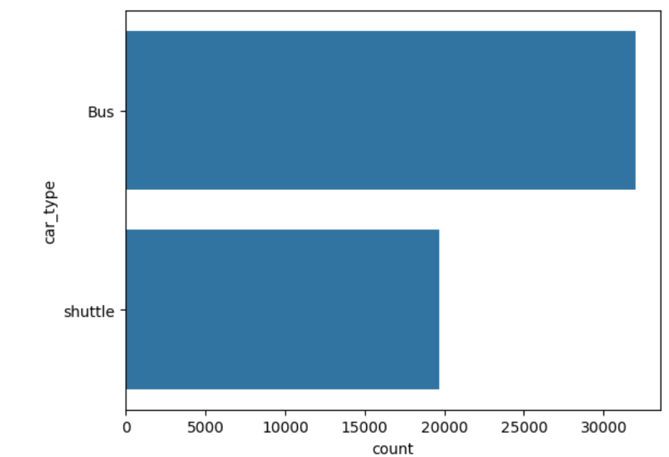
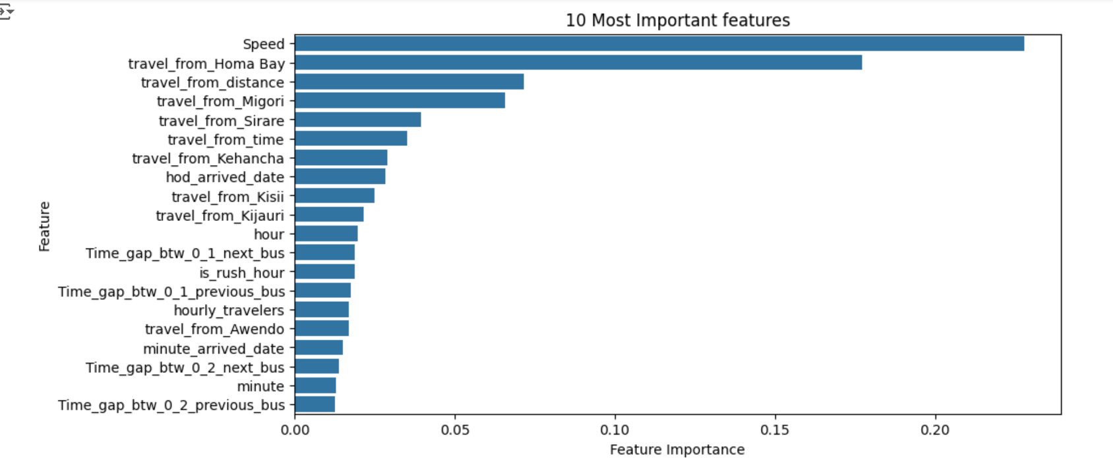
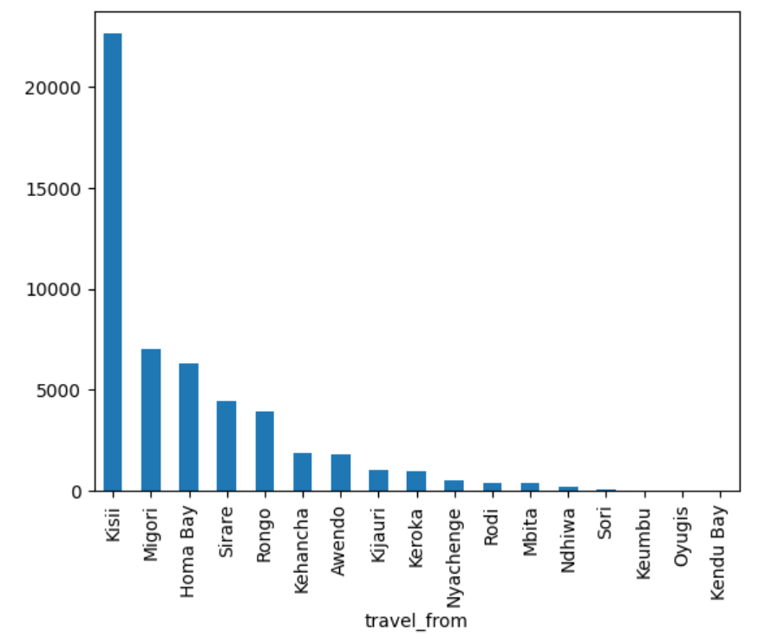
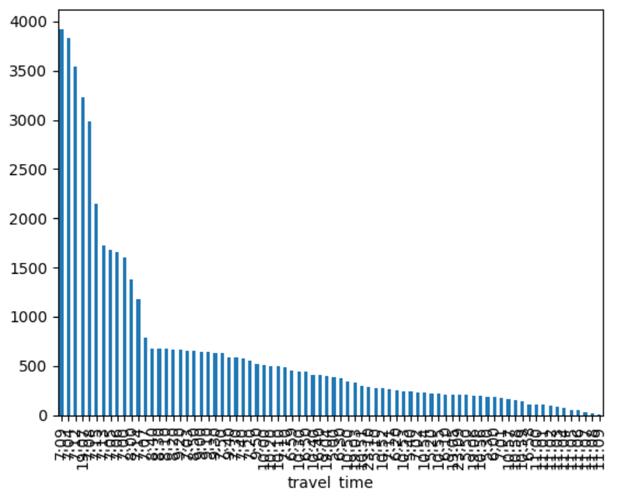
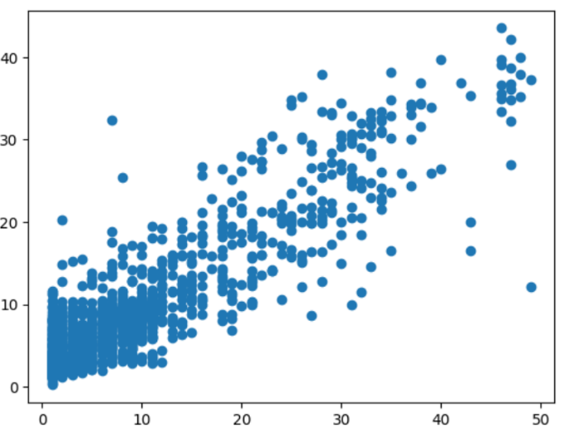

Slide 7
Data preprocessing is a crucial step in preparing raw data for modeling, consisting of data wrangling and feature engineering . Data wrangling involves cleaning and organizing the data by handling missing values (e.g., imputation or removal), removing duplicates, and managing outliers. It also includes encoding categorical data (using methods like one-hot encoding) and scaling numerical features to ensure consistency across different feature ranges. Feature engineering creates new variables that capture underlying patterns in the data. This includes extracting date and time-based features (e.g., day of the week, peak traffic hours), adding route-specific features (e.g., distance to Nairobi), and integrating external data like traffic conditions and holidays. Aggregated features, such as historical average seat sales, and interaction features between variables can also provide valuable insights. These preprocessing methods ensure the dataset is clean, structured, and enriched with relevant information. This ultimately enhances the performance of machine learning models by providing them with better features and reducing noise, leading to more accurate predictions for Mobiticket’s seat sales.
Data preprocessing methods

Slide 8
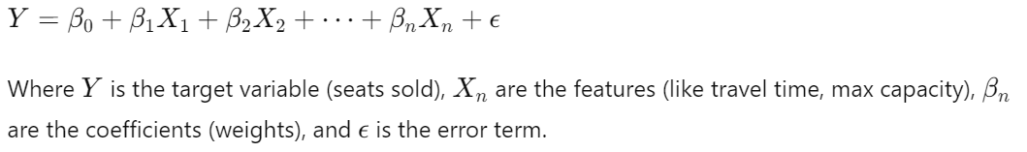
Linear Regression and Data Splitting
Data splitting is vital in machine learning to evaluate how well a model generalizes to unseen data. It involves dividing the dataset into three parts:
- Training set : Used to train the model and learn the underlying patterns.
- Validation set : Used for hyperparameter tuning and to ensure the model does not overfit the training data. Cross-validation may be employed here.
-Test set : A final evaluation set used to assess how the model will perform in real-world scenarios on unseen data.
Linear Regression :
Linear Regression is a simple yet powerful model that assumes a linear relationship between the features and the target variable. It fits a straight line (or hyperplane in multiple dimensions) to minimize the difference between the predicted and actual values, using the formula:
Linear regression is favored for its simplicity and interpretability. However, it assumes that the relationships between variables are linear, which might not always be the case. Despite this, it serves as a good baseline model for comparison with more complex methods.

Slide 9
R Code:-
# Load necessary libraries
library(ggplot2)
library(readr)
library(dplyr)
# Load the dataset
dataset <- read_csv('/content/drive/MyDrive/AlmaBetter/Cohort Aravali/Module 4/Week 1/Copy of Nairobi Transport Data.zip (Unzipped Files)/train_revised.csv')
# Display the first few rows of the data
print(head(dataset))
# Display information about the dataset
print(str(dataset))
# Create a count plot of the payment method, car type, and max capacity columns
plot_count_cols <- c('payment_method', 'car_type', 'max_capacity')
for (col in plot_count_cols) {
ggplot(dataset, aes_string(x = col)) +
geom_bar() +
labs(title = paste('Count of', col)) +
theme_minimal() +
theme(axis.text.x = element_text(angle = 45, hjust = 1)) +
xlab(col) +
ylab('Count') +
ggtitle(paste('Count Plot for', col)) +
theme(plot.title = element_text(hjust = 0.5)) +
scale_y_continuous(expand = c(0,0)) -> p
print(p)
}
# Display the unique values in each column and their frequencies
print(summary(dataset %>% select(where(is.character))))
# Create a bar chart of the top 10 most frequent values in the payment method column
payment_method_freq <- dataset %>% count(payment_method, sort = TRUE) %>% head(10)
ggplot(payment_method_freq, aes(x = reorder(payment_method, n), y = n)) +
geom_bar(stat = 'identity') +
coord_flip() +
labs(title = 'Top 10 Most Frequent Payment Methods', x = 'Payment Method', y = 'Frequency') +
theme_minimal()
# Create a bar chart of the top 10 most frequent values in the car type column
car_type_freq <- dataset %>% count(car_type, sort = TRUE) %>% head(10)
ggplot(car_type_freq, aes(x = reorder(car_type, n), y = n)) +
geom_bar(stat = 'identity') +
coord_flip() +
labs(title = 'Top 10 Most Frequent Car Types', x = 'Car Type', y = 'Frequency') +
theme_minimal()
# Create a bar chart of the top 10 most frequent values in the max capacity column
max_capacity_freq <- dataset %>% count(max_capacity, sort = TRUE) %>% head(10)
ggplot(max_capacity_freq, aes(x = reorder(max_capacity, n), y = n)) +
geom_bar(stat = 'identity') +
coord_flip() +
labs(title = 'Top 10 Most Frequent Max Capacities', x = 'Max Capacity', y = 'Frequency') +
theme_minimal()

Slide 10
python Code:-
import pandas as pd
import numpy as np
import seaborn as sns
import matplotlib.pyplot as plt
# Load the dataset
dataset = pd.read_csv(‘C:\Users\Swarn\Downloads\3BI_A_T3_assignement.xlsx')
# Display the first few rows of the data
print(dataset.head())
# Display information about the dataset
print(dataset.info())
# Create a count plot of the payment method, car type, and max capacity columns
plot_count_cols = ['payment_method', 'car_type', 'max_capacity']
for plots in plot_count_cols:
sns.countplot(dataset[plots])
plt.show()
# Display the unique values in each column and their frequencies
print(dataset.describe(include='object'))
# Create a bar chart of the top 10 most frequent values in the payment method column
sns.barplot(x=dataset['payment_method'].value_counts().index[:10], y=dataset['payment_method'].value_counts().values[:10])
plt.title('Top 10 Most Frequent Payment Methods')
plt.xlabel('Payment Method')
plt.ylabel('Frequency')
plt.show()
# Create a bar chart of the top 10 most frequent values in the car type column
sns.barplot(x=dataset['car_type'].value_counts().index[:10], y=dataset['car_type'].value_counts().values[:10])
plt.title('Top 10 Most Frequent Car Types')
plt.xlabel('Car Type')
plt.ylabel('Frequency')
plt.show()
# Create a bar chart of the top 10 most frequent values in the max capacity column
sns.barplot(x=dataset['max_capacity'].value_counts().index[:10], y=dataset['max_capacity'].value_counts().values[:10])
plt.title('Top 10 Most Frequent Max Capacities')
plt.xlabel('Max Capacity')
plt.ylabel('Frequency')
plt.show()
theme(plot.title = element_text(hjust = 0.5)) +
scale_y_continuous(expand = c(0,0)) -> p
print(p)
}
# Display the unique values in each column and their frequencies
print(summary(dataset %>% select(where(is.character))))
# Create a bar chart of the top 10 most frequent values in the payment method column
payment_method_freq <- dataset %>% count(payment_method, sort = TRUE) %>% head(10)
ggplot(payment_method_freq, aes(x = reorder(payment_method, n), y = n)) +
geom_bar(stat = 'identity') +
coord_flip() +
labs(title = 'Top 10 Most Frequent Payment Methods', x = 'Payment Method', y = 'Frequency') +
theme_minimal()
# Create a bar chart of the top 10 most frequent values in the car type column
car_type_freq <- dataset %>% count(car_type, sort = TRUE) %>% head(10)
ggplot(car_type_freq, aes(x = reorder(car_type, n), y = n)) +
geom_bar(stat = 'identity') +
coord_flip() +
labs(title = 'Top 10 Most Frequent Car Types', x = 'Car Type', y = 'Frequency') +
theme_minimal()
# Create a bar chart of the top 10 most frequent values in the max capacity column
max_capacity_freq <- dataset %>% count(max_capacity, sort = TRUE) %>% head(10)
ggplot(max_capacity_freq, aes(x = reorder(max_capacity, n), y = n)) +
geom_bar(stat = 'identity') +
coord_flip() +
labs(title = 'Top 10 Most Frequent Max Capacities', x = 'Max Capacity', y = 'Frequency') +
theme_minimal()

