Slide 1
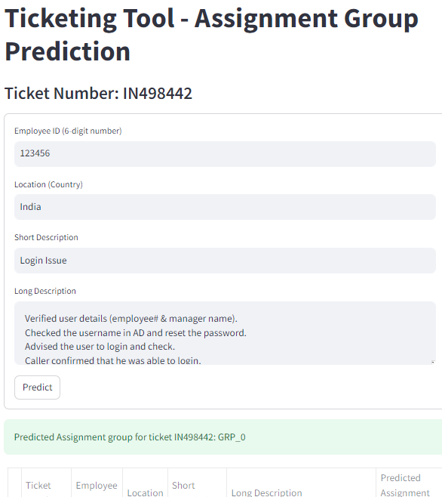
DISSERTATION TITLE
“INTEGRATING MACHINE LEARNING IN ITIL INCIDENT TICKETING FOR ASSIGNMENT GROUP PREDICTION”

Slide 2

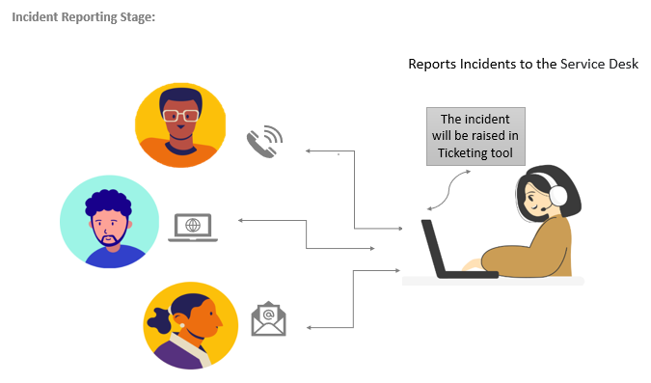
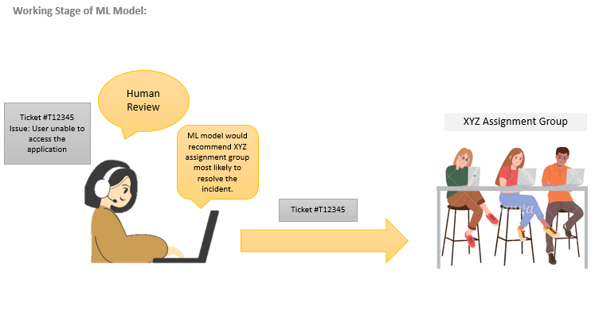

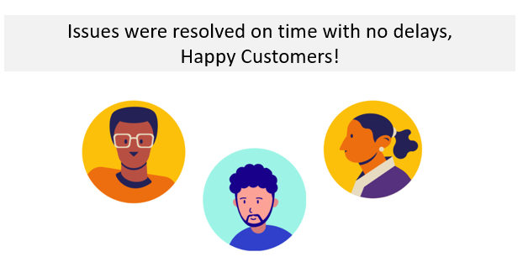
Problem Overview

Slide 3

Methodologies:
PACE Framework
Plan
Analyze
Construct
Execute
Data Collection and Problem Understanding
Text Preprocessing, Feature Engineering and Initial Model Building
Model Improvement - Feature Extraction, Hyperparameter tuning, Different Models Comparison.
Create an application - Deploying model

Slide 4


NLP Pipeline
Group0
0.5
0
0.87
0.9
0.1
0
...
0.45
“Hi team, I’m unable to login into HR tool, and unable to retrieve employee data to complete my task. Please assist asap”
Imbalance Class Handling/PCA etc.
Group1
Vectorization
ML or DL Model
Group2
...
Group16

Slide 5
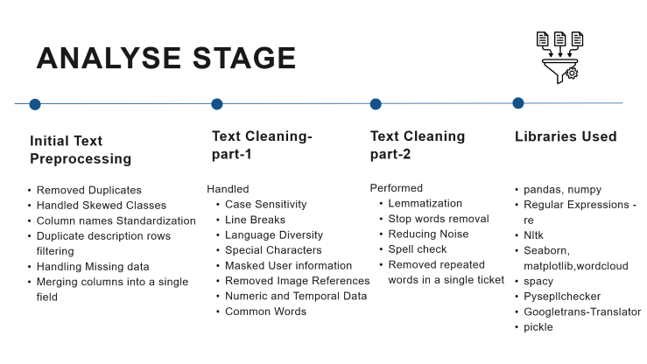
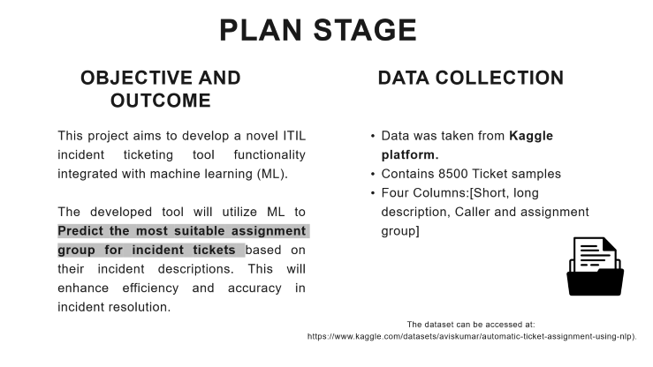
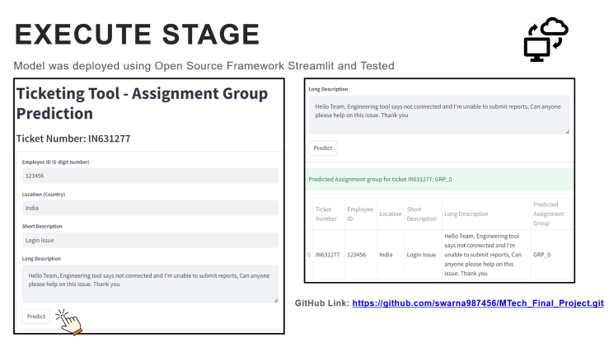
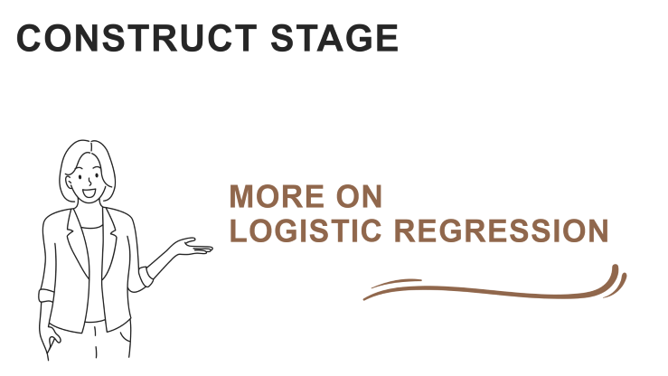

Slide 6

PLAN STAGE
OBJECTIVE AND OUTCOME
DATA COLLECTION
This project aims to develop a novel ITIL incident ticketing tool functionality integrated with machine learning (ML).
The developed tool will utilize ML to Predict the most suitable assignment group for incident tickets based on their incident descriptions. This will enhance efficiency and accuracy in incident resolution.
Data was taken from Kaggle platform.
Contains 8500 Ticket samples
Four Columns:[Short, long description, Caller and assignment group]
The dataset can be accessed at:
https://www.kaggle.com/datasets/aviskumar/automatic-ticket-assignment-using-nlp).

Slide 7
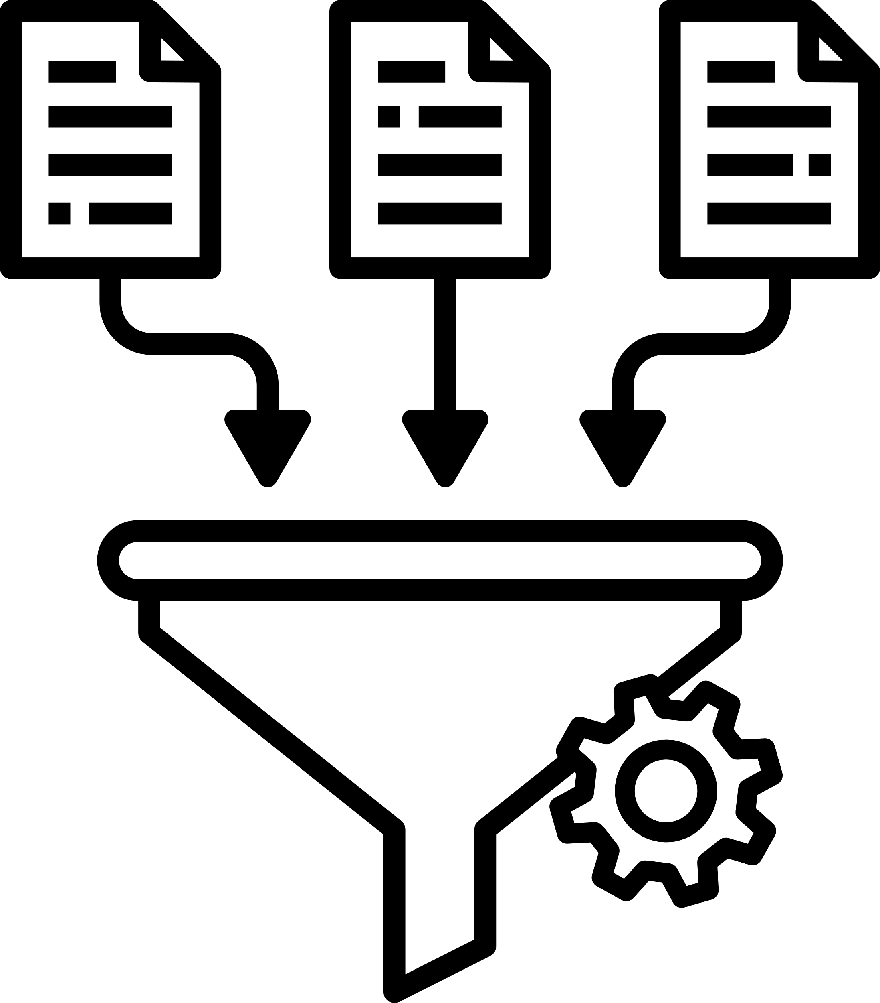
ANALYSE STAGE
Initial Text Preprocessing
Text Cleaning-part-1
Text Cleaning part-2
Libraries Used
Removed Duplicates
Handled Skewed Classes
Column names Standardization
Duplicate description rows filtering
Handling Missing data
Merging columns into a single field
Handled
Case Sensitivity
Line Breaks
Language Diversity
Special Characters
Masked User information
Removed Image References
Numeric and Temporal Data
Common Words
Performed
Lemmatization
Stop words removal
Reducing Noise
Spell check
Removed repeated words in a single ticket
pandas, numpy
Regular Expressions - re
Nltk
Seaborn, matplotlib,wordcloud
spacy
Pysepllchecker
Googletrans-Translator
pickle

Slide 8
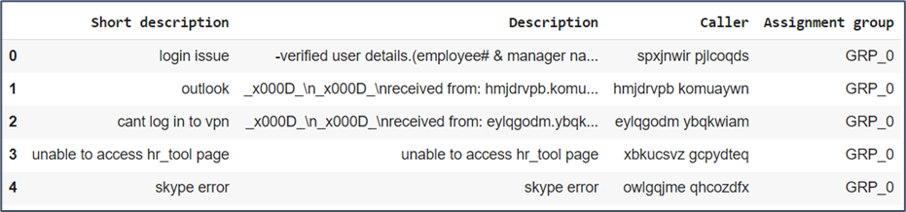

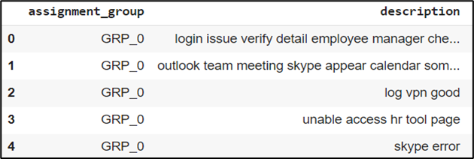
Dataset: Before Data Cleaning Process:
Dataset: After Data Cleaning Process:

Slide 9

Feature Transformation
Text to Number
Imbalance Class
Handling
Label Encoding
Libraries Used
To encode classes to numbers
scikit-learn
Gensim
Imblearn
scipy
nlpaug
Tensforflow
transformers(Hugging Face)
TF-IDF
Pre-trained Embeddings
from Gensim library
Word2Vec
GloVe
PCA Technique to reduce Dimensionality of Vectors
RandomOverSampling
SMOTE
nlpaug package - augmentation,
factor = 3
Pre-trained BERT mask prediction, factor = 3
from HuggingFace
transformers
ANOVA Test and
Scaling
Performed Anova F-test on Text-length feature, and performed standardization using MinMax Scaler

Slide 10
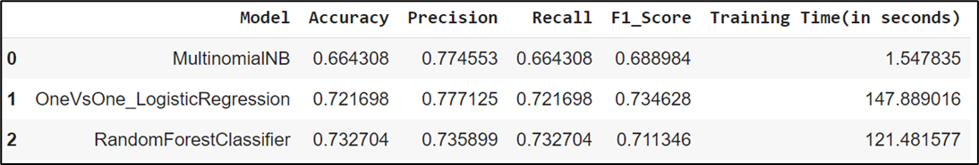

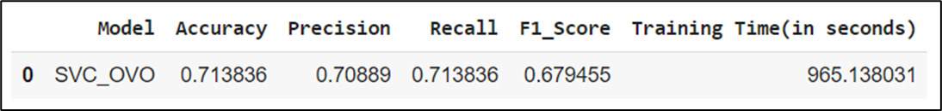
Performance of Machine Learning Models
Based on the evaluation metrics, the OneVsOne Logistic Regression model appears performing good so far, It offers a good balance between accuracy, precision, recall, and F1-score.
As Support Vector Classifier is taking longer time to train, Reduced the feature dimensionality from 3804 to 913 which can explain 95% of the variance in the data using PCA technique.

Slide 11


CONSTRUCT STAGE
MORE ON
LOGISTIC REGRESSION

Slide 12

Hyperparameter Tuning & Random Over Sampling of Minority Class to handle class Imbalance.
LOGISTIC REGRESSION WITH...
1
2
Text Length was added as a new feature on the above Model
SMOTE Technique was used on the above model for handling Imbalance data instead of ROS
3
4
NLPAug for synonym augmentation was used on the above model instead of SMOTE
5
Huggingface BERT pretrained prediction of masked data was used for adding augmented data

Slide 13

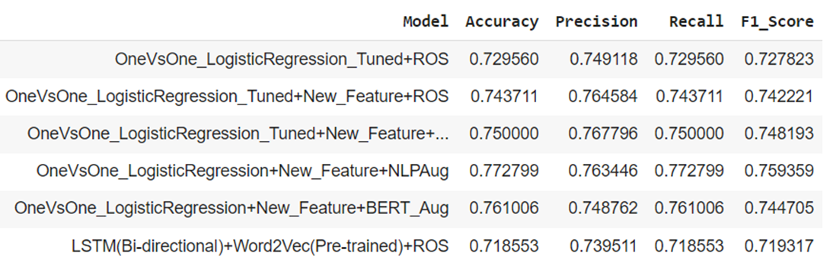
OneVsOne Logistic Regression with NLPAugmented data outperformed other models.

Slide 14

Deep Learning Models with Embeddings
1
2
3
Bidirectional LSTM with Word2Vec Embeddings and Random Oversampling
Bidirectional LSTM with GloVe Embeddings and Random Oversampling
GloVe Embeddings and BERT-Aug Data for Bidirectional LSTM

Slide 15
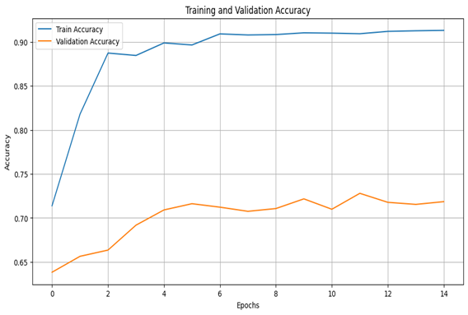
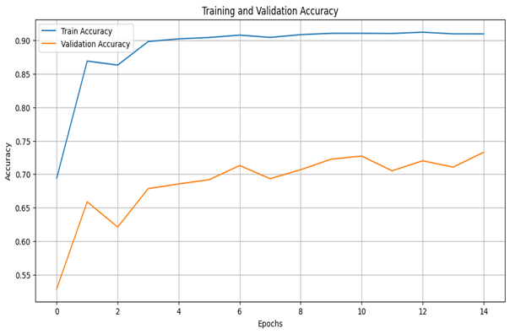
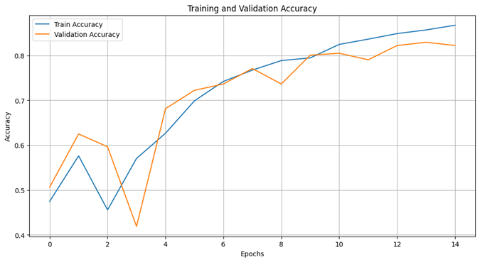
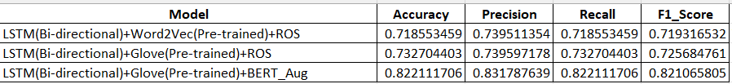
The first two models underperformed compared to OVO-Logistic Regression and the last model outperformed on Train and validation sets than OVO_LR

Slide 16
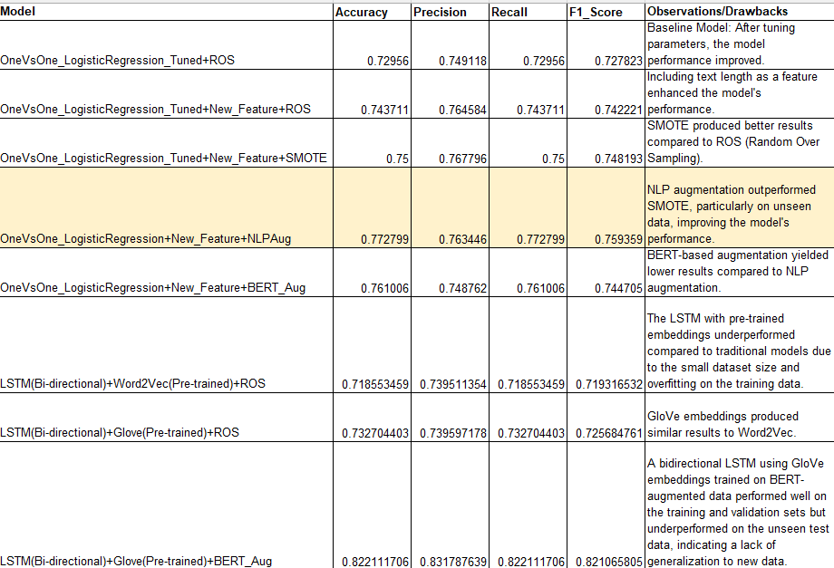
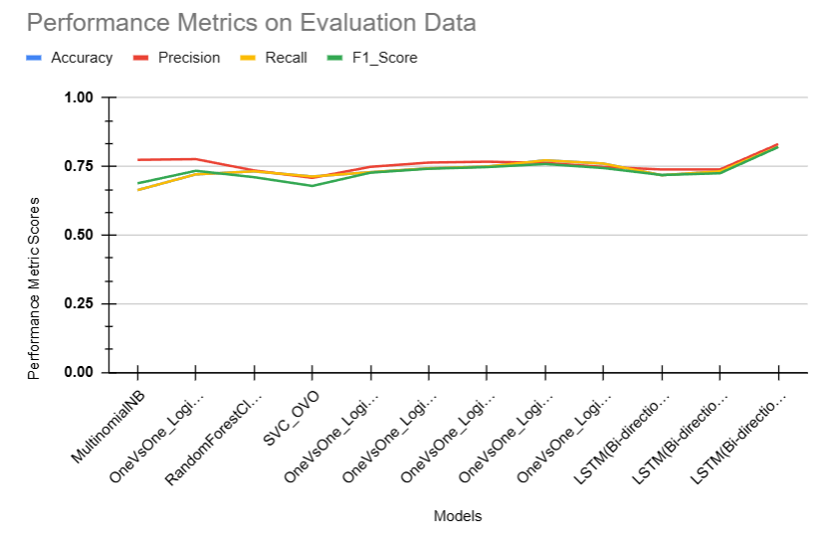
Performance Of All Models on Validation Dataset
An average performance score of 73% was obtained across all metrics for each model..

Slide 17
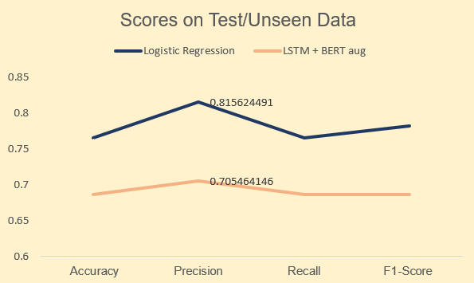

Performance of Final Models on Test Dataset
Logistic Regression
Logistic Regression model demonstrates better generalization to unseen data than Bi-directional LSTM

Slide 18

Conclusion: Final Model Selection
Logistic Regression performs well on Unseen/Test Data
A bidirectional LSTM using GloVe embeddings trained on BERT-augmented data performed well on the training and validation sets but underperformed on the unseen test data, indicating a lack of generalization to new data.
Logistic Regression model demonstrates better generalization to unseen data, prioritizing robustness over purely optimizing for validation accuracy.

Slide 19

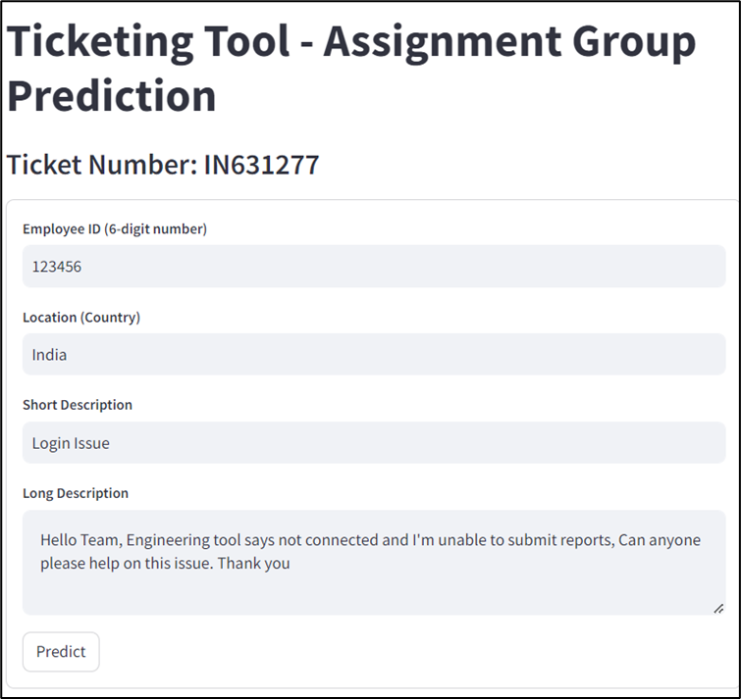
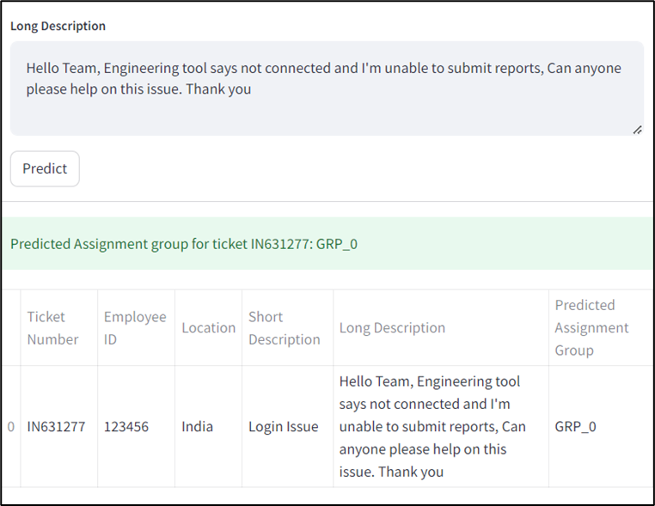


EXECUTE STAGE
Model was deployed using Open Source Framework Streamlit and Tested
GitHub Link: https://github.com/swarna987456/MTech_Final_Project.git

Slide 20
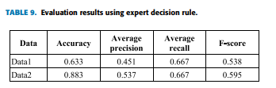
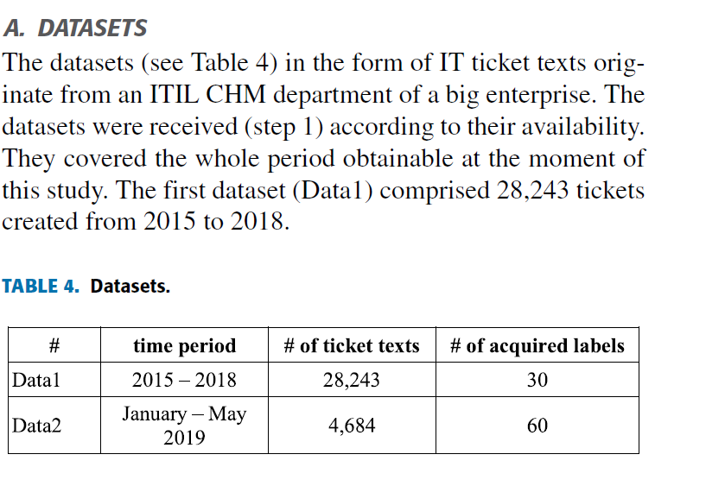
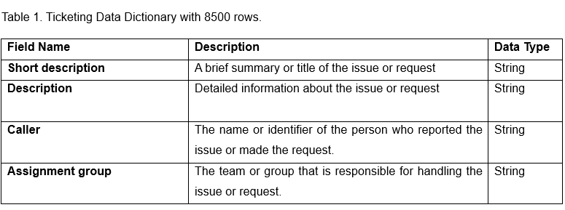
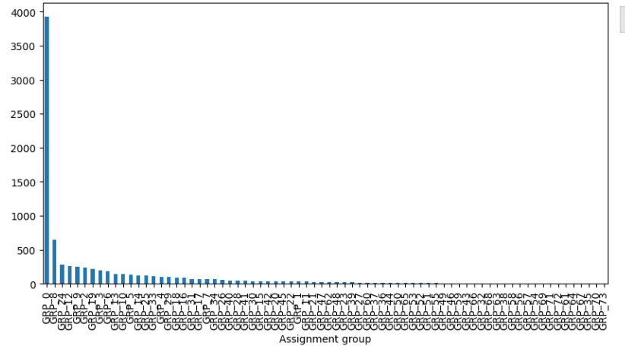
A. Revina et al.: IT Ticket Classification: The Simpler, the Better
Our results with additional approaches
Traditional Supervised Models + - Feature Engineering + Data Augmentation for imbalance | Avg Accuracy | Avg Precision | Avg Recall | Avg F1_Score
IT Support Tickets Data(Public) | 0.7322 | 0.7545 | 0.7322 | 0.7263
Deep Learning Models + Embeddings | Avg Accuracy | Avg Precision | Avg Recall | Avg F1_Score
IT Support Tickets Data(Public) | 0.7578 | 0.7703 | 0.7578 | 0.7554
Initial 74 labels
Final 16 labels
Frequency of Tickets in each Assignment group

Slide 21

Literature Review
01
Fuchs et al. (2022)
It suggests Random Forest (RF) and Support Vector Machines (SVM) as the best performing algorithms for ticket classification.
02
Revina et al. (2020)
Simpler approaches can be just as effective as more complex ones by focusing on text preparation and feature engineering (creating additional features).
In this project, the TF-IDF technique was used for feature transformation, and models such as Logistic Regression (One vs. One), Random Forest, and Multiclass Naive Bayes (Multinomial Naive Bayes) were employed, all of which achieved good results. Since SVM took longer to run, PCA was used to reduce dimensionality (feature count) in our model. Also, Bidirectional LSTM for training with Word Embeddings[Word2Vec and Glove] and BERT for text augmentation used. The accuracy and other metrics of all these models were compared.
Hyperparameter tuned - Logistic Regression by adding text length as an additional feature, along with augmented data to address class imbalance, led to improved results.
Future Scope of the Work:
While this solution is a good improvement, we can make it even better in the future. Here are some ideas:
Smarter Models:
Using advanced AI models such as Large Language models to understand the context of tickets more deeply.
Making sure the AI is fair and doesn't discriminate.
Privacy and Security:
Protecting sensitive information in tickets, following data privacy rules.

Slide 22
References
[1] A. Revina, K. Buza, and V. G. Meister, “IT Ticket Classification: The Simpler, the Better,” IEEE Access, vol. 8, pp. 193380–193395, 2020, doi: 10.1109/ACCESS.2020.3032840.
[2] S. Fuchs, C. Drieschner, and H. Wittges, Improving Support Ticket Systems Using Machine Learning: A Literature Review. 2022. Accessed: Oct. 05, 2024. [Online]. Available: http://hdl.handle.net/10125/79570
[3] P. Bafna, D. Pramod, and A. Vaidya, “Document clustering: TF-IDF approach,” in 2016 International Conference on Electrical, Electronics, and Optimization Techniques (ICEEOT), Mar. 2016, pp. 61–66. doi: 10.1109/ICEEOT.2016.7754750.
[4] B. Mahesh, Machine Learning Algorithms -A Review, vol. 9. 2019. doi: 10.21275/ART20203995.
[5] H. Abdi and L. J. Williams, “Principal component analysis,” WIREs Comput. Stat., vol. 2, no. 4, pp. 433–459, 2010, doi: 10.1002/wics.101.
[6] Z. Huang, W. Xu, and K. Yu, “Bidirectional LSTM-CRF Models for Sequence Tagging,” arXiv.org. Accessed: Oct. 05, 2024. [Online]. Available: https://arxiv.org/abs/1508.01991v1
[7] K. W. Church, “Word2Vec,” Nat. Lang. Eng., vol. 23, no. 1, pp. 155–162, Jan. 2017, doi: 10.1017/S1351324916000334.
[8] J. Pennington, R. Socher, and C. Manning, “GloVe: Global Vectors for Word Representation,” in Proceedings of the 2014 Conference on Empirical Methods in Natural Language Processing (EMNLP), A. Moschitti, B. Pang, and W. Daelemans, Eds., Doha, Qatar: Association for Computational Linguistics, Oct. 2014, pp. 1532–1543. doi: 10.3115/v1/D14-1162.
[9] M. V. Koroteev, “BERT: A Review of Applications in Natural Language Processing and Understanding,” arXiv.org. Accessed: Oct. 05, 2024. [Online]. Available: https://arxiv.org/abs/2103.11943v1
[10] J. Iden and T. R. Eikebrokk, “Implementing IT Service Management: A systematic literature review,” Int. J. Inf. Manag., vol. 33, no. 3, pp. 512–523, Jun. 2013, doi: 10.1016/j.ijinfomgt.2013.01.004.
[11] “Turn Data into Decisions with the PACE Framework,” https://www.michelebedin.com/en/. Accessed: Oct. 05, 2024. [Online]. Available: https://www.michelebedin.com/en/turn-data-into-decisions-with-pace-framework/
[12] F. Pedregosa et al., “Scikit-learn: Machine Learning in Python,” Mach. Learn. PYTHON.
[13] B. Pang, E. Nijkamp, and Y. N. Wu, “Deep Learning With TensorFlow: A Review,” J. Educ. Behav. Stat., vol. 45, no. 2, pp. 227–248, Apr. 2020, doi: 10.3102/1076998619872761.
[14] J. Praveen Gujjar, H. R. Prasanna Kumar, and M. S. Guru Prasad, “Advanced NLP Framework for Text Processing,” in 2023 6th International Conference on Information Systems and Computer Networks (ISCON), Mar. 2023, pp. 1–3. doi: 10.1109/ISCON57294.2023.10112058.
[15] Siva, “Automatic Ticket Assignment using NLP.” 2020. [IEEE]. Available: https://www.kaggle.com/aviskumar/automatic-ticket-assignment-using-nlp
[16] K. Kowsari, K. Jafari Meimandi, M. Heidarysafa, S. Mendu, L. Barnes, and D. Brown, “Text Classification Algorithms: A Survey,” Information, vol. 10, no. 4, Art. no. 4, Apr. 2019, doi: 10.3390/info10040150.
[17] J. E. F. Friedl, Mastering Regular Expressions. O’Reilly Media, Inc., 2006.
[18] J. Plisson, N. Lavrac, and D. Mladenic, “A Rule based Approach to Word Lemmatization”.
[19] F. Heimerl, S. Lohmann, S. Lange, and T. Ertl, “Word Cloud Explorer: Text Analytics Based on Word Clouds,” in 2014 47th Hawaii International Conference on System Sciences, Jan. 2014, pp. 1833–1842. doi: 10.1109/HICSS.2014.231.
[20] N. V. Chawla, K. W. Bowyer, L. O. Hall, and W. P. Kegelmeyer, “SMOTE: Synthetic Minority Over-sampling Technique,” J. Artif. Intell. Res., vol. 16, pp. 321–357, Jun. 2002, doi: 10.1613/jair.953.
[21] streamlit/streamlit. (Oct. 05, 2024). Python. Streamlit. Accessed: Oct. 05, 2024. [Online]. Available: https://github.com/streamlit/streamlit

Slide 23

Thank you!

